Slide 1
DOI Self Governance Program
June 8-9, 2016
Ferndale, WA

Slide 2
Housekeeping
Session Format: PowerPoints, group exercises
Question & Answer opportunities
Scheduled Breaks

Slide 3
DOI Self Governance Program
What Language are you Speaking?

Slide 4
Indian Affairs Fed-Speak
Handout
Notes:
Reference SGCE list of acronyms on tribalselfgov.org

Slide 5
DOI Self Governance Program – Organizational Structure
Who is OSG?

Slide 6
AS-IA Organizational Chart
Assistant Secretary Indian Affairs
Lawrence S. Roberts (Acting)
Office of Public Affairs
Office of Federal Acknowledgement
Principal Deputy Assistant Secretary
Deputy Assistant Secretary Policy and Economic Development
Deputy Assistant Secretary Management
Director
Bureau of Indian Affairs
Director
Bureau of Indian Education
Notes:
PDAS: Larry Roberts
DAS-PED: Ann Marie Bledsoe Downes
DAS-M: Jim Burkman (Acting)
Dir BIA: Mike Black
Dir BIE – Ann Marie Bledsoe Downes (Acting)

Slide 7
AS-IA Organizational Chart
Deputy Assistant Secretary Policy and Economic Development
Office of Self Governance
Executive Director to the White House Council on Native American Affairs
Office of Indian Energy and Economic Development
Notes:
Ex Dir to White House: (Anthony) Morgan Rodman
OIEED: Jack Stevens

Slide 8
OSG Organizational Chart
Director
Sharee Freeman
Program Analyst
Vickie Hanvey
Management Analyst
Tyler Scribner
Finance
Dan Santiago
Senior Policy Analyst
Ken Reinfeld
Northwest Field Office Manager
Matt Kallappa
Compact Negotiator
Gordon Smith
Financial Specialist
Rufina Villicana
Compact Negotiator
Shaunna McCovey
Financial Specialist
Celeste Engles
Financial Specialist
Thomas Gubatayao
Financial Specialist
Lance Fisher
Program Assistant
Maureen Marcellay
Compact Negotiator
Nicholas Longley

Slide 9
Foundational Legislation

Slide 10
Foundational SG Legislation
1921 – Snyder Act
BIA…shall direct, supervise, and expend moneys…for the benefit, care, and assistance of the Indians throughout the United States for...purposes…(as stated)
1934 – Johnson O’Malley Act
Authorized the DOI Secretary to enter into contracts with any State… for the education, medical attention, agricultural assistance, and social welfare, including relief of distress, of Indians in such State…

Slide 11
Indian Self Determination and Education Assistance Act of P.L. 93-638 (1975)
Established federal policy of Indian self-determination
Title I – Directs the respective Secretaries of DOI and HHS, upon request, to enter into self-determination contracts

Slide 12
Indian Self Determination and Education Assistance Act of P.L. 93-638
Title III – Tribal Self Governance Demonstration Project (1988) directed the DOI Secretary to conduct the Tribal Self Governance Project (superseded by Title IV in 1994)
Title IV – Tribal Self Governance Act (1994) directs the DOI Secretary to establish and carry out the Tribal Self Governance program
Notes:
10 Tribes selected initially, 7 compacted in 1991, couple more in subsequent years, one declined altogether. 10 additional tribes in each 1992 and 1993, total 27 demonstration project tribes.

Slide 13
25 CFR Part 1000 Tribal Self Governance – Final Rule
Effected January 16, 2001
A sample of what Self-Governance Regulations address
Application Process and Selection Criteria
AFAs for BIA Programs
Negotiation Process for AFAs
AFAs for Non-BIA Programs

Slide 14
DOI Self Governance Orientation
Self Governance Negotiations

Slide 15
Negotiations Overview
Begin after final Negotiation Guidance is issued – May
OSG Negotiator and Tribal SG Coordinator will connnect re: Compact, AFA, and Reprogramming Request
In-person negotiation meetings are at the request of the Tribe
Negotiations should be completed to have the Funding Agreement commence at the intended start date of October 1 or January 1
Notes:
In some instances OSG Negotiator will reach out to Tribe – established SG Tribes.

Slide 16
Negotiation Process
Tribe and OSG concur to begin negotiations
Either party may request pre-negotiation meeting(s) as necessary
Subsequent meetings held as needed
Lead negotiators must be authorized to negotiate on behalf of their government
Lead negotiators are: delegated tribal rep, the OSG negotiator, and the BIA regional director

Slide 17
Negotiation Process
The OSG negotiator is the lead negotiator for the Assistant Secretary – Indian Affairs
The BIA Regional Director is the lead negotiator for all BIA programs
The BIA Regional Director is responsible for coordinating with and notifying all pertinent BIA program offices
Notes:
BL1: issued by the Director, BIA for non base programs.
BL2: regarding dates and locations of the negotiations to support the timely completion of negotiations.
BL3:Affairs and coordinates with the BIE Education Line Officer, Special Agent in charge of law enforcement, OST and others as needed

Slide 18
Negotiation Process
The negotiation process should address:
The specific intentions of the Tribe, ie. which programs are to be included in the FA
Legal or programmatic issues identified as concerns by the BIA or Tribe
Options for negotiating programs and related budget amounts
Dates for conducting and concluding negotiations
Protocols for conducting negotiations
Who will prepare initial drafts of the documents
Notes:
We have a model compact and an FA.

Slide 19
DOI Self Governance Orientation
What Exactly is Negotiated?

Slide 20
Self Governance Compact
Applicable to all of DOI programs
Provides overriding administrative structure
Is negotiated once, subject to amendment
Should generally include:
The authority and purpose
Terms, provisions, and conditions of the compact
Obligations of the Tribe and United States
Other provisions
Notes:
Appenix A of Part 1000 of the regulations outlines the terms of the Compact.

Slide 21
Self Governance Compact - Trust Evaluations
Trust Evaluations – included in Obligations of the Untied States
Performed by the Office of Special Trustee (OST) annually
Monitor performance of trust functions by the Tribe
What is being evaluated?
Trust Resources – property interest held in trust
Trust Assets – trust revenue, royalties, rental assets, etc.
Notes:
Trust evals are a provision contained in the Compact.

Slide 22
Self Governance Compact – Trust Evaluations
If there is a finding:
The Tribe is primarily responsible for identifying and implementing corrective actions
More info in 25 CFR § 1000 Subpart O – Trust Evaluation Review
A finding of imminent jeopardy triggers the Federal reassumption process - 25 CFR Part 1000 Subpart M
Reassumption process not triggered if OST determines that the Tribe can cure the conditions causing jeopardy within 60 days
Notes:
A finding of imminent jeopardy triggers the Federal reassumption process - 25 CFR Part 1000 Subpart M. Reassumption process not triggered if OST determines that the Tribe can cure the conditions causing jeopardy within 60 days AND will not cause significant loss, harm, or devaluation of a trust asset, natural resources, or the public health and safety

Slide 23
Annual Funding Agreement (AFA)
Annual Funding Agreements (AFAs) are legally binding and mutually enforceable written agreements negotiated and entered into annually between a self-governance Tribe/Consortium and the BIA.

Slide 24
Annual Funding Agreements (AFAs)
The AFA must specify the programs.
It must also specify the applicable funding:
Retained by the BIA for “inherently federal functions” identified as “residuals”
Transferred or to be transferred to the Tribe/Consortium
Retained by the BIA to carry out functions that the Tribe/Consortium could have assumed but elected to leave with the BIA (“Retained Tribal Share” or “Buy-back”)
Notes:
Example of programs left with the BIA or services bought-back: Agency perform CDIB with $ left with BIA; Tribe performs the portion of Real Estate Services for tribal lands, BIA performs the portion of Real Estate Services for individual Indian allotments.

Slide 25
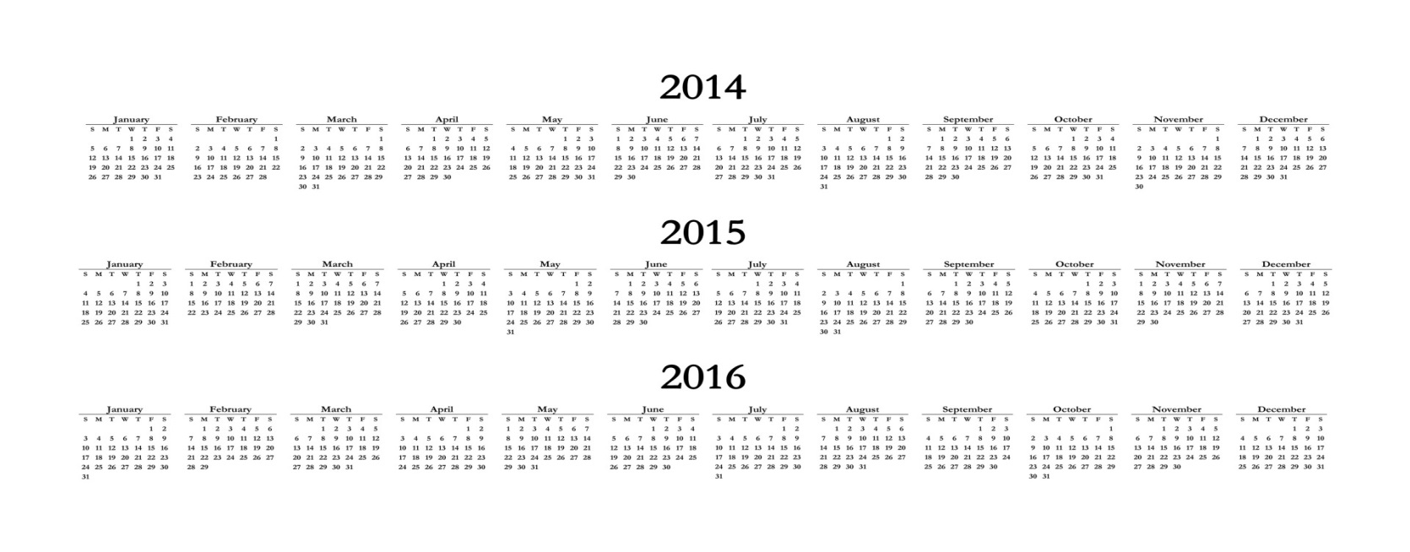
Multi-Year Agreement (MFA)
At the option of the Tribe/Consortium, and subject to the availability of Congressional appropriations, a FA may exceed one year (“Multi-year Funding Agreement” or MFA)

Slide 26
Reprogramming Request
Also known as “Reprogramming Request” and “FA Online”
Key financial document to be completed at negotiations
Specifies BIA programs
Specifies funding amounts
Specifies the sources of funding to be transferred
Footnotes identify unique factors concerning programs and/or amounts

Slide 27
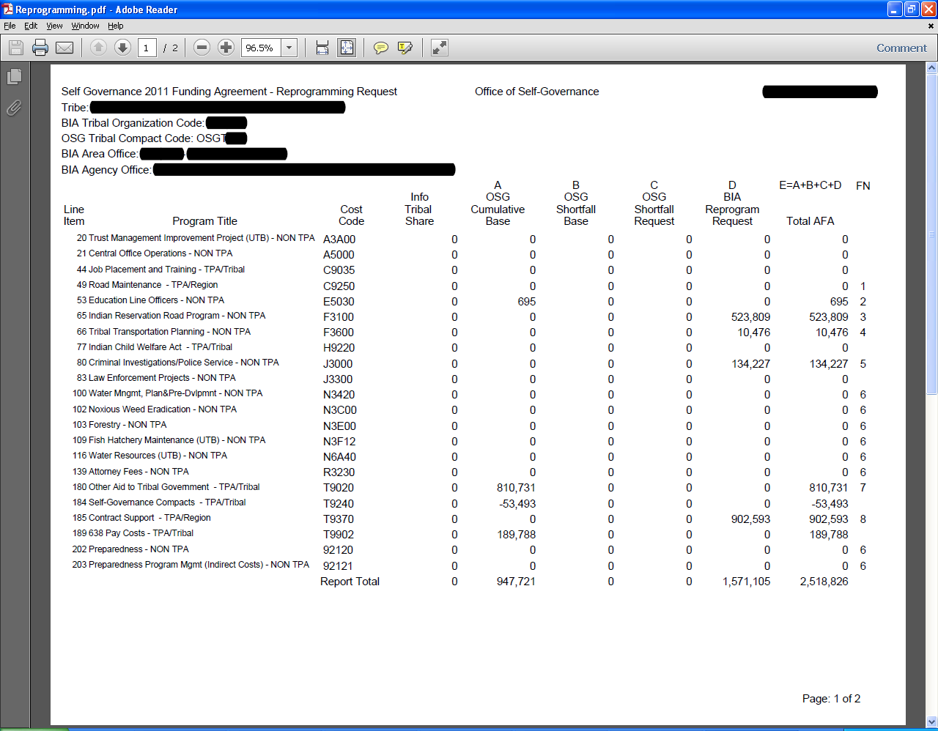
Worksheets / Reprogramming Requests / Funding Agreement Online

Slide 28
Funding Agreement Attachments
Local Agreement / MOU
Shared program service responsibilities
Phased program transition plan
Tribal Transportation Program Addendum
OST Programs
Appraisals MOU
Trust Beneficiaries Program MOU

Slide 29
DOI Self Governance
What Resources are Available for SG Negotiations?

Slide 30
Laws and…
Statutes
Snyder Act
Johnson O’Malley Act
Indian Self Determination and Education Assistance Act (P.L. 93-638, as amended)
Title I
Title IV
Notes:
Miscellanous: FOIA, Privacy Act, Audits, OMB Circs, Mgmt Systems, Use of funds, Savings and Carryover, Matching, Indian Pref, Supply Sources, Prompt Payment

Slide 31
…Regulations
25 CFR Part 1000
Subpart E for BIA Programs
Subpart G – Negotiation Process for AFAs
Subpart Q (miscellaneous)
Appendix A – Model Compact

Slide 32
Timeline for Negotiation Guidance
February - President’s Budget Request (Green Book) published in e-form
March - Draft circulated to feds
April - draft released for Tribal comment
May - final version released after conference
Final version posted on OSG website
Notes:
Green Book available on OSG website and BIA website
Feds: BIA - OJS, Indian Svc, Trust Svc, DOT; OST; SOL.

Slide 33
Negotiation Guidance
Guidance to federal negotiators
Programs Requiring Special Attention, i.e.
Trust Programs
Contract Support
Transportation Program
Law Enforcement
Process Checklist
Anticipated Data Calls
Model AFA
Model Addenda

Slide 34
Green Book (President’s BIA Budget Request to Congress)
Organization Charts, Maps
Executive Summary
Tribal Priorities
Program Changes
Summary Tables
BIA Programs
Budget Tables
Program Changes
Program Overview (program descriptions)

Slide 35
Green Book (President’s BIA Budget Request to Congress)
Appendix
Tribal Priority Allocation (TPA) tables
Bureau Regional Allocations
Self Governance Compact Participation
Self Governance Compact by Tribe/Consortium (SG Tribes’ Base funding)
Consolidated Tribal Government Program

Slide 36
Finalizing Negotiations
All parties have to sign the Funding Agreement
A second set of originals is sent to the Tribe
Copies are sent to appropriate Congressional Committees
Each Tribe served by the BIA Agency gets a copy

Slide 37
Finalizing Negotiations
Once final agreement has been reached, Tribes are responsible for preparing final negotiation packets for surname and signature which include:
Two signed original Compacts
Two signed original Funding Agreements
Two signed original Reprogramming Requests
Two copies of authorizing Tribal resolutions as needed
Two copies of any attachments

Slide 38
DOI Self Governance
Contract Support

Slide 39
Indian Affairs Policy
Currently operating under 2006 CSC policy
Tribal Consultation on revised CSC policy
Consultation sessions
Draft policy

Slide 40
OSG CSC Funding Process
2016
Award 80% of the prior-year CSC (not to exceed 100% of need)
Remainder/additional CSC awarded according to data received from each tribe
Applicable Indirect Cost Rate
Exclusions
Salary data (for award of Direct Cost CSC)
Eligible direct funds obligated
In the event of an overpayment the award official will communicate with the individual tribe

Slide 41
OSG CSC Funding Process
BIA CSC Shortfall Report
CSC Committees
BIA
SGAC subcommittee
2 CFR “Super Circular”

Slide 42
DOI Self Governance Orientation
What are OSG’s Responsibilities?

Slide 43
What Are Some Primary Things That Tribes Can Expect From OSG?
Select tribes to participate in Tribal Self Governance.
Complete Funding Agreement negotiations:
Fiscal year Tribes by June 30
Calendar year tribes by October 1
Award funding to SG tribes in accordance with Funding Agreements.
Assist with negotiations for non-BIA programs

Slide 44
What Are Some Primary Things That Tribes Can Expect From OSG?
Administer compliance with the Single Audit Act.
Process requests for waivers of BIA regulations within a 60-day time frame.
Prepare Secretarial SG Annual Report to Congress by each January 1.
Provide information to tribes, tribal members, other Federal agencies and the public regarding Self Governance.
Work with tribes and BIA regional offices to resolve problems related to implementation of Self Governance Funding Agreements.

Slide 45
I Used To Work With “____” At The BIA, Now Who Do I Work With At OSG?
SG Application – Ken
Funding Agreement negotiations – Assigned negotiator (Matt, Gordon, Shaunna, or Ken)
Fund awards/EFTs/drawdowns – OSG Finance (Dan, Fina, Celeste, Lance)
Contract Support – Tom, Nick
Single Audit Act compliance – Tom, Nick
Programmatic implementation – Assigned negotiator (possible participation from BIA region or agency)
Trust programs/transactions – BIA residual locale with participation from assigned negotiator

Slide 46
Visit the OSG Website
http//:64.58.34.34/osg
Headline News
Announcements
File Library
Reprogramming Request
Other important financial information
SGCE: tribalselfgov.org

Slide 47
Thank you! Please get in touch!
Sharee M. Freeman, Director Matt Kallappa Linda Austin
Director, OSG Manager, OSG Director of Operations
1951 Constitution Ave., NW 500 W. 12th St., Ste 102 Ysleta del Sur Pueblo
SIB 355-G Vancouver, WA 98660 119 S. Old Pueblo Rd.
Washington, DC 20240 (360) 699-1007 El Paso, TX 79907
(202) 219-0240 (915) 859-7913

