Slide 1
Leveraging the Affordable Care Act to Provide Greater Health Care Access Carolyn Crowder, Self-Governance Consultant
Indian Self-Determination and Education Assistance Act
Title I to Title V Training
December 14, 2016
Double Tree by Hilton Hotel Billings
Billings, MT

Slide 2
What We Will Cover…..
Review legislative and policy opportunities available to IHS and Tribal Health Programs to improve third party revenue and cost containment
Identify specific opportunities to maximize third party revenue through insurance enrollment under the Affordable Care Act, improve billing/collection practices, and negotiate provider agreements

Slide 3
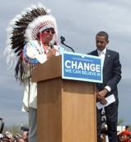
Tribes Operating Health Delivery Systems have an Added Complexity Requiring Accountability through 3 Complex Responsibilities as “Customer-Owners”:
Tribes or Tribal Health Organizations Who Opt to Enter into ISDEAA Agreements Juggle Multiple Roles:
-Tribal government
-Health Provider
-Employer
Tribal Objectives:
How to maximize revenues….
minimize costs of healthcare….
….while achieving governmental objectives of improving the physical,
spiritual, and economic well-being of Tribal members and communities

Slide 4
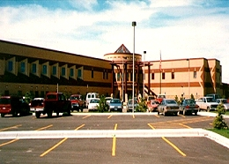
As a Health Provider….
IHCIA Authorizes:
Third Party Recovery
Reimbursement from Medicare, Medicaid & CHIP
Reimbursement from Federal Programs, including VA and DOD
Federal Torts for services to Non-Beneficiaries
ARRA Provided::
Medicaid Cost-Sharing Protections
Deemed Participating PPO by Medicaid Managed Care Plan & BBA of 1997 – no Mandatory Enrollment of AI/ANs in Medicaid Managed Care Plans
Electronic Health Record Incentive Payments
ACA Provides:
Exchange Plan Cost-Sharing Protections
Medicaid Presumptive Eligibility by Hospitals

Slide 5
As a Purchaser of Health Services/ PRC:
ARRA & ACA Provides:
Cost Sharing Protections
ACA Determined:
Indian Health is Payor of Last Resort
Medicaid Modernization Act:
Medicare Like Rates for Inpatient and now for ALL HEALTH SERVICES

Slide 6
As a Purchaser of Health Services: New Rule on Medicare Like Rates for ALL PRC Services:

Slide 7
As a Purchaser of Health Coverage for IHS Beneficiaries:
IHCIA Provides:
Authority to Purchase Coverage or Health Services
ACA Provides:
ACA Exchange Plan Coverage
ACA Exchange Plans
MMA:
Medicare Part D Prescription Drug Benefits

Slide 8
As a Provider of Health Coverage for Employees (Native & Non-Native):
IHCIA Provides:
Access to Federal Employee Health Benefit Plan
ACA Provides:
Medicaid Expansion Options
Tribes may opt to establish Self-Insurance Plans

Slide 9
Specific Revenue Enhancement Opportunities Provided under the Affordable Care Act (ACA)
More Health Care Resources:
Created State Option to expand Medicaid to all persons with household income under 138% federal poverty level ($16,243 for one person household)
-Federal government pays for 90% of costs
Established a Health Insurance Marketplace in each state
-Create mechanism to compare health plans
-Create mechanism to provide federal financial assistance
-Premium tax credits
-Cost-sharing reductions/protections
Included Permanent Reauthorization of the Indian Health Care Improvement Act (IHCIA)
Broadened range of services that can be funded with HIS appropriations & 3rd party revenues, including permitting the purchase of health insurance coverage for IHS beneficiaries

Slide 10
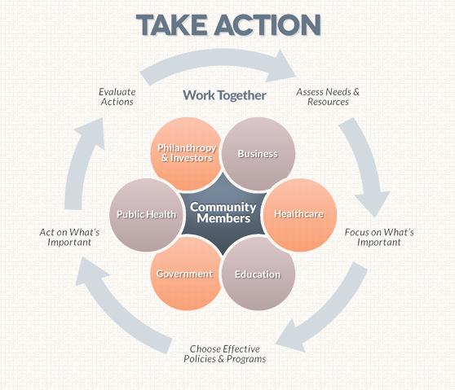
HOWEVER….. Taking Advantage of These Opportunities Requires Action & Proactive Monitoring!

Slide 11
FIRST STEP: Know your Patient Population Data
Look at your Population by Insurance Type
Look at Your Uninsured Population by Income Levels
Look at your Patient Utilization & unmet needs

Slide 12
Next Steps: Establish an Outreach & Enrollment Program

Slide 13
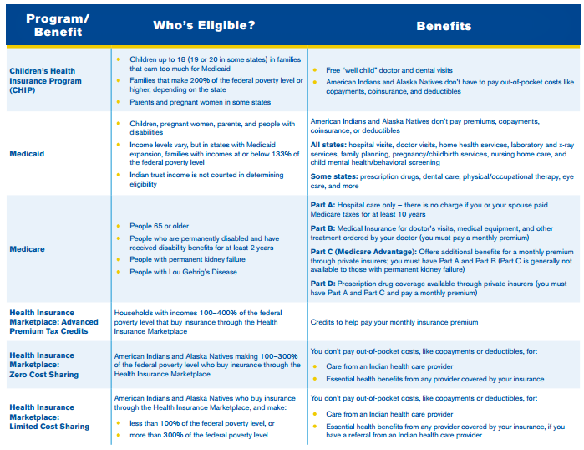
CHIP, Medicaid, Medicare & Health Insurance Outreach & Enrollment Program (Open Enrollment all Year):

Slide 14
Consider a Tribal Insurance Premium Sponsorship Program
Self-Governance Approaches and Issues
• Title V Compacting Tribes should add “sponsorship” language to existing Tribe-IHS contract / funding agreement
• History of Sponsorship of Medicare beneficiaries for
- Medicare Part B premiums
- Medicare Part B supplemental insurance
- Medicare Part D pharmaceutical coverage
• Some Tribes have decided to meet employer requirements under the Affordable Care Act by
As employer, pay” shared responsibility payment to IRS ($2,160 per full-time employee in 2016)
(2) As Tribal government, sponsor uninsured Tribal member employees along with other uninsured Tribal members
(3) As employer, provide income supplement to non-Tribal member employees not eligible for Tribal government Sponsorship program

Slide 15
Tribal Premium Sponsorship Program Option: Steps to Sponsor Tribal Members
The Tribe, along with IHS, could implement the following steps to initiate sponsorship of Tribal members in Marketplace coverage
• Identify funding source for Sponsorship program, such as– – For Title I Contracting Tribes: Purchased/Referred Care (PRC) program or Hospitals & Clinics (H&C) funds controlled by IHS or Tribe – For Title V Compacting Tribes: Appropriations or third party revenues
• Establish contract vehicle
- For Title I Contracting Tribes: Enter into a Title I contract with IHS to establish and fund the Sponsorship function
- For Title V Compacting Tribes: Insert “sponsorship” language in existing Tribe-IHS contract / funding agreement
• Indicate amount of funding required in Year 1
• Tribe establishes enrollee eligibility criteria for Sponsorship program • Transfer funds to Sponsorship program
• Enroll initial tribal members • Tribe begins Year 2 process by identifying funding needed for Year 2 3

Slide 16
Improving Collections Practices
You Can’t Collect if You Don’t Bill!
Must Haves:
Billing system or contractor
Trained staff: Coding, compliance, providers, Billers, Accounts Receivable
Good Negotiators with Payors
A Business Focus
Section 206 Third Party Recovery:
Right to Recover Reasonable Charges (rather than reasonable expenses) or highest amount the payor would pay a non-governmental provider
-from insurance companies, HMOs, employee benefit plans, and tortfeasors, and any other responsible or liable 3rd party
-Allows Tribal Health Organizations to use Federal Medical Care Recovery Act
-Allows self-insured Tribes to authorize payment to HIS
-Allows Tribal Health Organizations to recover costs and attorney’s fees if prevail

Slide 17
Best Practices
Expand Services to achieve more and better Health Care and increase revenues:
ACA requires health plans to pay for more prevention & wellness
{ ex. Screening for adults with high blood pressure or cholesterol, diabetes and cancer. Required to cover tobacco cessations to pregnant women}
If you aren’ providing these services, you are missing an opportunity to improve health status and generate revenues
TRIBAL HEALTH PROGRAMS SHOULD INCLUDE ALL EXPANDED HEALTH PROGRAMS IN ISDEAA FUNDING AGREEMENT TO ENSURE FTCA COVERAGE AND MORE CERTAIN REIMBURSMENT!
Enter into a payment contract with Insurance companies, and other payors
Negotiate to be a “Preferred Provider Organization” (PPO)
Insist on right to reasonable charges in absence of PPO status, vs “out of network” recovery
Aggressively pursue work claims
Enter into VA Memorandum of Agreement

Slide 18
Best Practices
Cost Sharing For PRC Programs:
-AI/ANs referred by PRC to any provider are not responsible for any cost sharing
-Cost Sharing Protections under Exchange Plans:
-Indians under 300% of poverty, enrolled in any Exchange plan, are exempt from Cost Sharing
-Qualified Health Plan will be paid by HHS for the Cost Sharing
Expansion Strategy:
-Consider Expanding Policies to include seeing non-Native Employees
-Expand Services to Community-at-large
-Evaluate Business cost/benefits of transitioning Purchased Referred Care (PRC) program funds to expand Direct Care services within Business Plan

Slide 19
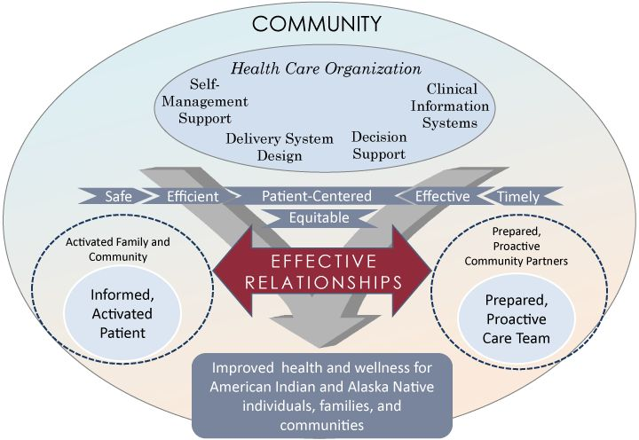
Best Practices
Tribal Quality Strategy Accelerates Ability to Expand Access to Health Care:
Institutionalize a Quality Model with Health Caring Customer Service to Attract New and Keep Existing Patients & Clients!

Slide 20
Finally……
Stay informed of new requirements and opportunities & make a timeline of when new requirements, including any impact on revenues or costs so you will be ahead of them
Evaluate impact of new requirements on your Tribal Health scope of practice
Develop a strategy with options to reduce cost, implementation steps & associated costs, and any revenue opportunities
Influence policy: review all proposed CMS Medicare, Medicaid rules and State Plan Amendments, seek protection of Indian Provisions, and engage in Tribal Consultation/comment
BE AHEAD OF REFORM EFFORTS:
Institutionalize a regular evaluation of your comprehensive health program & external factors which have potential to impact them
Include: Tribal Council, Executive Leadership Team
Catalog all health care provided: directly and through self-insurance, PRC, extended benefits to members, purchased insurance, reinsurance

Slide 21
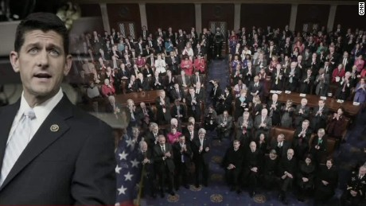
The Mandate is Clear…
In order to demonstrate Accountability,
We must develop a business model with a focus on Quality. We must innovate our approach to support and training. We must invest in our Health IT. And we need the I/T/U to work together to strategically lead the way.
And then, the Money will Follow.
Presentation Related to the 115th Congress’s Expected Focus on Accountability
NIHB Tribal Health Presidential Transition Summit, Dec. 8, 2016

Slide 22
Quyanna….thank YOU!
Carolyn Crowder, President
Crown Consulting & Management
P. O. Box 876661
Wasilla, AK 99687
crowder.healthiq@gmail.com
907-952-4184

