Slide 1
Financial Terms
Office of Tribal Self-Governance
Indian Health Service (IHS)

Slide 2
Key Concepts
Activities IHS carries out
Associated funds
Programs, Services, Functions, and Activities (PSFAs)
Tribal Share
Associated
means programs, services, functions, and activities (or portions thereof) that IHS carries out that an Indian Tribe may elect to carryout through a contract or compact
means the associated portion of funds used by IHS to carryout the PSFAs to be contracted
Inherent Federal Function
Associated
Residual
means those governmental functions which only IHS must perform which cannot legally be delegated to Tribes
means associated portion of funds used by IHS to carry out remaining inherent Federal functions when all other PSFAs are contracted

Slide 3
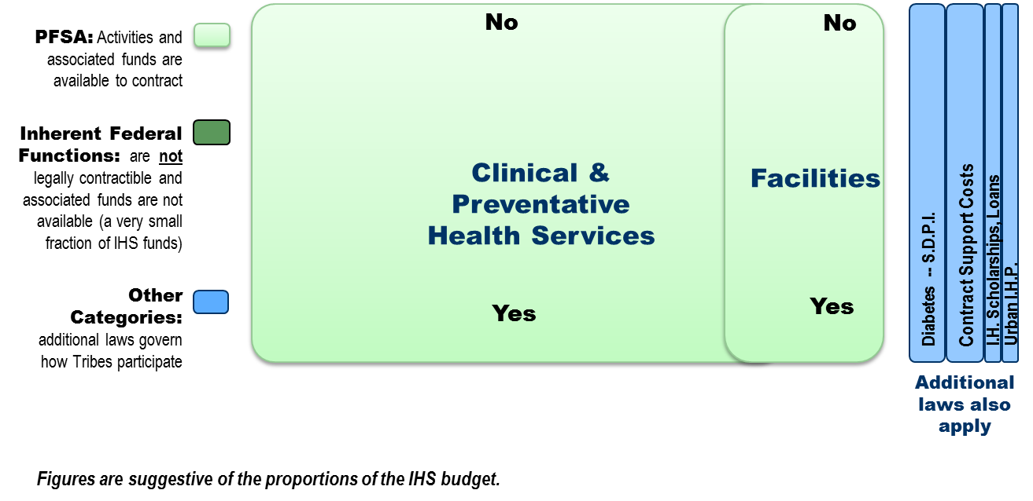
Transferrable Categories of PSFAs
No
No

Slide 4
PSFAs & Tribal Shares
IHS-wide (HQ) Shares
Portion benefiting each Tribe
Area Level Shares
Portion benefiting each Tribe
Local Level Shares
Portion benefiting each Tribe
PSFAs and associated funds are available from all 3 levels of the IHS. Location and dispersion does not affect amounts available for contract.
+
+

Slide 5
Transfer: IHS to Tribes

Slide 6
“Transferred” vs. “Retained”
PSFAs
Associated Shares
Funds associated with A, B, and C are transferred to the contract
A
B
$
Tribe elects to contract or compact A, B, C
C
. . .
Transferred
Associated funds are retained by IHS to perform X, Y, Z
$
Leaves X, Y, Z for IHS to perform
Retained
X
Shares retained for other Tribes
Y
Z

Slide 7
Summary
Key Terms:
Program, Services, Functions and Activities (PSFAs)
Inherent Federal Functions
Tribal Shares
Residual

Slide 8
Summary
PSFAs & Tribal Shares
Levels
Program
Area
Headquarters
Transferred vs. Retained

Slide 9
Contact Information
Office of Tribal Self-Governance :
http://www.ihs.gov/SelfGovernance
Carla Mayo:
Carla.Mayo@ihs.gov
(301) 443-7821

