Slide 1
IHS Headquarters (HQ) Tribal Shares
Office of Tribal Self-Governance
Indian Health Service

Slide 2
How are Tribal Shares Determined?
Direct Financial Measures: Shares are precisely determined when financial accounts record actual spending for PSFAs for a Tribe, e.g. IHS funds at a local site serving 1 Tribe.
Program Measures: Shares may be calculated in proportion to workloads, services, or patient counts for each Tribe. These formulas are most common for PSFAs associated with the Office of Environmental Health and Engineering.
Proxy Formula: A proxy formula calculates shares in proportion to indirect measures such as user counts, number of Tribes, or other general distributive factors. Most HQ PSFAs.
1. Otherwise
2. Otherwise
3.

Slide 3
Direct Financial Measure Example: 1 IHS Site Serving only 1 Tribe
When financial accounts record IHS expenditures for a program serving only 1 Tribe, the process to identify that Tribe’s shares is straightforward. The entire amount may be labeled “shares” and 100% are available when the Tribe contracts the program.
Budget of the Local IHS Site to be contracted
100% of the Site Budget is Available to that Tribe
Shares ($) for the Tribe
=
Only 1 Tribe is served there

Slide 4
Program Measure Formula Example: Fiscal Intermediary (FI) PSFA (IHS-wide)
The FI processes claims for IHS operated Purchased/Referred Care (PRC) programs. The FI is paid a fee per claim processed. A tribe can contract for this function. Shares associated with the PRC FI are proportional to the claims workload.
FI Fee Contract Amount $
Average Cost Per Claim
($ / #)
# Claims for the particular Tribe
Shares ($) for the Tribe
x
=
Total # Claims Processed by the FI

Slide 5
Proxy Formula Example: Tribal Size Adjustment Formula
Most of HQ PSFAs collectively benefit more than 567 Tribes.
The TSA formula calculates a dollar benefit for all Tribes in proportion to Tribal user counts.
TSA Formula
92% of TSA $ is calculated per user for all Tribes
Aggregate funds for ~ 50 HQ PSFAs
Portions for all Tribes
+
8% if < 2,500 users

Slide 6
Tribal Shares Tables
3) National Level Tables
2) Area Level Tables
Table #1
Area Budget
NEW APPROPRIATION
Shows any CHANGES to entire IHS appropriation
Area PSFA & $
Local Budgets
Table #2
Splits Appropriation into parts managed by HQ and Areas
HQ Budget
AREA Budgets
Area Shares
Table #3
HQ PFSA & $
1) Local Level Tables
Breakout of HQ PSFA and funds.
Local PSFA & $
HQ Tracked $
Table #4
HQ SHARES
Exists for each individual tribe and shows the portion of $ available to it.
Local Shares
Format and content of Area and Local level tables will vary, but will generally cover the topics listed above.

Slide 7
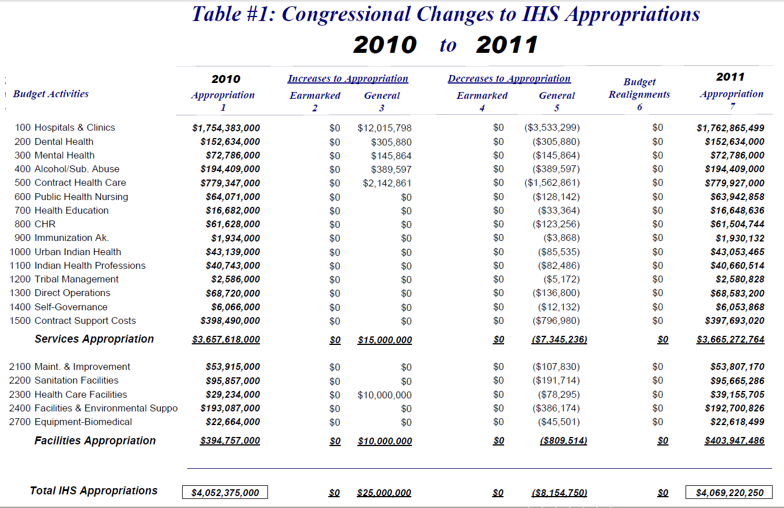
Table 1 -IHS Appropriation
Major IHS Accounts
Final IHS Budget
Changes Made By Congress

Slide 8
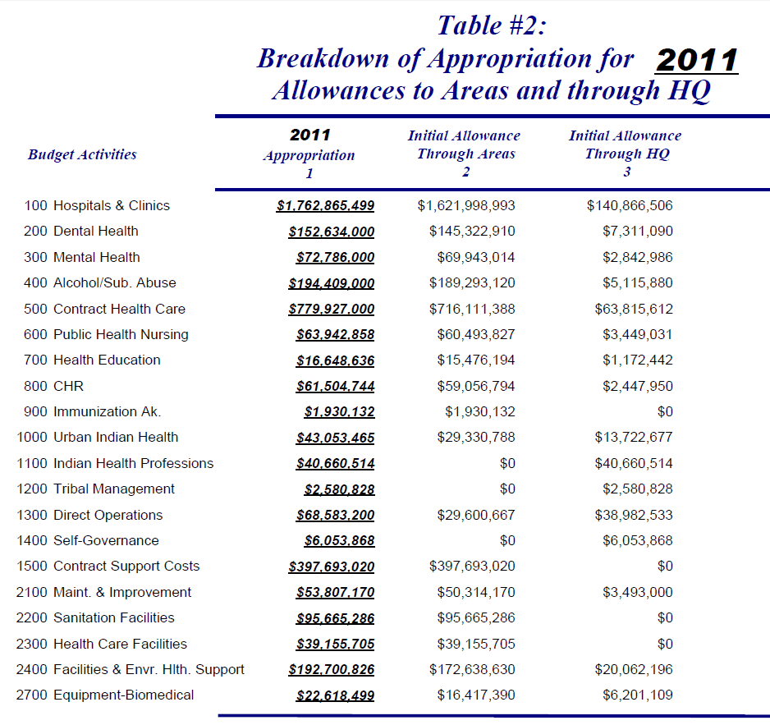
Table 2 – HQ and Area Budget Split
Amounts Tracked On HQ Tables
Total Amounts Tracked On Area Or Local Tables

Slide 9
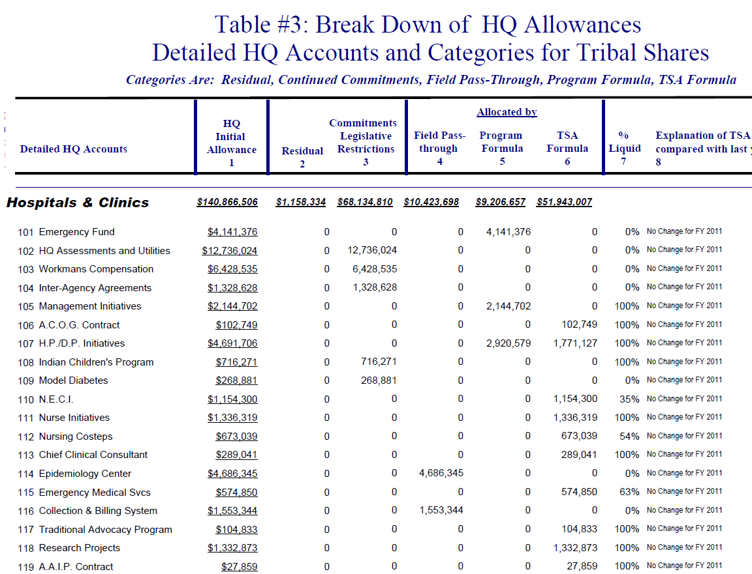
Table 3 – HQ PSFA Breakout
Unavailable For Shares
Available For Shares
PSFAs

Slide 10
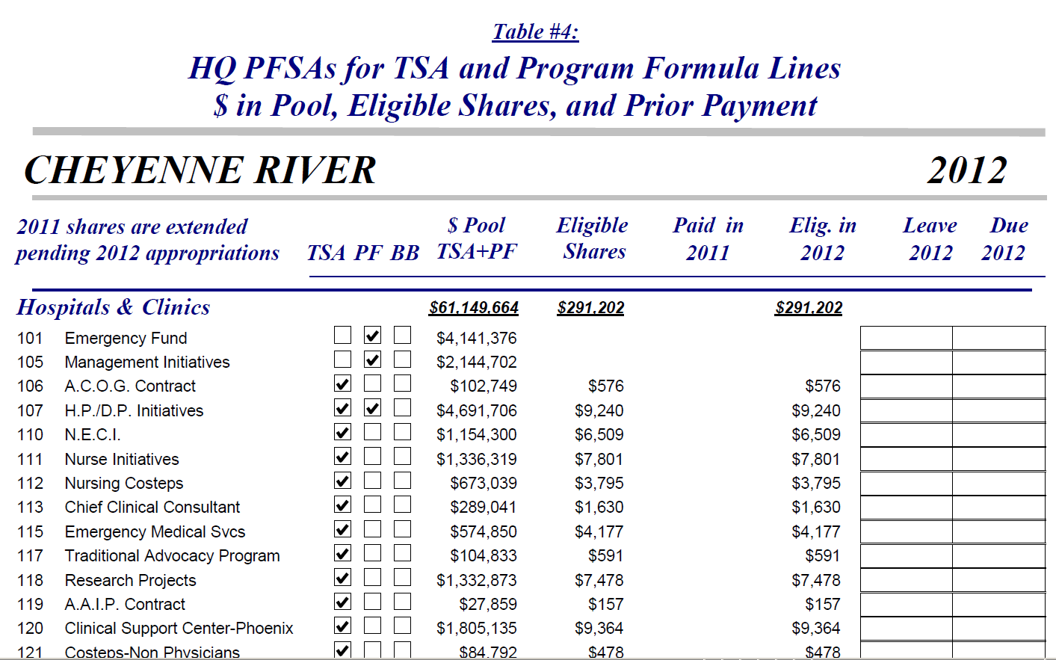
Table 4: HQ Shares Available to a Tribe
Portion Available In FA
Tribe’s Portion Of Each PSFA

Slide 11
Self-Governance FA Table

Slide 12
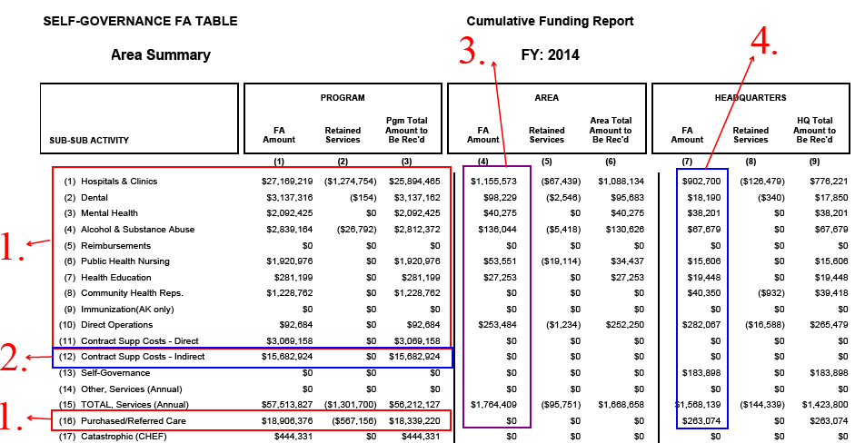
Self-Governance FA Table
Program – Recurring Amounts
CSC Indirect – Non-Recurring
Area Tribal Shares – Recurring
Headquarters Tribal Shares - Recurring

Slide 13
Self-Governance FA Table
5. Program/Area/Headquarters Facilities – Non-Recurring

Slide 14
Self-Governance FA Table
6. Retained Amounts – Retained and Buybacks

Slide 15
Final Points About HQ Tables
PSFAs relate to functional categories
HQ PSFA tables do NOT correspond closely with the HQ organizational structure or staffing
HQ staff contribute to many different PSFAs and staffing is managed in aggregate

Slide 16
Final Points About HQ Tables
Protected Shares
Although the organizational structure has changed several times to address changing circumstances and needs, shares for every Tribe are protected – regardless of HQ internal realignments

Slide 17
Final Points About HQ Tables
Office of Finance and Accounting
Creates HQ tables
Other HQ Offices
Responsible for carrying out the PSFAs and descriptions in the PSFA manual

Slide 18
Albert Einstein Quote:
“Learn from yesterday, live for today, hope for tomorrow. The important thing is not to stop questioning. “

Slide 19
Contact Information
Office of Tribal Self-Governance :
http://www.ihs.gov/SelfGovernance
Carla Mayo:
Carla.Mayo@ihs.gov
(301) 443-7821

