Slide 1
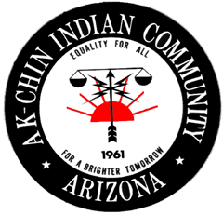
Ak-Chin Indian Community
HEARTH ACT

Slide 2
Community Overview
The Ak-Chin Indian Community, ‘ the Community,’ is nestled in the Santa Cruz Valley of Southern Arizona and about 20 miles south of Phoenix.
There are 1,046 enrolled Ak-Chin Community Members.
The Community is governed by 5 member Community Council which oversees governmental operations and departments that service the Community of Ak-Chin.

Slide 3
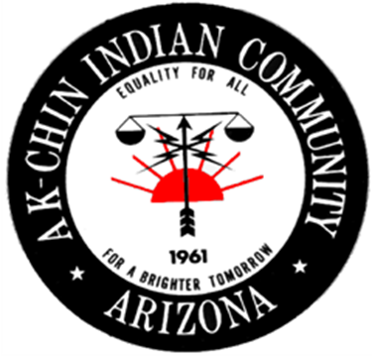
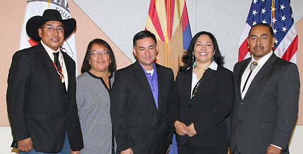
Ak-Chin Indian Community Council

Slide 4
Community Overview
The Ak-Chin people are a mixture of Pima and Tohono O’odham tribes whose background is farming. The word Ak-Chin comes from an O’odham word meaning mouth of the wash or place where the wash loses itself in the sand or ground.
Ak-Chin also refers to the type of farming that is dependent on washes created by seasonal flood plains. The relationship of land and water has always been at the heart of Ak-Chin’s identity and as such the entire 22,000 acre reservation.

Slide 5
HEARTH Act
The Community started the process in early 2013.
Our regulations were approved by the Bureau of Indian Affairs on November 10, 2013 for Business.
The Community followed the guidance when developing the tribal regulations for requirements in leasing approvals.
The clear upside is that the Community now has the power to grant leases involving it’s real property.
However, there are costs involved in assuming such authority

Slide 6
HEARTH Act: Ak-Chin Tribal Regulations
The HEARTH Act has conferred the right to take on this responsibility, but appropriated no money for doing so.
The HEARTH Act specifically states that the Secretary shall not be liable for any losses by parties to a tribal lease that’s executed under tribal regulation. See 25 USC 415(b)(7).
To obtain approval, the tribal regulations must put in place an Environmental Review Process. If the necessary Process isn’t completed, the lease is “null” and “void.”

Slide 7
HEARTH Act: Ak-Chin Tribal Regulations
Costs also may be incurred in regard to the process created per the regulation for determining, “Fair Lease Value.”
Ak-Chin tribal regulations also impose a number of terms and conditions which tribal leases are required to contain. Including insurance and performance bond requirements.
As well as the requirement that leases be submitted to BIA for recordation.
Challenges to the Community’s determinations regarding leases may be brought in Community Court.

Slide 8
HEARTH Act: Implementation
When the Community started implementing the HEARTH Act into Departments the new process did take some time to get used to for all.
Adjustment period for everyone
Experienced some growing pains
Overall, starting to smooth out and becoming a regular process with a strong future in leasing in business.

Slide 9
HEARTH Act: Impact
The HEARTH Act assisted greatly in timing to execute leases.
Leases on average are 45 days including Council Review.
Before the HEARTH Act leases would take up to 90-120 days.

Slide 10
HEARTH Act: Sum Up
There are benefits and costs involved in developing a tribal leasing regulation that warrant consideration.
Notably, federal involvement isn’t eliminated entirely, federal approval of the tribe’s regulations is required.
There are terms and conditions that must be included in the tribal lease that are intended to protect the federal government against potential liability risk.

Slide 11
HEARTH Act: Going Forward
Enabled the Community to say, “Do business with us, not a process”
The Community is exercising Self-Governance and take on the responsibility.
Now a streamlined process for the Community to venture into new leases and expand/diversify business interests.
Made the Community a lot more competitive with neighboring cities of Maricopa, Chandler, and Casa Grande.

Slide 12
Ak-Chin Industrial Park Board
Formally established by the Ak-Chin Community Council to develop, operate, and manage the Community’s industrial properties.
The Board is committed to being a one- stop resource for tenant needs, which saves both time and money for potential tenants seeking space in existing buildings or future development in the Center.
The Board works with Community departments and outside entities to facilitate the process for planning and zoning, architecture and construction, and building permitting and signage within the Community on behalf of the tenant.
Directly reports to Community Council.

Slide 13
Ak-Chin Means Business
The Community is committed to economic diversification to support new industry and job growth for tribal members as well as surrounding communities .
A recent economic impact analysis documented that the total output of the Ak-Chin Indian Community is nearly at $437 million in 2010.

Slide 14
Ak-Chin Enterprises
Ak-Chin Farms
Ak-Chin Industrial Park
Ak-Chin Regional Airport
Ak-Chin Quail Run Steel Company
Harrah’s Ak-Chin Casino & Resort
Hickman’s Egg Farm
Santa Cruz Commerce Center
Southern Dunes Golf Club
Vekol Market
UltraStar Multi-tainment Center at Ak-Chin Circle

Slide 15
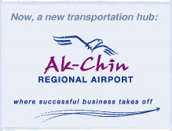
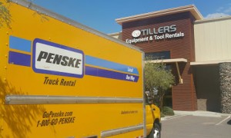
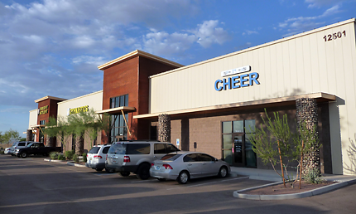
Variety of Leasing Tenants
Tillers Equipment & Tool Rentals
M&S Equipment
Fyrestorm Cheer
Hickman’s Eggs
Expected End Ministries
Gymnastics
Batting Cages
Cross Fit

Slide 16
Grow Your Business in the Ak-Chin Indian Community
https://youtu.be/6g2ifoa6YMQ

Slide 17
Questions?

Slide 18
Karen Fierro Self-Governance Director 520.568.1036 kfierro@ak-chin.nsn.us
Contact Information

