Slide 1
HHS STRATEGIC PLAN FY 2018 – 2022
AN OVERVIEW
U.S. Department of Health and Human Services Public Consultation
Sarah Potter
Strategic Planning Team
Office of Science and Data Policy
Office of the Assistant Secretary for Planning and Evaluation

Slide 2
2
DRAFT HHS STRATEGIC PLAN FY 2018 - 2022
Goal 1.
Reform, Strengthen, and Modernize the Nation’s Health Care System
Goal 2.
Protect the Health of Americans Where They Live, Learn, Work, and Play
Goal 3.
Strengthen the Economic and Social Well-Being of Americans across the Lifespan
Goal 4.
Foster Sound,
Goal 5.
Promote Effective and Efficient Management and Stewardship
Sustained
the
Advances in
Sciences
1.1. Promote affordable health care, while balancing spending on premiums, deductibles, and out-of- pocket costs
2.1. Empower people to make informed choices for healthier living
3.1. Encourage self- sufficiency and personal responsibility, and eliminate barriers to economic opportunity
4.1. Improve surveillance, epidemiology, and laboratory services
5.1. Ensure responsible financial management
4.2. Expand the capacity of the scientific workforce and infrastructure to support innovative research
2.2. Prevent, treat, and control communicable diseases and chronic conditions
3.2. Safeguard the public against preventable injuries and violence
5.2. Manage human capital to achieve the HHS mission
1.2. Expand safe, high- quality health care options, and encourage innovation and competition
4.3. Advance basic science knowledge and conduct applied prevention and treatment research to improve human health and development
2.3. Reduce the impact of mental and substance use disorders through prevention, early intervention, treatment, and recovery support
3.3. Support strong families and healthy marriage, and prepare children and youth for healthy, productive lives
5.3. Optimize IT investments to improve process efficiency and enable innovation to advance program mission goals
1.3. Improve Americans’ access to health care and expand choices of care and service options
3.4. Maximize the independence, well- being, and health of older adults, people with disabilities, and their families and caregivers
4.4. Leverage
translational research, dissemination and implementation science, and evaluation investments to support adoption of evidence- informed practices
1.4. Strengthen and expand the health care workforce to meet America’s diverse needs.
2.4. Prepare for and respond to public health emergencies
5.4. Protect the safety and integrity of our human, physical, and digital assets

Slide 3
Public and Congressional Consultation
When:
September 26 – October 27
Where:
Find the plan on the HHS.gov Website under “About Us” - https://www.hhs.gov/about/draft-strategic-plan/index.html
How:
Federal Register Notice of Availability Letters to Congress
Social Media
Letters to and Conference Calls with Tribal Leaders, Tribal Health Directors, and Urban Indian Health Directors

Slide 4
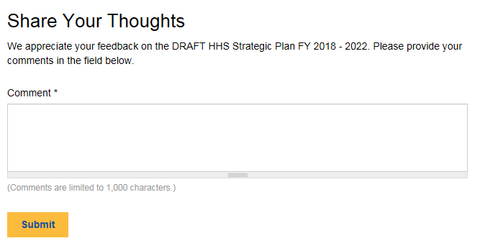
How to submit a comment:
Directly into the comment boxes found on the online draft at https://www.hhs.gov/draft-strategic-plan

Slide 5
Other ways to submit comments:
By e-mail:
By fax:
Mail:
HHSPlan@hhs.gov (202) 690-5882
U.S. Department of Health and Human Services Assistant Secretary for Planning and Evaluation Strategic Planning Team
Attn: Strategic Plan Comments
200 Independence Avenue, SW, Room 415F Washington, DC 20201

