Slide 1
Panel on Indian Economic Development, Labor and Population Data
Tom Krolik
U.S. Department of Labor
Bureau of Labor Statistics
Local Area Unemployment Statistics program
October 26, 2017

Slide 2
Background
The Local Area Unemployment Statistics (LAUS) program of the Bureau of Labor Statistics (BLS)
Federal-state cooperative effort
Produces monthly estimates of civilian labor force and unemployment for subnational areas

Slide 3
Geography
LAUS geography—roughly 7,500 unique areas
States
Office of Management and Budget federal statistical areas (e.g., metro and micro areas)
All counties and equivalents
Cities with populations of 25,000 or more
All minor civil divisions in New England

Slide 4
Data Measures
Four data measures published for each area
Civilian labor force
Employed persons
Unemployed persons
Unemployment rate
Employed and unemployed persons are independently estimated; civilian labor force and unemployment rate are derived

Slide 5
Data Concepts
Concepts are based on activity during a reference week (12th day of the month)
Employed people are those who did any work at all for pay or profit, including those who had a job from which they were temporarily absent
Unemployed people are those who did not have a job, had actively looked for work in the prior four weeks, and are currently available for work

Slide 6
Methodologies
LAUS uses a hierarchy of methodologies, based on availability of inputs
U.S. data come from a survey of 60,000 households
State data are model-based
County data use a building block approach
Cities are disaggregated from counties using population and unemployment insurance claims data

Slide 7
Input Data Sources
LAUS input data sources:
Current Population Survey
Current Employment Statistics survey and Quarterly Census of Employment and Wages
Unemployment insurance systems (state, federal, and Railroad Retirement Board)
Decennial Census and Population Estimates Program
American Community Survey

Slide 8
American Community Survey
American Community Survey, or ACS
Census Bureau survey of 3.5 million households
1-year estimates for areas with 65,000 or more population; 5-year estimates for all areas
Provides on a more frequent basis data that had been available as a once-per-decade snapshot from the decennial census long-form surveys
Includes employment status questions that reflect the activity concepts of the Current Population Survey

Slide 9
ACS Share Ratios
$$R01= \frac{{\text{ACS} \text{Emp}}_{\begin{aligned} &City \\ &ACS 5−Year\end{aligned}}× \frac{{\text{Census} \text{Pop}}_{\begin{aligned}& City \\ & July−1 PEP\end{aligned}}}{{\text{ACS} \text{Pop}}_{\begin{aligned}& City \\ & ACS 5−Year\end{aligned}}}}{{\text{ACS} \text{Emp}}_{\begin{aligned}& County \\ & ACS 5−Year\end{aligned}}× \frac{{\text{Census} \text{Pop}}_{\begin{aligned}& County \\ & July−1 PEP\end{aligned}}}{{ACS Pop}_{\begin{aligned}& County \\ & ACS 5−Year\end{aligned}}}}$$
$$Emp share=\frac{{\text{ACS} \text{Emp}}_{\begin{aligned} & ResCity \\ & ACS 5−Year\end{aligned}}}{{\text{ACS} \text{Emp}}_{\begin{aligned}& County \\ & ACS 5−Year\end{aligned}}}$$
$$Unemp share=\frac{{\text{ACS} \text{Une}\text{mp}}_{\begin{aligned} & ResCity \\ & ACS 5−Year\end{aligned}}}{{\text{ACS} \text{Une}\text{mp}}_{\begin{aligned}& County \\ & ACS 5−Year\end{aligned}}}$$

Slide 10
ACS Share Ratios

Slide 11
Disadvantages
No current information specific to the reservation areas themselves is used
The ACS data from which the shares are calculated pertain to a remote, 5-year period
Conditions may have varied considerably within the 5-year base period
Average shares over the 5-year base period may not be representative of the current relationship

Slide 12
Disadvantages
Little independent variation from the county out of which the reservation area is shared
The underlying ACS data are survey-based estimates, subject to sampling error
This can be large, particularly for very small reservation areas

Slide 13
Advantages
Data can be generated on a current, monthly basis
Reflect the official concepts of employment and unemployment that come from the Current Population Survey
Consistent with the official county-level estimates published by LAUS

Slide 14
Montana Reservations
In March 2015, Montana requested BLS’s assistance to produce estimates for its seven reservation areas
BLS provided share ratios calculated from the 5-year ACS dataset for 2009–13 and advised them on adding the areas into the LAUS production database as state-specifics

Slide 15
Montana Reservations

Slide 16
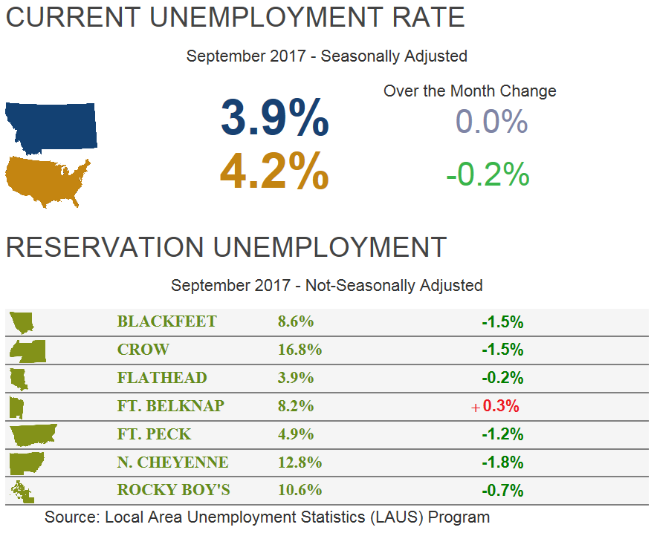
http://lmi.mt.gov/

Slide 17
All Reservation Areas
In April 2017, BLS ran data unofficially from January 2010 through December 2016 for all 692 reservation areas included in the 5-year ACS dataset for 2009–13
What would be needed to get data into production for all reservations?

Slide 18
Tom Krolik
Branch Chief
LAUS Operations & Analysis
https://www.bls.gov/lau/
202-691-6417
krolik.thomas@bls.gov

