Slide 1
Race and Ethnicity Data from the U.S. Census Bureau
Hyon B. Shin
Chief, Racial Statistics Branch
Population Division (POP), U.S. Census Bureau
Presented at the DOI Self-Governance Advisory Committee Quarterly Meeting
Washington, D.C.
October 26, 2017

Slide 2
Current Data on American Indian and Alaska Native (AIAN) Populations
2
Notes:
2

Slide 3
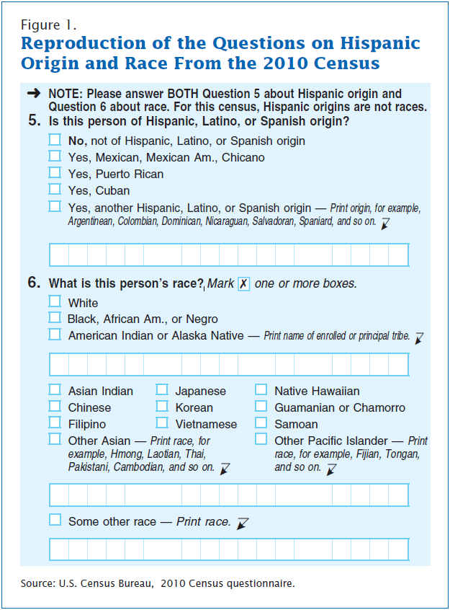
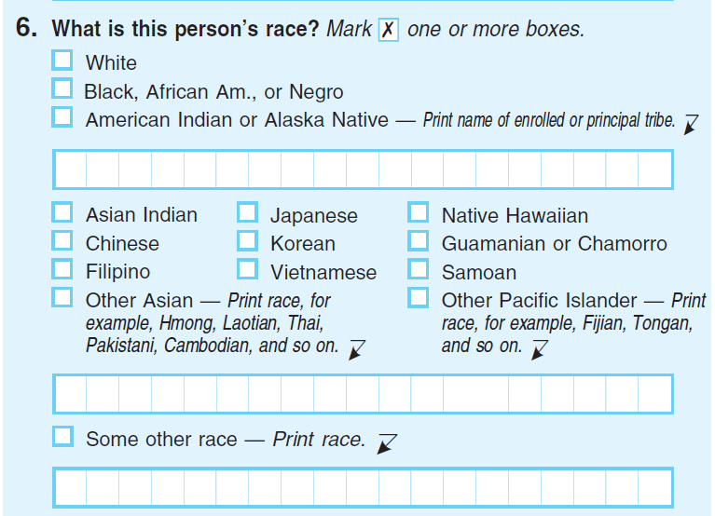
2010 Census Question on AIAN

Slide 4
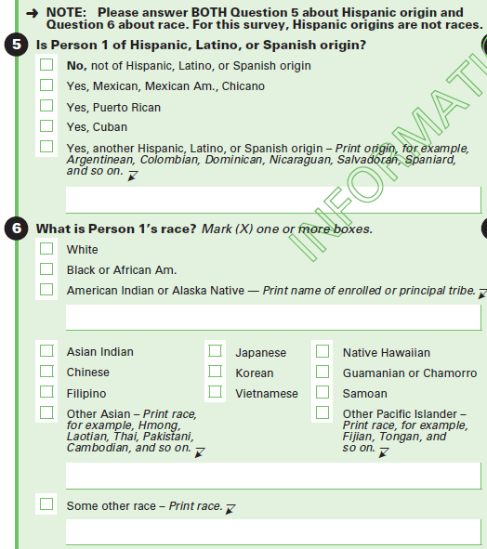
American Community Survey (ACS) Question on AIAN

Slide 5
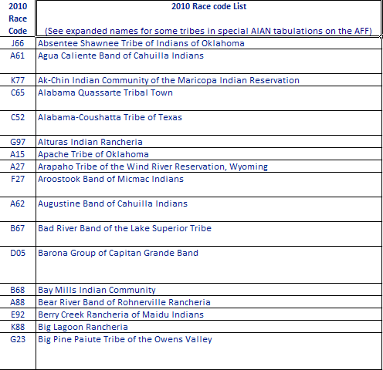
Excerpt from 2010 Census Code List
5
Notes:
5

Slide 6
Data Products
2010 Census
Summary File 2
American Indian and Alaska Native Summary File
2010 ACS 5-Year Special Population Tables (SPT) and American Indian and Alaska Native Tables (AIANT)
ACS release
1-year estimates
5-year estimates
2015 ACS 5-Year SPT and AIANT release

Slide 7
2015 ACS SPT/AIANT Release
https://www.census.gov/newsroom/press-releases/2017/acs-selected-population-tables-aian.html
7
Notes:
7

Slide 8
Mid-Decade Research on Race and Ethnicity Questions

Slide 9
Concerns with the Current Race/Ethnicity Questions
Growing number of groups find the race and Hispanic origin questions confusing
Increasing responses of “Some Other Race”
Campaigns and lobbying of the U.S. Census Bureau and the U.S. Congress for changes to the race and Hispanic origin questions
Led to the 2010 Census Race and Hispanic Origin Alternative Questionnaire Experiment (AQE)

Slide 10
Overview of Mid-Decade Research for AIAN
2014 focus groups on alternative race questions and instructions for tribal reporting
2015 cognitive testing of alternative answer formats
2015 National Content Test (NCT)
2017 Census Test (CT)

Slide 11
2014 Focus Groups
Purpose of focus groups was to evaluate different words and instructions for the AIAN population
Diverse representation of AIAN population: representing different tribes, different ages, different education attainment, etc.
Participants didn’t agree what the different terms and concepts (e.g., “enrolled,” “affiliated,” “villages,” “race,” “origin,” “tribe,” etc.) meant
Majority of AIAN participants preferred “Print, for example…” instruction wording

Slide 12
2014 Focus Groups Results
Tested “Print, for example….” instructions, with varying combinations of question instructions in the 2015 NCT
(e.g., “What is your race or origin?”
“Which categories describe you?”)
American Indian or Alaska Native – Print, for example,
Navajo Nation, Blackfeet Tribe, Mayan, Aztec,
Native Village of Barrow Inupiat Traditional Government,
Nome Eskimo Community, etc. 

Slide 13
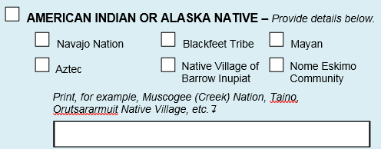
2015 Cognitive Interviews
✓
✓
✓
Version 1
✓
✓
✓
Version 2
✓
✓
✓

Slide 14
2015 Cognitive Interviews Results
Desire to report participant’s complex and diverse racial identify
Examples provided guidance to participants to find themselves and report their identities
For AIAN respondents, a sense of fairness among the different tribes was important

Slide 15
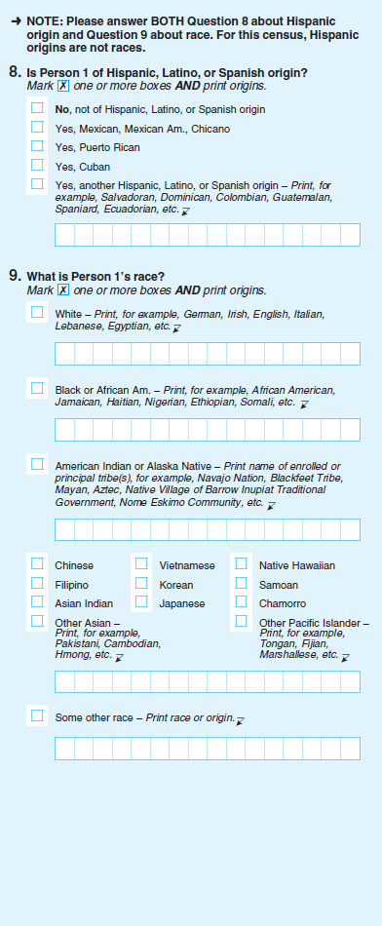
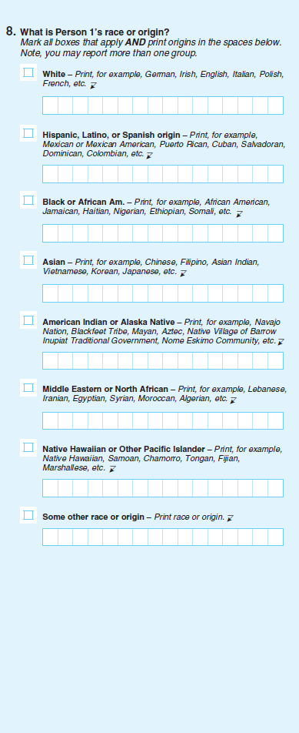
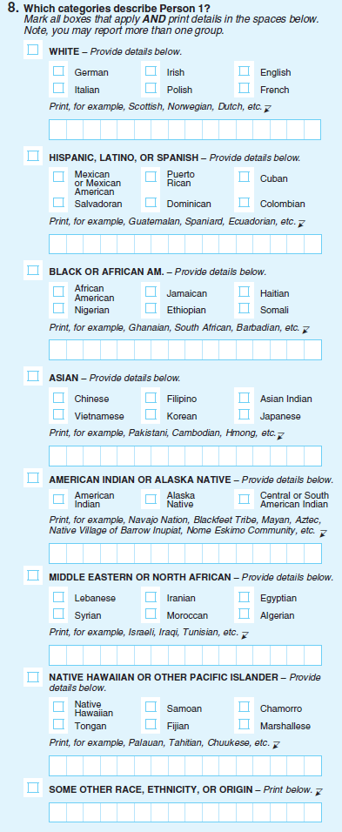
2015 National Content Test Designs

Slide 16
2015 National Content Test Designs for AIAN
Version 1
Version 2

Slide 17
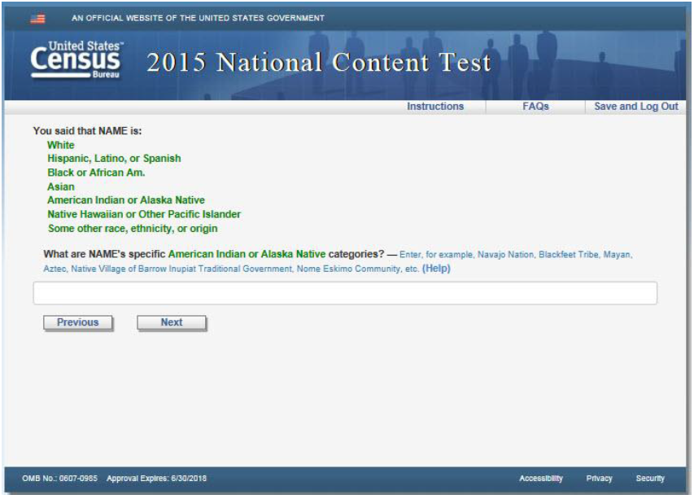
2015 NCT Question Designs for AIAN Version 1
Paper
Internet

Slide 18
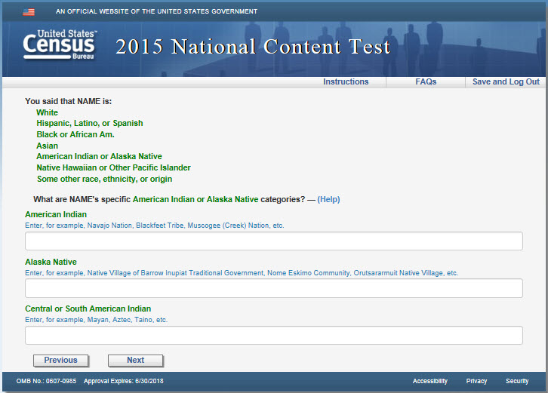
2015 NCT Question Designs for AIAN Version 2
Paper
Internet
✓
✓
✓

Slide 19
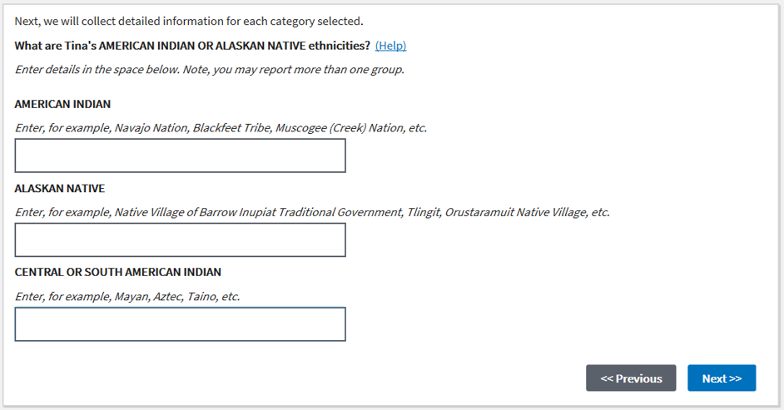
2017 Census Test AIAN Response Options
Paper
Internet

Slide 20
AIAN Coding and Classification Survey
Coding and classification of Race and Ethnicity codes
Engagement with Tribal Leaders on any updates to the coding and classification for AIAN tribes, tribal entities, and tribal groups
Feedback and spreading the word about the survey

Slide 21
Thank You!
Hyon B. Shin
hyon.b.shin@census.gov

