Slide 1
Indian Health Legislative Update
Presented by:
Caitrin Shuy
Director of Congressional Relations

Slide 2
Current Legislative Issues
Issue | House Bill | Senate Bill
Affordable Care Act Repeal and Replace | H.R. 1628 | -
Special Diabetes Program for Indians (SDPI) Reauthorization Act of 2017 | H.R. 2545 | S. 747
Restoring Accountability in the IHS Act | H.R. 2662 | S. 1250
Native Health Access Improvement Act | H.R. 3704
Native Health and Wellness Act | H.R. 3706

Slide 3
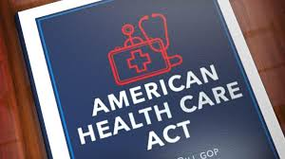
Affordable Care Act Repeal and Replace
Congressional Republicans vow to repeal and replace the Affordable Care Act
Legislation (H.R. 1628) passed the House in May by 217-214
Senate considered similar legislation but it did not garner the 50 votes needed by deadline of Sept. 30
Draft bills would have:
Ended Cost-sharing reductions
Drastically reformed (and cut) Medicaid to states
Expanded 100% FMAP for AI/ANs to all providers
Ended Individual and Employer Mandates
Eliminated Prevention and Public Health Fund
Kept IHCIA intact as well as other provisions pertaining to Indian Health
Notes:
Congress had worked to repeal and replace the Affordable Care Act since winning the House, Senate, and Presidency in the 2016 elections.
To kick off this process, they first passed a budget resolution which allowed for specific instructions to repeal the law with only 50 votes in the senate. The House passed legislation in May by only 3 vote margin. The Senate looked a similar legislation with deeper cuts to Medicaid, but it was not successful in passing by the September 30 deadline needed under reconciliation rules.
The bill would have made major cuts to Medicaid; ended cost sharing reductions for insurance; ended individual mandate and employer mandate; eliminated prevention and public health fund; expanding 100% FMAP to all providers (more on this later); and ended individual and employer mandates.
The bill would have preserved the Indian Healthcare Improvement Act and other Indian-specific provisions such as:
Section 2901(b) – IHS as Payor of Last Resort
Section 2902 – Permanent authority to bill Medicare Part B
Section 9021 of ACA (Section 139D of Internal Revenue Code) allowing tribal health benefits to be tax exempt

Slide 4
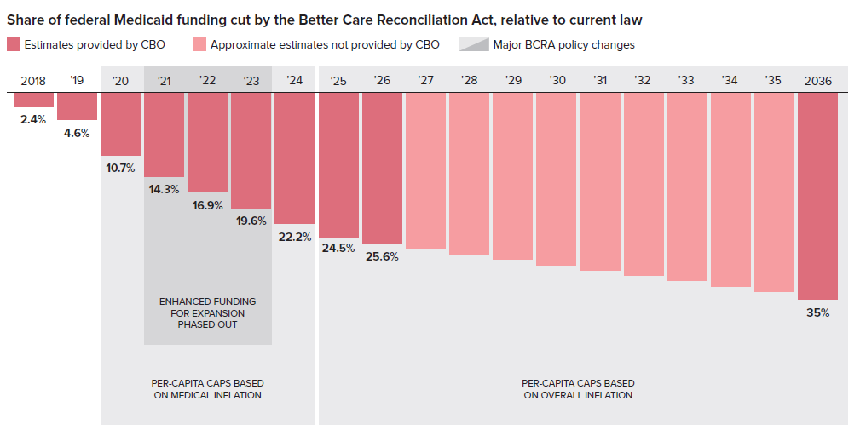
Affordable Care Act Repeal and Replace
Notes:
This is an example of the cuts to Medicaid relative to current law that would have been included in the Senate's healthcare reform bill.
Medicaid is roughly 13% of the total IHS budget. The cuts to Medicaid will mean less services, and less revenue for IHS and Tribal providers, putting pressure on the Indian health service which is already severely underfunded.
For over 40 years, Congress has recognized Medicaid as a means to help fulfill the trust responsibility for health to Indian Country and today represents about 13% of total IHS spending. This means, that cuts to the Medicaid program, are really cuts to IHS.
IHS/ Tribal and Urban health programs have benefited tremendously from Medicaid expansion since the enactment of the ACA.

Slide 5
Affordable Care Act Repeal and Replace
Tribes universally opposed these proposals largely due to cuts in Medicaid.
NIHB/NCAI/NCUIH/ SGCE sent a letter to Senate Leaders on June 27:
Maintain Medicaid funding based on need, rather than capping it according to a complicated per capita allocation formula or through capped block grants.
Continue Medicaid Expansion, and at the very least, continue Medicaid Expansion for AI/ANs
Protect AI/ANs from barriers to care that are inconsistent with the federal trust responsibility, such as work requirements under Medicaid
Retain cost-sharing protections at Section 1402 of the Patient Protection and Affordable Care Act (ACA); and
Maintain funding for preventative services, including the Prevention and Public Health Fund and women’s health services.
Notes:
NIHB and other tribal organizations set letters to Congress at various stages in the repeal / replace process. Always expressing united tribal opposition to this bill. You can see the main points we objected to here. Other letters were sent with similar language on March 23; May 5; June 7; July 21; and September 20.
We also encouraged tribes to do the same – many did. Universal opposition from Indian Country

Slide 6
Affordable Care Act Repeal and Replace
Draft Senate bill also contained language that would expand 100% FMAP under Medicaid to all providers without care coordination agreements. Tribes have voiced opposition to this.
Expanding 100% FMAP to all providers would:
Significantly increase federal Medicaid expenditures.
Divert federal Indian health expenditures to pay for services that are not targeted to Indian people.
Weaken incentives for State support of Tribal programs and State-–Tribal cooperation and innovation regarding Medicaid.
Tribal citizens would not gain, providers would not gain, but only state government revenues would increase.
Notes:
Another “new” piece of language was added to the Senate drafts that would expand the 100% Federal reimbursement under Medicaid to all providers. Right now, 100% FMAP goes through the I/T/U system because it was started as a way to increase federal revenues at IHS.
Patients don’t gain. They can already go to any provider they like. Providers get the same amount of payment either way. States get more $ without having to get more to the Indian health system.
Instead, tribes would lose bargaining power with state Medicaid programs because they don’t have incentives to work with states on exemptions to think like work requirements or lifetime caps.

Slide 7
Affordable Care Act Repeal and Replace
Congressional Inaction → Administration Changes
October 12 – Executive Order
Small employers will be allowed to buy health insurance through association health plans.
Lifts limits on short-term health insurance plans
Expands availability by allowing these groups to side-step the Marketplace and permits the use of Health Reimbursement Arrangements
October 12 – President announces that they will not pay Cost Sharing Reductions (CSRs)
Will likely be offset by increase in Premium Tax Credits (CBO)
Both measures will likely destabilize the Health insurance marketplace and cause insurers to leave
Notes:
NIHB has heard Tribal concerns that this action would destabilize the Marketplace for the poor and underserved populations. By encouraging healthier people to join cheaper insurance plans outside of the Marketplace, the risk pool is shifted to include sicker people which will drive up premiums or cause Insurers to drop out of the Marketplace altogether.

Slide 8
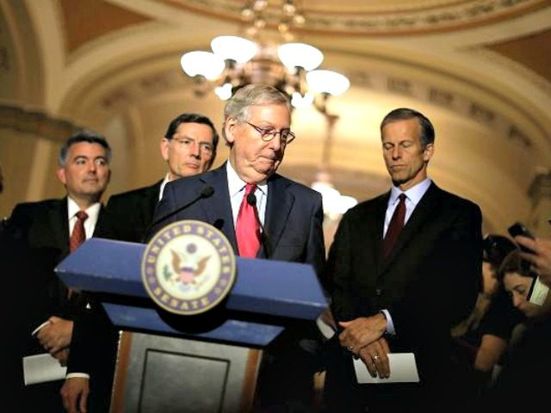
Affordable Care Act Repeal and Replace
Bipartisan legislation may move in the Senate
Alexander-Murray Bill Would:
Restore CSR subsidies for 2 years
Make procedural changes for Obamacare waivers to speed up approvals
More flexibility for states via 1332 waivers
Allow All Individuals to Purchase a Lower-Premium “Copper” Plan in the Individual Market, regardless of age
Restores funding and requires reporting on ACA outreach and education efforts
24 co-sponsors (bipartisan)
Trump’s position -- ??
MORE RESOURCES AVAILABLE AT:
https://www.nihb.org/legislative/ihcia_and_aca.php
Notes:
On October 17, the leading Senators on the Health, Education, Labor, and Pensions (HELP) Committee, Sens. Lamar Alexander (R-TN) and Patty Murray (D-WA) unveiled a bipartisan plan to stabilize health insurance marketplaces.
The legislation agreed on by Sens. Alexander and Murray would restore the subsidies the White House canceled last week for a period of two years as well as give states more flexibility through a state innovation waiver process. The bill would also make procedural changes to the way states apply for these waivers in an attempt to speed up the approval process.
The bill also restores funding and outlines reporting requirements for the Administration to measure and report out on enrollment outreach and education efforts. The Trump Administration has been critical of federal funding being spent on education and enrollment efforts for the health insurance marketplaces that were set up by the Affordable Care Act.
Indian Country has greatly benefited from increased health insurance outreach and education, as evidenced by increased enrollment of American Indians and Alaska Natives (AI/AN) in Medicaid and other third party health insurance since the ACA was enacted.

Slide 9
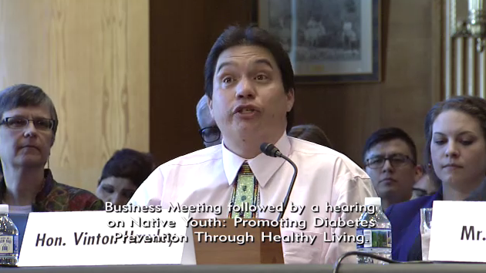
Special Diabetes Program for Indians
SDPI was renewed on September 29 for the first quarter of FY 2018
October 4 – House Energy and Commerce Committee advanced 2 year renewal as part of CHIP reauthorization
Likely to be considered in the next few weeks by the whole House and then the Senate
SDPI Reauthorization of Act of 2017 has now been introduced in both Chambers
H.R. 2545/S. 747
Reauthorizes until 2024
$150M/year
+medical inflation annually
Notes:
SDPI has funded hundreds of diabetes treatment and prevention in Indian Country for the past 19 years. The program is currently funded through December 31, 2017. The IHS will likely use this extension to get funds to grantees for the first part of calendar year 2018.
Legislation is working through congress that would renew SDPI for 2 years at $150M/year. Longer was hard to do because of “pay fors” which are already running into partisan disagreement in Congress
Continuing broad bipartisan support for the program – September 2016 – letter with 356 House Members and 75 Senators supporting SDPI.
Other legislation that would renew SDPI for 7 years and base increases on medical inflation has been introduced. Seeking cosponsors.
Based on history, that’s about $39,554,906.60 increase over 7 years.

Slide 10
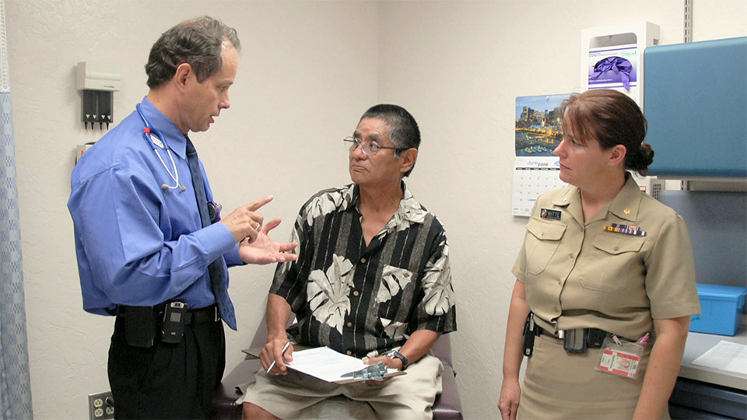
Restoring Accountability at IHS Act S. 1250/ H.R. 2662
Pay flexibility and relocation reimbursements for employees
Mandated IHS employee cultural competency training
Reforms Hiring and Firing for IHS Employees
Additional incentives for hiring medical professionals
Measure appt. wait times
Requiring HHS to revisit and reform Tribal Consultation policy
Regular reports to Congress
HHS OIG reports every 2 years on patient harm and denial of care
Notes:
Representatives Kristi Noem, Rob Bishop (R-UT), Markwayne Mullin (R-OK), Cathy McMorris-Rodgers (R-WA), and Tom Cole (R-OK) in the U.S. House of Representatives and by Senators John Barrasso (R-WY), John Thune (R-SD) and John Hoeven (R-ND) in the U.S. Senate introduced the Restoring Accountability at the IHS Act earlier this year.
The Bill would
provide incentives to health care professionals to serve in the IHS, including pay flexibility and relocation reimbursements when employees move to high-need areas, as well as a housing voucher program for rental assistance to employees.
Require IHS to create standards to measure wait times and for IHS employees to attend cultural training annually
Amend processes to make volunteering at IHS facilities easier by providing liability protections for medical professionals who want to volunteer at IHS hospitals or service units and centralizing the agency's medical credentialing system.
Require IHS to engage in a negotiated rulemaking process to establish a new tribal consultation policy for IHS. → Many tribes in Great Plains area have said that IHS is not consulting with them on big issues, and need a better definition of what triggers consultation.
Put additional requirements on IHS to ensure that reports and plans are provided to Congress in a timely manner
The HHS Office of the Inspector General must put together reports every two years on "patient harm events occurring in Service units and deferrals and denials of care of patients of the Service.“
Requires 3rd party revenue to be used on essential medical equipment, purchased/referred care, and staffing only for IHS operated facilities

Slide 11
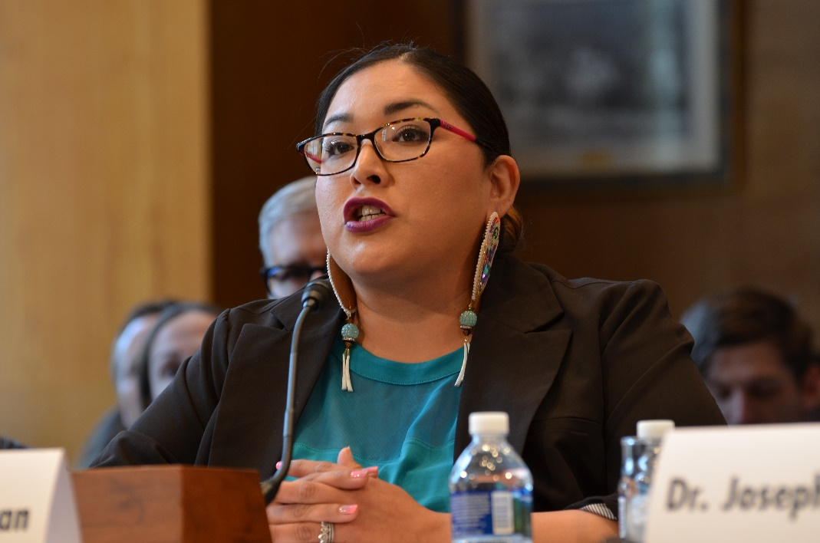
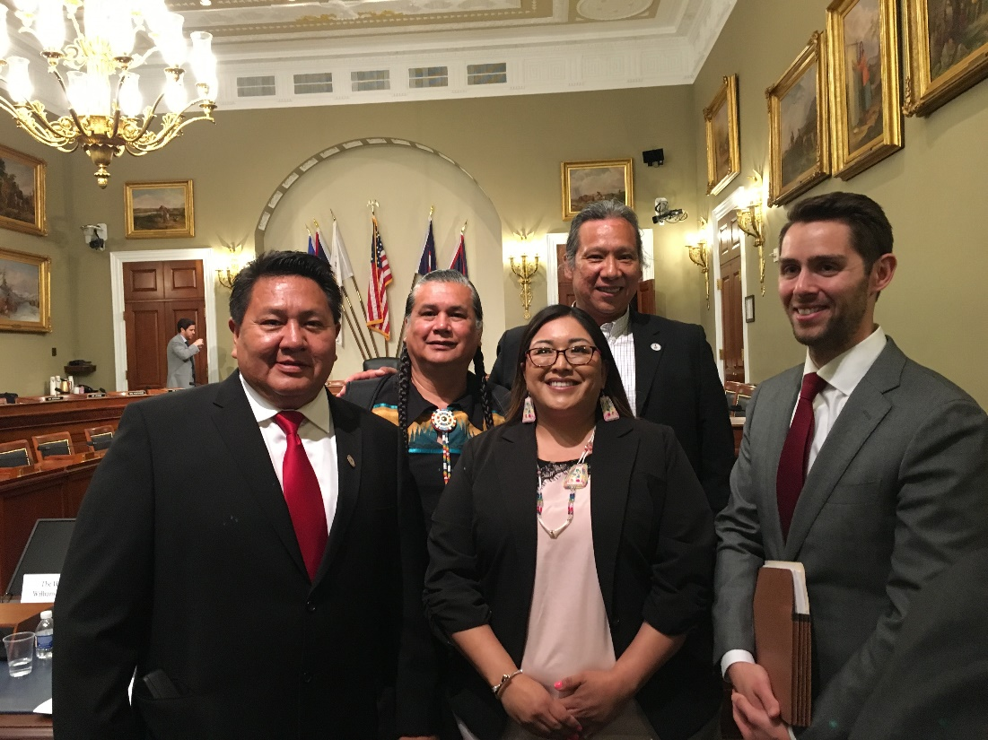
Restoring Accountability at IHS Act
NIHB Board Member Victoria Kitcheyan Testified before the Senate Committee on S. 1250 before Senate Committee on Indian Affairs on June 13 and on June 21 at the House Natural Resources Committee
Stressed the need for full-time permanent staff, innovative care models like DHAT
Need for more Tribal consultation on the bill and provisions in the bill
More reporting on quality of care for referral services
Better language on self-governance exemptions needed
More flexibility for 3rd party revenues
Additional Tribal consultation on reporting
Current Status: Committees are working on amended language in a bicameral process. Looking to markup sometime this fall.

Slide 12
Native Health Access Improvement Act & Native Health and Wellness Act
In September 2017, Congressman Ruiz (D-CA) and Pallone (D-NJ) introduced the Native Health Access Improvement Act and the Native Health and Wellness Act
Native Health Access Improvement Act (H.R. 3704):
Creates a “Special Behavioral Health Program for Indians” modeled off the Special Diabetes Program for Indians.
Makes technical corrections to the definition of “Indian” in the Affordable Care Act.
Notes:
In September 2017 Ranking Democratic Member of the House Energy and Commerce Committee introduced HR 3704 and HR 3706 to address public health concerns in Indian Country. Staff were inspired to start working on these bills after a briefing they attended that NIHB did on public health issues in Spring 2017.
The first bill – the Native Health Access Improvement Act – would “Special Behavioral Health Program for Indians” modeled off the Special Diabetes Program for Indians. It also would make corrections to the definition of Indian in the Affordable Care Act.

Slide 13
Native Health Access Improvement Act & Native Health and Wellness Act
Native Health and Wellness Act (H.R. 3706)
Creates a block grant for Indian Tribes/ Tribal organizations with the purpose of promoting health, preventing disease, and reducing health disparities among American Indians and Alaska Natives. It is modeled off of a similar program that supports these activities in states.
The bill would also create a program designed to recruit and mention American Indian and Alaska Native youth and young adults to enter health professions.
Notes:
The second bill Native Health and Wellness Act - Creates a block grant for Indian Tribes/ Tribal organizations with the purpose of promoting health, preventing disease, and reducing health disparities among American Indians and Alaska Natives. It is modeled off of a similar program that supports these activities in states. Consultation would be done to figure out the formula to get the funds to tribes.
The bill would also create a program designed to recruit and mention American Indian and Alaska Native youth and young adults to enter health professions.

Slide 14
Contacts
More info: www.nihb.org
Stacy Bohlen, Executive Director: sbohlen@nihb.org
Devin Delrow: Director of Federal Relations: ddelrow@nihb.org
Caitrin Shuy, Director of Congressional Relations: cshuy@nihb.org
Twitter @NIHB1
Facebook, too!

