Slide 1
IHS Health Information Technology Update
CAPT Mark Rives, DSc, CHCIO, Chief Information Officer
Indian Health Service
January 2018

Slide 2
Recent Cybersecurity Events
Cybersecurity events
Ransomware outbreaks
WannaCry
Petya
Not-Petya
Impacted many organizations around the globe
IHS and Tribal IT organizations worked together to address vulnerabilities
Meltdown and Spectre
Both are 10 year old vulnerabilities in the processors
Vulnerabilty affects all Devices with processors and is cumbersome to patch
IHS is reporting to DHS through HHS our efforts to patch
Vulnerabilty has impacted the cloud-service providers most but all devices are at risk

Slide 3
Health IT Events
VA Sec Shulkin announced in June 2017
Announcement to implement Cerner
Current status: Under review pending examination of interoperability capabilities
MHS
Cerner deployment progressing
Current status: eight week assessment period at four test sites
IHS
Response to VA action: Already planning a Health IT modernization effort when VA made announcement
Current status: RFI published for HIT Modernization with responses due 1 Feb 2018

Slide 4
What Is an RFI?
Request for Information (RFI)
An effective RFI is an information gathering tool
Announces to the marketplace there where may be a competitive procurement
Introduces the RFP process that will follow the RFI
Obtains preliminary budget and financial data
Achieves an greater understand of products and services available.
Used in the process of identify a group of preferred vendors or products.

Slide 5
Why Use an RFI?
When to use an RFI
RFI is an information gathering tool
Products
Services
Used to understand the market place of services and products available
Determine scope of work for RFP
Collect budgetary information

Slide 6
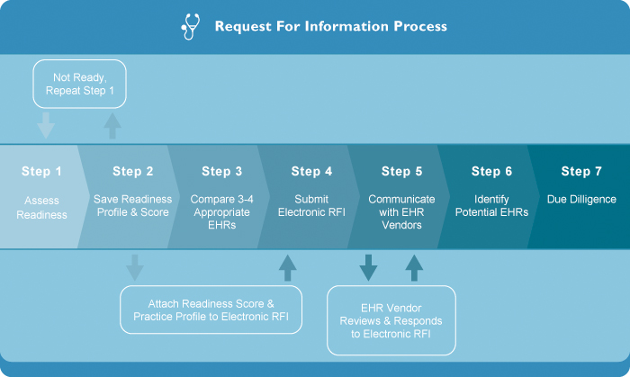
What is the RFI process?

Slide 7
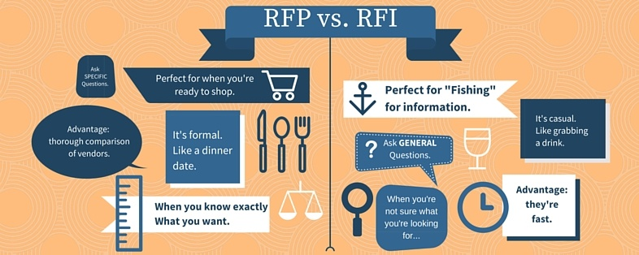
RFI vs RFP
RFI – document that requires respondents to provide information on their product, service, or solution and typically provide budgetary pricing
RFP- Firm numbers and commitments are made by respondents

Slide 8
Notional Timeline
Exploration, Engagement, Requirements Development
Year 1
System Selection and Acquisition
Year 2
Begin Implementation
Year 3
Rolling Implementation
Year 4
Rolling Implementation
Year 5
Rolling Implementation
Year 6
Rolling Implementation
Year 7
Operations & Maintenance
Year 8

Slide 9
Year 1
Engagement of stakeholders
Acquisition workgroup created
Market Survey
Requirements Development
Organizational Goals
Identify Key success factors
Use Case Development
Exploration of Alternatives
RFI
Infrastructure readiness
Identification and evaluation
Organizational change readiness
Identification and evaluation
Organizational workforce analysis
Identification and evaluation

Slide 10
Year 2
Stakeholder engagement
Vendor Selection(s)
Acquisition(s)
RFP
Capability Gap Analysis
RPMS System development
Acquisition workgroup sunsets
RPMS Data interoperability prep
Data sharing agreements
Security & Privacy approvals
Support staff needs identified and begin fill
Governance structure
Standardization of processes, nomenclature, workflows
Workgroup established
Infrastructure
Purchase and Implementation
Organizational Staffing change
NDW Prep
External Reporting Prep
User and staff training

Slide 11
Year 3-7
Budget support arrives / Acquisition occurs
Stakeholder engagement
Implementation workgroup created
User and staff training
Rolling implementation of new systems
Implement Data Query capabilities
New system access to legacy RPMS data
Rolling upgrades for infrastructure
RPMS support continues
Monitor new system and evaluate against agency goals and key success factors
RPMS and NDW evolution activities

Slide 12
Information Systems Advisory Committee (ISAC)
Purpose: Established to guide the development of a co-owned and co-managed Indian health information infrastructure and information systems.
Goal: assure the creation of flexible and dynamic information systems that assist in the management and delivery of health care and contribute to the elevation of the health status of Indian people.
Charter: Located on IHS.GOV/ISAC
Note: Being revised to simplify membership nomination and expand tribal participation
Meetings & Calls
Last meeting: Oklahoma City – Sept 2017
Last call: December 8, 2017
Next meeting: Phoenix Area Office– March 14-15, 2018

Slide 13
Continuing work for HIT
Must continue to develop interoperability functionality to ensure access to patient data.
Continuing development for
EPCS
New Medicare Cards (NMC)
8 RPMS applications that will require modifications
Expected to release in March, 2018 (FY18Q2 release)
Other minor application updates for reporting will occur throughout 2018 to address reports.
Routine updates
For modernization, all options are still in consideration.
Working towards a broader HIT Modernization initiative including the use of Healthshare

Slide 14
Questions?
Mark.Rives@ihs.gov

