Slide 1
2017 Enacted Budget:
$2.86 Billion, $67 Million More Than 2016
2018 Administration Budget:
$2.49 Billion, $375 Million Below 2017 Enacted
2018 Enacted Budget:
$3.06 Billion, $204 Million More Than 2017
2019 Administration Budget:
$2.39 Billion, $665 Million Below 2018 Enacted
Notes:
Last May Congress enacted the 2017 BIA budget at $2.86 billion, which was $67 million above the 2016 level. Considering the environment we are in, this was pretty good.
President Trump then proposed a 2018 budget of $2.49 billion, which is $375 million below the 2017 enacted level.
Congress enacted the 2018 BIA budget just last month, at $3.06 billion, $204 million more than 2017.
President Trump released his 2019 budget last February, proposing massive BIA cuts totaling $665 million below the 2018 level. This will make budget negotiations much more complicated going forward.

Slide 2
2018 BIA Enacted Budget Highlights
$3.1 billion, $204 million above 2017 (7.1%)
Bulk of increase ($165+ million) in Construction and Infrastructure
All of the Administration’s proposed cuts were restored
Notes:
So here’s some good news, the BIA budget has crossed the $3 Billion mark for the first time. The bulk of the increases ($165+ million) were in construction and infrastructure projects. The Administration’s proposed $375 million in cuts were restored.
Everyone should take the time to write the House and Senate appropriations committees, and thank them for what they’ve done!

Slide 3
2018 Programmatic Increases
+ $4.3 million for Road Maintenance
+ $1.2 million for Welfare Assistance
+ $3 million for Natural Resources
+ $6.7 million for Real Estate Services
+ $9.6 million for Criminal Investigations/Police Services
+ $4 million for Detention/Corrections
+ $5 million for Tribal Justice Support
+ $4.6 million for Community & Economic Development
+ $23 million for BIE
+ $105 million for School Construction
+ $24 million for Public Safety Construction
+ $31 million for Natural Resource Construction
Notes:
There are a number of modest bump ups for several programs seen here. For Real Estate Services there was a $1.5 million increase for Land Records & Title Improvements, and $3 million for abandoned well sealing. In Criminal Investigations and Police Services, $7.5 million was added to address the opioid crisis. $5 million was added to Tribal Justice Support for VAWA activities and PL 280 Courts. And under BIE $17 million was added as one-time forward funding for Haskell & SIPI. The increases for School construction include schools, facilities, housing, and improvements. The increase for public safety construction includes funds for new facilities for the first time in many years. Natural Resource construction includes irrigation projects and dam safety projects.

Slide 4
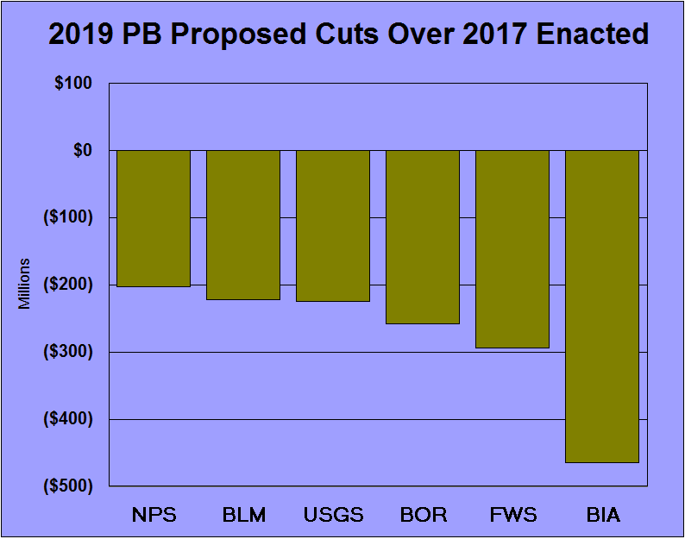
?
Notes:
The 2019 BIA budget request is $2.39 Billion, which is $465 Million below the 2017 enacted level. As expected, this massive cut is even much worse than last years reckless proposal. This slide shows that Indian Affairs is the big loser again in the President’s budget request for Interior agencies.

Slide 5
Notes:
And this slide shows the 2019 PB budget for Interior agencies, over the 2018 enacted level. This proposed cut for BIA is $665 million, or 22%.

Slide 6
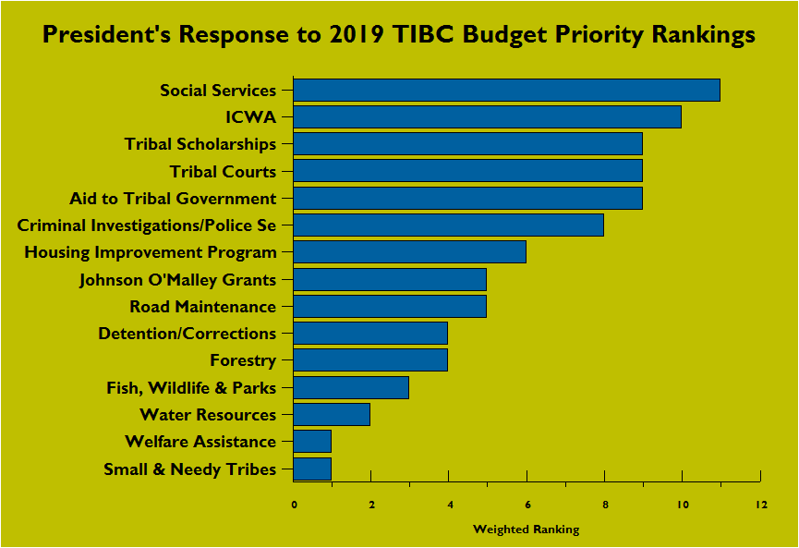
37% Cut
28% Cut
Eliminated
28% Cut
10% Cut
5% Cut
Eliminated
Eliminated
7% Cut
2% Cut
10% Cut
25% Cut
18% Cut
12% Cut
Eliminated
Notes:
This slide shows the 2019 budget priorities of the Tribal Interior Budget Council, alongside the Administration’s response to our priorities. Our highest priorities were cut the most, or outright eliminated by the President in his 2019 budget request. Tribal TPA programs are cut more than $134 million, and the greatest cuts and eliminations are for those programs that serve our children and families, and educate our youth. And they serve tribes all across the country, not just a few as the Administration would like you to believe. The budget proposal also includes $8.3 Million in additional cuts, which are disguised as Administrative Savings and Program Efficiencies.
I want to mention, the House Interior Appropriations committee is holding hearings on native American programs on May 9 & 10. Written testimony on Trumps 2019 budget will be accepted for the record until Friday May 18. I cannot stress enough, just how important it is to submit testimony for the record!

Slide 7
Many Tribal Programs Proposed for Elimination!
Tribal Government:
-Small & Needy Tribes
Human Services:
-Tiwahe Initiative
-Domestic Violence Initiative
-Methamphetamine Initiative
-Housing Program
Trust Natural Resources:
-Tribal Climate Resilience
Trust Real Estate Services:
-Alaska Native Programs
-Litigation Support/Attorney Fees
-Other Indian Rights Protection
Public Safety & Justice:
-Recidivism Reduction Initiative
-Tribal Justice Support for tribes subject to P.L. 83-280
-Conservation Law Enforcement Program
Indian Education:
-Tribal Scholarships
-Johnson O’ Malley Program
-Tribal Education Departments
-Early Child & Family Development
-Juvenile Detention Education
-Special Higher Education Scholarships
-Science Post Graduate Scholarships
-Replacement School Construction
-Replacement Facility Construction
Notes:
In addition to the many budget line cuts, there are at least 21 important tribal programs that are proposed to be eliminated entirely! You can see from this list that these programs impact small and needy tribes, programs that serve our children and families, and programs that educate our youth! And they serve tribes all across the country, not just a few as the Administration has claimed. All of the programs proposed for elimination serve tribes directly, no program eliminations are proposed for BIA or BIE operated programs.
Even though Congress will save us from much of the proposed cuts in 2018 and 2019, it is important to be aware of them because the Administration’s proposals are dangerous, and this will likely continue in FY 2020. And, we now have to pay for tax reform, at the expense of Discretionary Spending going forward.

Slide 8
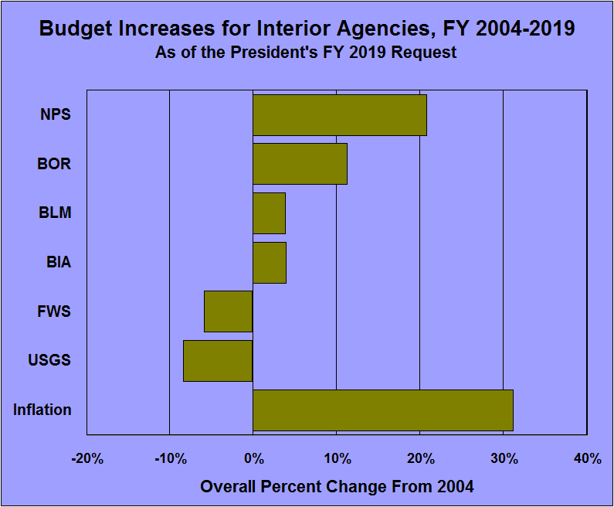
Notes:
Under the President’s 2019 budget proposal, the budget for BIA would see an overall increase of 4% over 15 years. That works out to an increase of only .27% per year on average. During the same time period, the rate of inflation was 31.2%, an average annual rate of 2.1%. So, the rate of inflation outpaced the growth of the BIA budget by 8 times.

Slide 9
Cuts to Tribal Government Funding
____________________________________________________
1996 General Reduction (enacted) - 16%
2000-2018 ATB Rescissions (enacted) - 9.5%
2013-2018 Sequester Cut (enacted) - 5%
President’s 2019 Budget (proposed) - 21.7%
Total Cuts since 1996: - 52.2%
_____________________________________________________
- Only increases for most tribal programs were Pay Costs,
but Pay Costs have only been partially funded most years
Notes:
Tribes’ government service programs have experienced steep declines for many years. For instance, all tribes’ TPA accounts were permanently cut by 16% back in 1996.
These same programs were permanently cut an additional 9.5% from 2000 to 2018, from at least 20 different rescissions to pay for things like tax cuts, wars, hurricanes, and even technology upgrades.
Tribes lost an additional 5% beginning in 2013 from Sequestration. Now, we have another 22% cut proposed with the 2019 budget. If enacted that would mean cuts of 52% to our core program funding since 1996.

Slide 10
Notes:
This table shows all of the rescissions tribes have suffered from going back to 2000 – at least 20 different rescissions if you include sequestration! They were applied to pay for things like tax cuts, wars, hurricanes, and even technology upgrades. They all represent permanent cuts to tribal Base programs! It is our belief that most members of Congress do not even realize that these rescissions are permanent, they think they are only for one year! Here’s a not so fun fact: all of our tribal programs were permanently reduced back in 2006 by 1%, to pay for Hurricane Katrina recovery. And we are still having that 1% taken from us, years after the recovery was completed!

Slide 11
We are facing dire times for the BIA budget. It appears that our only hope to avoid severe budget cuts lies with Congress, not the Administration.
A primary role of Tribal Leaders and Indian Affairs Leadership, through TIBC & SGAC, is to advocate for BIA funding increases. This job has become much more complicated under the present Administration.
The Administration says it wants to preserve Core Tribal Programs, but does not understand what the Core programs are. Most of the budget lines cut or eliminated do in fact deliver Core funding to tribes.
Notes:
We are facing dire times for the BIA budget. It appears that our only hope to avoid severe budget cuts lies with Congress, not the Administration.
A primary role of Tribal Leaders and Indian Affairs Leadership, through TIBC, is to advocate for BIA funding increases. This job has become much more complicated under the present Administration.
The Administration says it wants to preserve Core Tribal Programs, but does not understand what the Core programs are. Most of the budget lines cut or eliminated do in fact represent Core funding for tribes.

