Slide 1
TITLE VI
LOAN GUARANTEE PROGAM

Slide 2
Purpose of Title VI
Native American Housing Assistance and Self-Determination Act
To assist and promote affordable housing on Indian reservations and in other Indian areas for occupancy by low/moderate income Indian families
To encourage the participation and investment by traditional financial institutions who historically have not served tribal entities
To leverage resources

Slide 3
Eligible Projects
NO MINIMUM SIZE
One or more of NAHASDA (IHBG) eligible activities.
All IHBG regulations apply to Title VI projects.

Slide 4
Title VI Development Projects
Development
New Construction
Rehabilitation
Infrastructure (roads, utilities, water & sewer)
Community Facilities

Slide 5
How Does Title VI Work?
Tribe/TDHE pledges current and future IHBG funds to HUD as security for a loan guarantee.
Lender issues loan to tribe/TDHE
HUD issues a guarantee to lender on the loan to the Tribe/TDHE.
Guarantee is for 95% of the outstanding principal and interest
Land/Buildings are not collateral for the loan.
No guarantee fee

Slide 6
$$ How Much $$ Determining Title VI Maximum Commitment
The guarantee is based on most recent final IHBG allocation:
Need Allocation $400,000
X 5 X 5
Product $2,000,000
Other Title VI Loans - 0
Maximum Commitment Amount (MCA) $2,000,000

Slide 7
Debt Service
Title VI financing is a loan guaranteed by HUD
The annual debt service must not exceed the annual Need portion of the annual IHBG allocation.
The Need portion of your IHBG allocation is leveraged, but is still available for the project, debt service or other eligible IHBG activities.)
The loan term may be up to 20 years.

Slide 8
Title VI Results
Infrastructure Loans
# of Loans 7
# of Tribes 6
Impacted Units 488
Title VI Funding $12,570,000
Loans Paid Off 3

Slide 9
Title VI Application
PLA Application From Borrower - Optional
(preliminary information and concept)
Listing major items necessary for project
Firm Commitment request is due in 120 days
Extensions available
Firm Commitment Request From Lender (refined project with limited future changes)
Lists conditions for guarantee
Closing in 90 days
Extensions available

Slide 10
General Checklist PLA & Firm Commitment
Cover Letter - Summary of vision & project
1. Project Overview
Tribal support
Primary contacts
Description of project
Implementation plan (Title VI Loan Amount)
Population to be served Location of project - site specific
Site control

Slide 11
Title VI Application
2. Alignment of Costs and Sources of Funds
Itemized project cost
Sources and uses of funds
Documentation of sources of funds that are not IHBG of CDBG
3. Operating Income and Expense
Projected income
Itemized expenses
Operating subsidies and sources

Slide 12
Title VI Application
4. Title VI Loan Details
Lender contact information (if applicable)
Terms and conditions of loan
Borrower’s credit report (from lender)
Assistance available from HUD’s ONAP Area Office and Office of Loan Guarantee

Slide 13
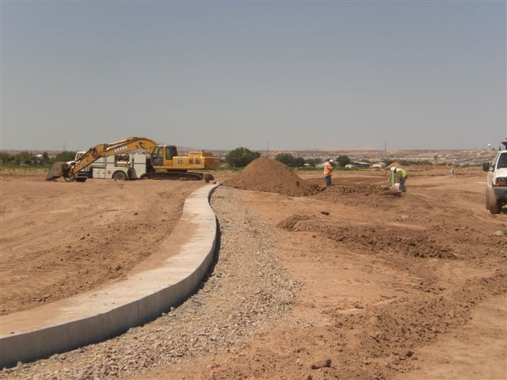
Ysleta del Sur Pueblo

Slide 14
Contact Information
Robert Lamp
Loan Guarantee Specialist
Office of Loan Guarantee
U.S. Dept. Housing & Urban Development
451 7th Street SW, Room 4108
Washington, DC 20410
202-402-4134 (phone)
202-401-2475 (fax)
Robert.A.Lamp@HUD.GOV
www.hud.gov/codetalk

