Slide 1
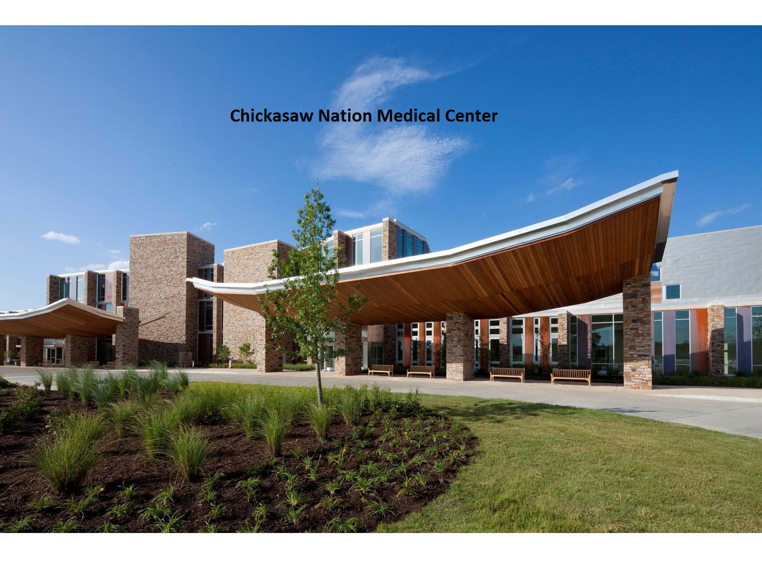

Slide 2
Chickasaw Nation Department of Health
Ada, Oklahoma
Emergency room visits annually 55,000
Inpatient visits annually 4,300
Babies born annually 1,000
Gross outpatient visits annually 552,000
Licensed 72 bed Joint Commission accredited hospital

Slide 3
Premium Assistance Program Facts
Tribes can assist with the cost of health insurance for specific American Indians who qualify.
Eligibility is determined by income and need.
There is no cost to the qualified applicant.
No co-pay or deductible when served by the CNDH or when referred in the health care network by our facility.
Gives you more treatment options and choices when traveling away from your tribal health care facility.

Slide 4
Premium Assistance Program
Applicant requirements:
65 years of age or younger
Currently receive services at CNDH facilities
Enrolled citizen of a federally recognized tribe
Live in the Chickasaw Nation service area
Eligibility and income guidelines of the program are met
No other medical insurance coverage
Filed a tax return in the last year and intend to file in the upcoming year

Slide 5
Premium Assistance Program
Pilot Program
Implemented September 1,2014
High cost medical patients and pharmacy expenses for patients in Service Unit
246 patients enrolled in the pilot
ROI 6.4 to 1 with 73 percent third party revenue and 27percent cost avoidance
Blue Cross Blue Shield of Oklahoma Blue Preferred Bronze PPO 102 marketplace plan

Slide 6
Hepatitis C Clinic
Premium Assistance Program
April 2016
Return on investment: 1.88 to 1
118 patients completed treatment
84 cured patients as of Jan. 31,2018

Slide 7
Medicare Part B
Medicare Part B Pilot Program
Implemented July 1, 2017
Patients who did not elect Part B at 65 and now have a surcharge penalty associated with their monthly payment
Patient will pay the $134 premium; we pick up the penalty associated with them
38 patients in Service Unit with multiple visits to our facilities and purchase refer care

Slide 8
Medicare Part D Premium Assistance
Pilot Program
(Patient’s on Medicare but did not have a prescription plan)
Started Jan.1,2013 currently in year six
High cost pharmacy use
816 patients enrolled
Return on investment of 13 to 1
Coventry First Health

Slide 9
Questions?
Brenda Teel, Executive Officer of Revenue
Brenda.Teel@Chickasaw.net

