Slide 1
Indian Health Legislative Update
Jessica Steinberg
Director, Center for Indian Health Policy and Research
Notes:
Good Afternoon. I am Jessica Steinberg, Director for the Center for Indian Health Policy and Research at NIHB. I am a member of the Little River Band of Ottawa Indians, a self-governance tribe located on the beautiful eastern shore of Lake Michigan, in Manistee MI.
First, I want to congratulate all of the Tribes participating in what is now 30 years of self-governance. I also want to acknowledge the assistance of our Legislative Department, and my colleagues Caitrin Shuy on today’s presentation.

Slide 2
Opioid Crisis in Indian Country – Overview
Congress is focusing on solutions to the nationwide opioid crisis. NIHB has been working with allies on Capitol Hill to ensure that Indian Country is included in any legislation moving through Congress
Indian Country Statistics:
The rate of drug overdose deaths is twice that of the general population, according to the IHS.
Deaths from prescription opioid overdoses increased four-fold from 1999 to 2013 among AI/ANs.
The CDC reported that AI/ANs consistently had the highest drug overdose death rate every year from 2008-2015, and the highest percentage increase in drug overdose deaths from 1999-2015 at 519%.
IHS Deferred Care for 80,000 ($371M) visits in FY 2016, leading many patients to use opioids instead
Minnesota: AI/AN women are 8.7 times more likely to be diagnosed with maternal opioid dependency, and AI/AN infants are 7.4 times more likely to be born with neonatal abstinence syndrome (NAS) – meaning that the repercussions and trauma of this crisis are intergenerational.
Notes:
Let’s jump right in. Tribes have faced many challenges, but perhaps none more threatening than the current Opioid crisis. This has the nation’s focus; the topic dominates news and media outlets, the stories we hear are devastating. We all know someone who has been impacted by this class of medications, this highly addictive treatment modality and sadly, one of the largest diversion challenges presented across the nation. It has been especially devastating to Indian Country. The data speaks for itself;
Drug overdose twice the rate of the general population, deaths increased four-fold between 1999 and 2013; our people have the highest drug overdose rates. There are many factors, and deferred care, the inability to get our folks the care they need, resulting in patients being placed on pain management as an alternative while waiting for treatment, plays a role as well. But, there is hope. We have successfully elevated this issue with Congress, and the focus is now on a nationwide effort to address this crisis.

Slide 3
Opioid Crisis in Indian Country - Testimony
February 16, 2018 – NIHB Sent Comments to the Senate Finance Committee on ways to address Opioids through CMS programs.
Discussed the importance of Medication Assisted Therapy access in Indian Country and creating standards around it; traditional healing; expansion of CHAP; Prescription Drug Monitoring Program (PDMP) penetration in Indian Country; better electronic health record system tracking; and better data sharing with Tribal Epidemiology Centers
February 27, 2018 – Testimony for the Record before the Senate HELP Committee: “The Opioid Crisis: The Role of Technology and Data in Preventing and Treating Addiction”
Stressed the need to improve RPMS and Health IT generally; improve broadband access on reservations; and the integration of PDMPs with the I/T/U system.
Notes:
National Indian Health Board is working on behalf of Tribes to assist Congress to understand how this crisis impacts our people. This February provided opportunity to educate Senate Committees regarding the importance of Medication Assisted Therapies to save lives, allowing our Tribes to have access to these lifesaving drugs, and how they should be deployed. We (Tribes) know our Traditional healing and ceremonies work in intervention and creating healthy lives; physically, mentally, spiritually and culturally, and that this is a critical component if we are to stop this deterioration of our future. We have resources but we need broadband access in our remote areas, we need health IT to assist with creating data to support our needs requests and support for epi-centers. We need access to tools to make the Prescription Drug Monitoring Program available across Indian Country.

Slide 4
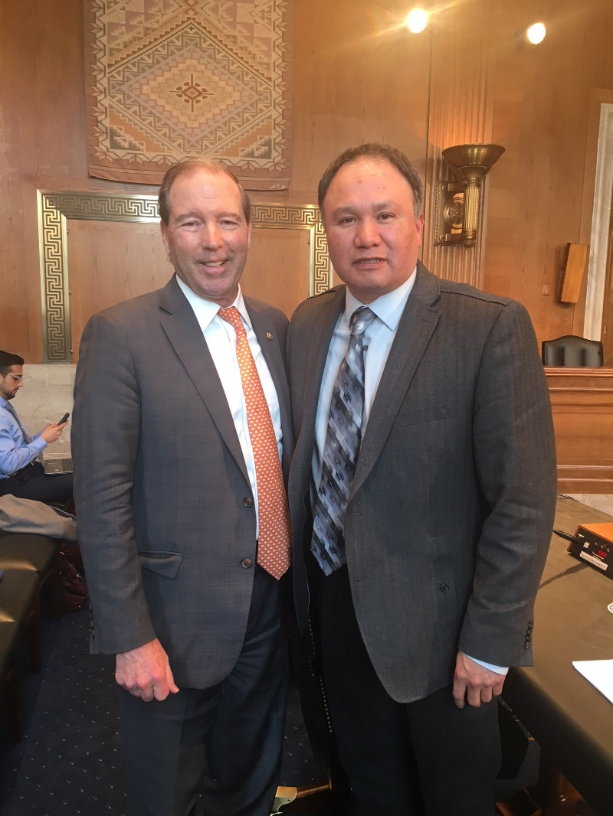
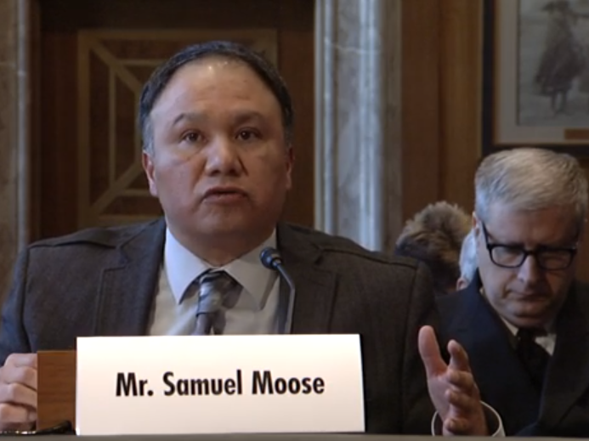
Opioid Crisis in Indian Country - Testimony
NIHB Treasurer Samuel Moose testified on March 14 before Senate Committee on Indian Affairs and House Energy and Commerce Committee
Emphasized the need to fund Tribes directly; embrace traditional health with federal funds; consultation on PDMPs; and Health IT upgrades
Outlined the higher disease burden for AI/ANs and the need to have Tribal specific funding for opioids.
Stressed program flexibility and integration of traditional healing
Notes:
Our Board of Directors has been actively engaged presenting Testimony on the Hill. (Highlight the slide).

Slide 5
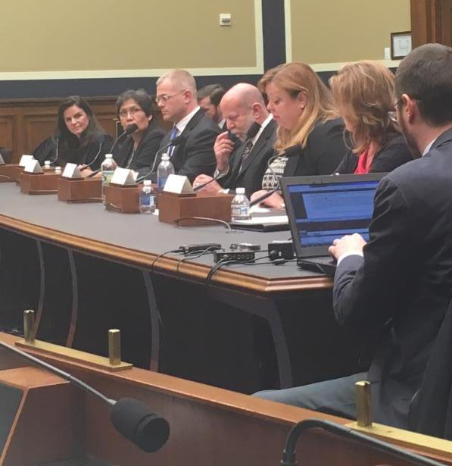
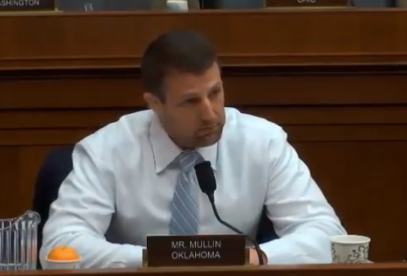
Opioid Crisis in Indian Country - Testimony
NIHB CEO Stacy A. Bohlen testified on March 22 before the House Energy and Commerce Committee
Emphasized the need to fund Tribes directly; embrace traditional health with federal funds; consultation on Prescription Drug Monitoring Programs (PDMP’s); and Health IT upgrades
Grant programs should include Tribes and allow Traditional health practices to be funded with federal dollars.
“Getting funding to Indian Country is vitally important because most health care for Native Americans is done through the IHS system. That was a federal government obligation through the treaties that were signed… The treaty was made with the federal government. It is not a handout. It is payment for land that was taken from the Tribes years and years ago. That obligation and that payment still stays in place.” – Congressman Markwayne Mullin (R-OK)
Notes:
March was also a busy month, and this issue continues to evolve at a rapid pace. (HIGHLIGHT SLIDE)

Slide 6
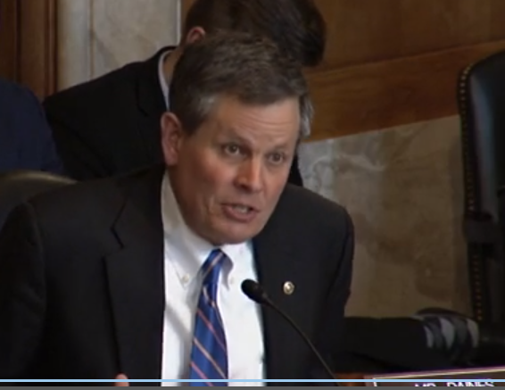
Opioid Crisis in Indian Country Legislation
Bills introduced:
H.R. 3704 – Native Health Access Improvement Act & S. 2545 – Native Behavioral Health Access Improvement Act
H. R 3706 – The Native Health and Wellness Act
S. 2270 – Mitigating the Methamphetamine Epidemic and Promoting Tribal Health Act
S. 2437 – Opioid Response Enhancement Act*
H.R. 5140 – Tribal Addiction and Recovery Act
All grant access to the State Targeted Response to Opioids
S. 2437 that provide 10% Set-aside within the program
Comprehensive Addiction and Recovery Act 2.0 – S. 2456 Introduced by Senator Portman (R-OH). Asking for changes to help Indian Country including:
Access to technical assistance grants for naloxone training; inclusion of Tribal law for prescribing exemptions; access to funding for pregnant and post partum women; and consultation requirement on state PDMPs.
*Senator Warren Legislation – would create 10% Tribal set-aside for formula-based grants for opioids; additional funding for data for surveillance to epi-centers; possible study on impacts of deferred care at IHS on opioid crisis
Notes:
There is action occurring and here is a listing of the legislation that has been introduced to combat this epidemic. Advocacy has been impactful; Indian Country set asides have been included in many of the initiatives, and NIHB continues to advocate the notion that funds should be put in the hands of the Tribes directly, in non-competitive grants, as often as possible.
A list of legislation will be available for the attendees here today on the NIHB and SGEC website.

Slide 7
Opioid Crisis in Indian Country Legislation
Senate HELP Committee released a comprehensive opioid package
5% set aside out of $500 million for Tribes under the State Response to Opioid Grants
3% Tribal set aside for grants to help with infants with substance abuse disorder
Funding for disease surveillance
IHS included on trauma informed care task force
Energy and Commerce Committee is creating a package of opioid legislation to be marked up before Memorial Day
Staff willing to work with us and would like “wish list” of top priorities to include
Notes:
Here are some particulars on current legislation moving forward; (HIGHLIGHT SLIDE)

Slide 8
Victories
FY 2018 Omnibus contained a $50 million (out of $1 billion) Tribal set aside for the State Response to Opioid Grants
Also contained a $5 million (out of $84 million) Tribal set aside out of Mediation Assisted Treatment program
Both will be Administered through SAMHSA
No timeline yet on how funding will be distributed; discussions at SG
Encourage Tribal Leadership to Continue to Seek Tribal Consultation on the distribution.
Notes:
NIHB would like to thank the Tribes for their efforts to assist us in our advocacy; your engagement has resulted in some good news!
(HIGHLIGHT SLIDE)

Slide 9
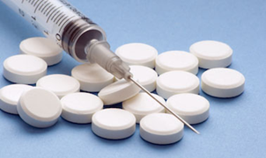
NIHB Opioid Project
Funding through the Centers for Disease Control and Prevention
Three primary goals:
Report on prescription and illicit opioid statistics, challenges, priorities, needs and technical assistance requests from all twelve IHS areas to the CDC
Development of a Tribal provider-based toolkit to improve safe and effective prescribing of opioids
Piloting of provider toolkit in 4 Tribal clinics
Notes:
I just want to take a minute to highlight some work that our staff is doing now to strengthen our voice in advocacy. Our Public Health division currently has a project focused on the opioid crisis. Shervin Azmati is the lead on an extensive project funded by the Centers for Disease Control and Prevention;
(HIGHLIGHT SLIDES) For more information please access our NIHB.org website.

Slide 10
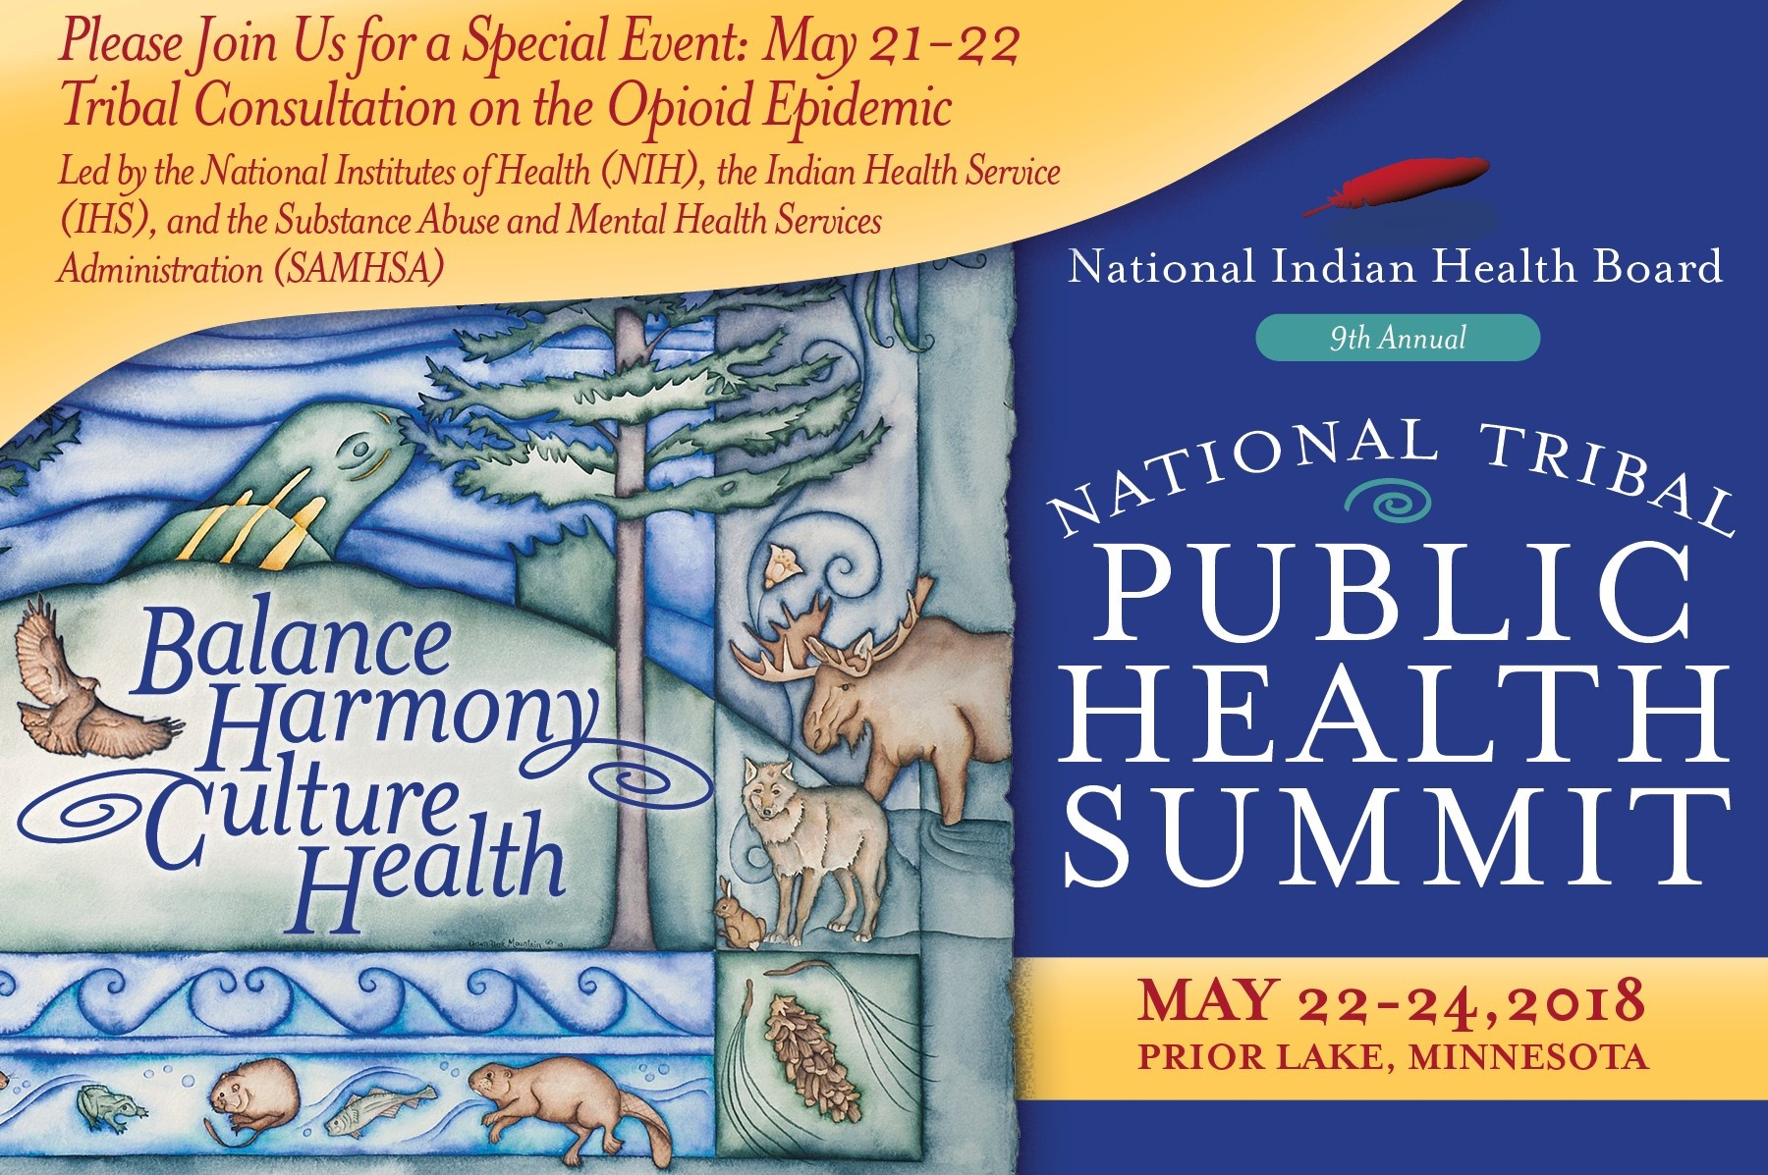
Tribal Consultation on the Opioid Epidemic – May 21-22
Notes:
NIHB will host a 3-agency Tribal consultation on the opioid epidemic during the Tribal Public Health Summit in Priori Lake, MN from May 21-22. Agencies present are:
Indian Health Service
National Institutes of Health
Substance Abuse and Mental Health Services Administration

Slide 11
Resolutions
Asking for Consultation on distribution of funding for State Targeted Response (STR) grants in FY 2018 omnibus; passed April 10, 2018.
Midwest Area Tribes - State of Emergency
Share Area/Tribal Resolutions with NIHB
Notes:
NIHB continues to advocate on behalf of Tribes; this crisis impacts our people disproportionately, impacting our families, our friends and our nations. The NIHB Board of Directors passed a resolution asking for Tribal Consultation on the distribution of State Targeted Response grants that were placed in the 2018 Omnibus---I believe this initiative will be further discussed by SAMHSA here at this conference.
We received a resolution from Midwest Alliance of Sovereign Tribes declaring a State of Emergency surrounding opioid use, abuse and intervention. I have a favor to ask of all of you; would you forward your resolutions on this issue to us? We would like to assist with carrying the water on this issue, so devastating to all of us.

Slide 12
Kchii Miigwech (Many Thanks) Jessica Steinberg Director, Center for Indian Health Policy and Research jsteinberg@nihb.org 202-507-4083
Notes:
To paraphrase: one arrow alone, is easily broken—many arrows together in a bundle, are not. NIHB is ready to assist our Tribes, NIHB is ready to be that bundle of arrows.
Kchii Miigwech,
Thank You.

