Slide 1
NIHB update to the Tribal Self Governance Advisory Committee April 23, 2018
Presented by
Stacy Bohlen, Chief Executive Officer

Slide 2
3 NIHB 2018 National Tribal Health Conferences
9th Annual National Tribal Public Health Summit
May 22-24, 2018
Prior Lake, Minnesota
Balance, Harmony, Culture, Health
Notes:
Please join us for the Tribal Public Health summit in Prior Lake, MN (30 min outside Minneapolis) from May 22-24, 2018. Please join us!!

Slide 3
2. NIHB Tribal Behavioral Health Conference SAVE THE DATE!!
Notes:
Please join us for our 2 upcoming conferences later in the year as well!
Behavioral Health is July 25-27, 2018 in Washington DC (Omni Shoreham).
Check the NIHB website for hotel/agenda information soon!

Slide 4
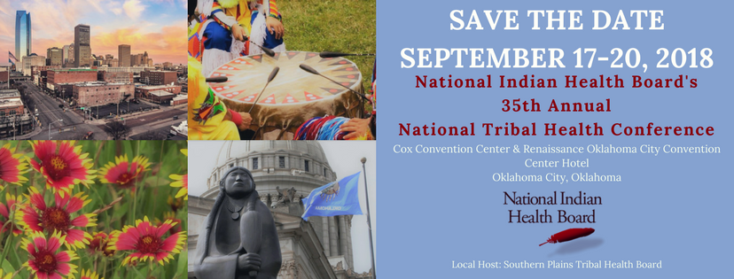
3. NIHB 35th Annual National Tribal Health Conference (Annual Consumer Conference)
Notes:
Our 35th Annual NTHC is also coming up!
35th Annual National Tribal Health Conference is September 17-20 in Oklahoma City, Oklahoma (Renaissance Center). Please mark your calendars to join us!!
Details to follow on the NIHB website.

Slide 5
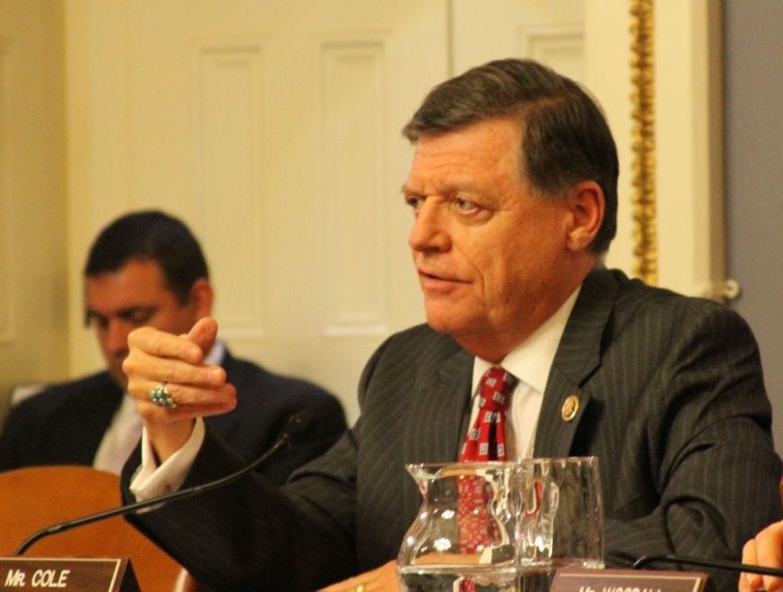
FY 2018 Omnibus Spending Bill
Signed on March 23, 2018 to avoid shutdown
Government funded through September 30, 2018
$50 million to Tribes and Tribal Orgs for Opioids
Treatment, reducing unmet need, & reducing overdose related deaths
$5 million to Tribes and Tribal Orgs for Medication-Assisted
Treatment Programs
NIHB Board Resolution Approved April 10th to request Tribal Consultation on how these funds are distributed!
IHS HIGHLIGHTS
$5.5 billion for HIS - an increase of nearly $500 million
(10%) above the FY 2017 enacted level.
$3.9 billion for services,
$867 million for facilities
$718 million for Contract Support Costs.
Notes:
President Trump signed omnibus on March 23, 2018 to avert a government shutdown and fund the government through September 30, 2018.
Omnibus included an additional $500 million for IHS, and $50 million for Tribes to treat opioids, and another $5 million for MAT programs.
These funds can go directly to programs on the reservations offering treatment, reducing unmet need for addiction services, and decreasing the fatality rate on overdose related deaths.
These will be in the form of grants. NIHB has continued to stress the needs for formula funding for Indian health, but these resources will still make a huge difference.
At the April 2018 meeting of the Board of Directors, NIHB passed a resolution calling for SAMHSA to consult with Tribes to ensure that money reaches the Tribes with the greatest need.

Slide 6
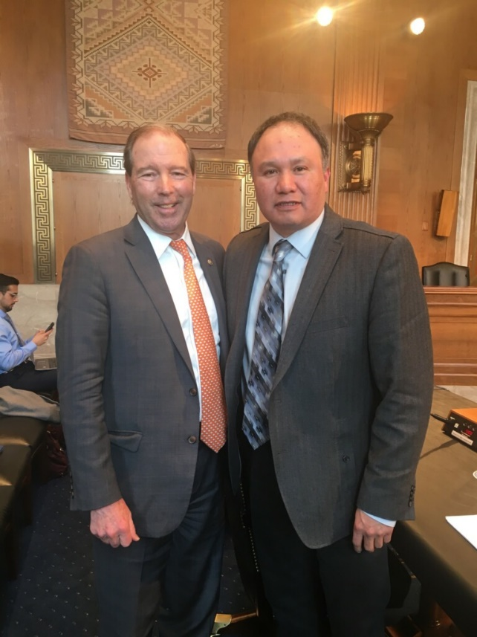
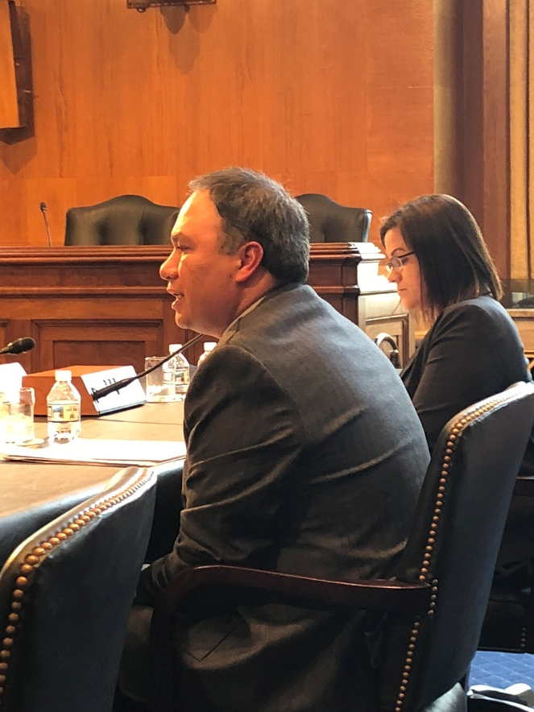
Opioids—NIHB on Capitol Hill
Senate Committee on Indian Affairs (3/14)
Sam Moose, NIHB Great Lakes Rep.
House Energy & Commerce Subcommittee on Health
Stacy A. Bohlen, NIHB CEO (3/22)
House Opioids Package/Direct Tribal Spending
Written Testimony to Senate Committee on Health, Education, Labor and Pensions advancing Tribal set asides in opioid spending
Notes:
NIHB Board of Directors Member and Bemidji Area Representative Sam Moose testified at a Senate Committee on Indian Affairs hearing devoted to the opioids crisis on March 14, 2018.
He spoke on the Tribes in his area and how they are responding to the opioids crisis and what support Congress needs to give them.
I myself testified to the House Energy and Commerce Subcommittee on Health on March 22 to talk about public health and prevention efforts in Indian Country.
The House is still developing its opioids legislative package, and I made recommendations on several bills currently being considered by the House.
I spoke in support of Rep. Mullin’s Tribal Addiction Recovery Act (TARA, H.R. 5140) and on the need for Tribal inclusion in infectious disease elimination program.
I also made recommendations to incorporate Tribal best practices into the RESULTS Act
NIHB Board of Directors Capitol Hill Day was April 11. We met with 13 congressional offices and talked about Tribal needs for opioids in each and every one.
We have also submitted written testimony for the record on issues such as data sovereignty, Health IT needs, and treatment funding and flexibility to multiple committees.

Slide 7
Opioid Crisis Action for Indian Country
HR 5140 (Congressman Mullin R-OK-Cherokee Nation Citizen) Tribal Addiction and Recovery Act (“TARA Act”)
Working to Amend the RESULTS Act – Reinforcing Evidence-Based Standards Under Law Treating Substance Abuse – met with authors/amend to include AI/AN Traditional Practices and Honor Indigenous Knowledge
21st Centuries Cures Act=$1 billion to states over 2 years – not for Tribes

Slide 8
Opioids—Ongoing Work
Opioid Crisis Response Act (HELP Committee)
5% Set Aside for Tribes in State Targeted Response
3% Set Aside for Tribes for Infant Programs
Working to include Special Behavioral Health Program for Indians ($150 million/year)
Notes:
Lots is going on right now on opioids. Basically every committee with jurisdiction has either already held a hearing, is holding a hearing, or both.
There are lots of different bills floating around, some better for Tribes than others.
The House is still developing its opioids package, and the Senate is a little further along in that process.
The Senate Health, Education, Labor and Pensions Committee is marking up their bill tomorrow. It is fairly good for Tribes.
It includes 5% of State Targeted Response funds going directly to Tribes—this is a long standing Tribal priority
3% set aside to Tribes to fund programs treating new borns and infants affected by opioids
Our number 1 priority for further inclusion is to add SBHPI into the bill. This would fund behavioral health programs in Indian Country similar to how SDPI operates.

Slide 9
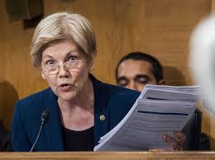
Opioids—CARE Act
Comprehensive Addiction Resources Emergency Act of 2018
Sen. Warren and Rep. Cummings
Based off Ryan White HIV/AIDS Bill in 1990s
Includes significant direct funding to Tribes
$400 million per year for 10 years
NIHB worked with Senator Warrant to
ensure Tribes appropriately included
Wrote Letter of Support to accompany Bill intro.
Will continue to advance Tribal-specific language
in any moving legislation.
Notes:
Another bill that would be good for Tribes is Elizabeth Warren’s Comprehensive Addiction Resources Emergency (CARE) Act.
$400 million per year for 10 years to Tribes with the highest overdose levels. This would be a huge resource for Indian Country!
Based off the Ryan White HIV/AIDS bill, which gave states and local governments resources to combat the AIDS epidemic.
NIHB aided in the language including Tribes as eligible for funding along with States and local governments.

Slide 10
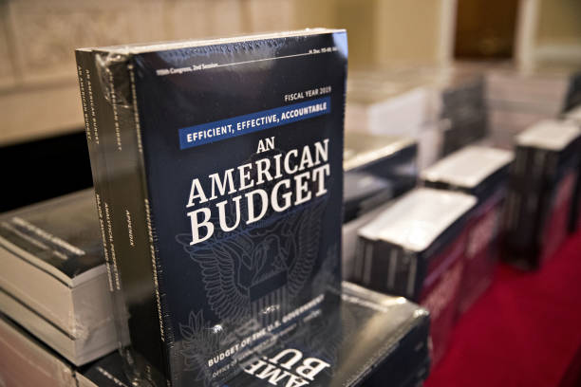
President’s Budget Request – FY 2019
February 12– President released “skinny” FY 2019 budget
$5.4 billion to IHS--$413 million (8%) above FY 2018
$150 million to IHS specifically for opioids
Not Good
$900 million (12%) cut to CDC
22% cut to SNAP ($213 billion over 10 years)
Worse
SDPI moves from mandatory funding to discretionary
CHR program completely eliminated
NIHB Board approved Resolutions on both issues April 10, 2018 and advanced them to Hill
This is not the final word! Continued Advocacy needed! NIHB Testifies next 2 weeks before House Appropriations Interior Subcommittee and Labor Health and Human Services
Notes:
POTUS Budget Request came out on Feb 12. Overall it’s a mixed bag for Tribes
Good to see IHS get an increase, and especially glad to see targeted funding for opioids. Tribes are requesting $6.4 billion for IHS in 2019.
However, the cuts to CDC will harm Indian Country’s ability to cope with infectious diseases.
The cuts to SNAP are also hurtful, 1 in 4 AI/AN households receive SNAP. The right to health includes the right to healthful foods.
Community Health Representatives also must stay in place. (More on next slide)

Slide 11
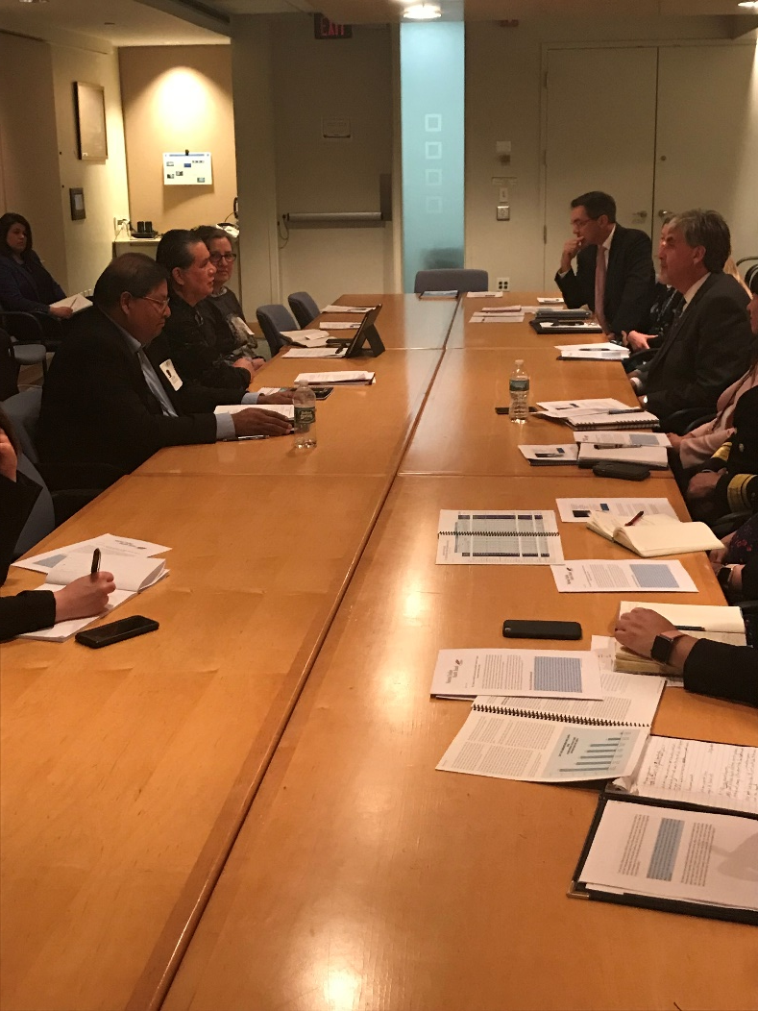
Community Health Representatives
Powerful stories and Tribal Support
NIHB Board of Directors passed a Resolution supporting the CHR program.
Budget Testimony to the U.S. Department of Health and Human Services.
Notes:
On March 28th, NIHB solicited feedback from Tribes on the CHRs in their communities and the responses we received were very powerful. In 10 days we heard back from over 370 Tribes, Tribal Members, and Health professionals, all describing how import these CHRs are for their community.
92 percent said they would not be able to provide the necessary health services to their community without the CHR program.
On April 11 the NIHB Board of Directors pass a resolution in support of the CHR program and requested funding for FY19 and in the Fiscal years ahead.
We have testified in from of HHS leadership, including the Deputy Secretary, Eric Hargen on the need for Tribal consultation and stressed the importance of CHR and the Health education program.

Slide 12
SDPI Proposed Reforms
Special Diabetes Program for Indians funded through Sept. 2019 at $150 million/year
FY 2019 Budget Request proposes moving SDPI to discretionary.
Discretionary funding would jeopardize SDPI funding and potentially reverse the gains Indian Country has seen.
NIHB Board of Directors passed a Resolution supporting the current SDPI model.
Should be talking about moving IHS to mandatory!
Notes:
The President’s FY 2019 Budget Request to Congress came out in February. Among many things, it proposed moving SDPI to discretionary funding.
This means SDPI would be subject to the appropriations process.
Tribes would be competing with other, more powerful interest groups for funding.
This was included in the request with NO Tribal input and does not have support from Indian Country.
This alone should disqualify the idea from being seriously considered.
Moving SDPI to discretionary funding could jeopardize the program and reverse all the gains we’ve seen in diabetes prevention and treatment.
At the April 2018 Board of Directors meeting, NIHB passed a resolution supporting keeping SDPI under mandatory funding.
If anything, we should be having the opposite conversation: moving IHS to mandatory funding to ensure full funding and the fulfillment of the trust responsibility.

Slide 13
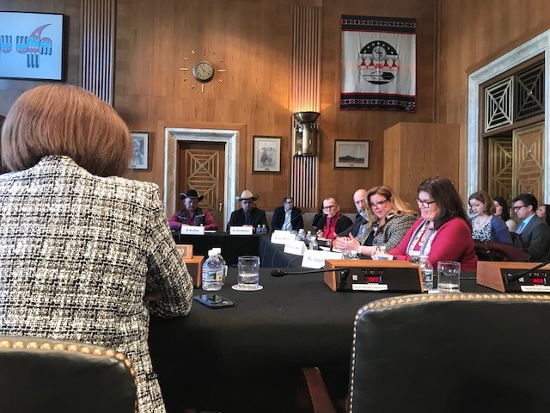
Farm Bill
March 1, 2018 NIHB joined the Native Farm Bill Coalition.
Over 120 Tribes and 11 Intertribal and Native Organizations.
Senate Committee on Indian Affairs RoundTable discussion on the Tribal policy recommendations in the Farm Bill
Notes:
One of the largest pieces of legislation coming up this year that will have significant implications for the overall health and nutrition of Tribal communities is the Farm Bill.
On March 1st NIHB joined the Native Farm Bill Coalition along with over 120 Tribes and 11 intertribal and native organizations. Tribes have often been excluded from the planning, development and implementation of national food and agriculture policy and this coalition is meant to be a unified Tribal voice in these discussion.
On January 18th I was also able to testify in front if the Senate Committee on Indian Affairs on Tribal policy recommendation for the Farm Bill. NIHB will continue these discussion throughout the year.

Slide 14
Farm Bill --Priorities for Self Governance
Biggest Self-Governance Priority is creation of a pathway for Tribes to administer their own food assistance programs.
Modeled off of PL-93-638.
Allow Tribes to choose food delivery method that works for them.
The right to healthcare is the right to healthful food.
Not included in the current House Farm Bill.
Notes:
The Biggest Self-Governance Priority for NIHB and the Native Farm Bill Coalition is the creation of a pathway for Tribes to administer their own food assistance programs.
Modeled off of PL-93-638 to allow Tribes to choose food delivery method that works for them and administer food distribution using local knowledge.
The right to healthcare is the right to healthful food.
This priority is not included in the current House Farm Bill, but NIHB is working with our allies on Capitol Hill to include this.

Slide 15
Farm Bill—Other Tribal Priorities
Tribal exemptions from work requirements and time limits for Supplemental Nutrition Assistance Program (SNAP).
Expand Food Distribution Program on Indian Reservations (FDPIR).
Provide Tribes with base funding to develop or expand traditional foods programs.
Require a Congressional inquiry into the impact of drastic cuts or elimination of food assistance programs on the overall food security of Tribes.
Notes:
Other Legislative Priorities for NIHB include:
Exempt Tribes and Tribal members from work requirements and corresponding time limits for receiving SNAP benefits
Expand the Food Distribution Program on Indian Reservations (FDPIR) through increased funding for purchasing of traditional foods, infrastructure development, and nutrition education.
Provide Tribes with base funding to develop or expand traditional foods programs
Require a Congressional Budget Office (CBO) or Congressional Research Service (CRS) inquiry into the impact of drastic cuts or elimination of food assistance programs on the overall food security of Tribes.
We saw on April 12 the first House version and the bill included changes to the SNAP program:
New 20 hour a week work requirement (it was 80 hrs a month) in FY21-25 and increases to 25hrs a week in FY26
Failure to find work/ job training programs requirements within 1 month you are ineligible for SNAP for 1 year. Additional violation, ineligible for 3 years.

Slide 16
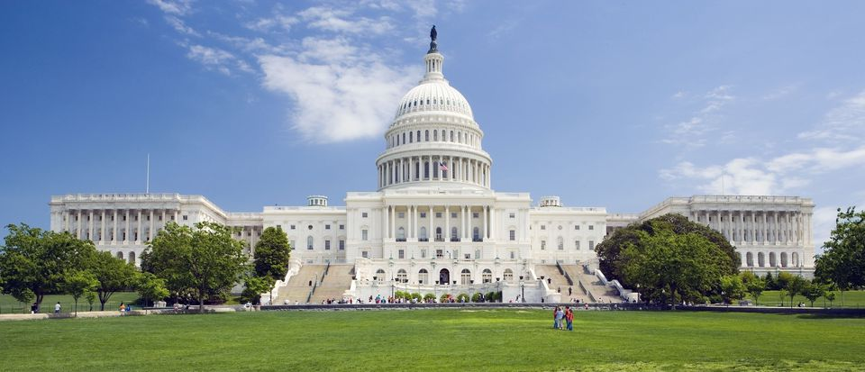
Farm Bill Timeline
Current Farm Bill is authorized until September 30, 2018
H.R. 2 The Agriculture and Nutrition Act of 2018 (Released on April 12, 2018)
Full House Vote expected in May
Senate version of the Farm Bill expected in May
Notes:
The current Farm Bill is set to expire on September 30th this year.
The new work requirements don’t directly impact FDPIR but the change could increase the demand for FDPIR by 20-45 percent or more. Increasing the risk of dramatic food shortages.
The house bill lacks support from the democrats and a large section of the Freedom caucus. The bill passed on party line vote out of the House Agriculture Committee on April 18th and chairman Mike Conaway (R-TX) hopes to get a full vote in early May.
The Senate Leadership in the Agriculture Committee have promised a bipartisan bill, which if they stay on schedule could also come mid to late May.
NIHB is continuing its advocacy with members of this committee and will work to get our priorities included.

Slide 17
NIHB NEEDS A HOME
Please help…
Stacy A. Bohlen (202) 680-2800
Cell Phone – Please do not hesitate to contact me.

Slide 18
Miigwe h Thank you!

