Slide 1
The Late-Principal Chief Wilma Mankiller Cherokee Nation

Slide 2
The Late-President Joseph B. De La Cruz
Quinault Indian Nation

Slide 3
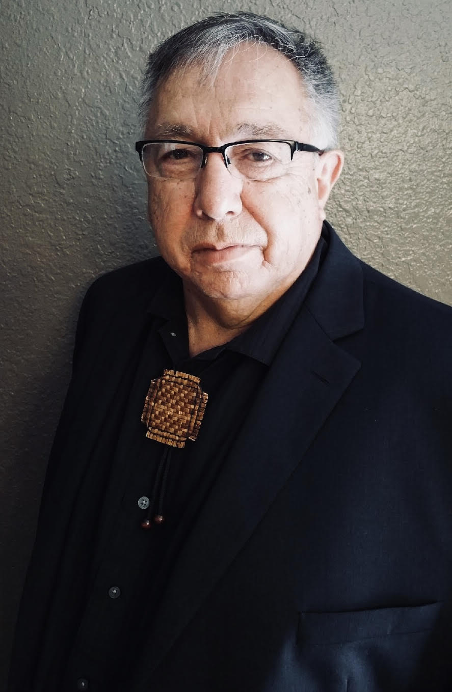
The Late-Chairman Larry Kinley Lummi Indian Nation

Slide 4
The Late-Chief Executive Marge Anderson
Mille Lacs Band of Chippewa Indians

Slide 5
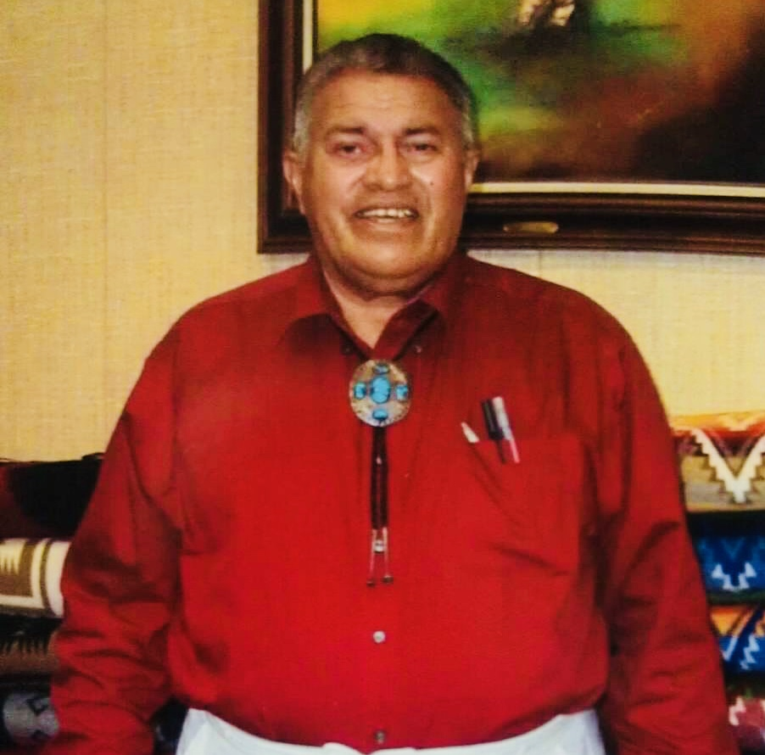
The Late Governor Dr. John Edwards
Absentee Shawnee Tribe

Slide 6
Chairman Ron Allen
Jamestown S’Klallam Tribe

Slide 7
The Former Chairman Dale Risling
Hoopa Valley Tribe

Slide 8
Thank you to the families & the tribal governments for providing these photographs

