Slide 1

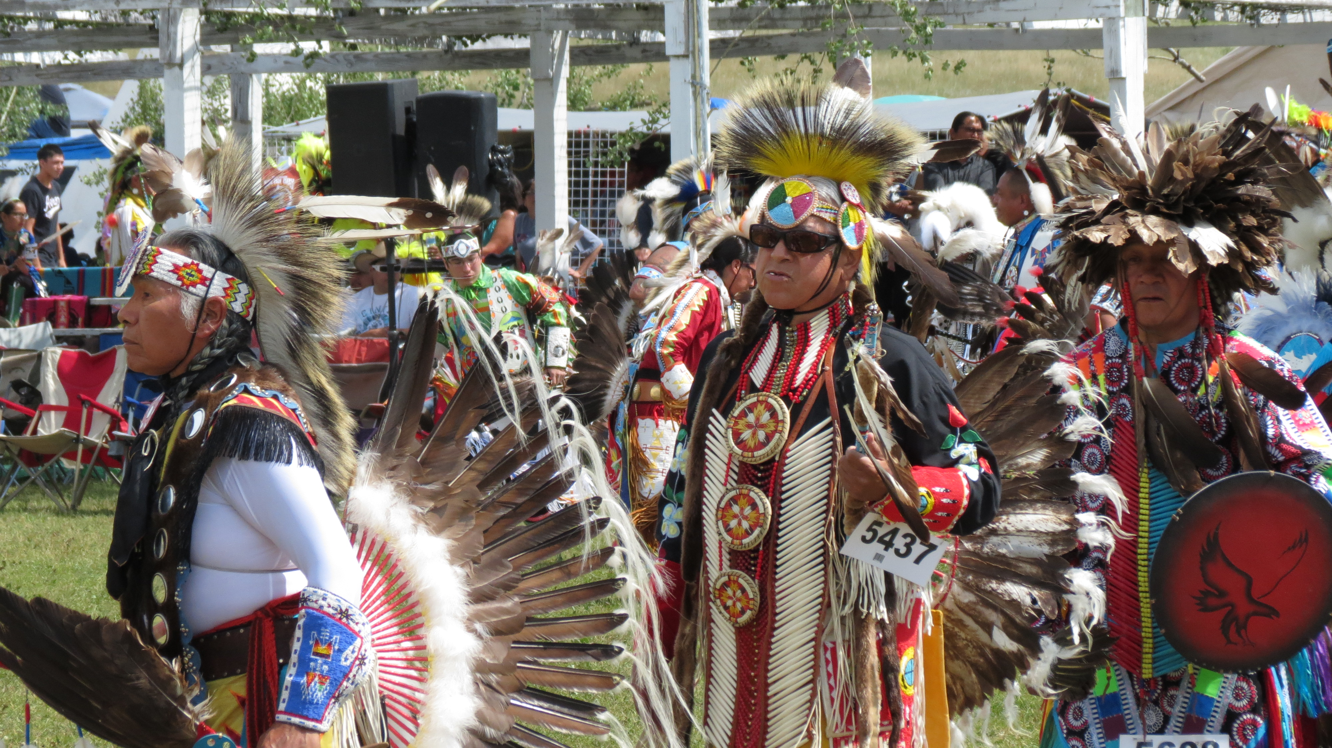
SELF-GOVERNANCE: 30 YEARS IN ACTION
Indian Lands,
Natural Resources and Environmental Impacts: Sustaining our Culture and Traditions
2018 Annual Tribal Self-Governance Conference
April 22-26, 2018
Albuquerque Convention Center
Albuquerque, NM

Slide 2
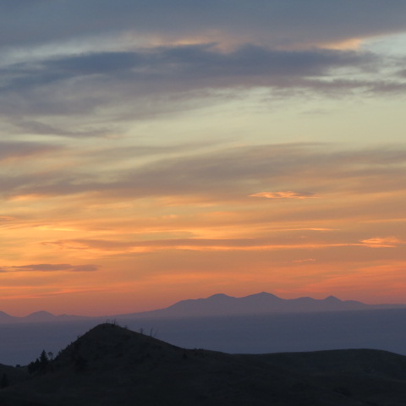

The Philosophy of the Chippewa Cree
We believe the Maker of All Things put us on our Mother Earth to respect one another in our relationships to all things and to all people.
The Great Holy Being told the old people long ago that all people and all things are but different branches on the same tree. We are told in our daily lives we must do these things.
Respect Mother Earth and all things that live here. Respect the elders, our mothers, and our sisters. Love one another and help one another.
Pray in a good way that we might get the power to help one another and to respect one another for our differences.
Be truthful and respectful in our speech, which in itself is a miracle and a gift from our Creator that we might use it only to speak good of each other and to pass on the good things in life.
Remember that everything that is created on Mother Earth is useful, has a purpose, and was put here for a reason. Nothing is to be abused that has been created.
Remember that all things are related and that all things are perfect as they have been created: wind, fire, water, rocks, animals, crawlers, birds, plants, the moon, the sun, and humans.
Remember that the earth was created for everyone and everything and that we are not to selfishly claim it. We are all to share the good things in life so that we may all live in harmony.
Realize that we as human beings have been put on this earth for only a short time and that we must use this time to use our minds to gain wisdom, knowledge, respect and understanding of all human beings since we are all brothers.
Be humble and respectful before the Creator every day and give thanks for putting us here on earth.
Always be respectful of life. We are not to kill our fellow man.
The elders also said, “We believe in the uniqueness of the individual and want our children to have a deep respect for others and for those things and people who may be different from them. We believe that racism and prejudice in any form is a useless exercise for the human mind because it only breeds hatred, misunderstanding, and unhappiness; it ignores the realities of the world because there are different people and beliefs which have the right to exist as long as theirs does not attempt to do away with our way of life.”

Slide 3
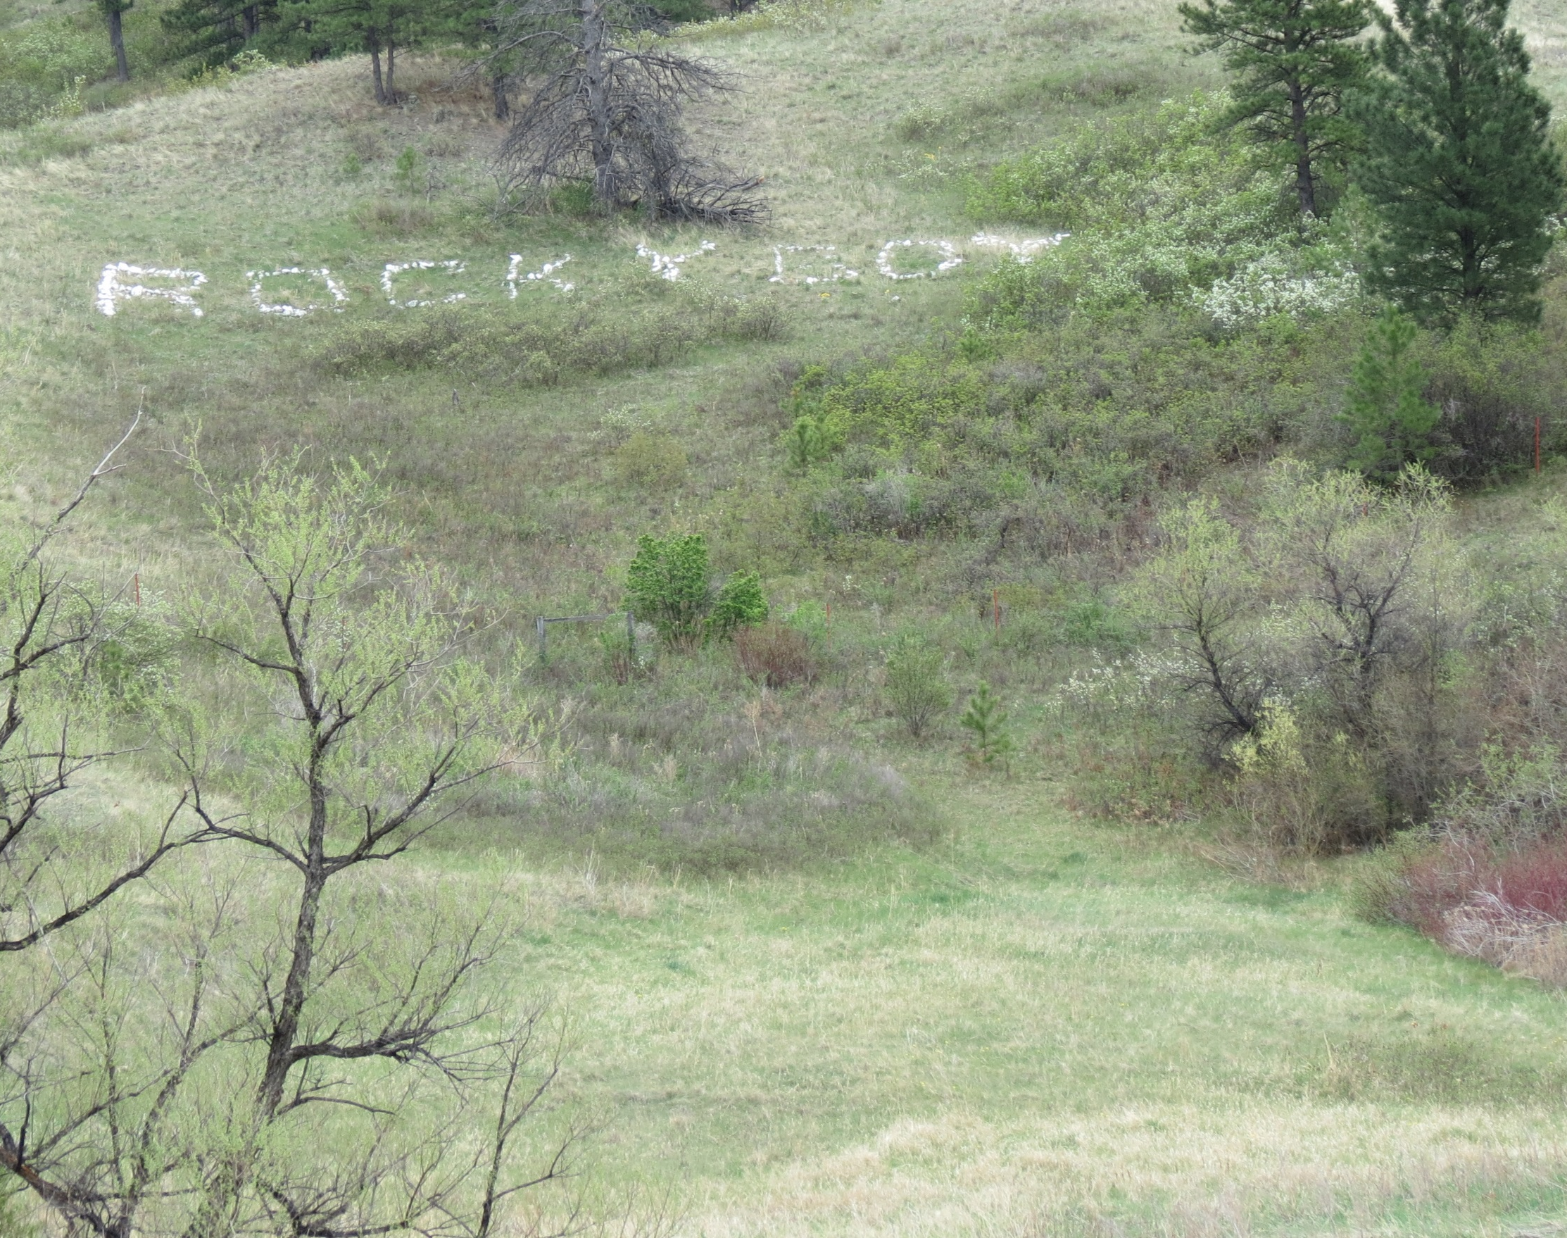
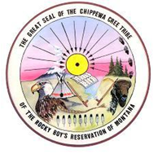
Chippewa Cree Tribe of the Rocky Boy’s Reservation

Slide 4
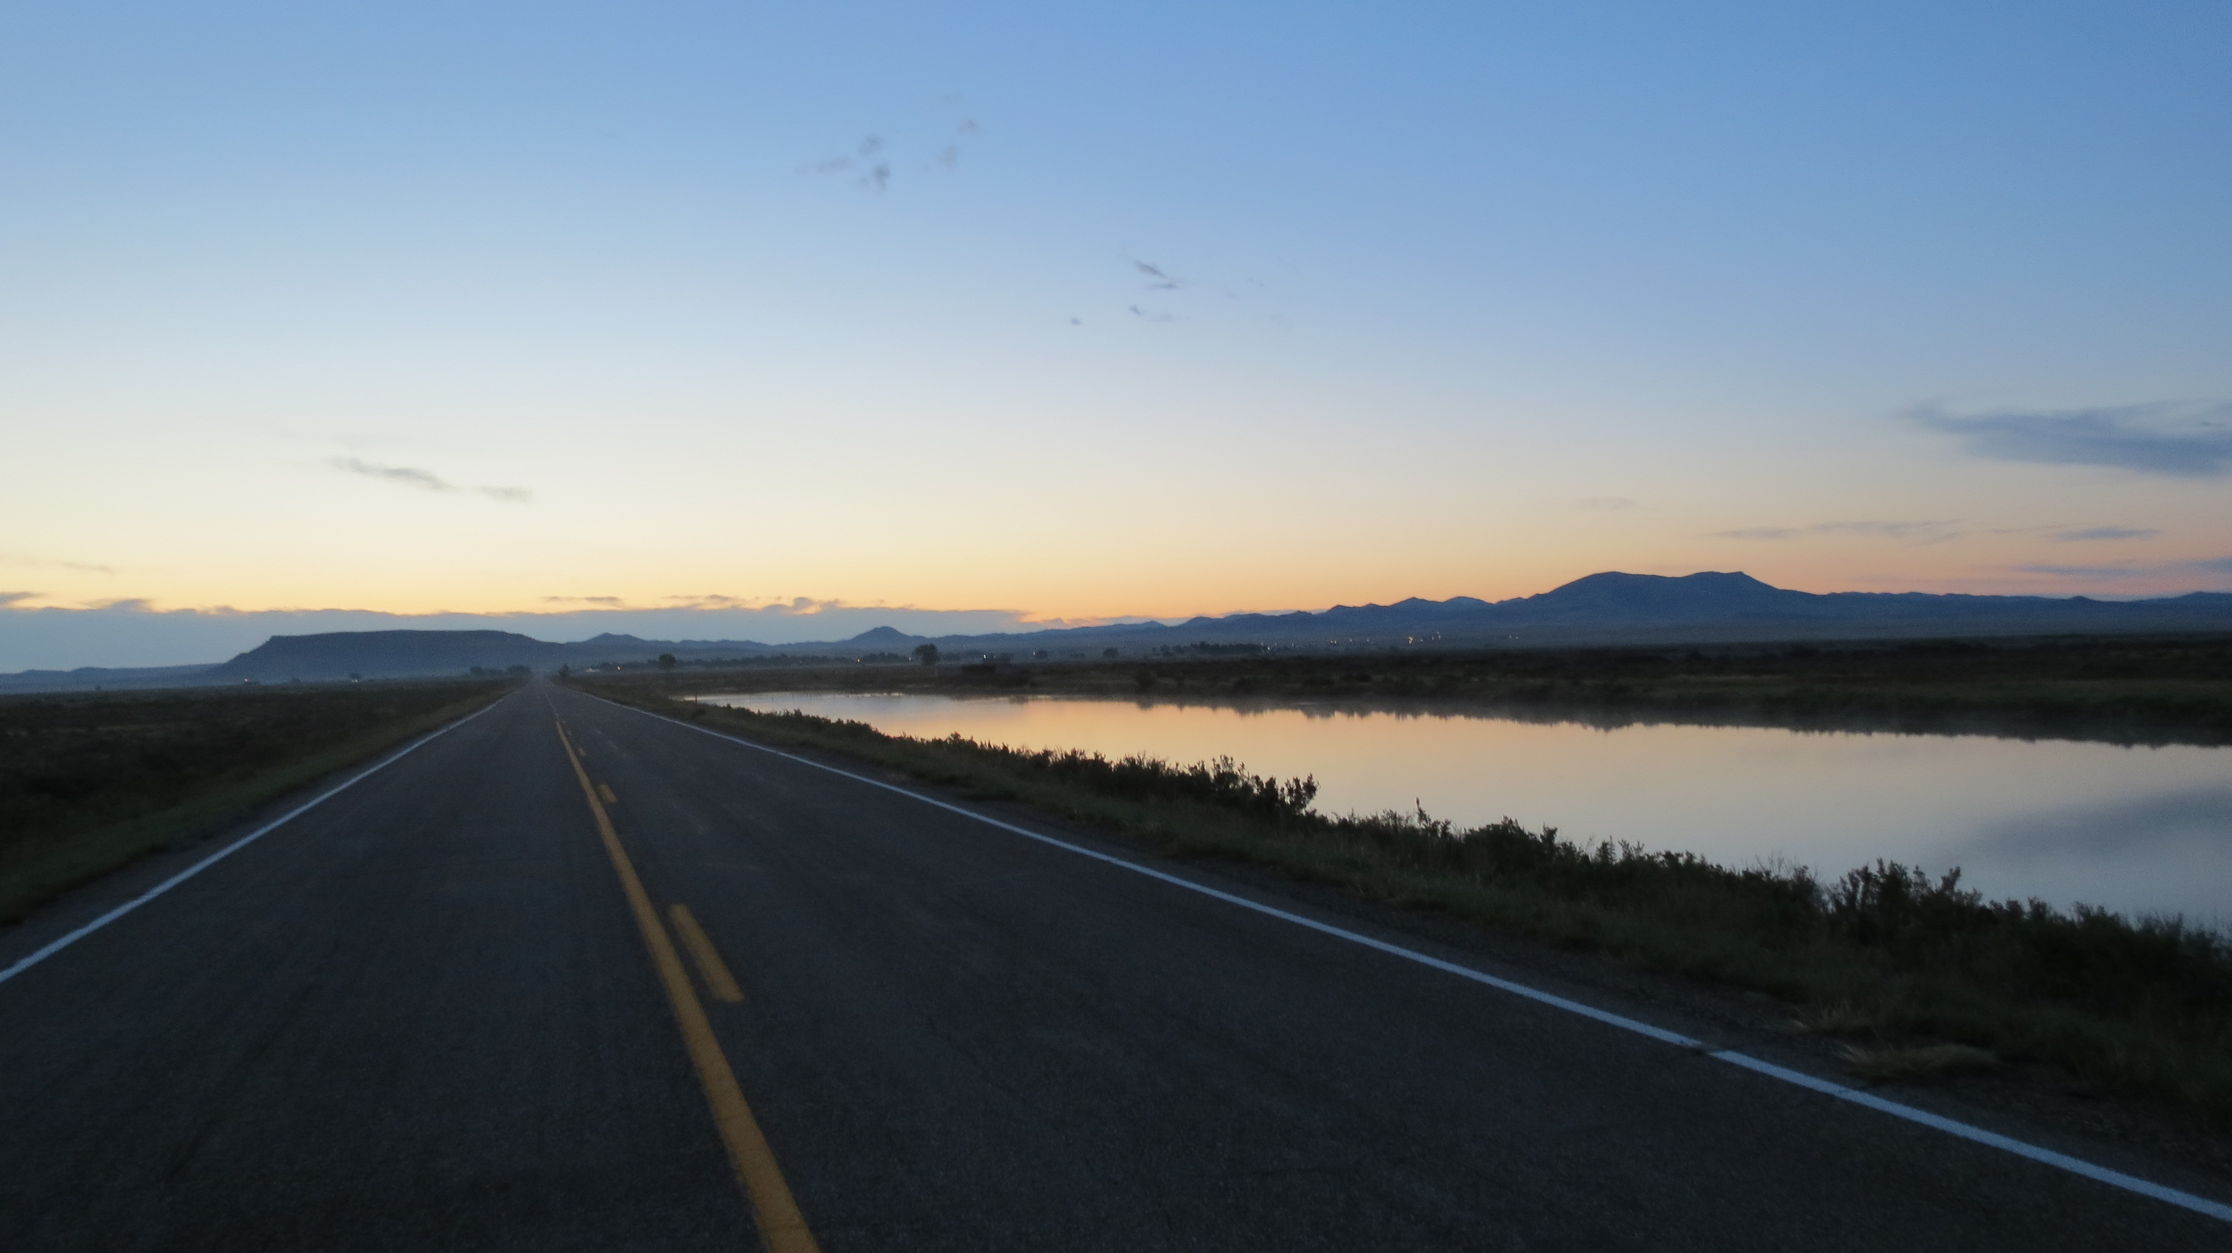
The Chippewa Cree Tribe of the Rocky Boy’s Reservation
SUSTAINABILITY, CULTURE, and SELF-GOVERNANCE

Slide 5
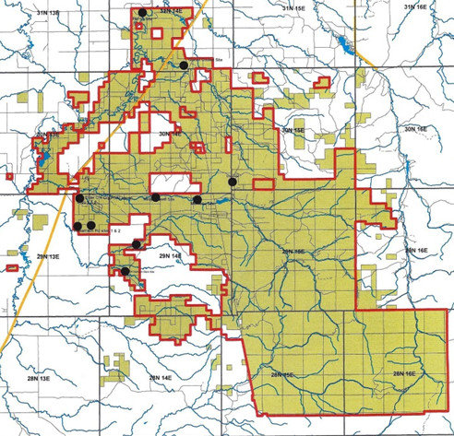
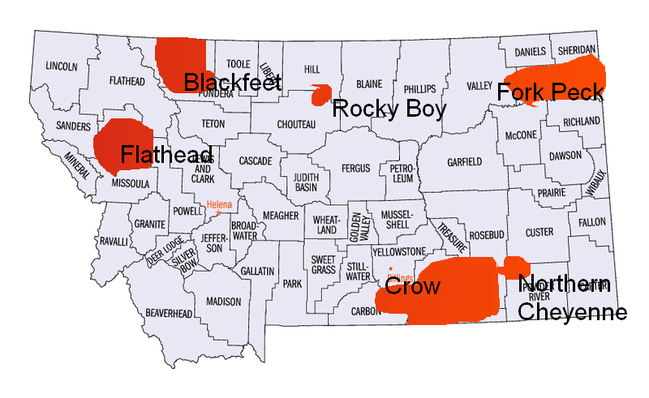
The Rocky Boy’s Reservation
Box Elder, MT
Montana USA

Slide 6
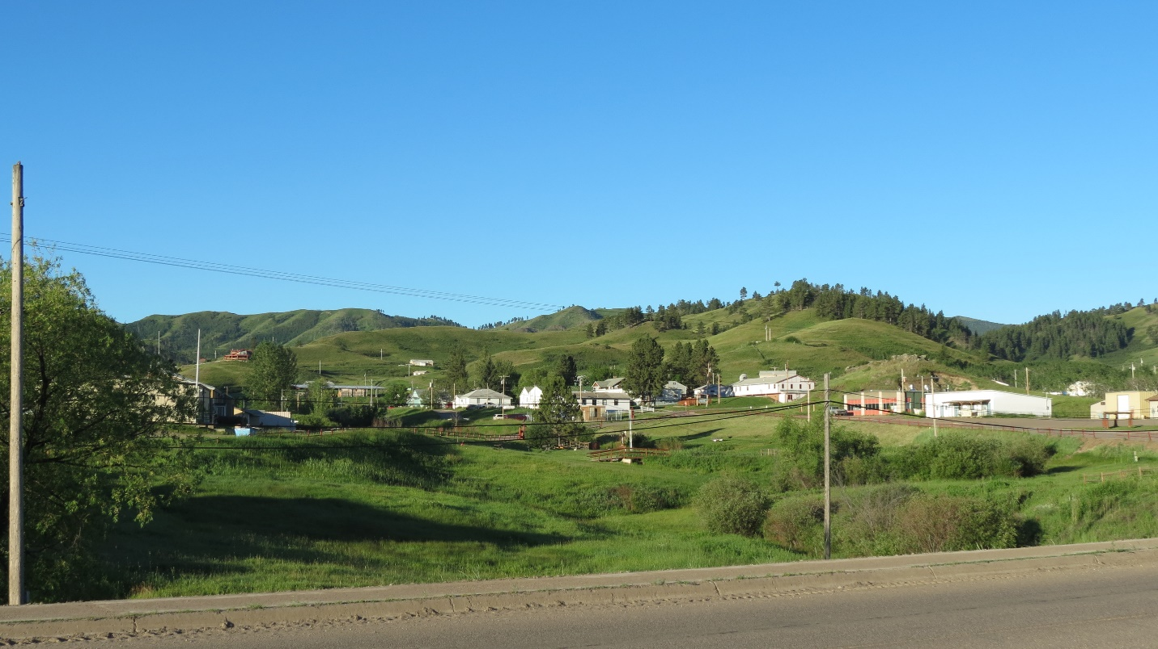
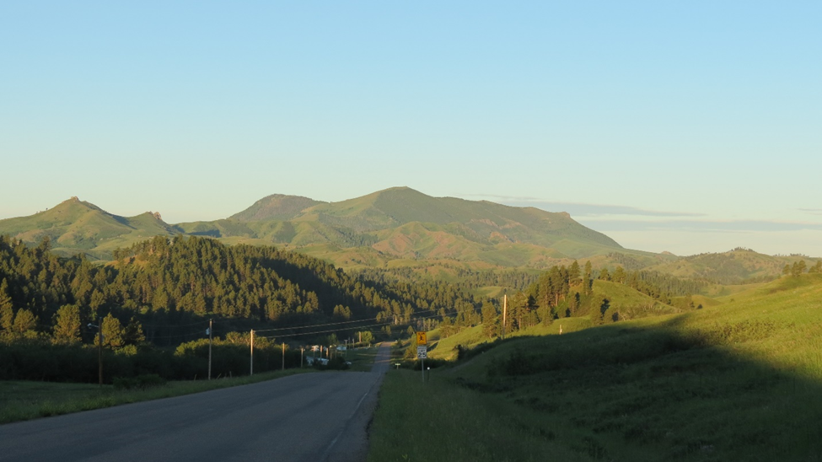
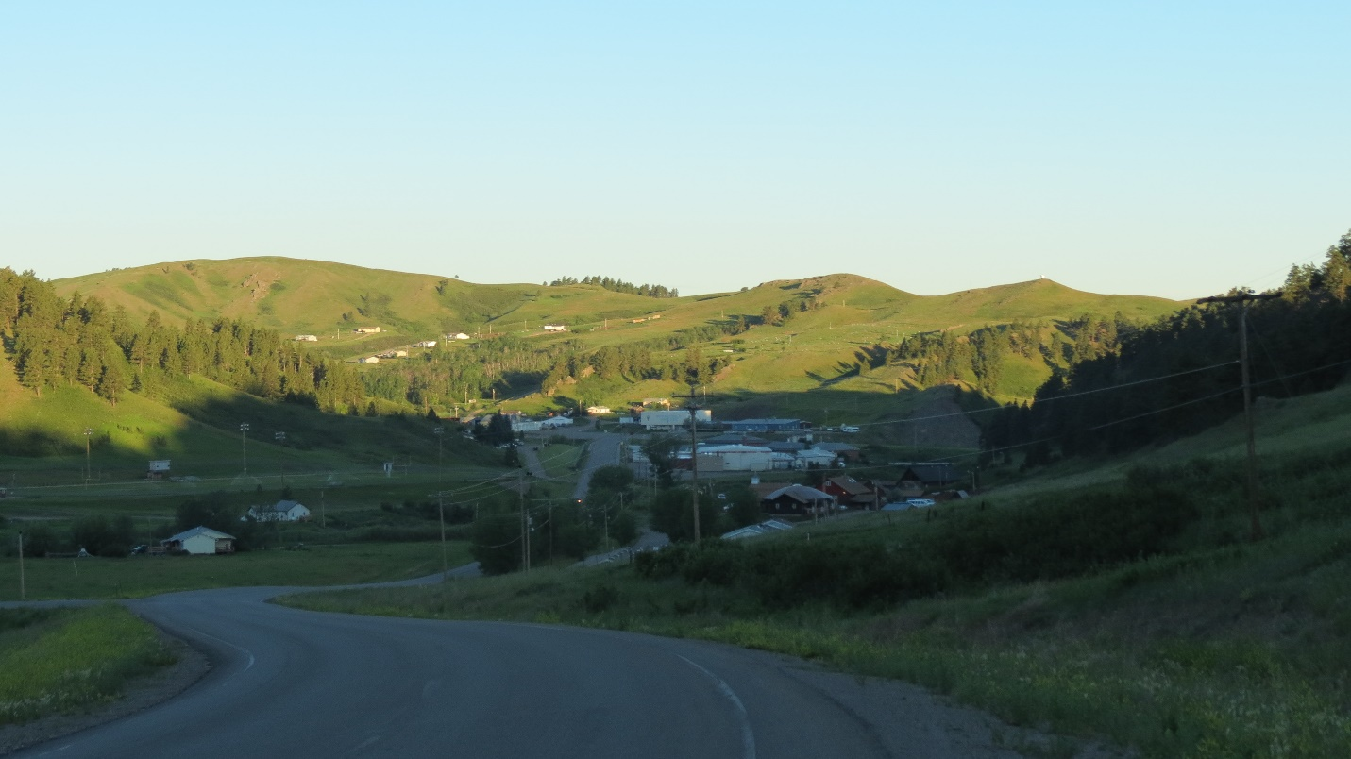
The Community

Slide 7
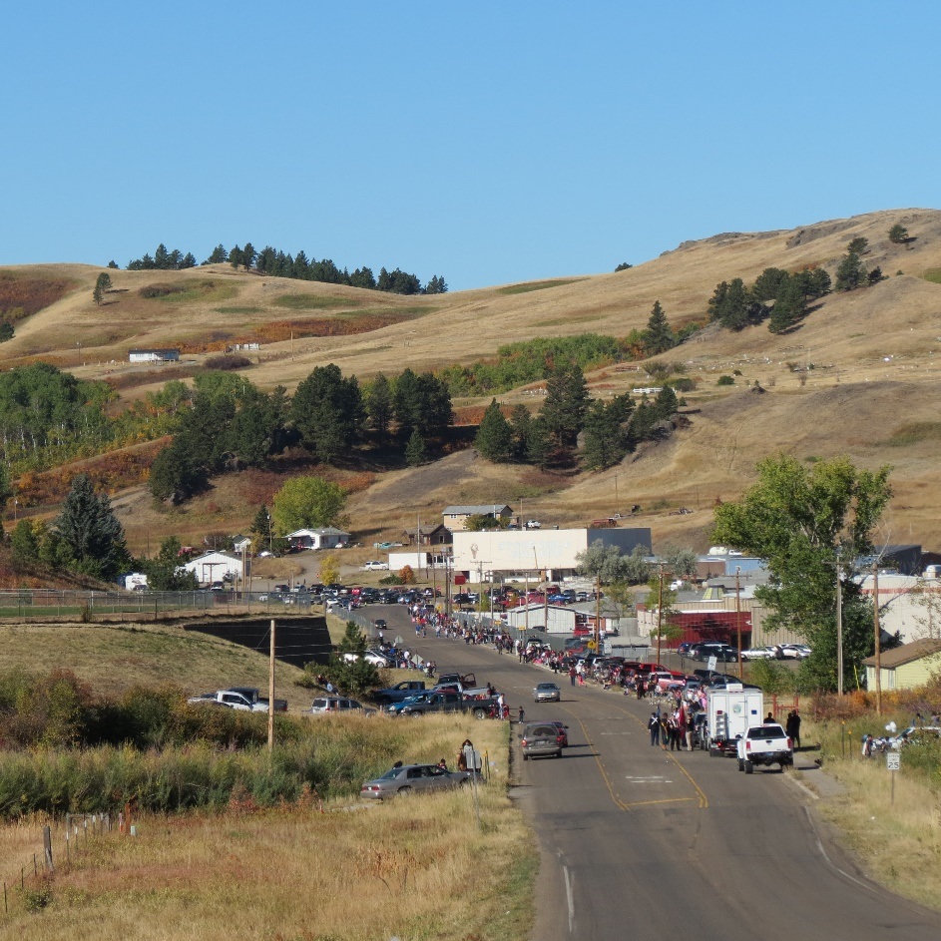
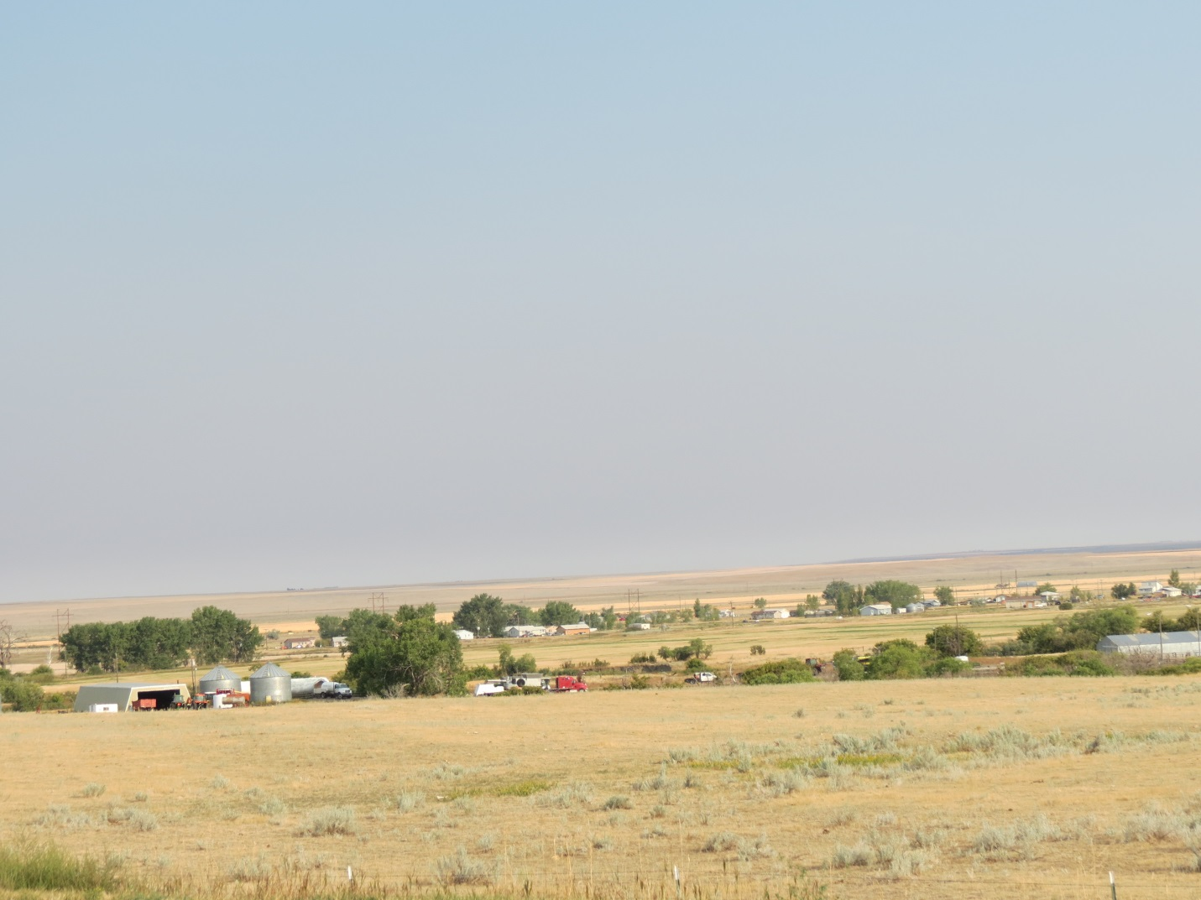
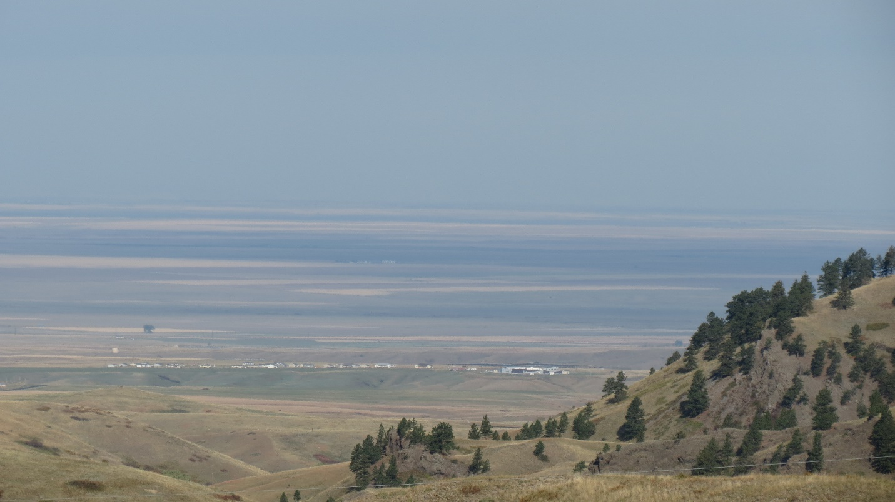
The Community

Slide 8

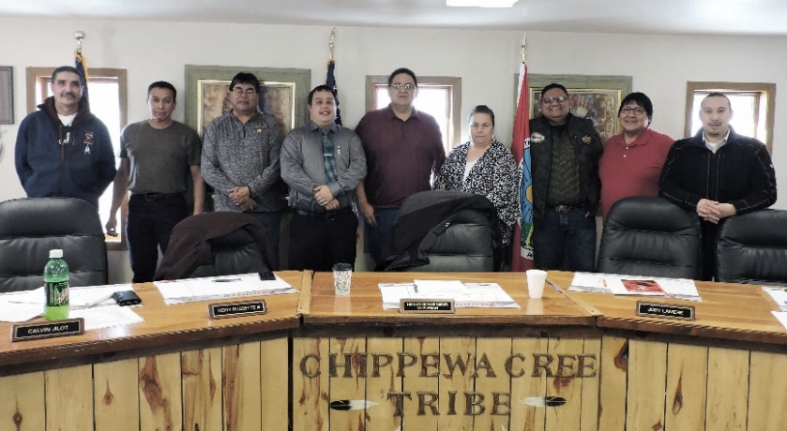
Governance
Chippewa Cree Tribal Business Committee
Mission Statement
As a sovereign nation, the Chippewa Cree Tribe of the Rocky Boy’s Reservation brings the culture of our native Chippewa Cree into all decisions of the tribal leadership to strengthen self-governance, guide prosperity and success, and deliver good health and education for the people we serve. We are empowered with strength, courage, truth, dignity, and community.

Slide 9
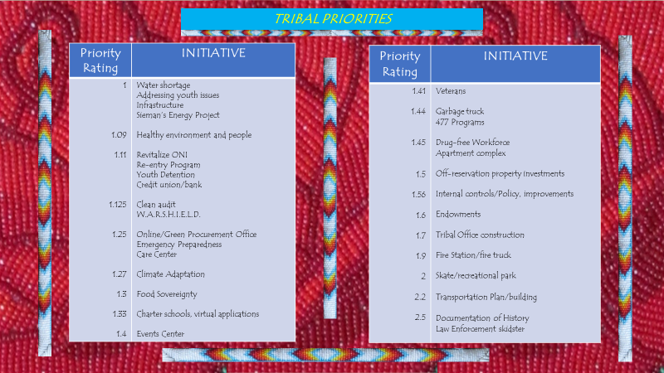

Slide 10

Culture and Wellness
Year 1
Signs in native language
Resolve youth detention issues
Community healing
Communication & outreach to our people
Awareness of youth issues
Reduce recidivism
Native language in the workplace
Youth leadership & financial autonomy
More resources for Elders
Year 3
Implement 477
Long-term Treatment Center
More activities for youth and elders
More community events for everyone
Drug & alcohol rates reducing
Increased youth awareness
Strengthen VAWA jurisdiction, crimes committed against Native women in the community
Year 5
Elderly living center, assisted care center, long-term care center
Youth home, group home, recreation center
Youth wraparound services & facilities
Year 10
Parks and Recreation Department
Rocky Boy Children’s Earth Science Museum
Seed bank for ag production and climate adaptation

Slide 11
Sovereignty
and
Governance
Year 1
Move into new tribal office/facilities
Safe, secure absentee voting system
United tribal government & community working together
Exercise sovereignty, review gaming compact, revenue sharing agreement
Have a plan
Revise constitution
Year 3
Clear, concise communication between all departments and with the Tribal Business Committee
Develop more projects and contribute more ideas
Year 5
Codification of all tribal codes
Year 10
True tribal sovereignty, move away from state jurisdiction
Diversity on Tribal Business Committee, gender-based

Slide 12
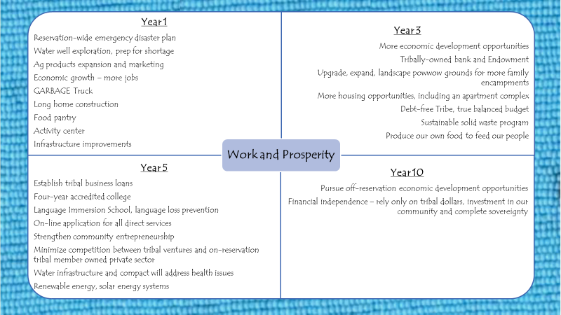

Slide 13
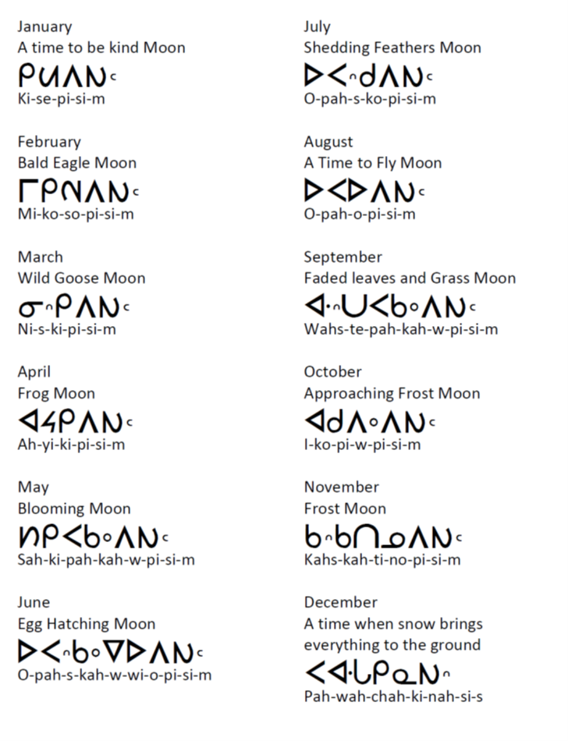
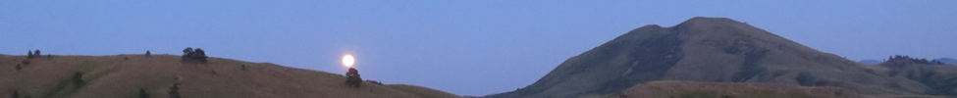
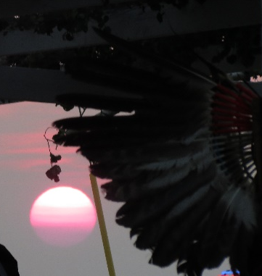
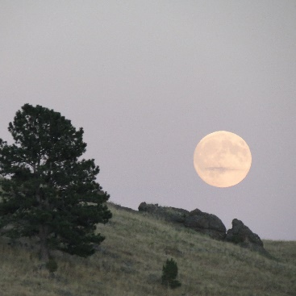
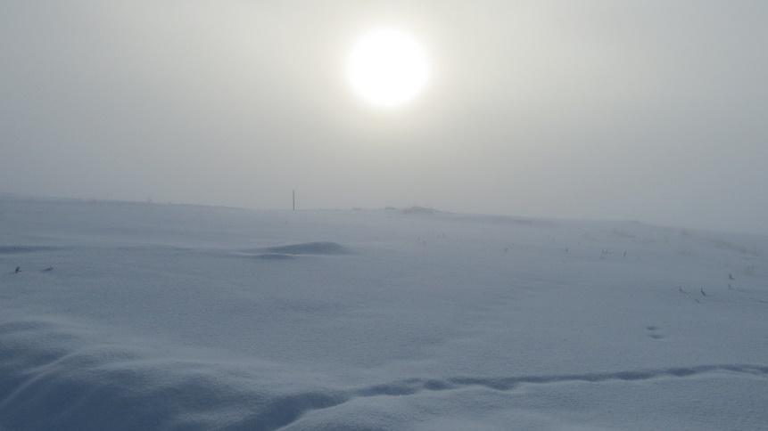
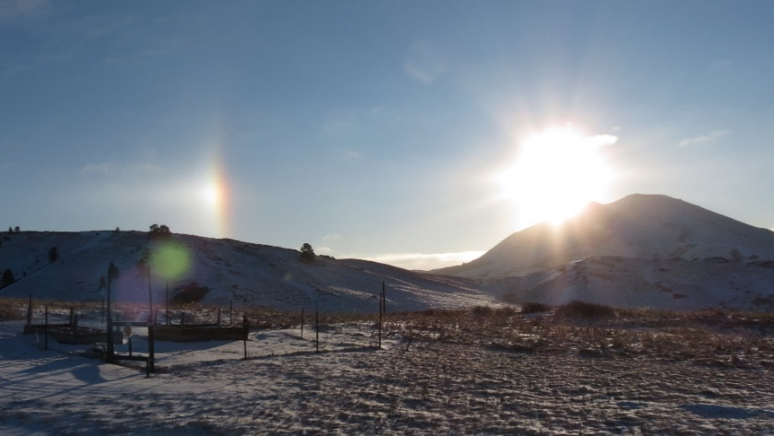
The Cree Calendar

Slide 14
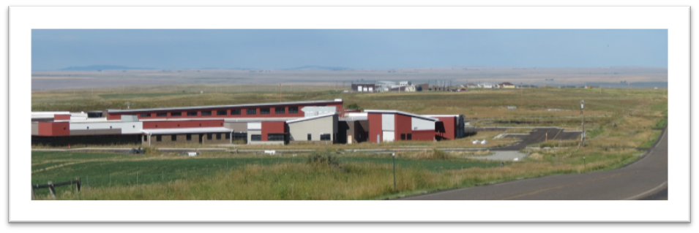
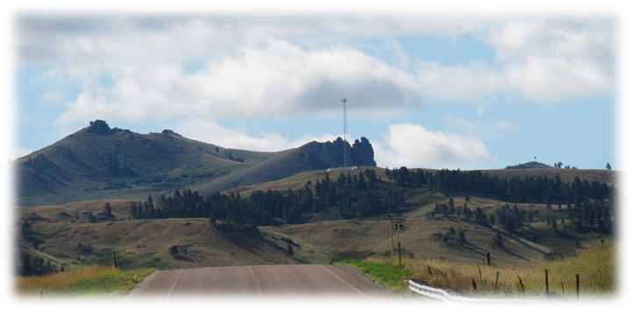
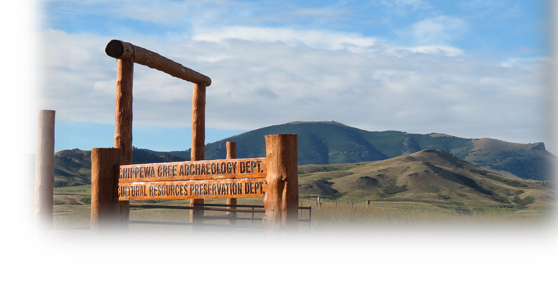
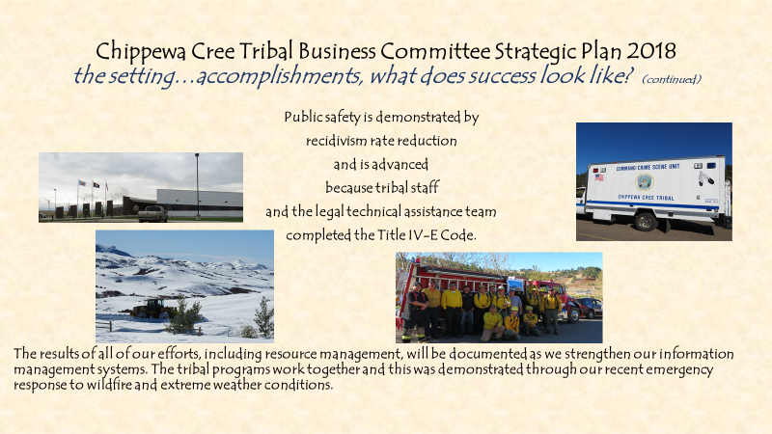
Governance
Community Development

Slide 15
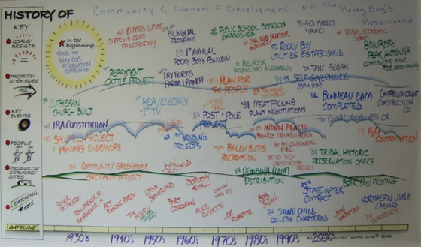
Governance
JOURNEY MAP

Slide 16
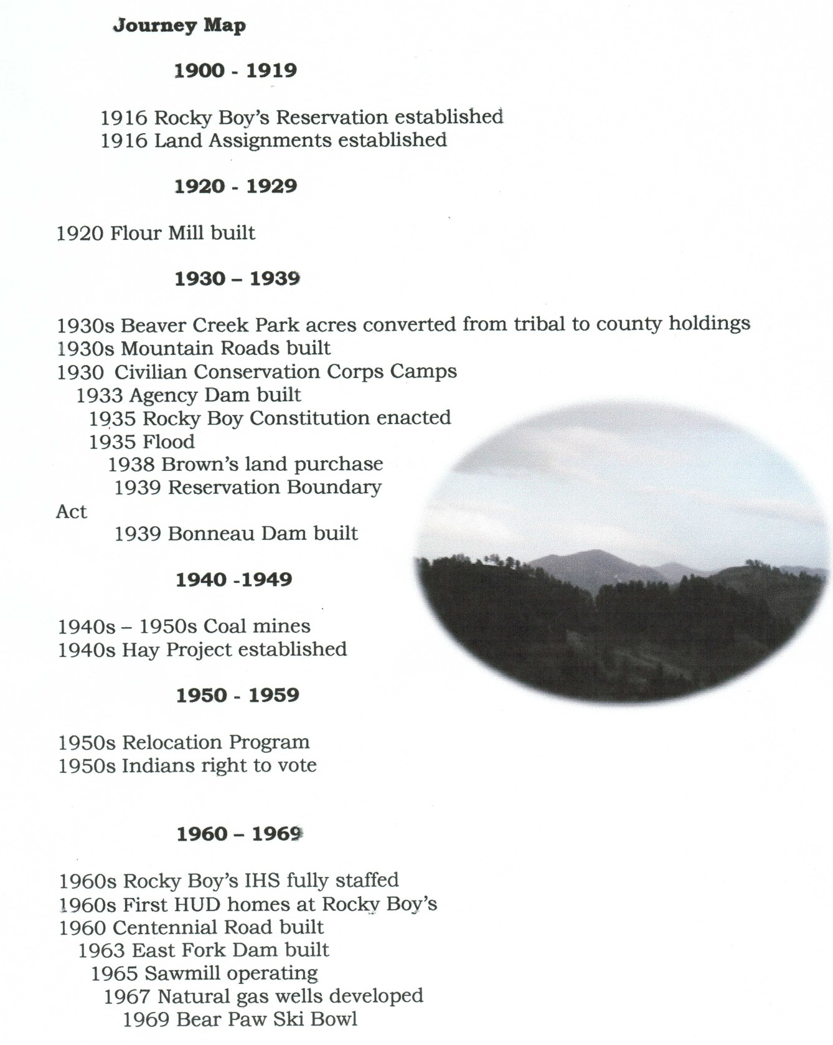
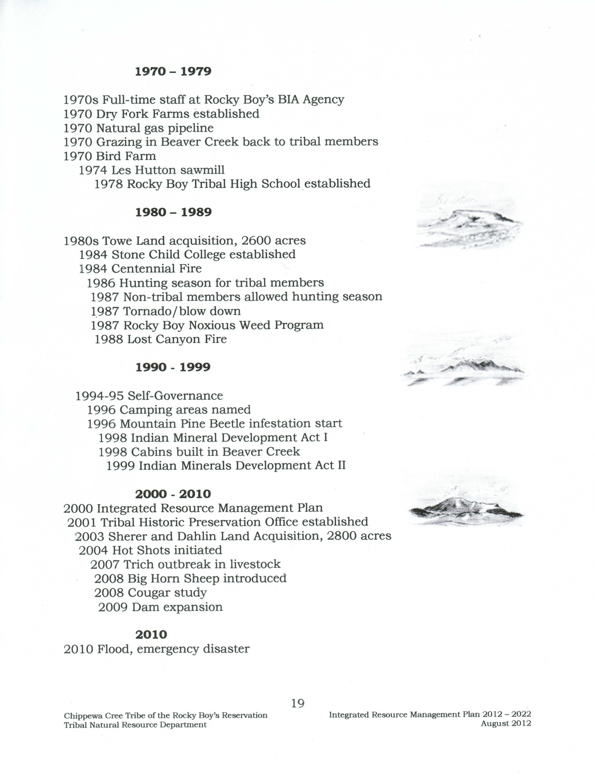
Governance JOURNEY MAP

Slide 17
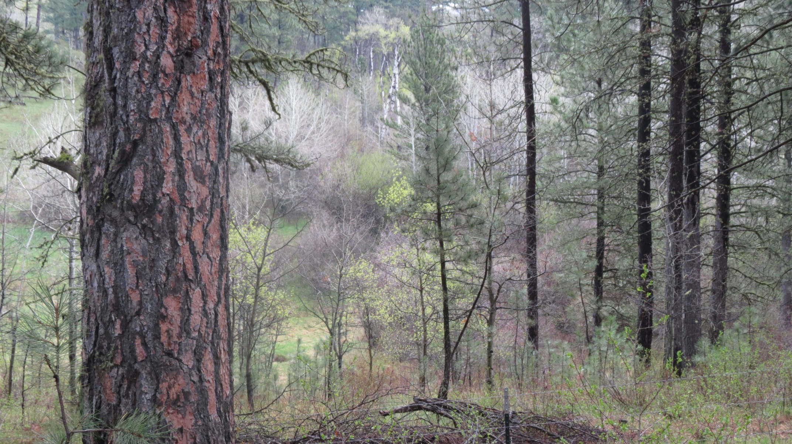
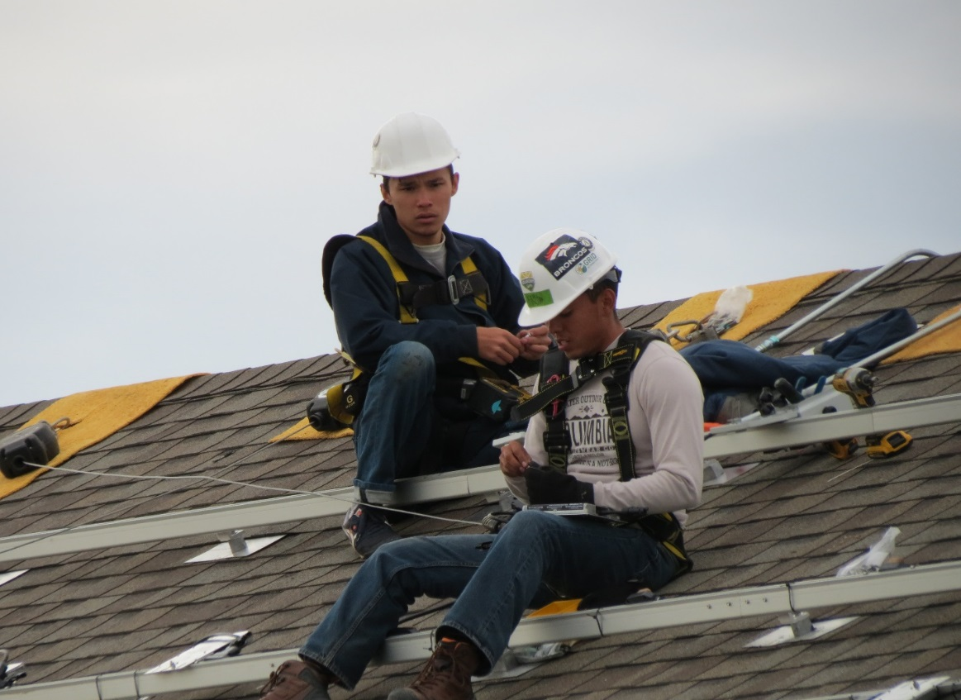
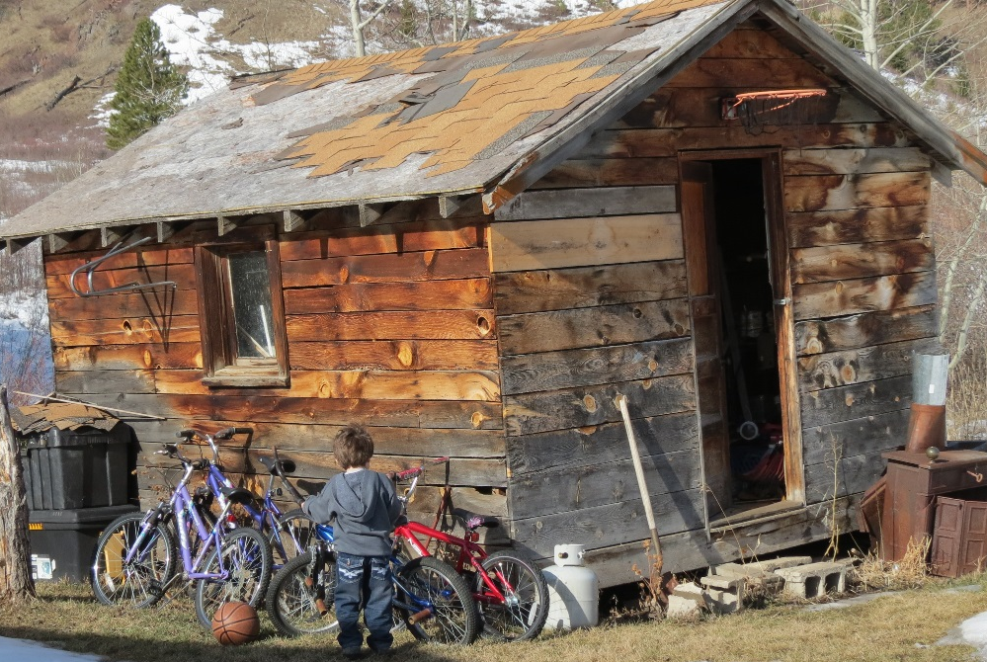
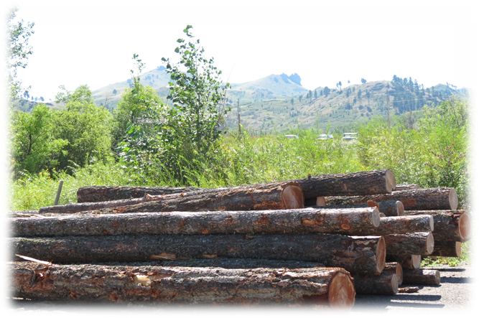
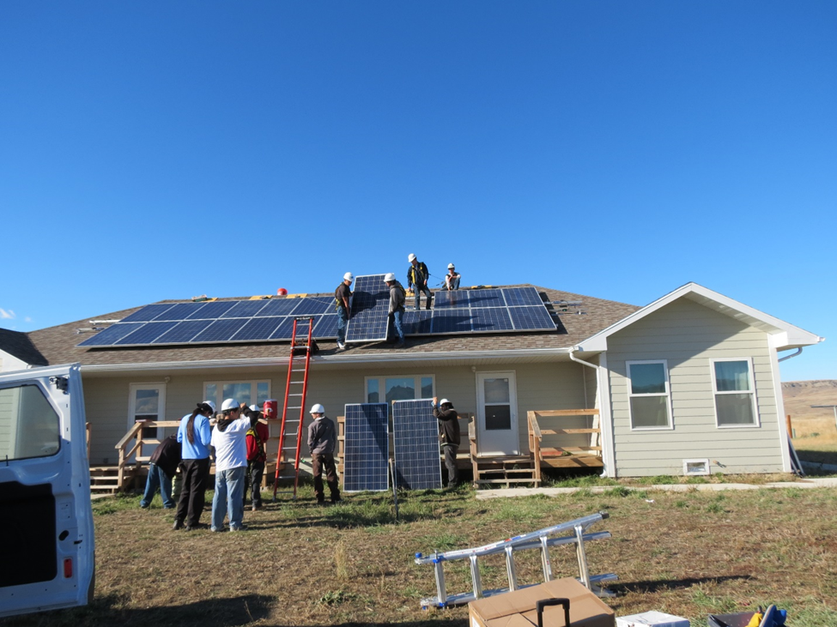
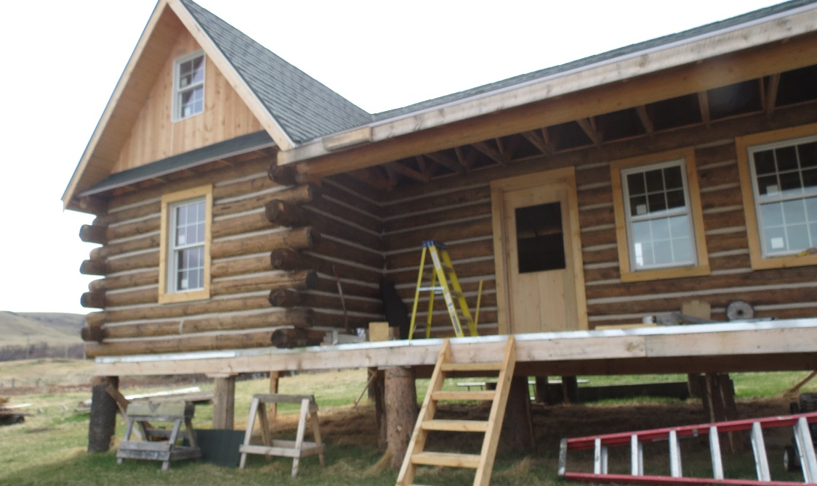
Chippewa Cree Tribe SELF-GOVERNANCE

Slide 18
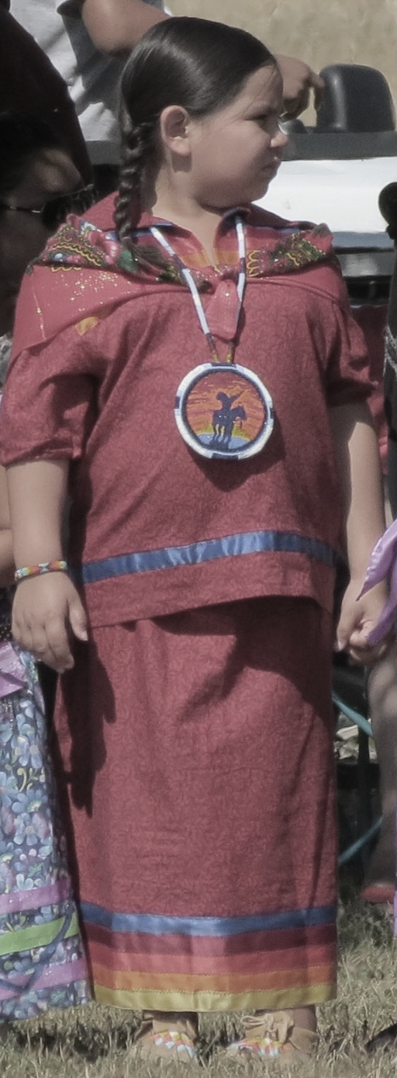
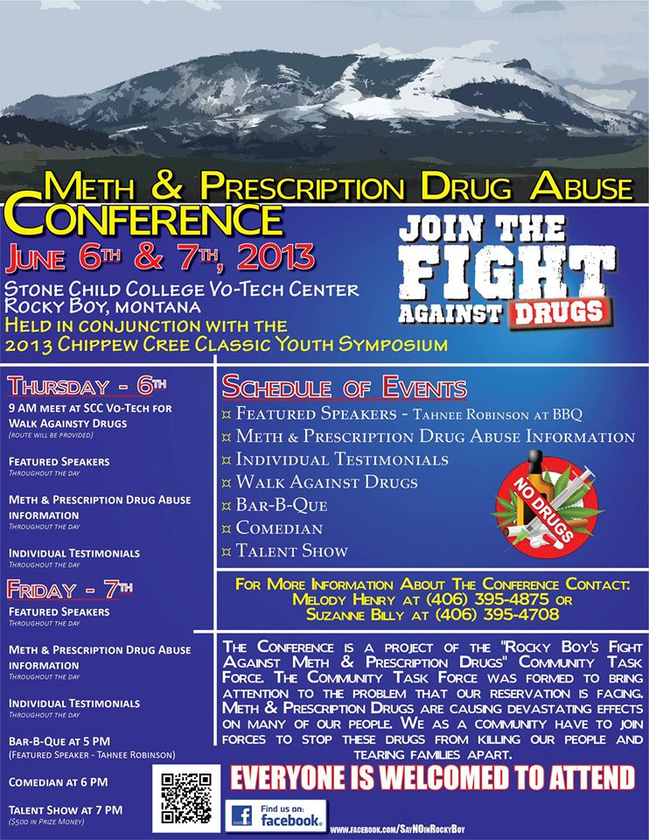

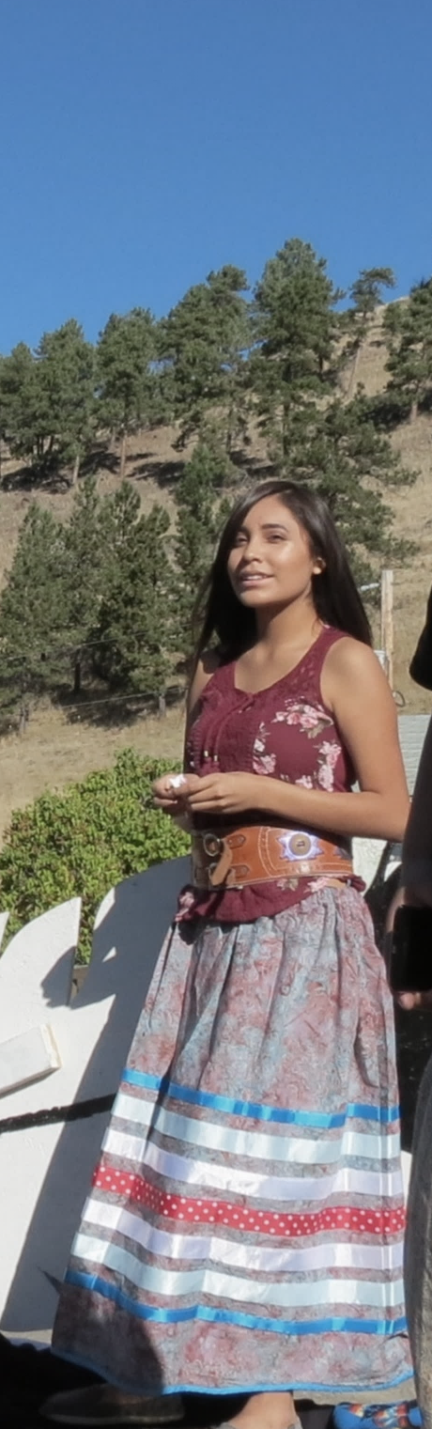
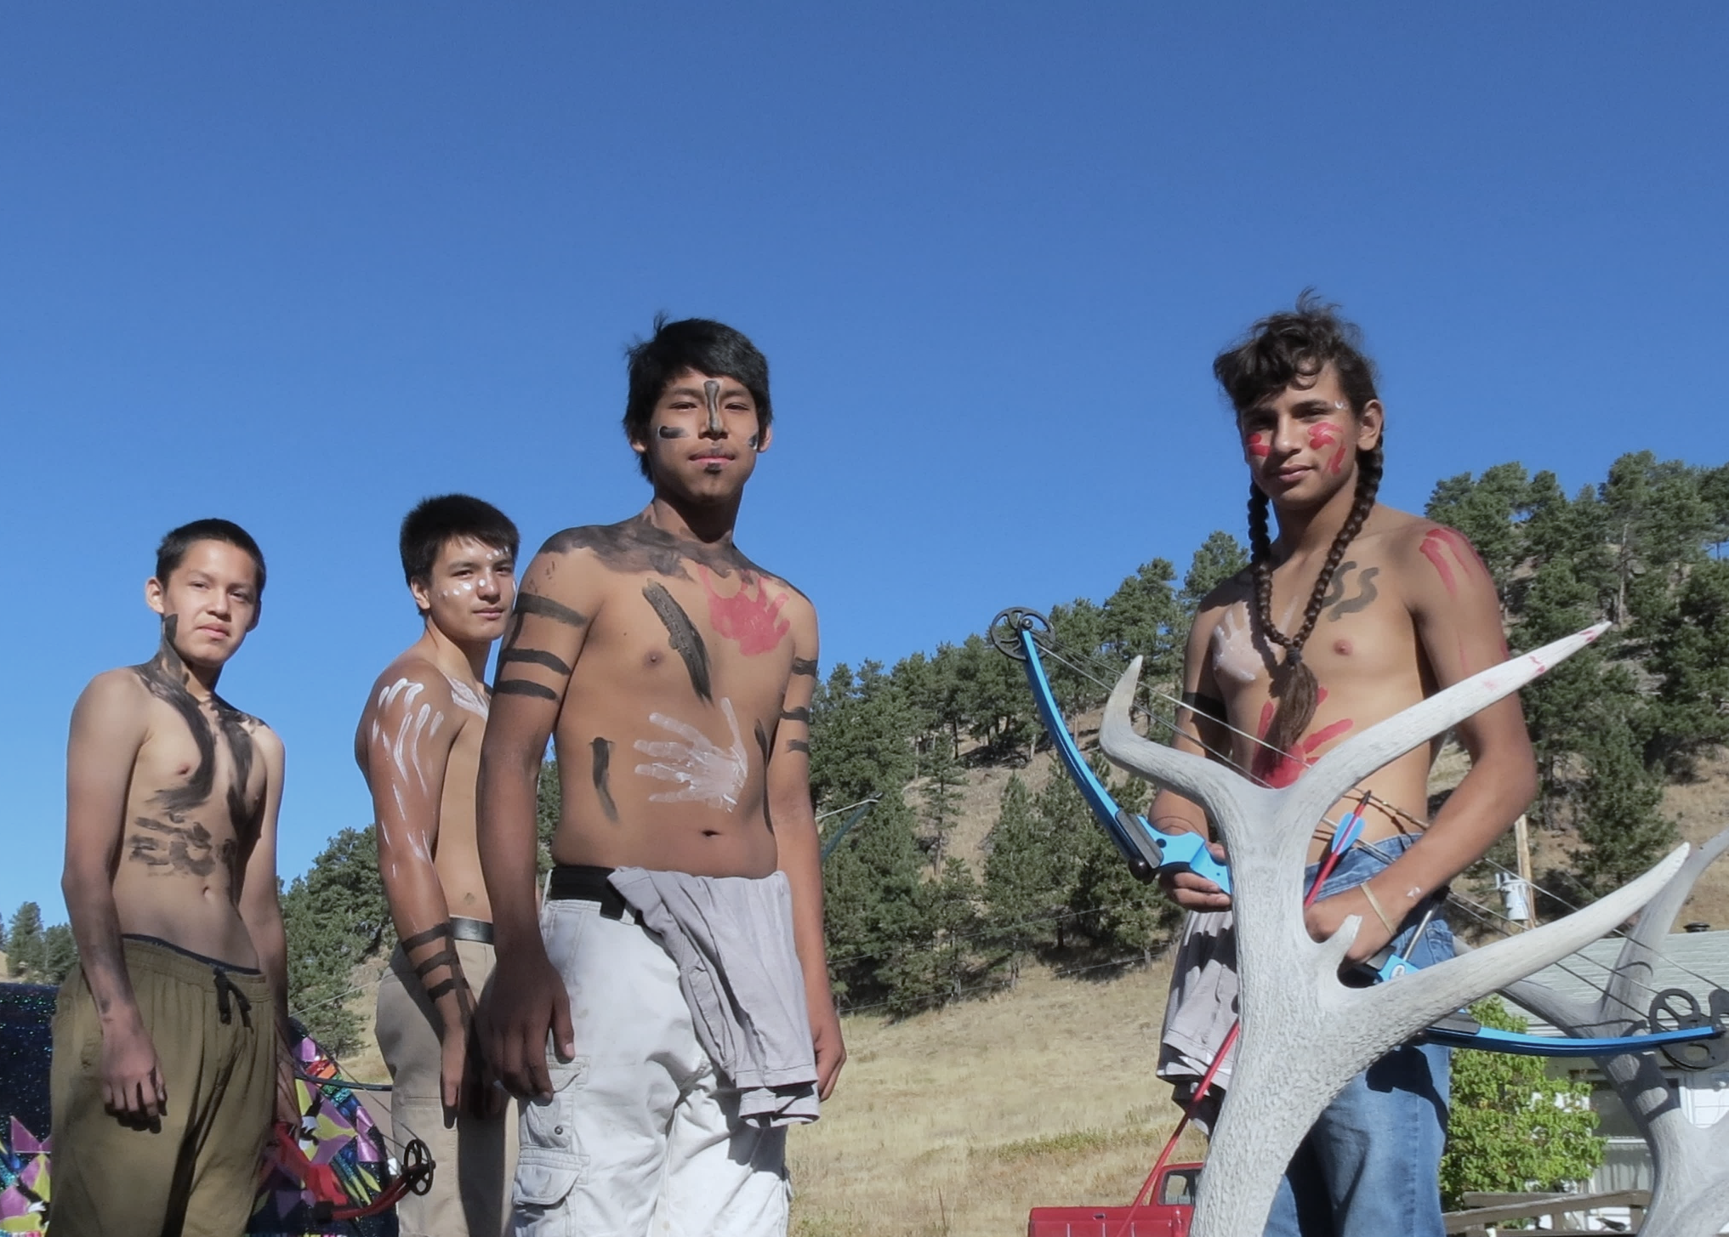
Sustainability - PEOPLE

Slide 19
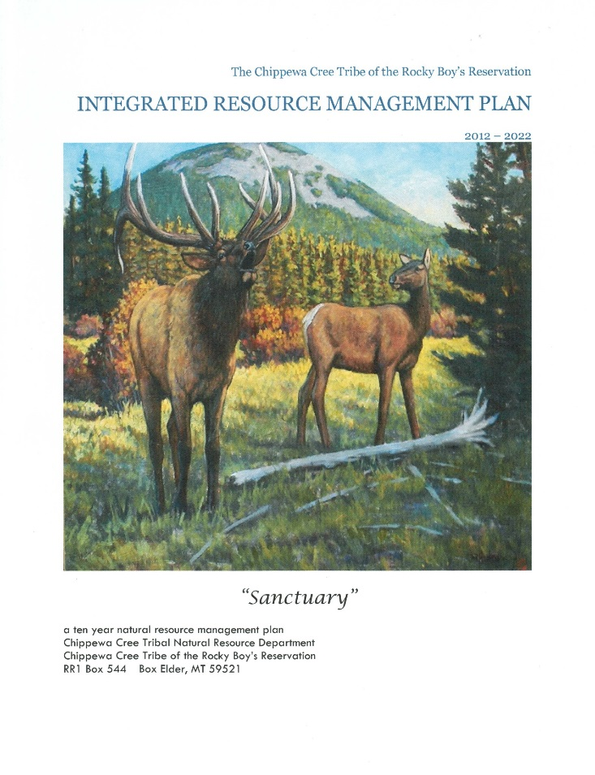
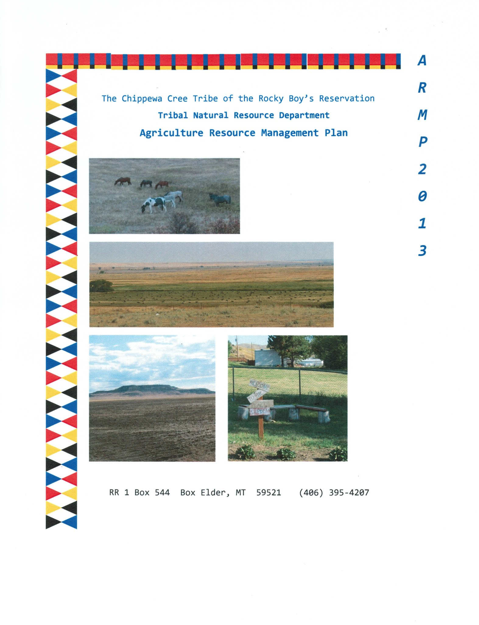
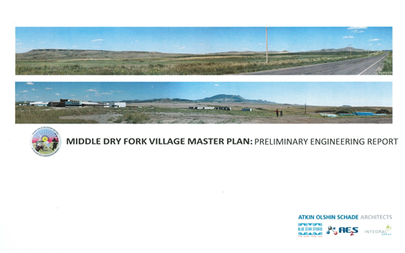
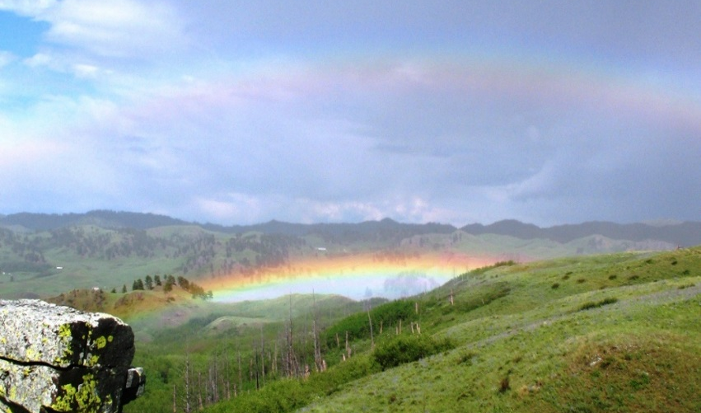
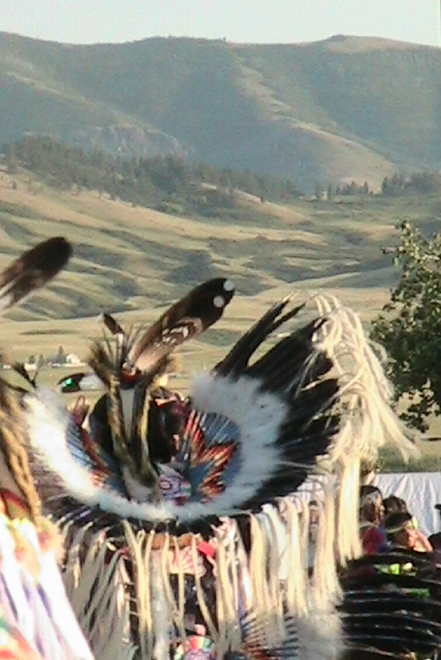
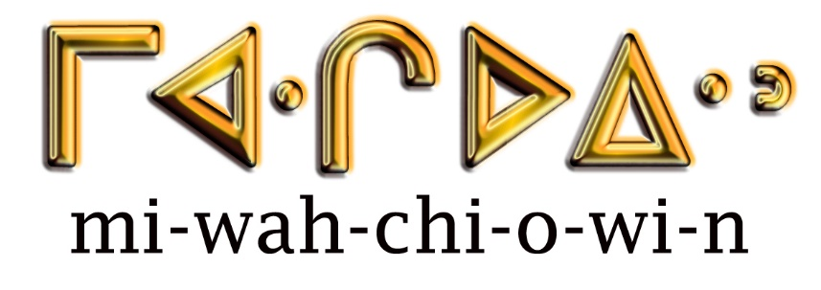

Sustainability –PROSPERITY
CEDS 2014

Slide 20
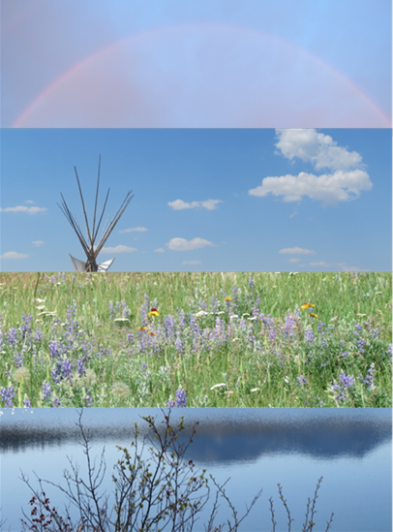
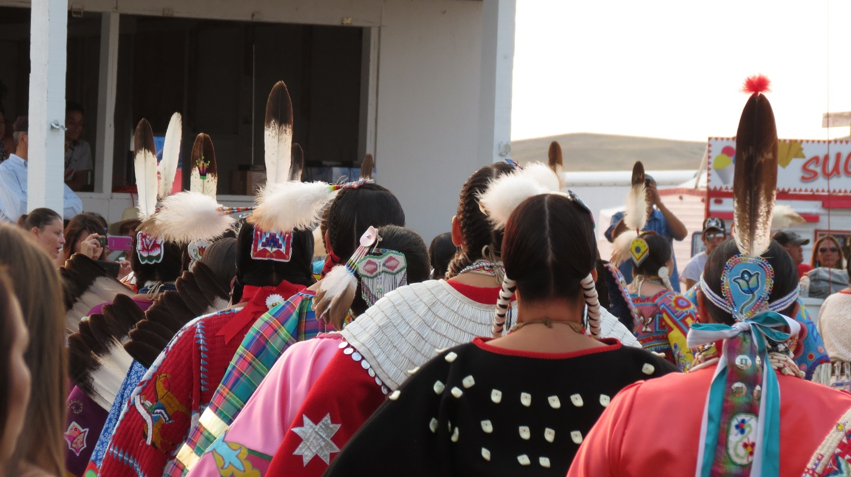
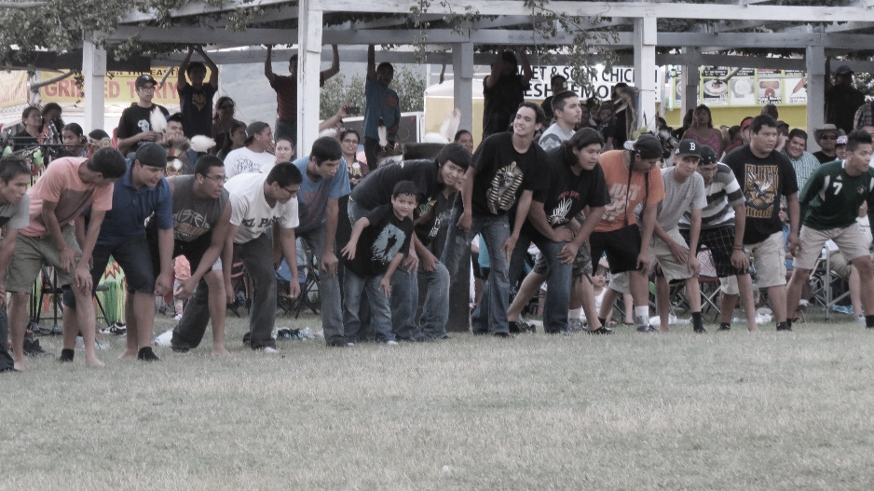
Sustainability –
PLACE

Slide 21
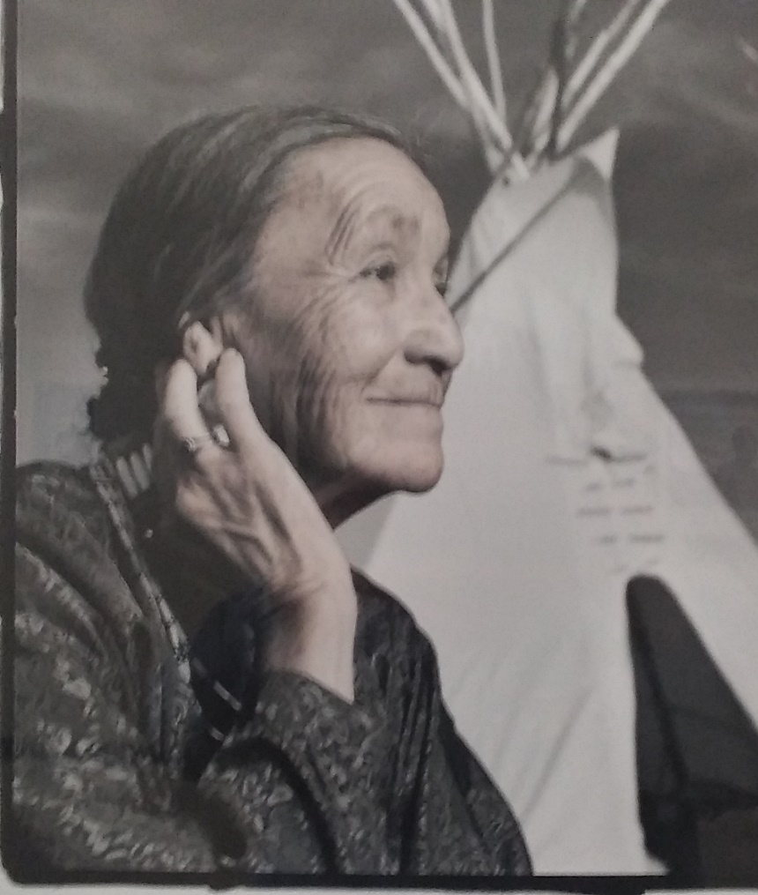
Sustainability - PEACE

