Slide 1
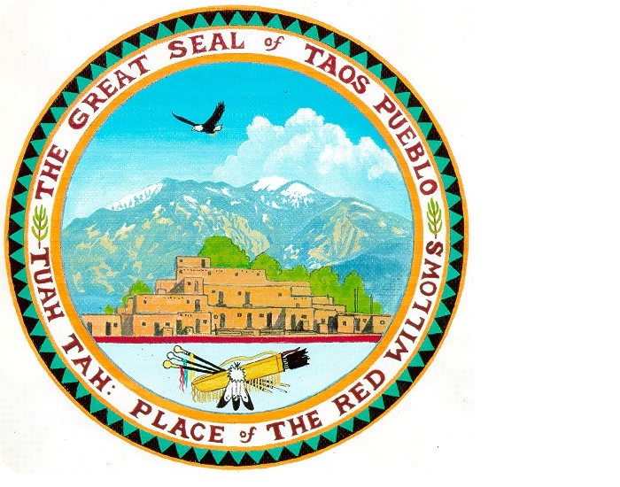

Slide 2
Welcome to the Great Southwest-Our Homeland!
19 Pueblo Nations in NM-one in Texas
3 Apache Nations in NM
Navajo-Dine Nation in NM, Arizona & Utah
2 Ute Nations in Colorado

Slide 3
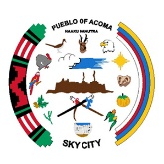



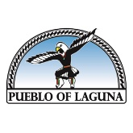
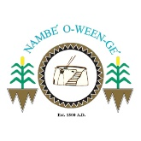
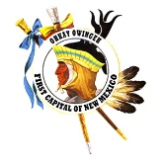

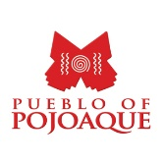





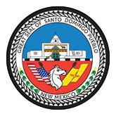
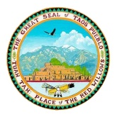


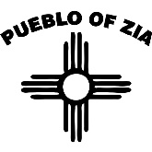
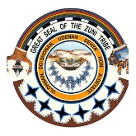

Twenty Pueblo Nations
United under All Pueblo Council of Governors

Slide 4

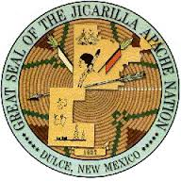

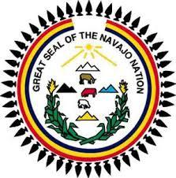
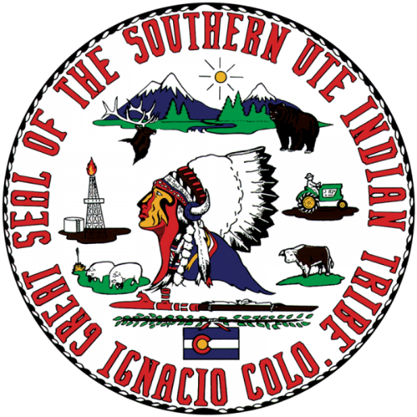
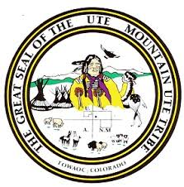

Slide 5
The Governing Canes
Pueblo Nations have canes presented by King Phillip of Spain in the 1600’s and by President Lincoln in the 1800’s
Canes given in recognition of our sovereignty and our right to our own governments
The canes are a symbol of our authority as tribal officials
Taos Pueblo has 6 Canes, including one from President Nixon in 1970.

Slide 6
My Home-Taos Pueblo
Time Immemorial Aboriginal Homeland
Tuahtah-Place of the Red Willows
A World Heritage Site-Recognized for enduring structures and living culture
Water from Blue Lake-our spiritual and physical nourishment

Slide 7
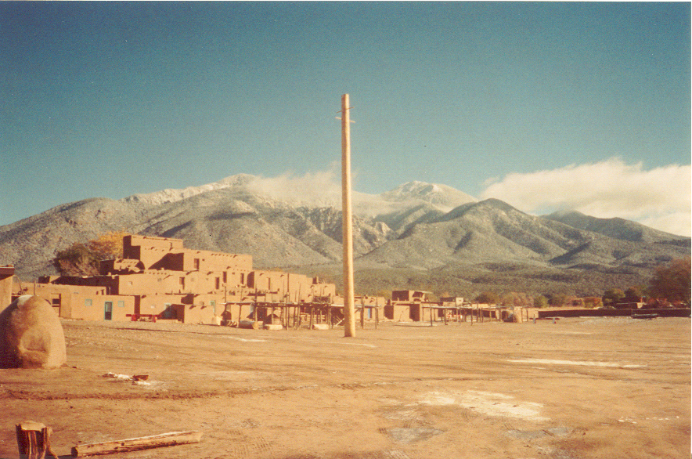

Slide 8
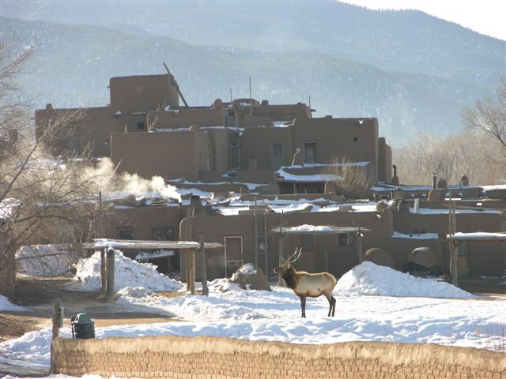

Slide 9
Taos Pueblo Government
Traditional unwritten system
Tribal Council: Policy making body; former tribal leadership officials and cultural leaders;
Governor and Staff: 10 Men; domestic, civil and external business affairs
War Chief and Staff: 12 men; Protectors and caretakers of lands and natural resources
Central Management System and other entities provide program support

Slide 10
Traditions and Culture
Complex culture; Activities year round
The People, Land, Places, Water, Crops, Wild plants, Birds, Animals, Seasons, Heavenly bodies, all have a role and place in the culture
Christianity: St. Jerome Catholic Church
All this as a whole gives us our cultural identity.

Slide 11
Taos Pueblo’s Role-the birth of Self Determination
1970-Taos Pueblo was fighting for return of Blue Lake Land
The Taos Pueblo Delegation was summoned to White House for a meeting with President Nixon on July 8, 1970
The President announce a new policy direction for American Indians
It was the birth of Self Determination that has evolved into Self Governance

Slide 13
Cornerstone of the New Indian Policy
The President announced his support for return of Blue Lake to Taos Pueblo
He said the return of Blue Lake would be the “tangible” example of the new Indian Policy and called it the Cornerstone of that policy;
“…an important symbol of this government's responsiveness to the just grievances of the American Indians.”

Slide 14
The Return of Blue Lake
July 8, 1970: President Nixon endorsed Taos Pueblo’s Blue Lake Bill
December 5, 1970: President Nixon signed Blue Lake Bill into Law
Congress passed the Indian Self-Determination and Education Assistance Act in 1975

Slide 15
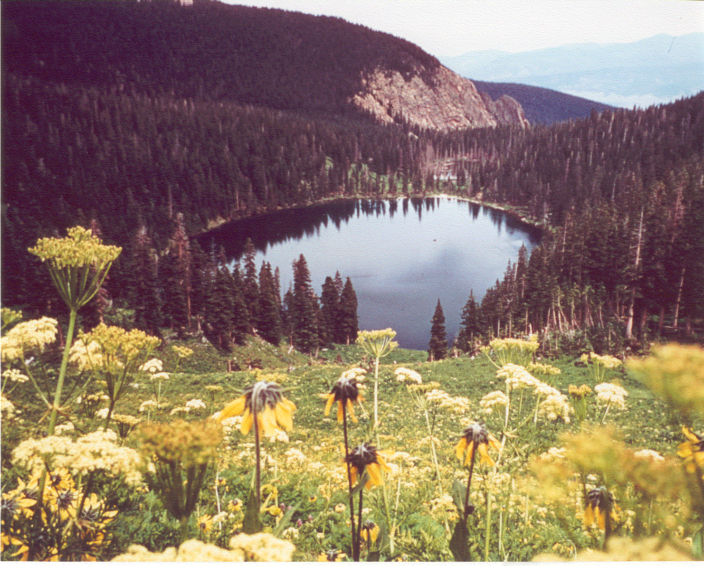
Blue Lake

Slide 17
Thank you
Gilbert Suazo Sr.
Kallquina - Standing Wolf

