Slide 1
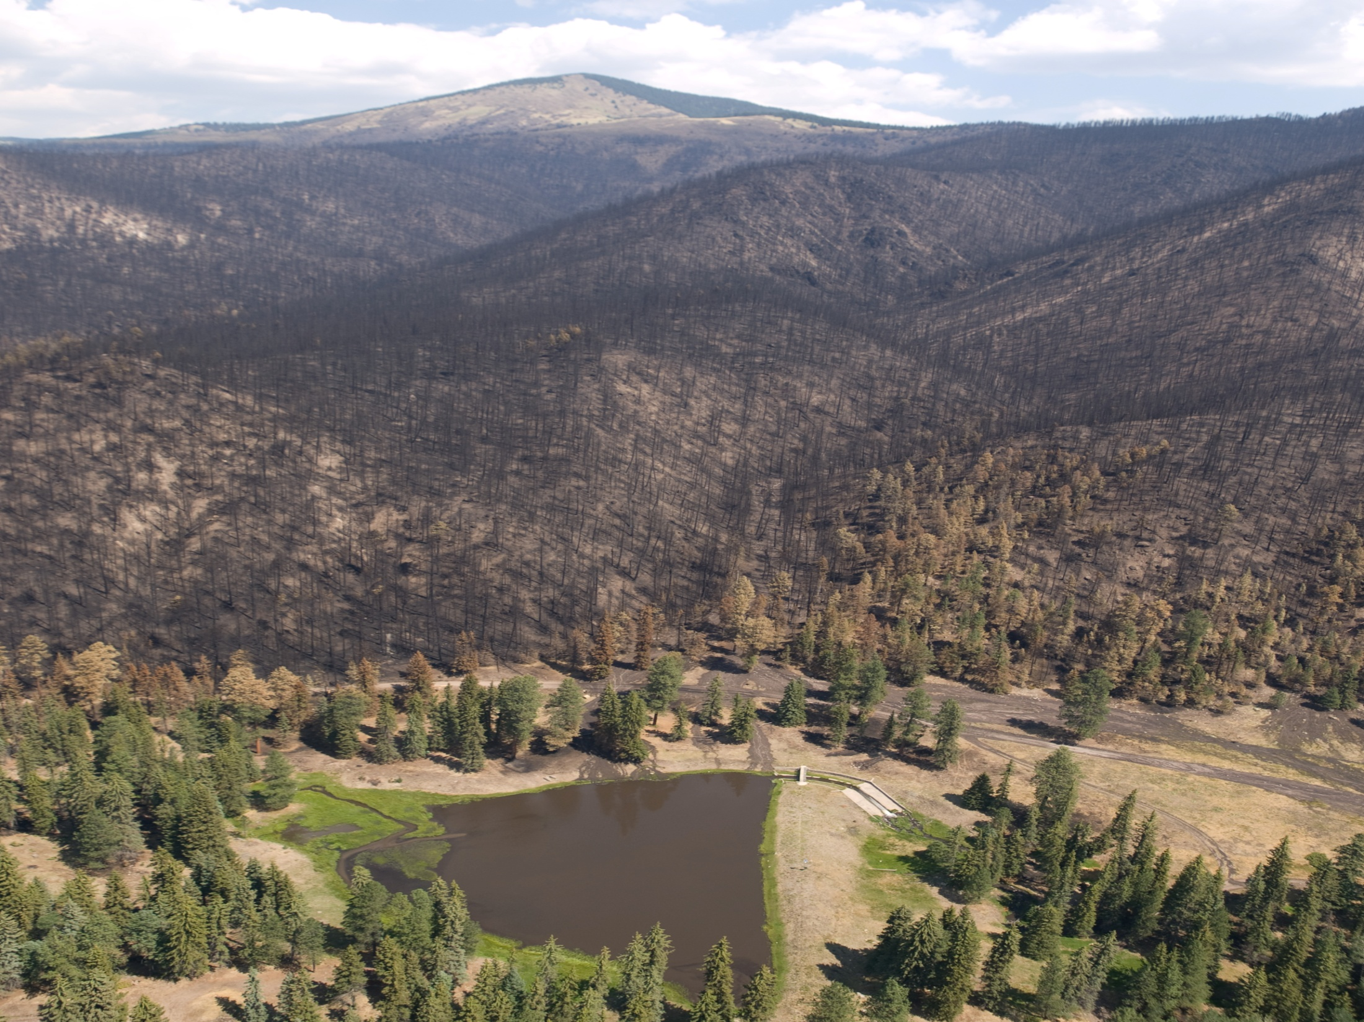
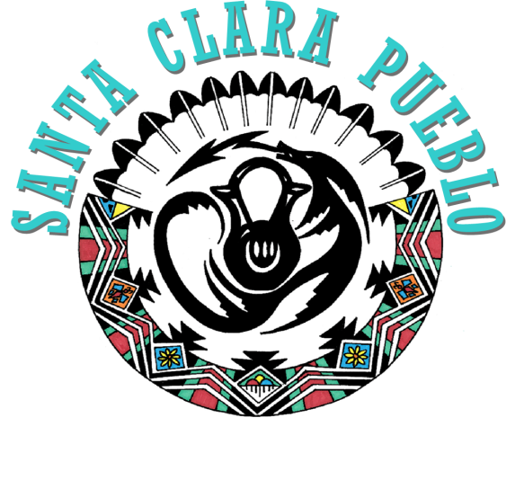
Tribal Collaboration & Partnership
Presented by:
J. Michael Chavarria, Governor
Santa Clara Pueblo

Slide 2
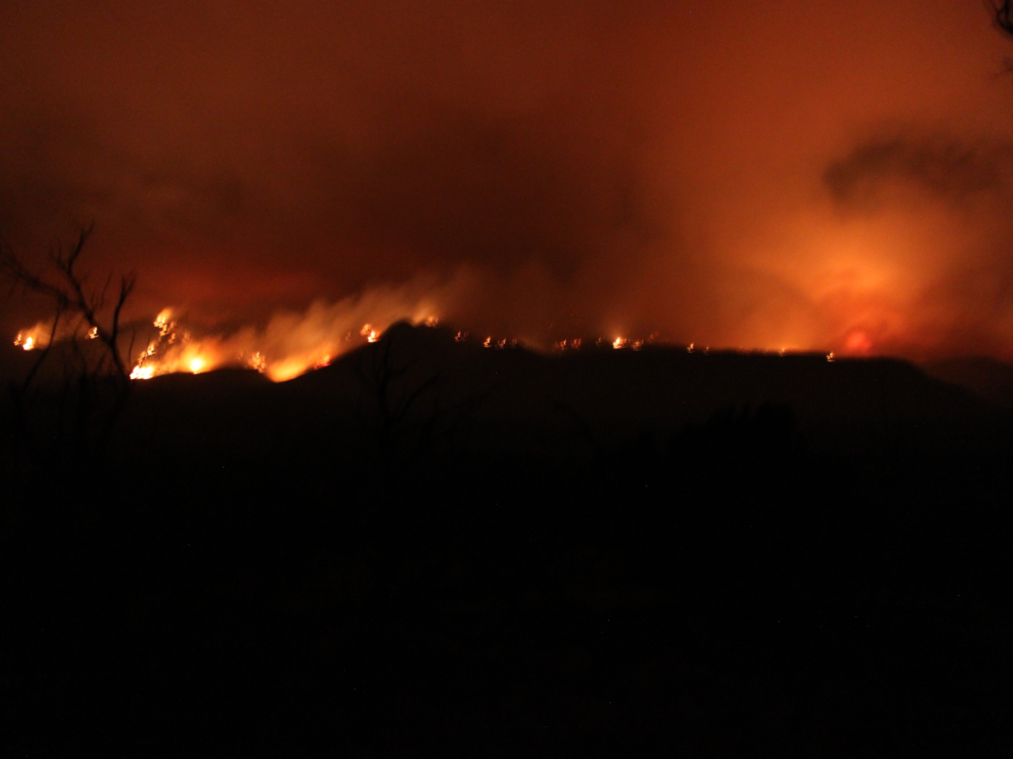
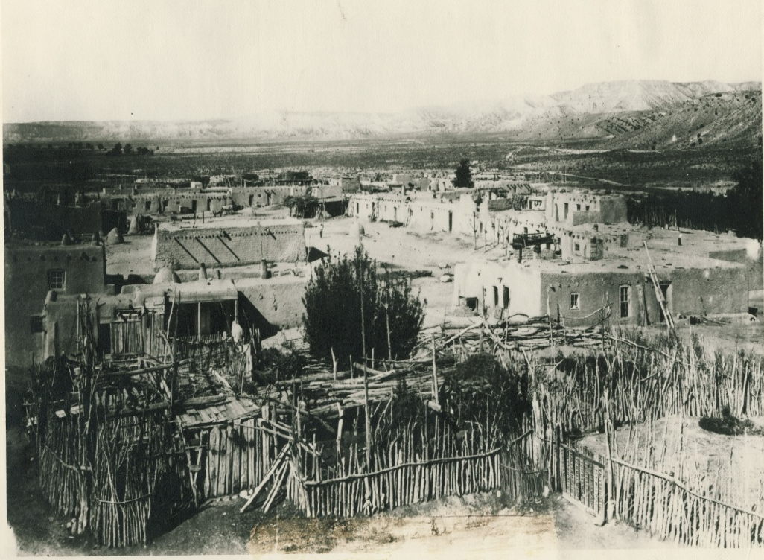
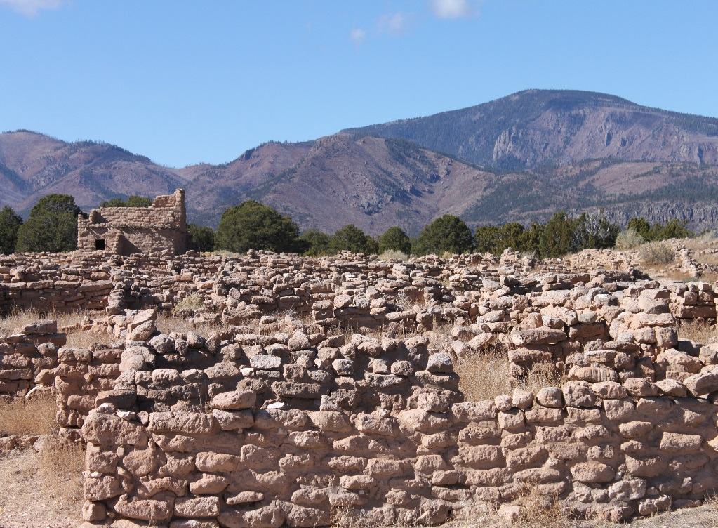
History of Santa Clara Pueblo
  Kha’p’o (Place of Wild Roses) Santa Clara Pueblo is one the oldest occupied settlements in the United States.
  Having been in our present location since time immemorial.
  Prior to our present location our Santa Clara people lived at our ancestral village of Puje.

Slide 3
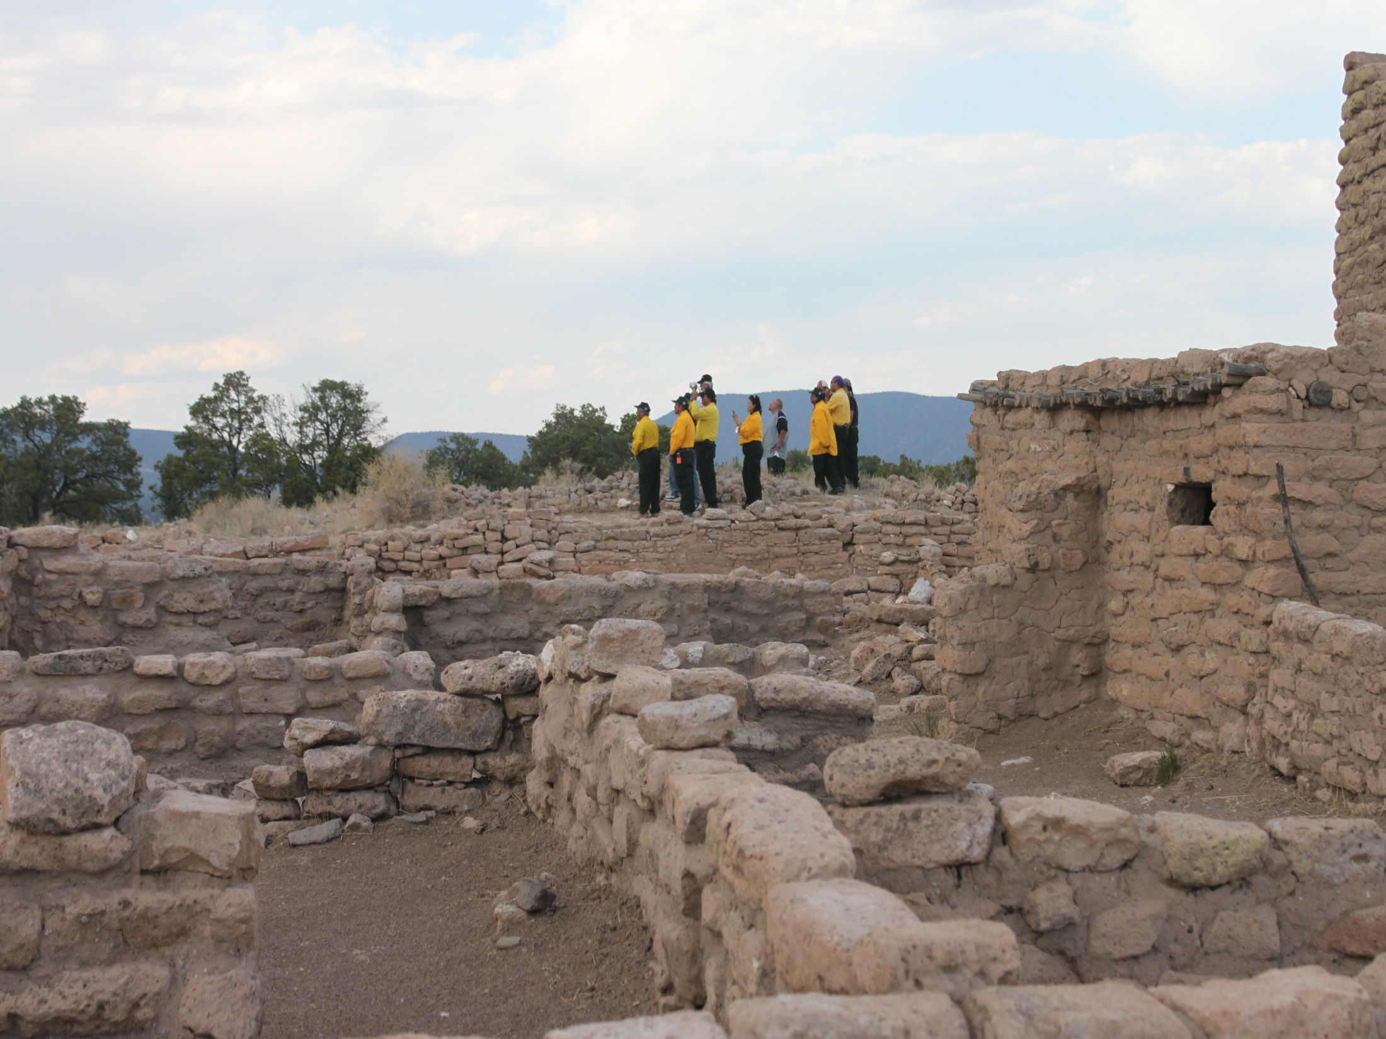
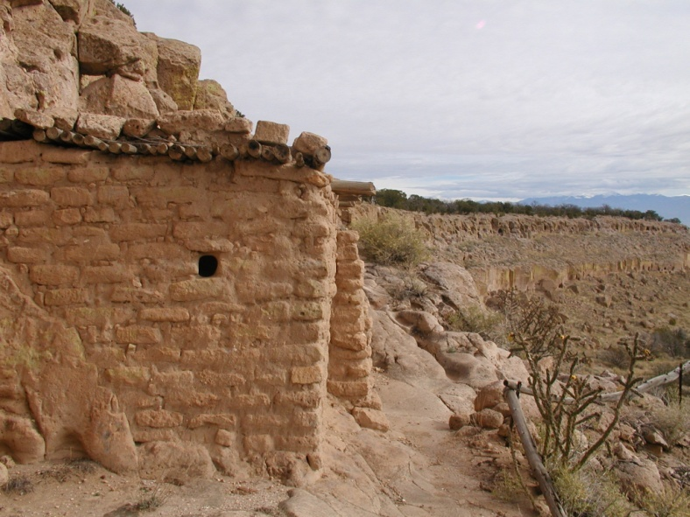
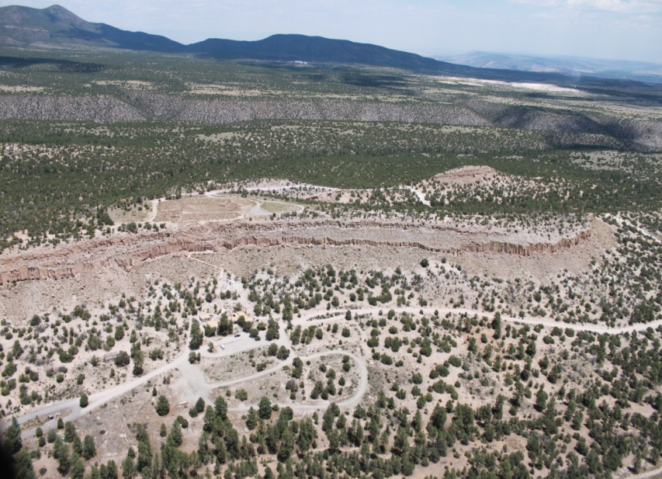
The village of Puje -(Where the Rabbits Gather) was carved out of soft volcanic tuff into cliff dwelling areas.
Santa Clara Pueblo is one of six Tewa speaking Pueblo’s in the State of New Mexico

Slide 4
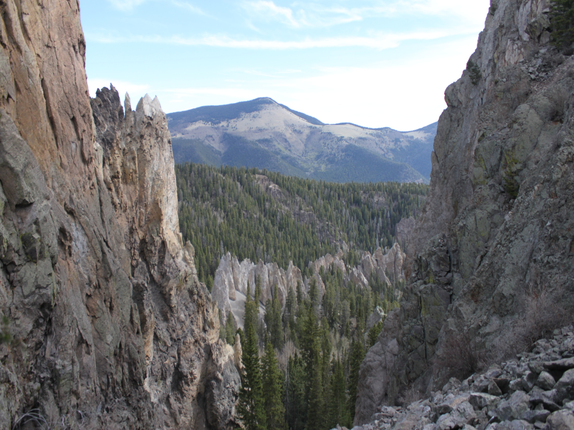
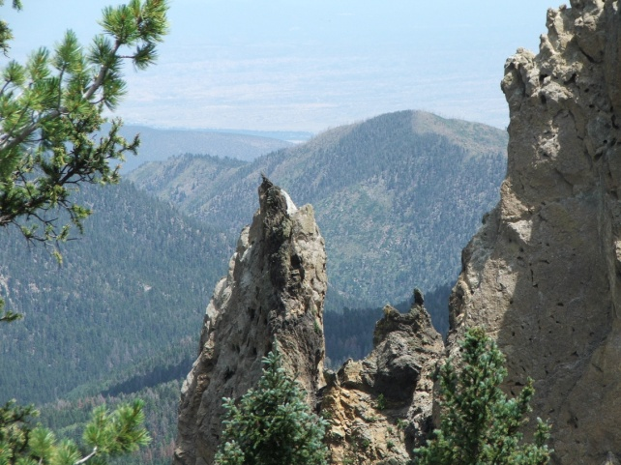
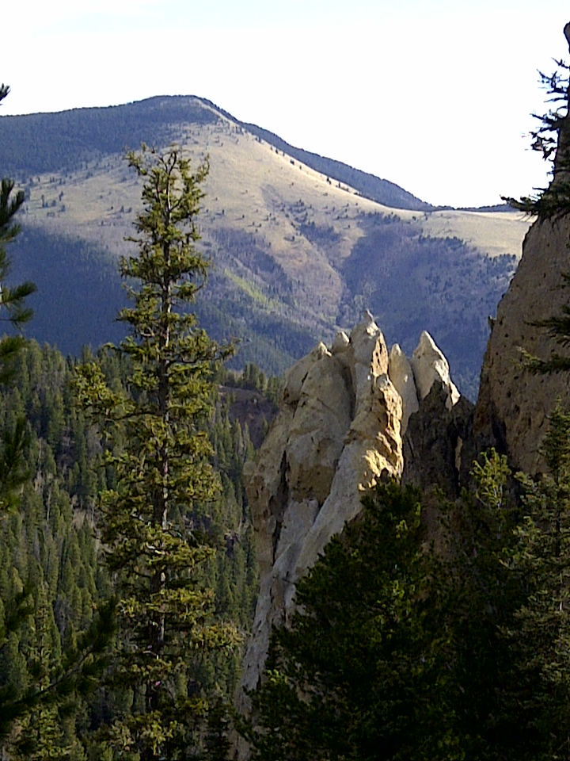
Like most other Tribes in the United States, Santa Clara has lost much of our aboriginal lands to other governments and settlements.
Santa Clara Pueblo has coexisted with the rule of three governments (Spain, Mexico, and the United States)

Slide 5
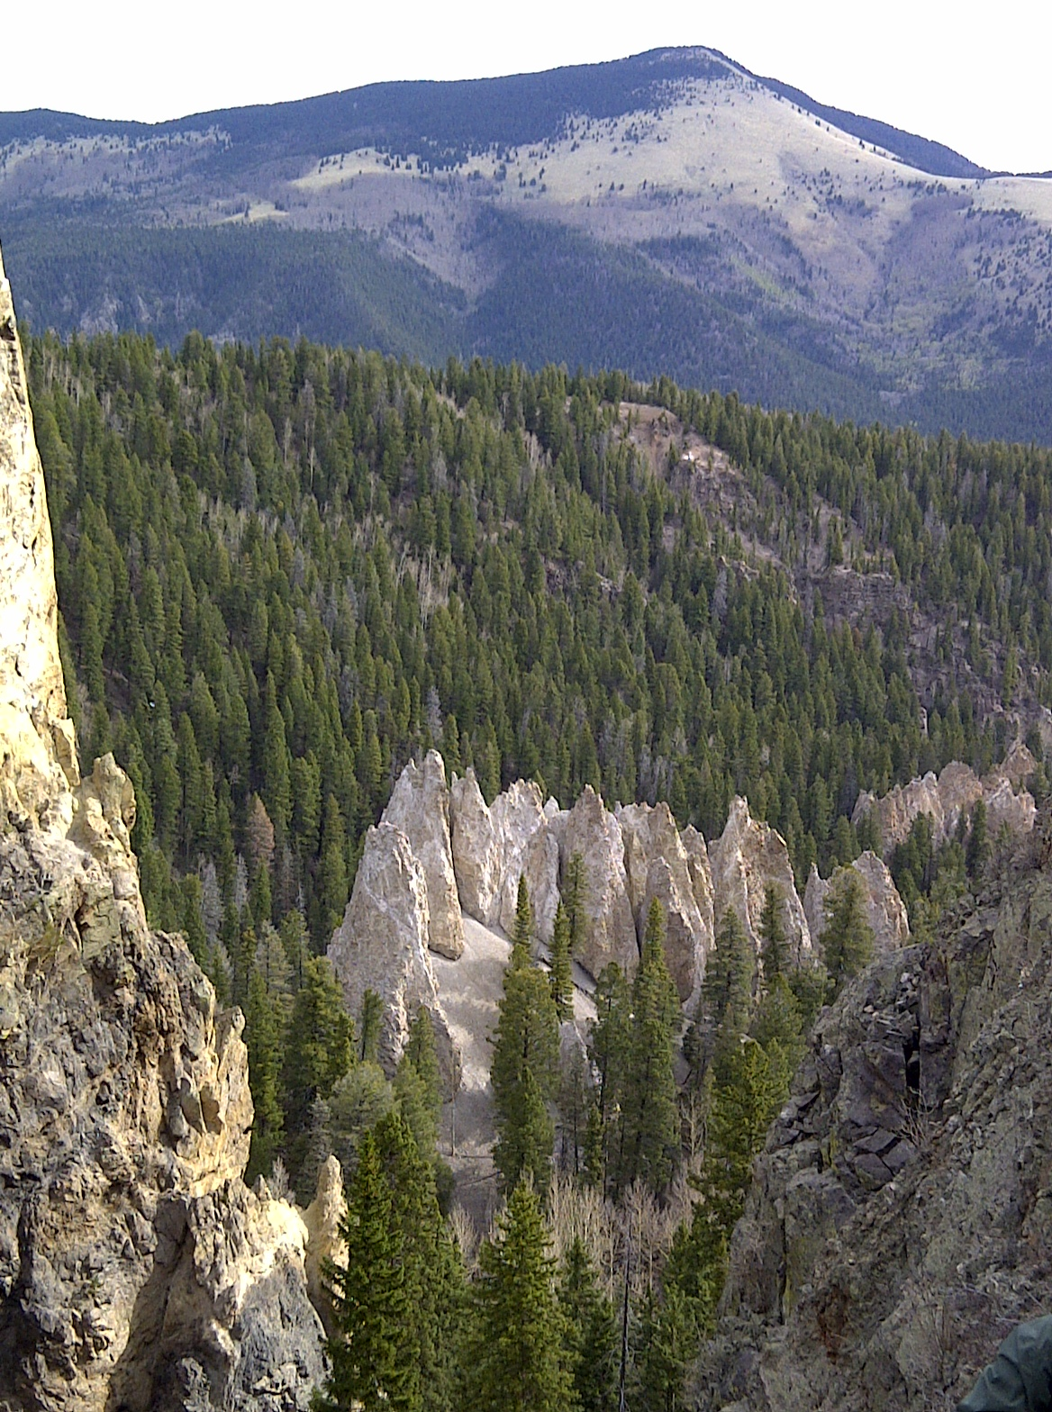
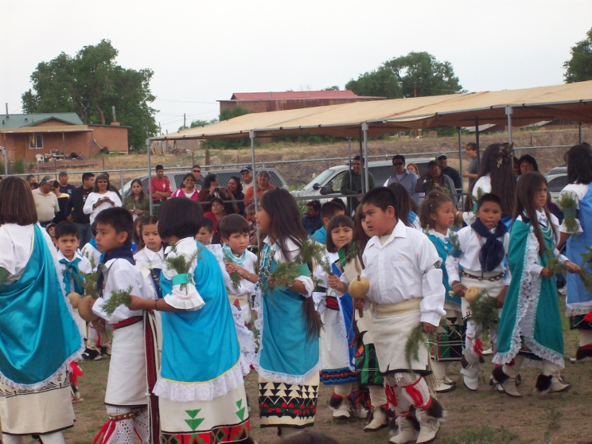

Our cultures and traditions have strongly survived over the years and continue to be passed down from generation to generation.
We are also well known for our pottery making ability and many of our artists are well known world wide.

Slide 6
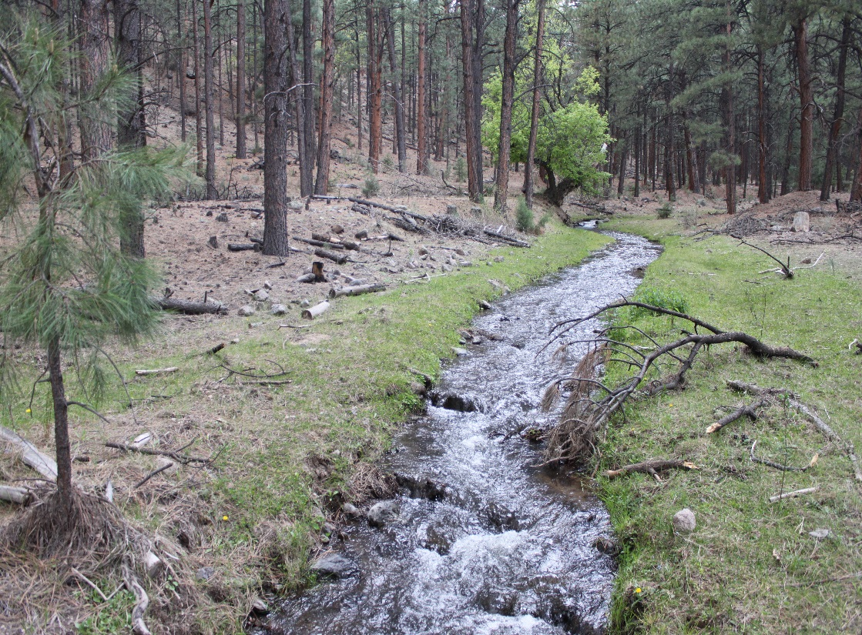
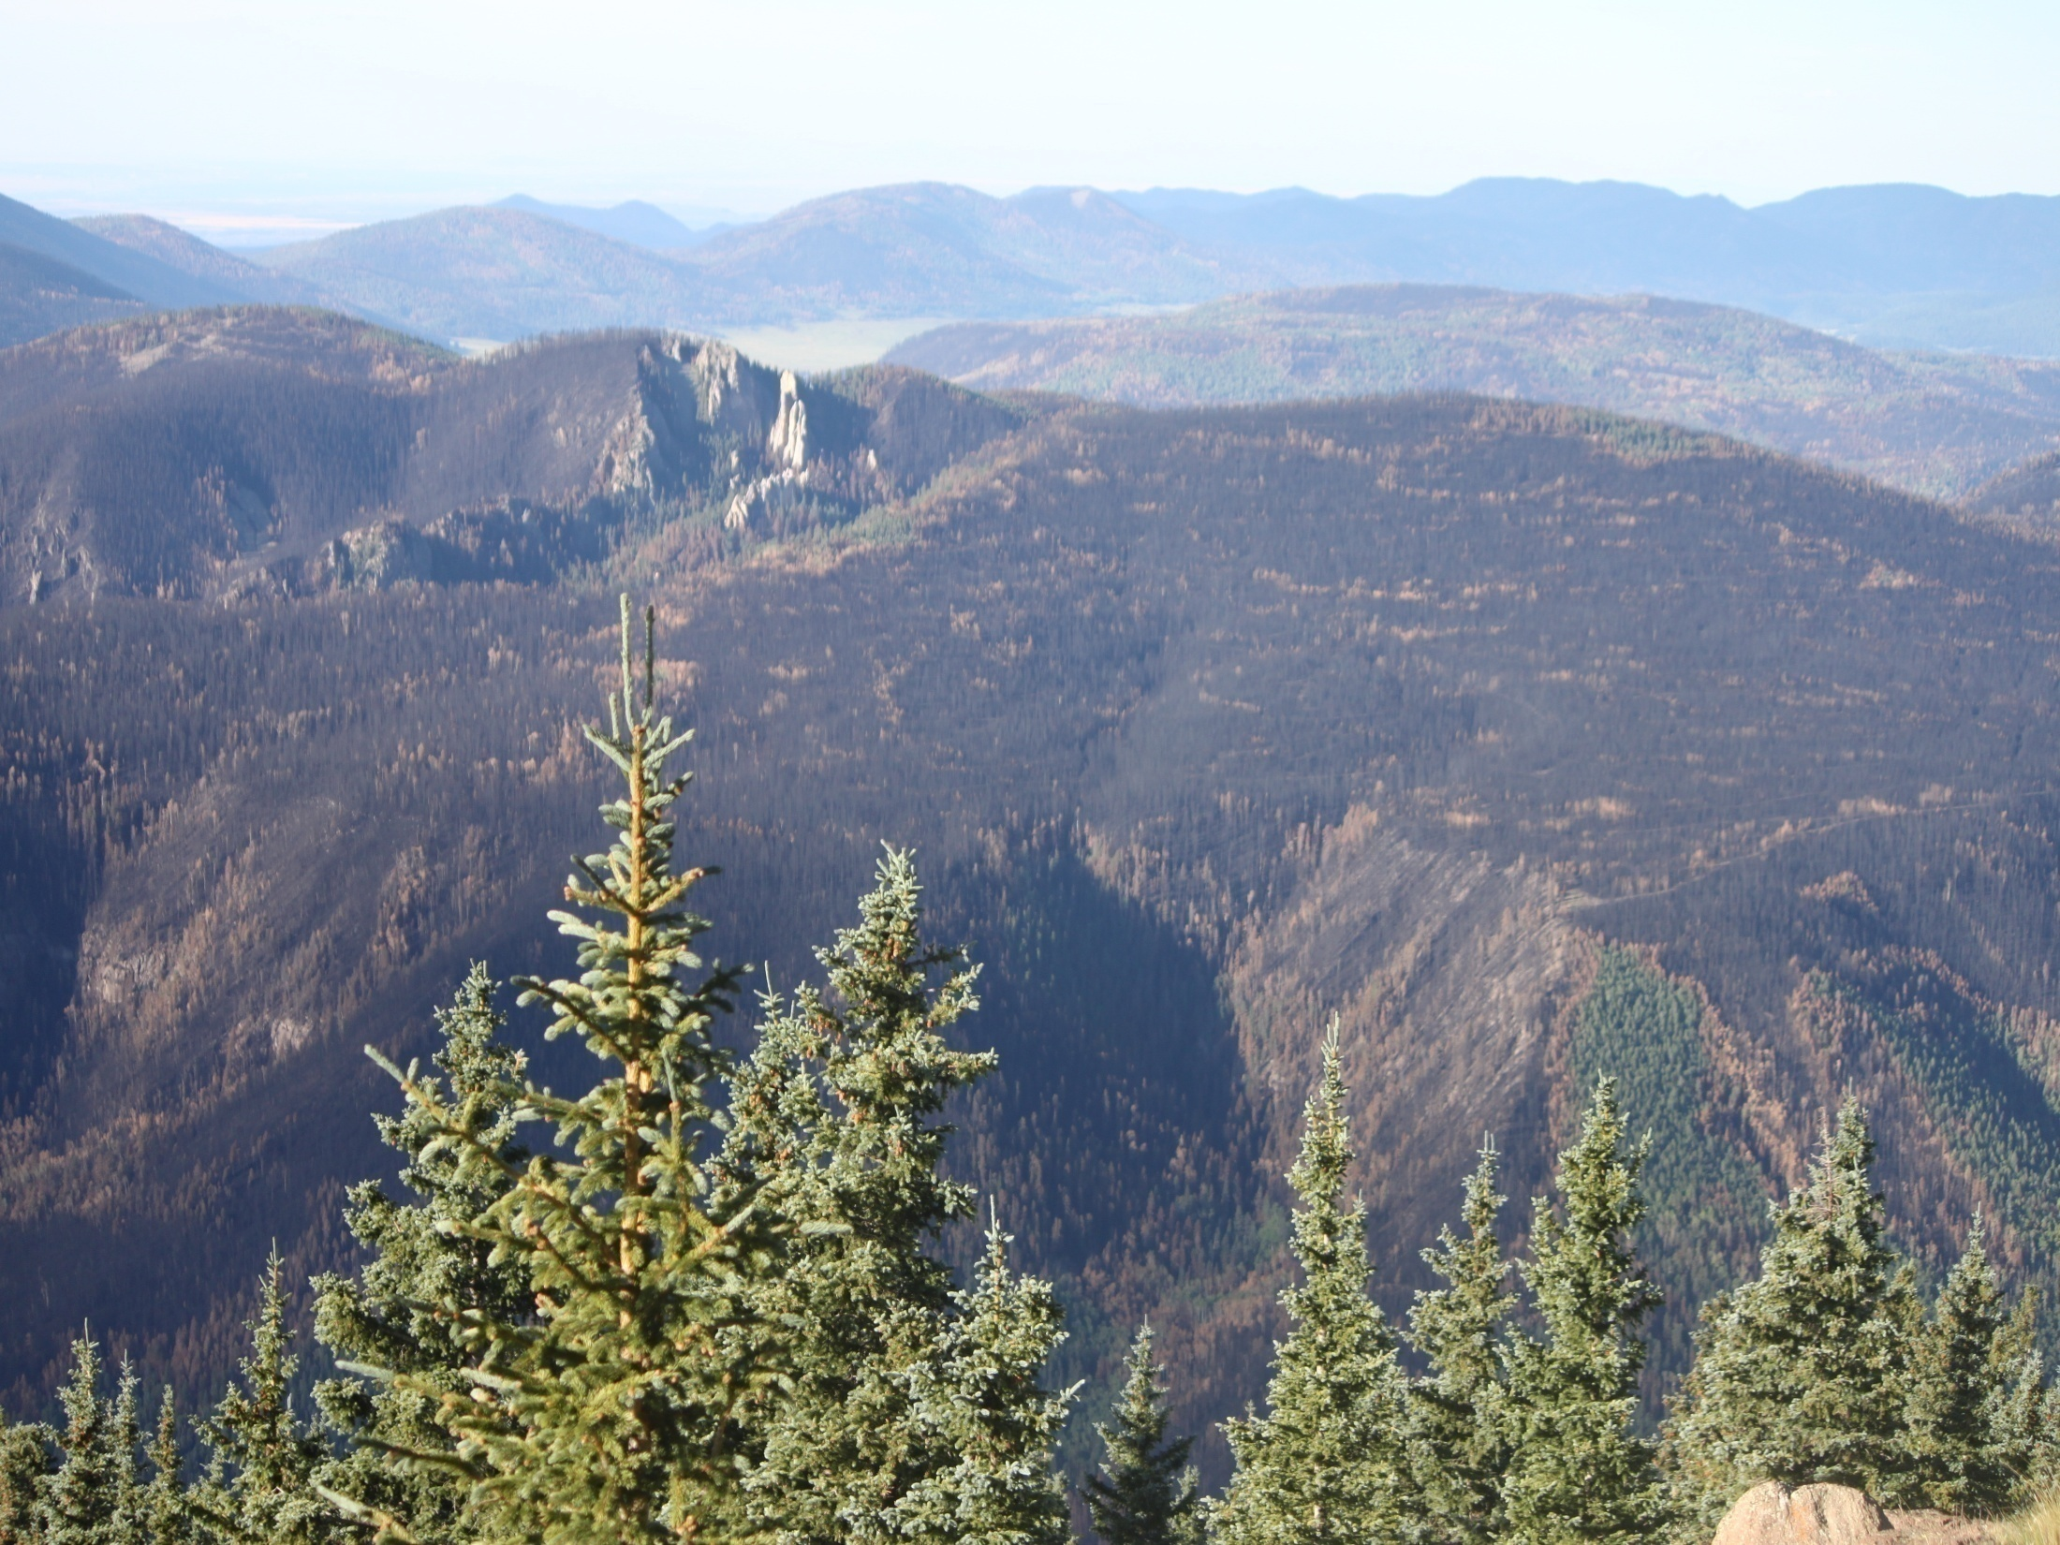
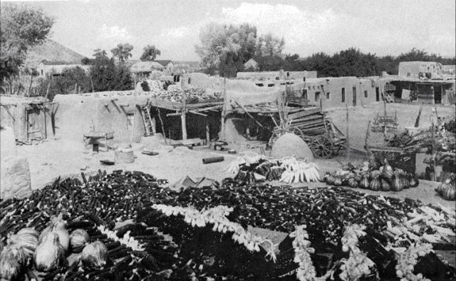
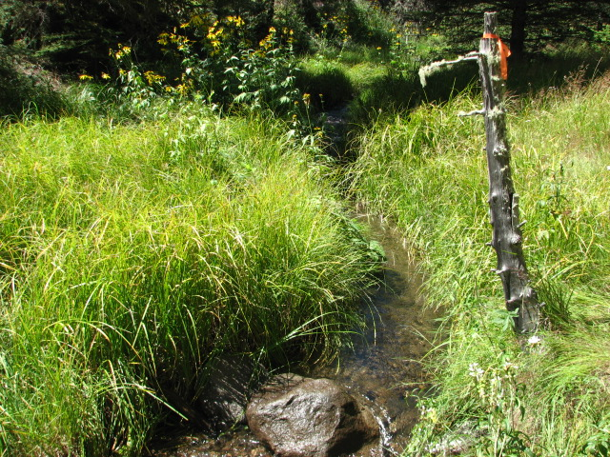
Our culture and people are very dependent on our lands and we use our lands for hunting, fishing, gathering food, gathering medicinal plants, agriculture, and as a spiritual sanctuary.

Slide 7
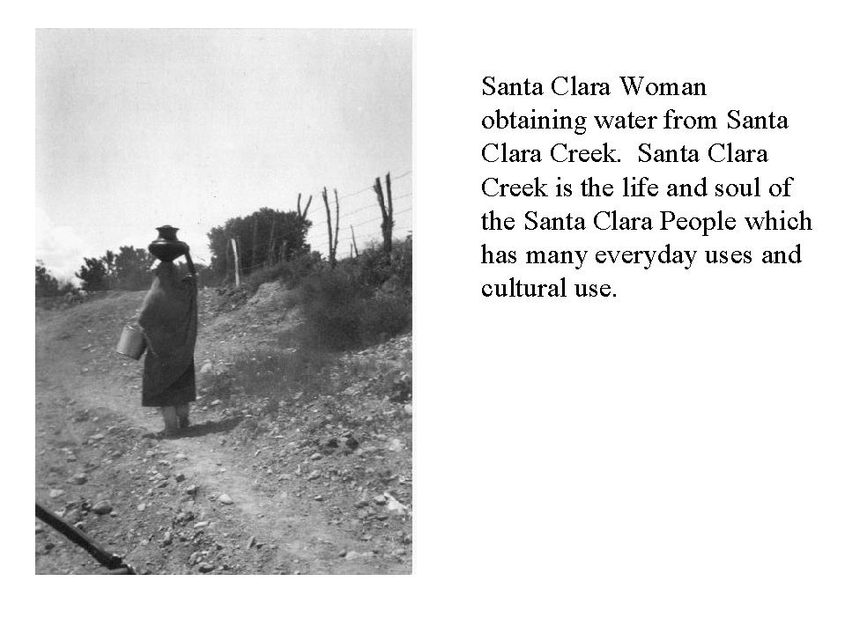

Slide 8
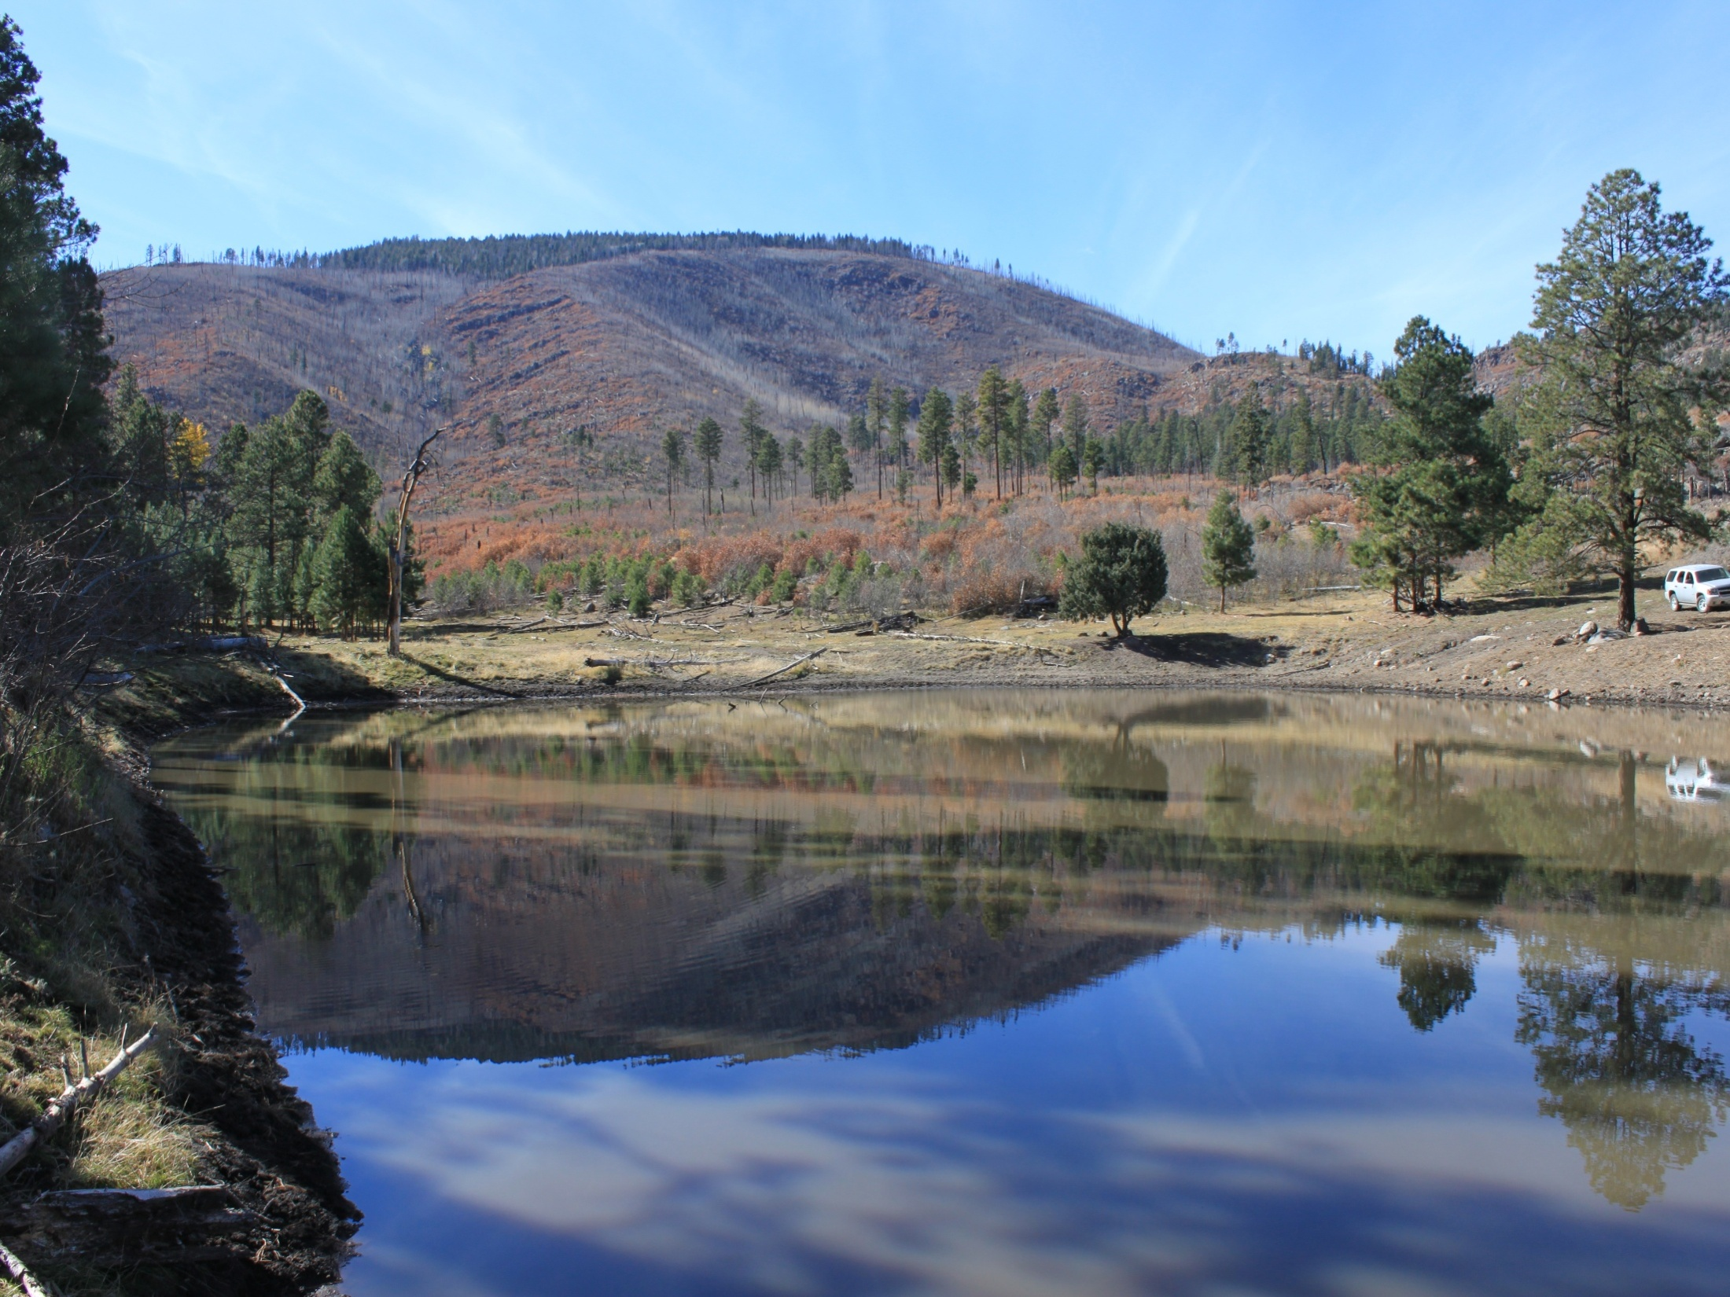
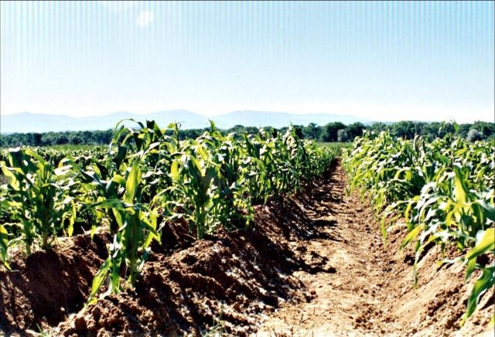
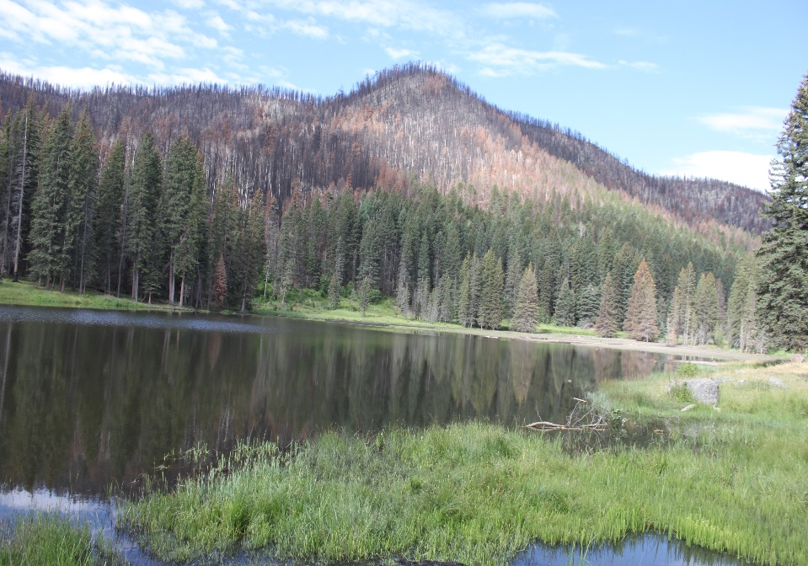
SANTA CLARA PUEBLO WATER QUALITY STANDARDS
Approved Code by EPA in 1995 for all waters within the exterior boundaries of SCIR.. To protect the chemical, physical and biological integrity of tribal waters.
The code designates the existing and attainable uses
Prescribes WQS narrative and numeric
Assure degradation of existing H2O quality doesn’t occur
Promote health, social welfare and economic well-being of the Pueblo, its people, and all residents of the Pueblo.
Notes:
8

Slide 9
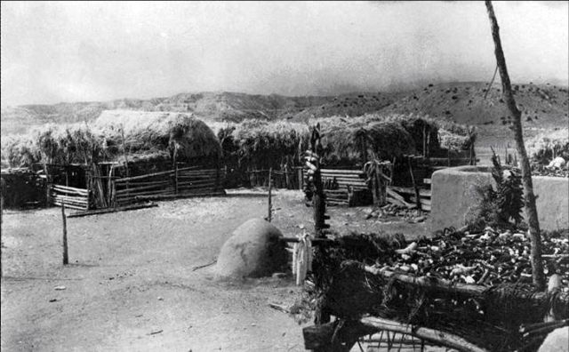
Self-Governance

Slide 10
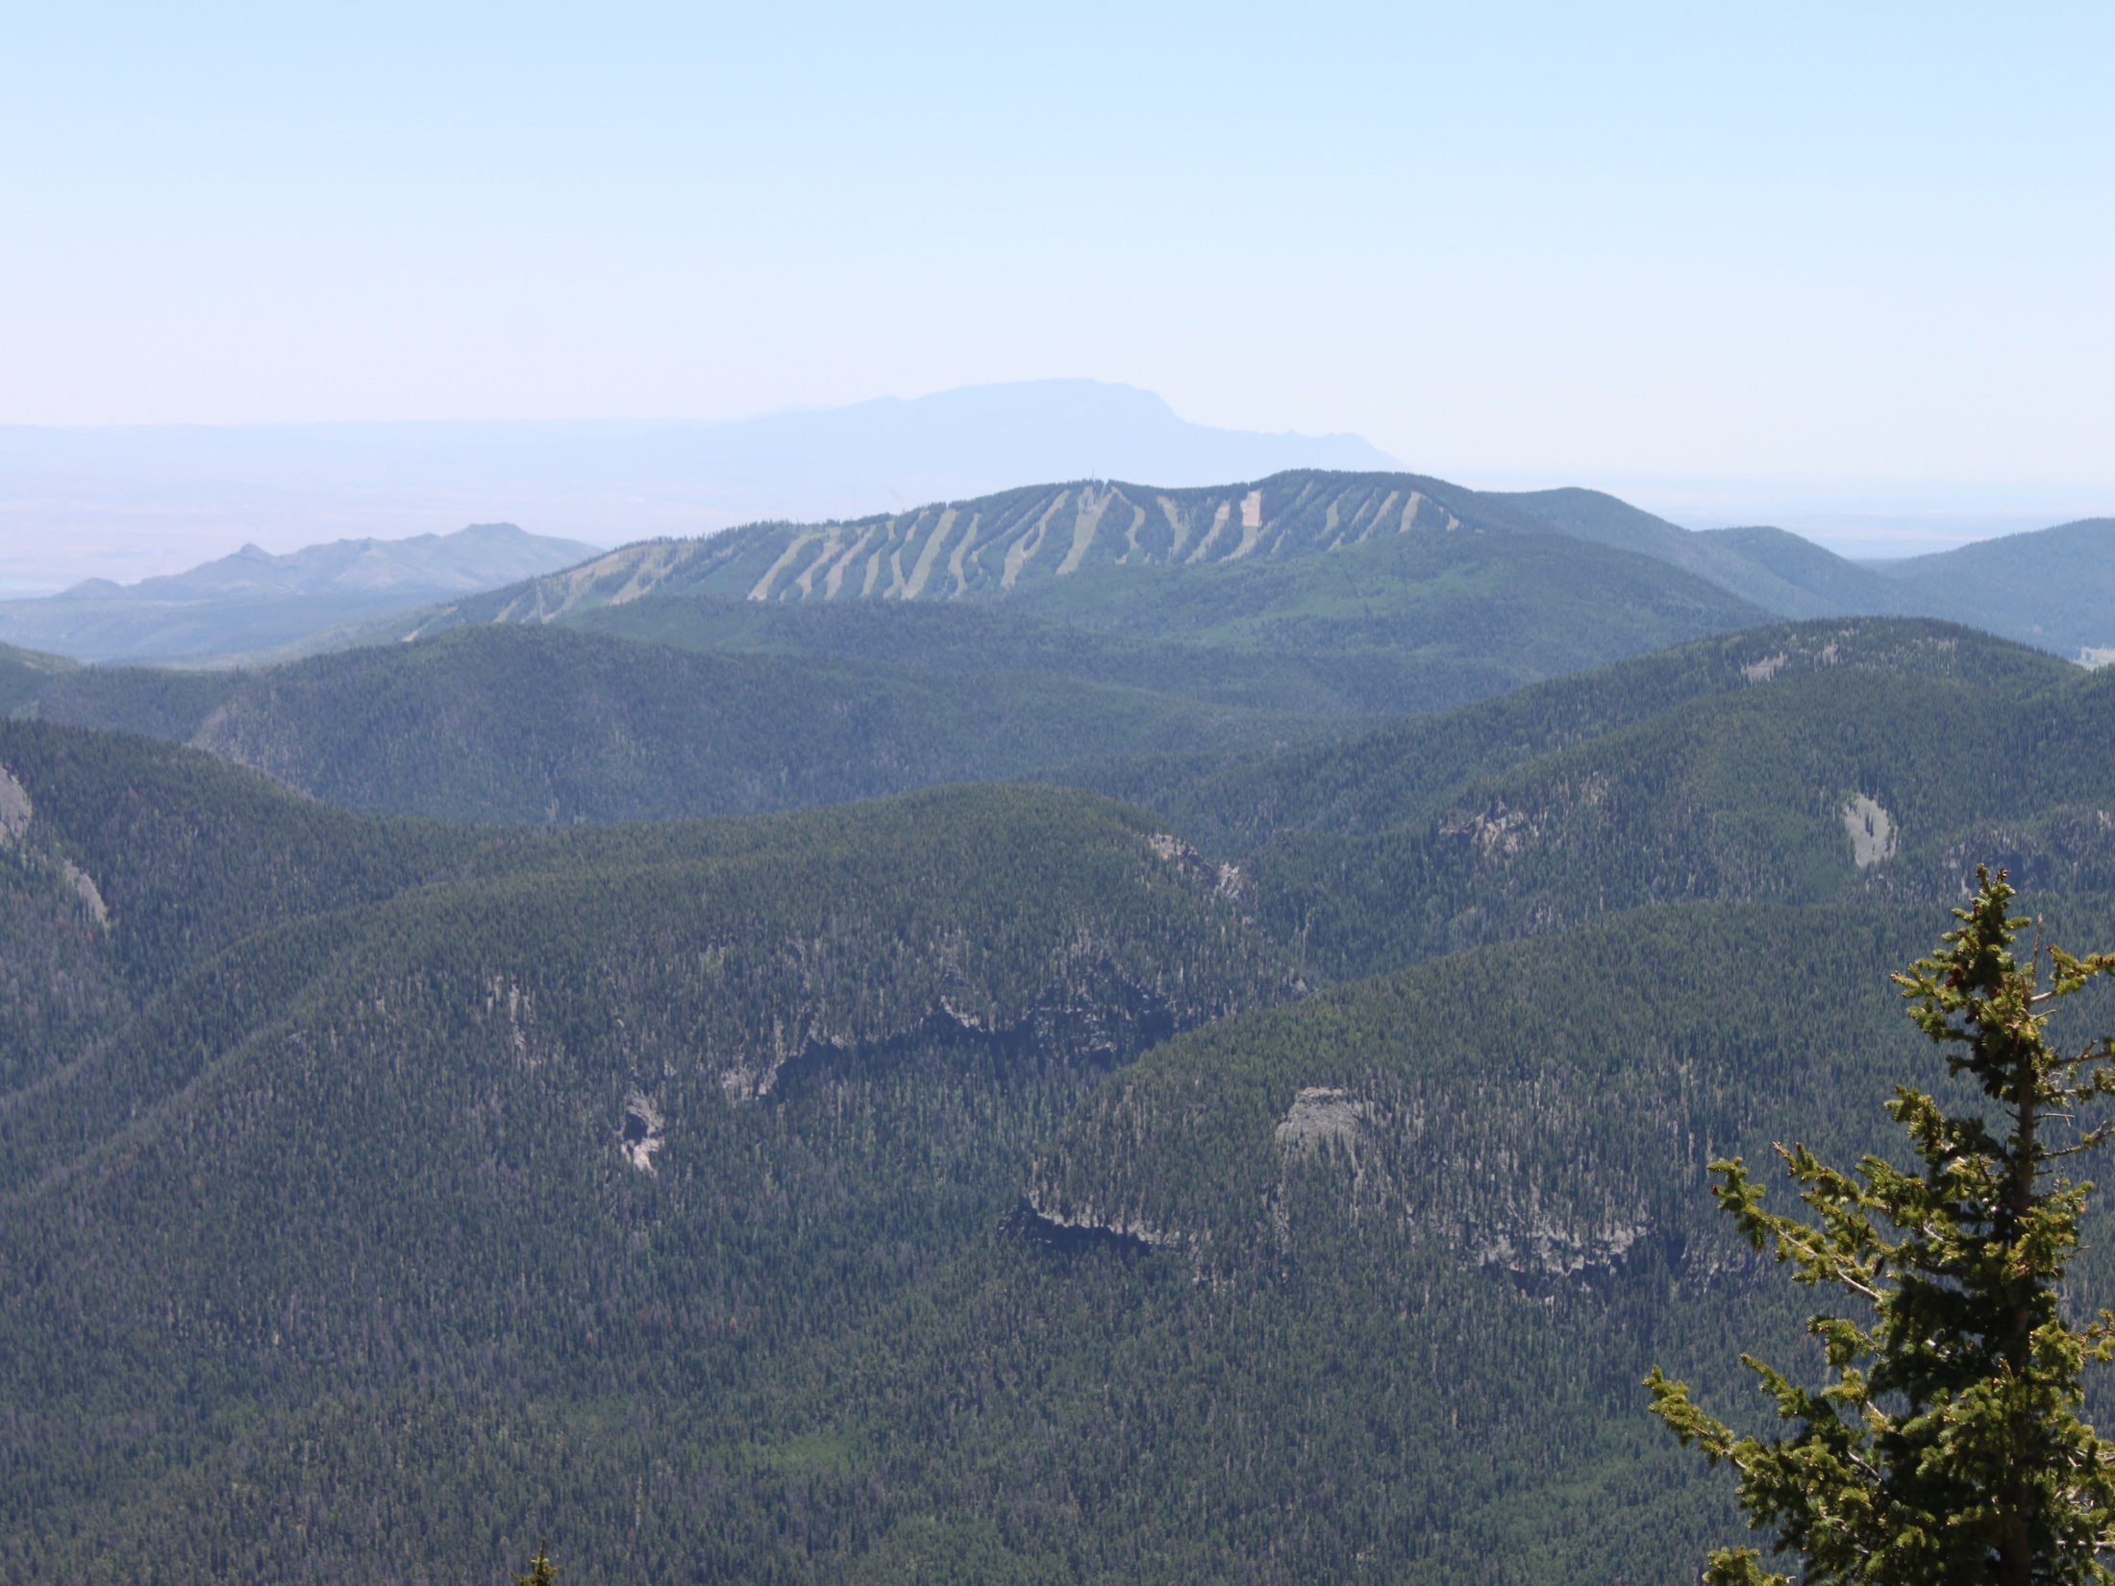
History of Santa Clara Forestry
Historically Santa Clara did not have a forest management department until 2000
Oso Complex Fire of 1998 burned 1,500+ acres of forested land on Santa Clara
Cerro Grande Fire of 2000 burned over 6,700+ acres of forest at Santa Clara
After fires Santa Clara made enormous efforts to get funding to start managing their forest resources
Currently SCP has compacted Forest Development, Forest Management, and Fire Preparedness.

Slide 11
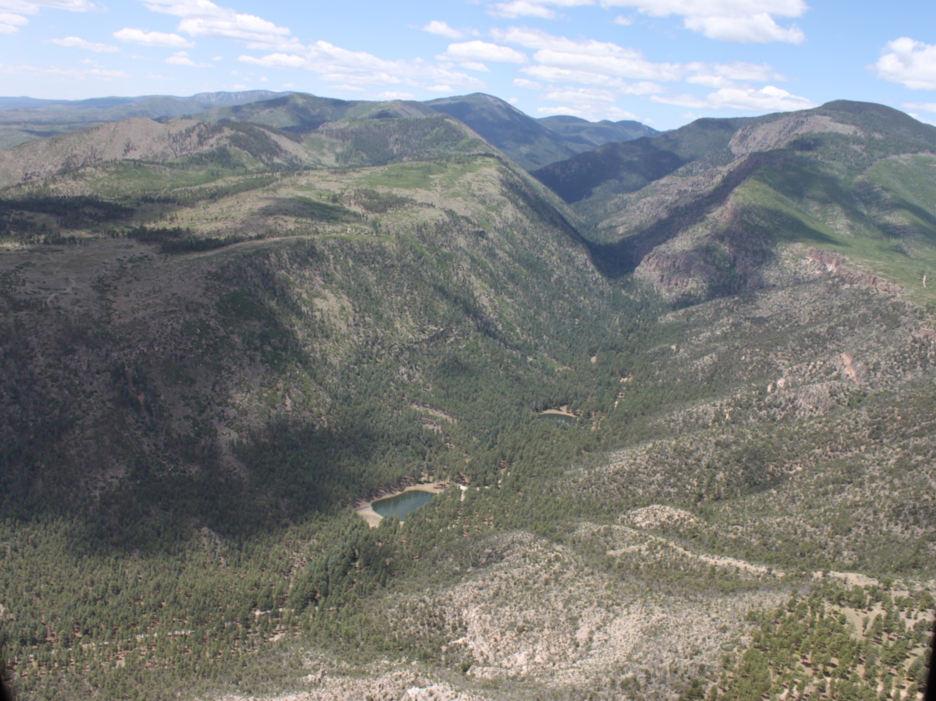
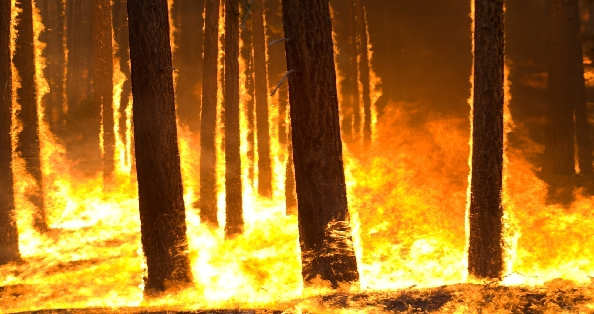
Cerro Grande Fire 2000 6,700 acres
OSO Fire 1998 1,500 acres
Las Conchas Fire 2011
15,516 acres

Slide 12
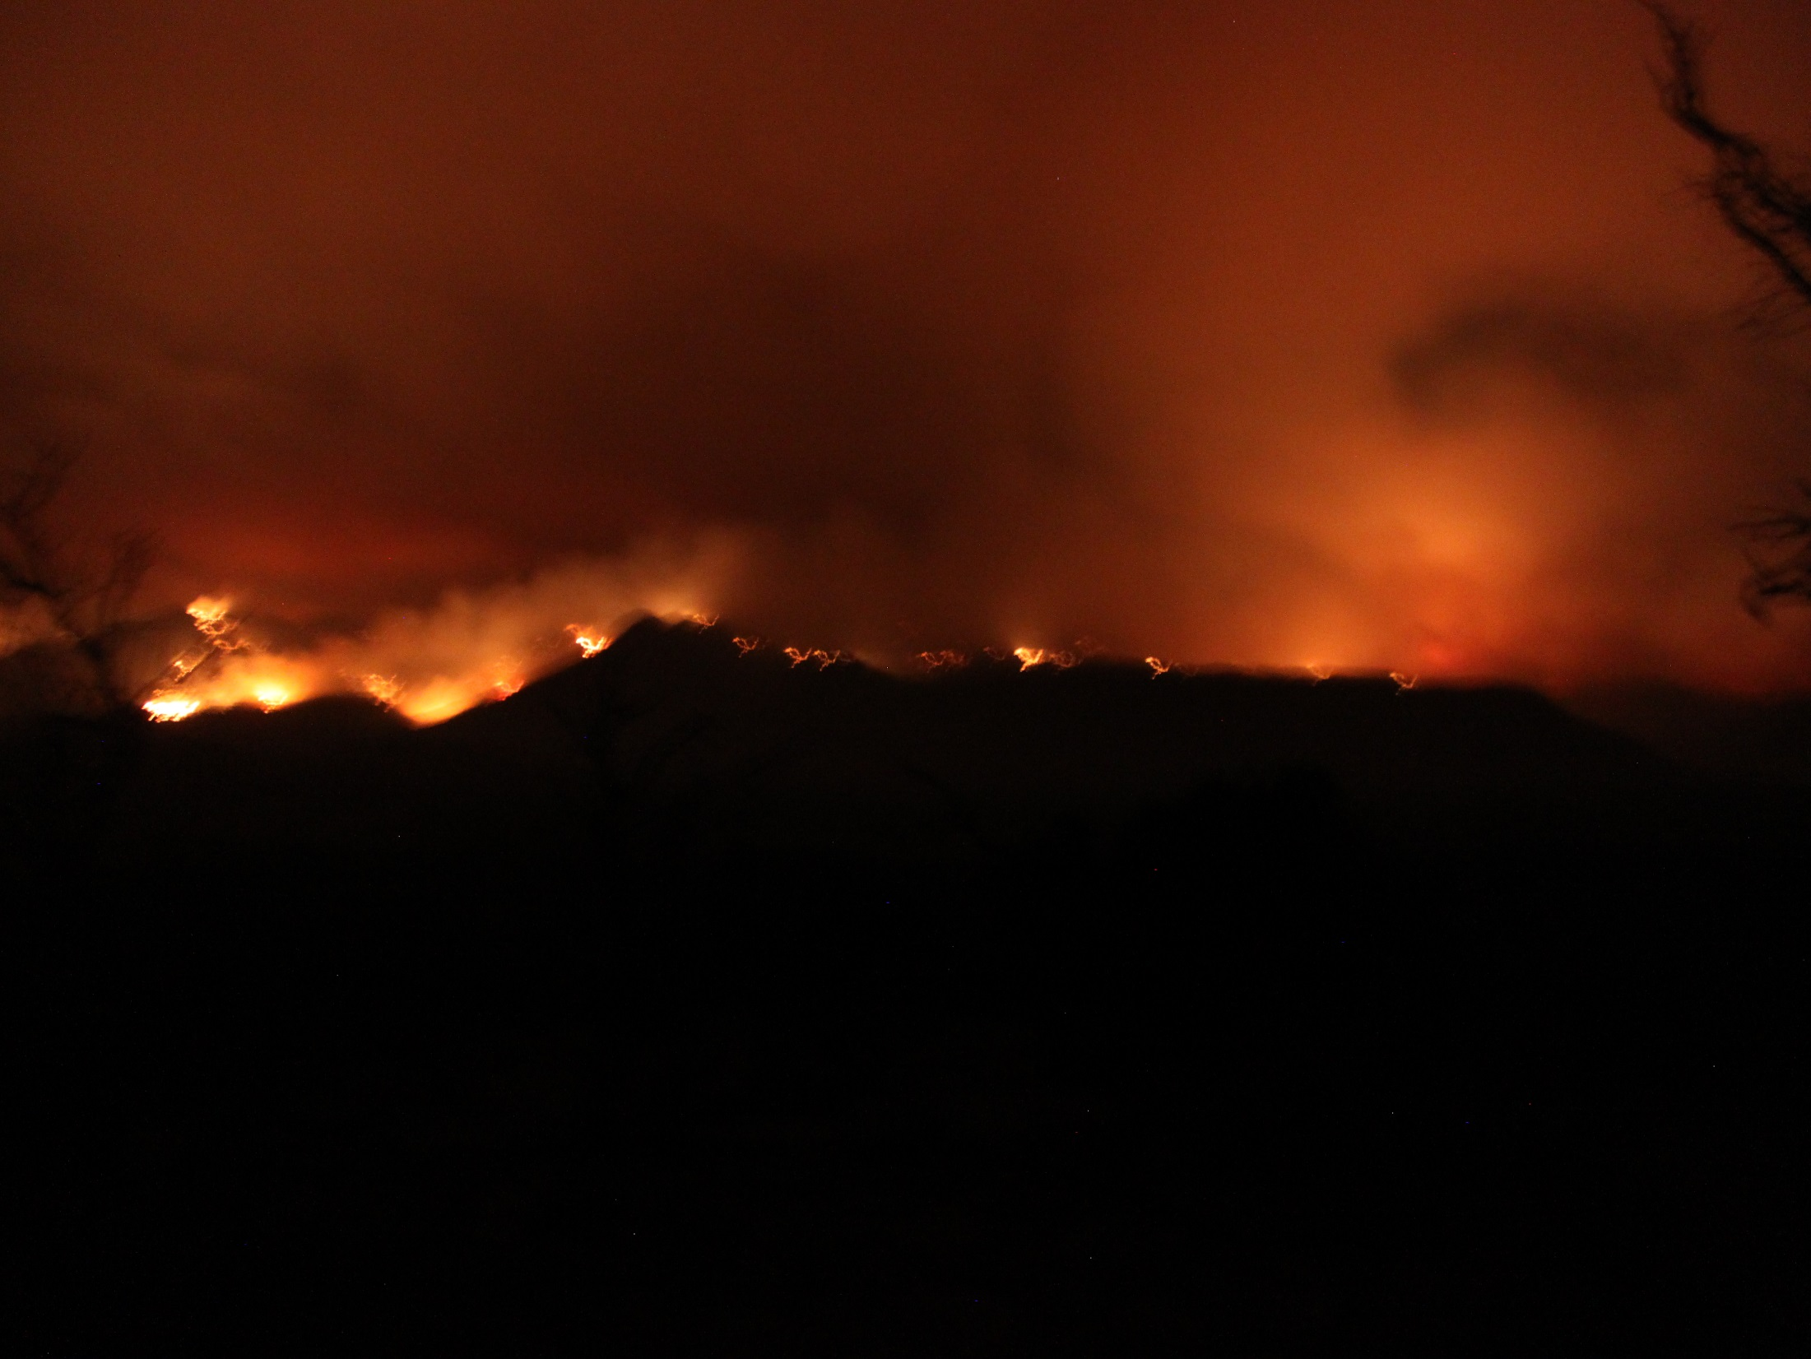
FIRE FACTS
Total Las Conchas Burn Area 2011 = 156,600 acres
First Day: 40,000 acres
First 2 Days: 60,000 acres
Burn Rate (peak est.): 1 acre/second
Santa Clara Canyon
Total Burn Area: 15,516 acres
Santa Clara Creek Watershed Area: 31,400 acres
Entered Watershed: June 29, 2011
Burn Area of Watershed: 14,700 acres
Roughly 50% of Entire Watershed Impacted

Slide 13
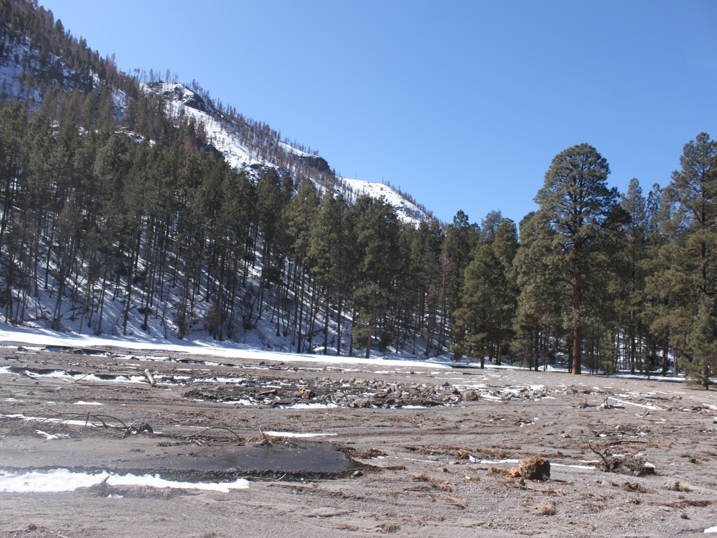
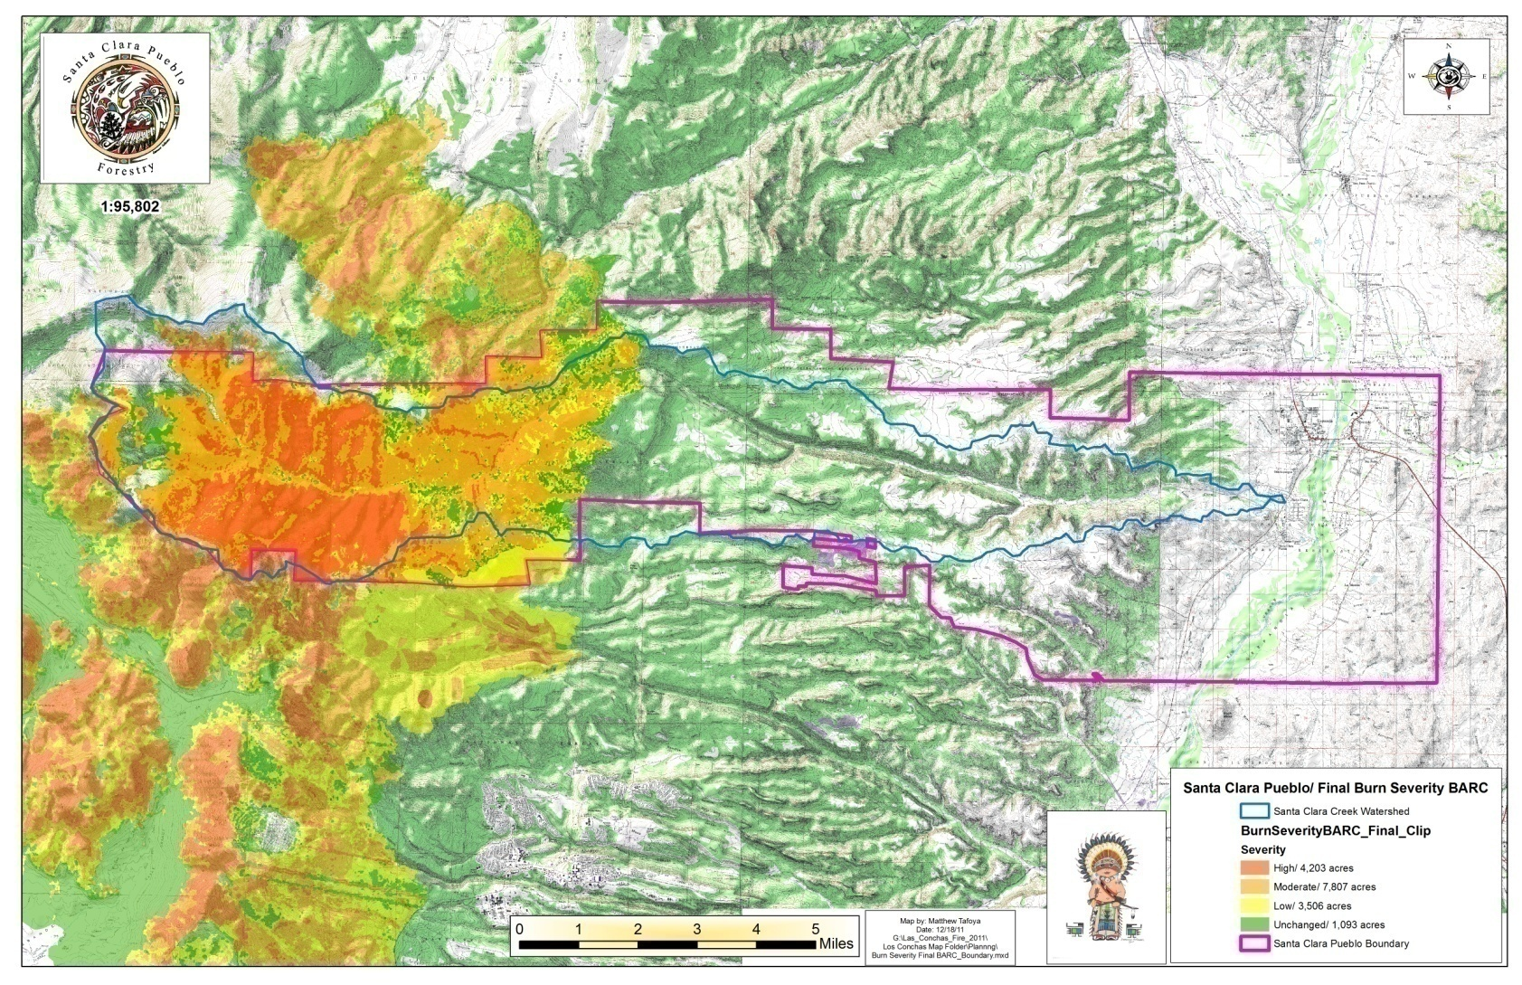
BURN AREA STATISTICS
High Burn Area= Over 4,200 acres
Moderate Burn Area= Over 7,800 acres
Low Burn Area= Over 3,500 acres
Areas within Burn Area classified as unchanged,= Approximately 1,200 acres. These areas will need to be closely monitored for Burn Mortality and impacts of subsequent flooding.

Slide 14
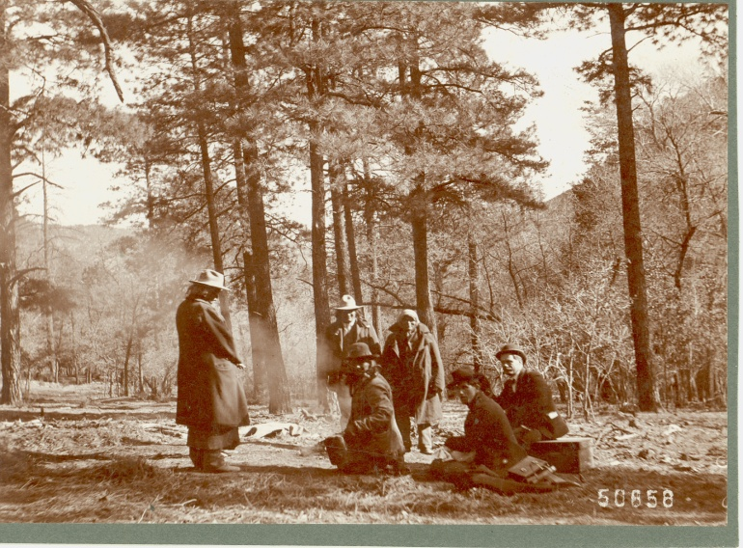
Santa Clara Pueblo
Forest Management Projects

Slide 15
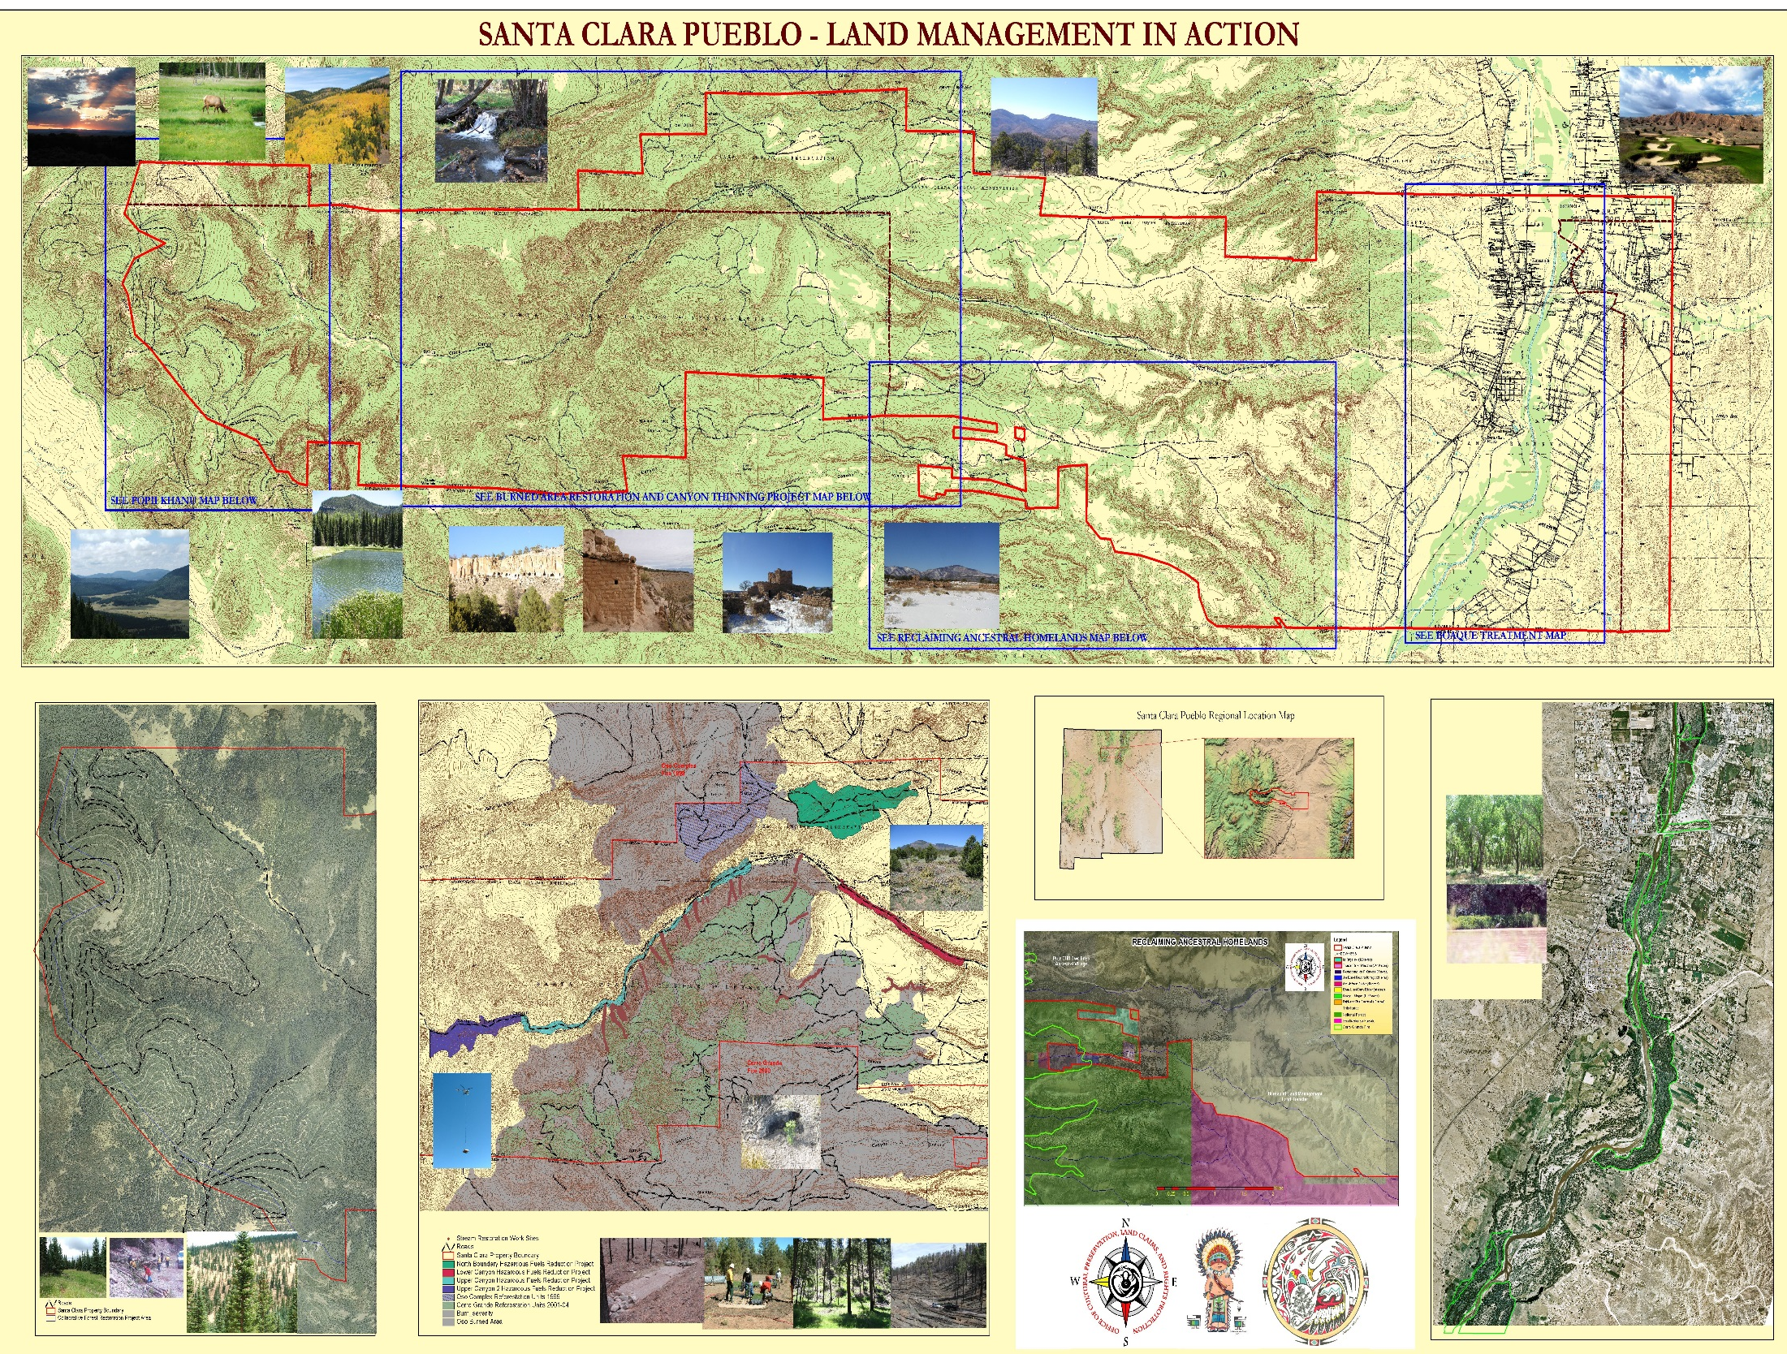

Slide 16
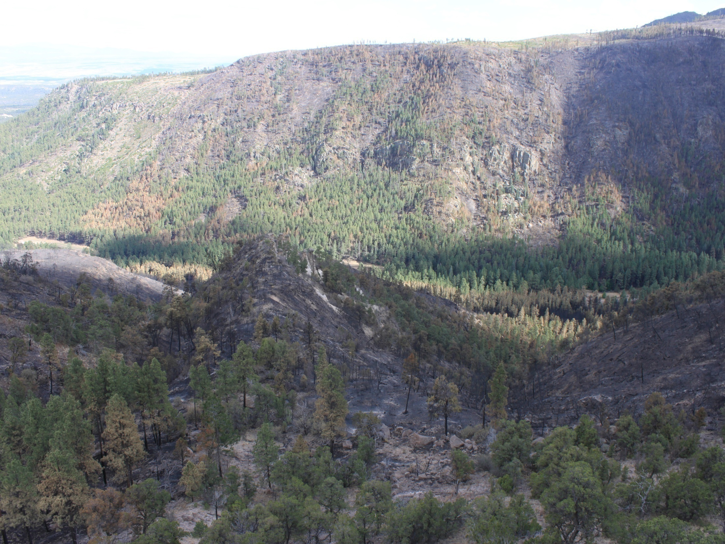
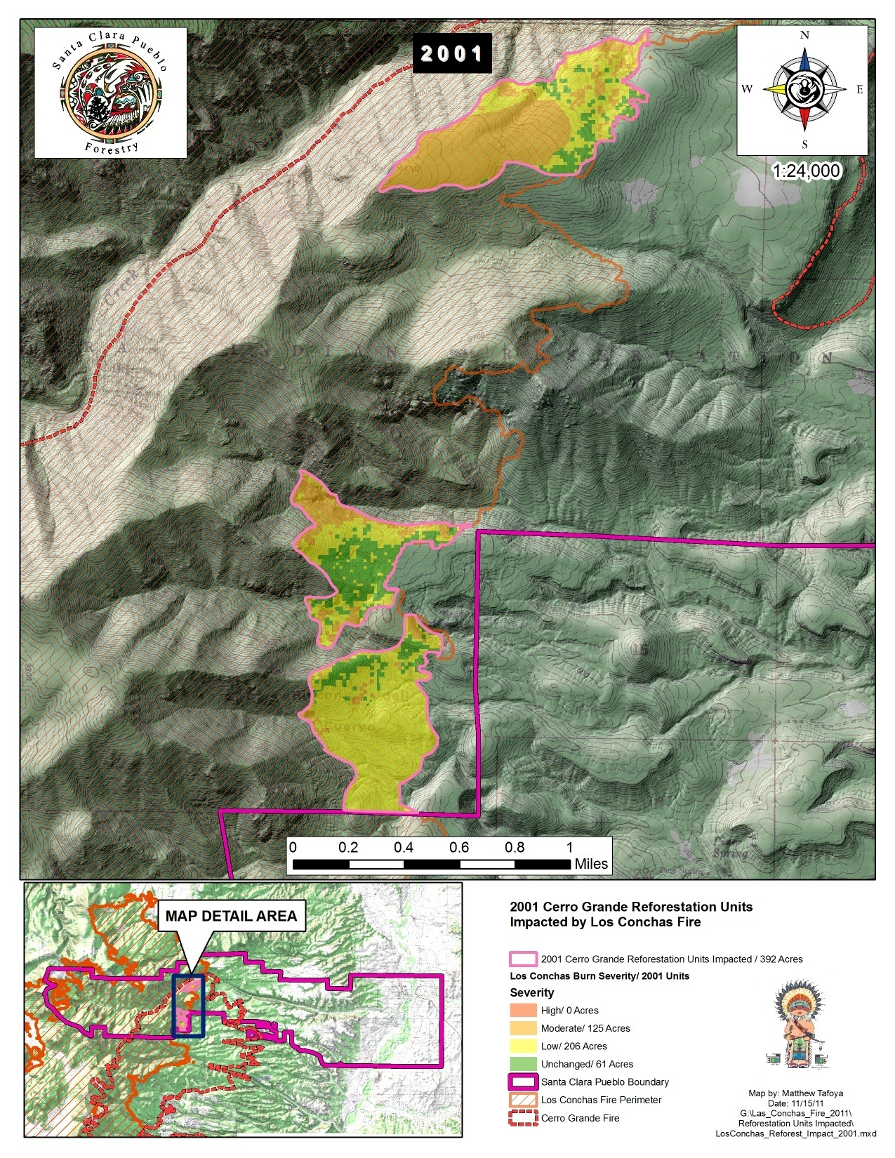
EXAMPLE OF REFORESTATION
PLANNING AND IMPLEMENTATION
High Burn Area= Over 4,200 acres
(300 trees/ acre needed)
Moderate Burn Area= Over 7,800
acres
( 150 trees/acre needed )
Low Burn Area= Over 3,500 acres
(75 trees/ acre needed)
Areas within Burn Area classified as unchanged= Approximately 1,200 acres.

Slide 17
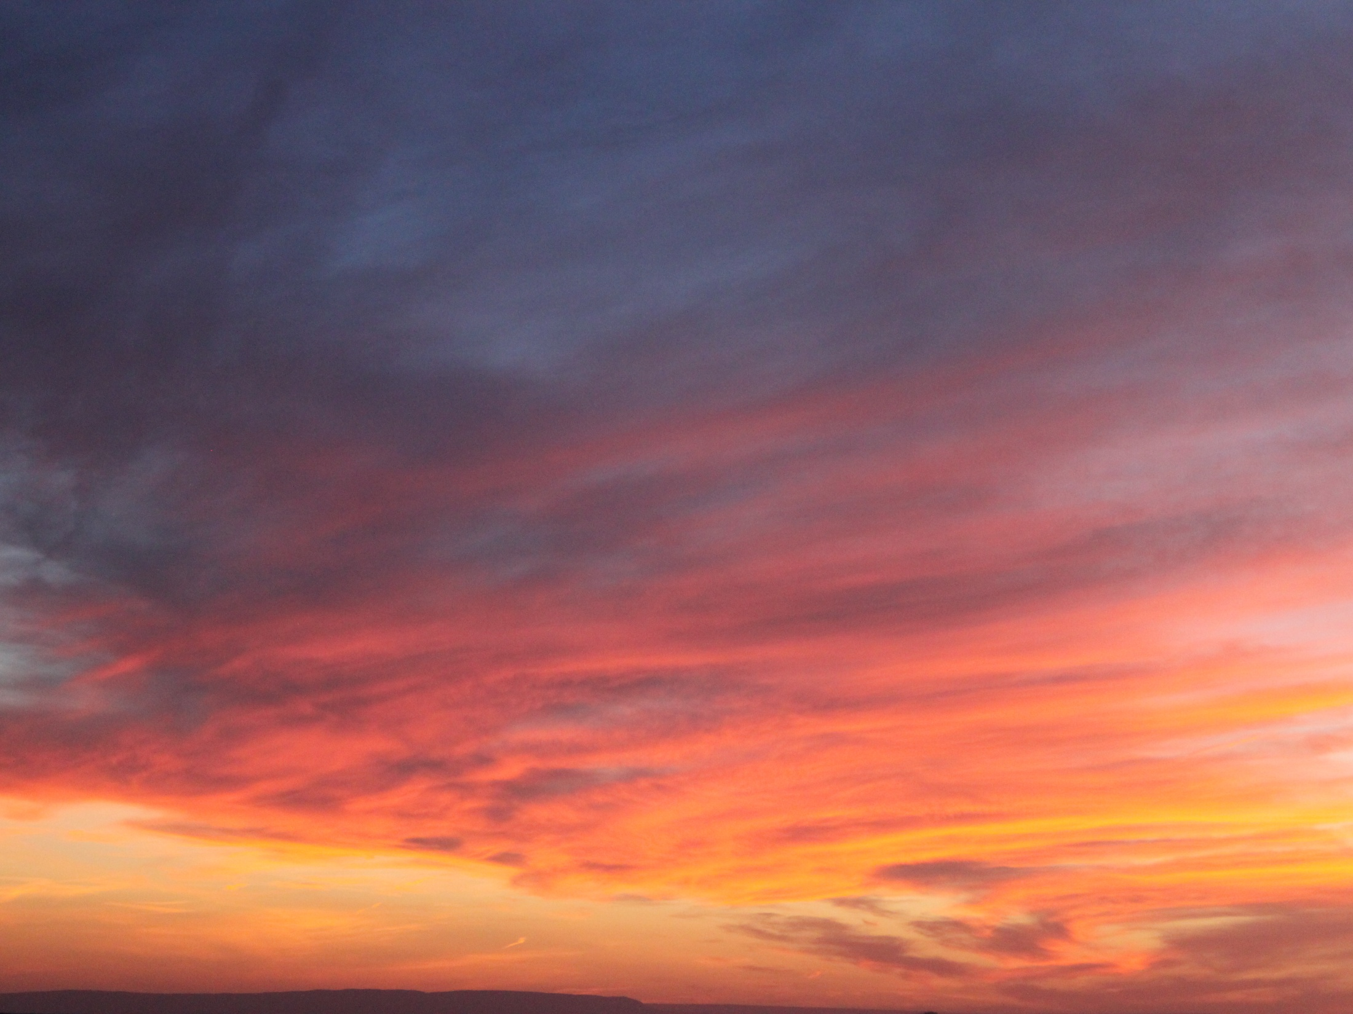
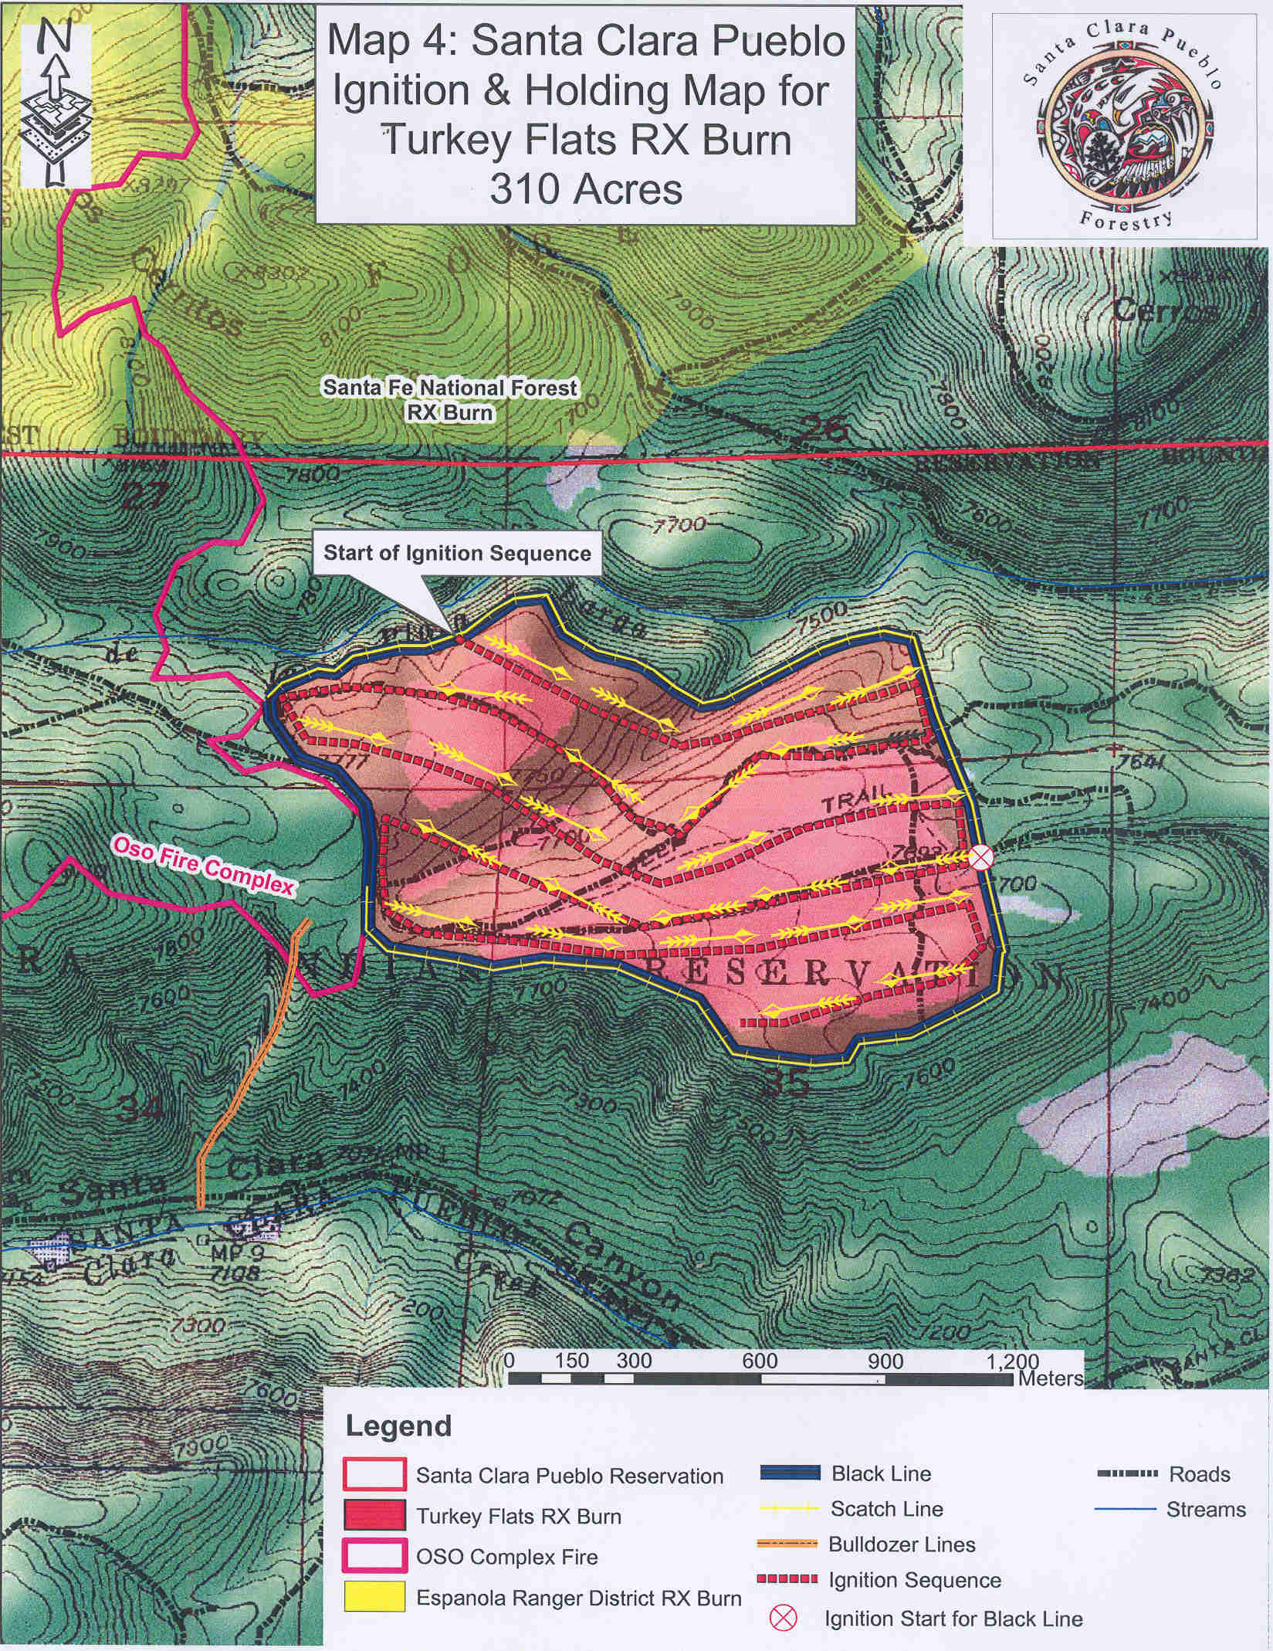
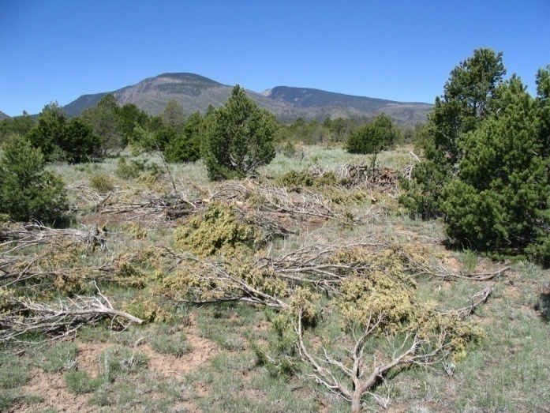
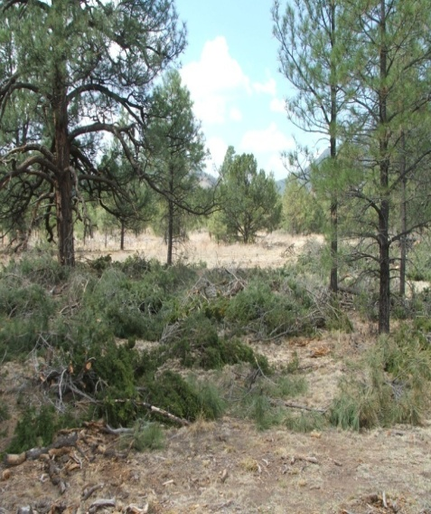
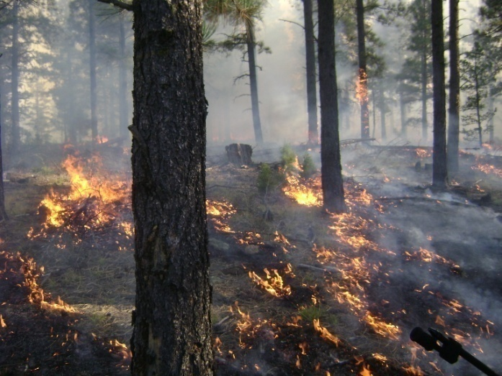
Northside Turkey Flats
Hazardous Fuels Reduction (HFR)
93-638 contract

Slide 18
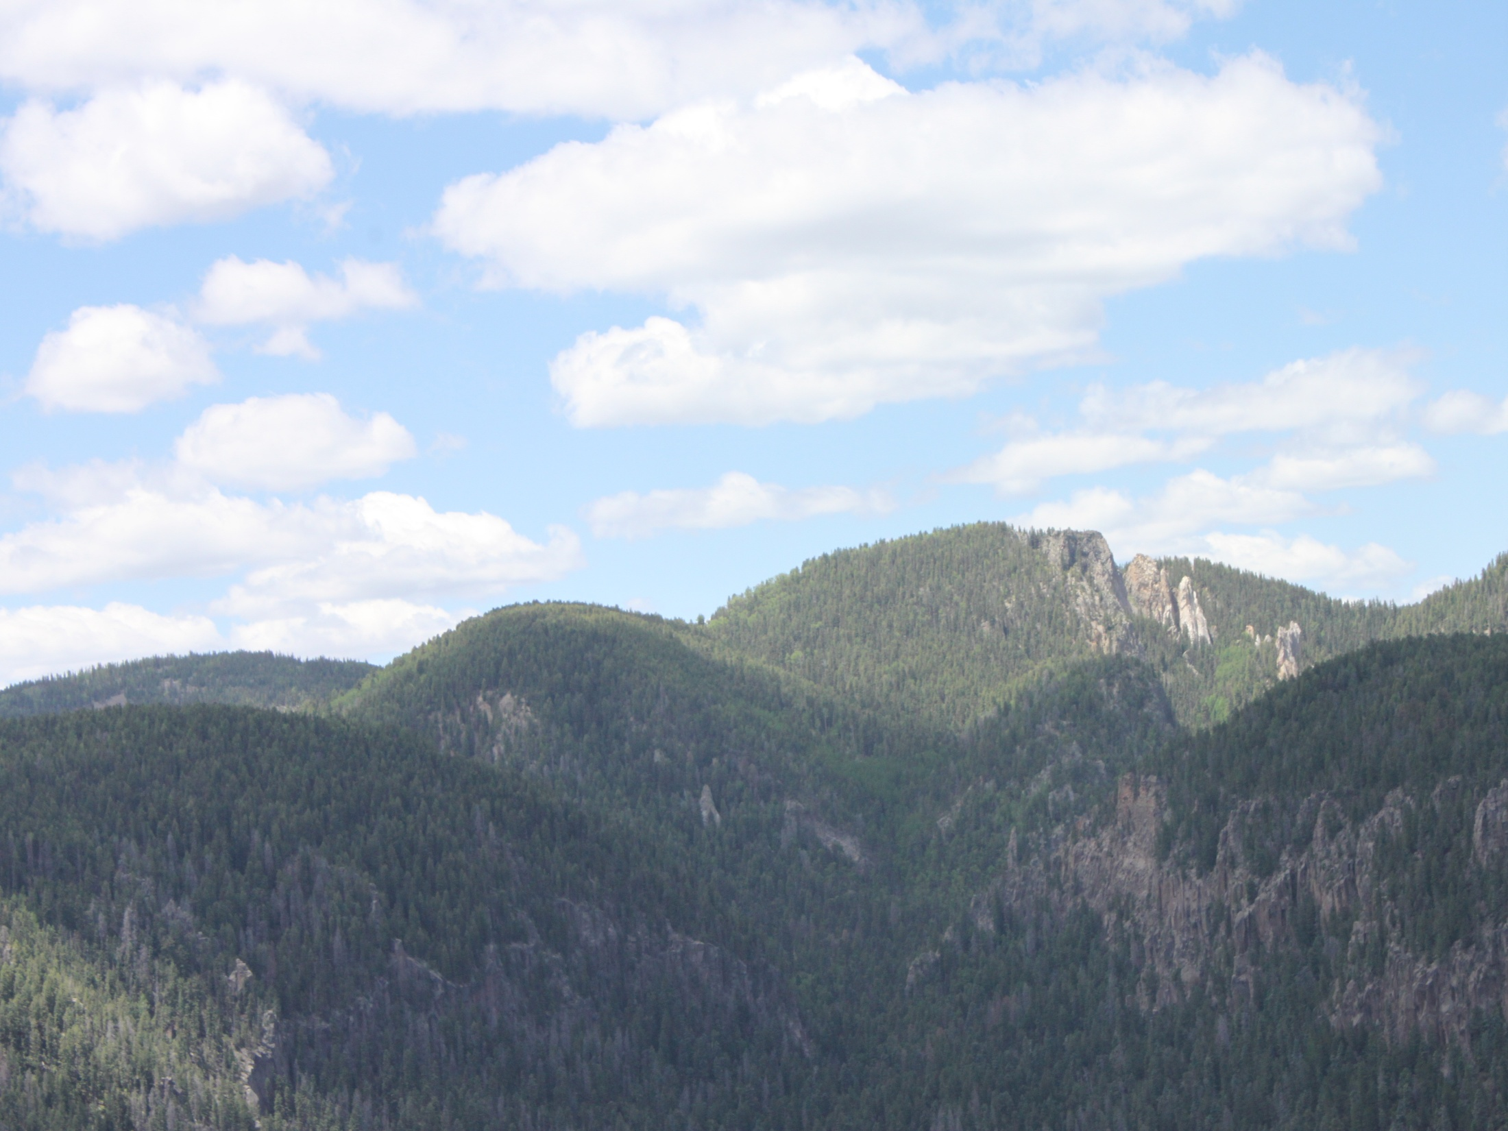
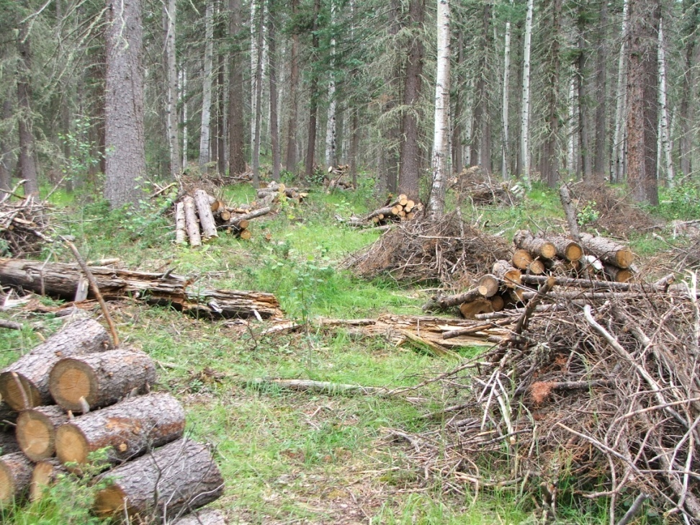
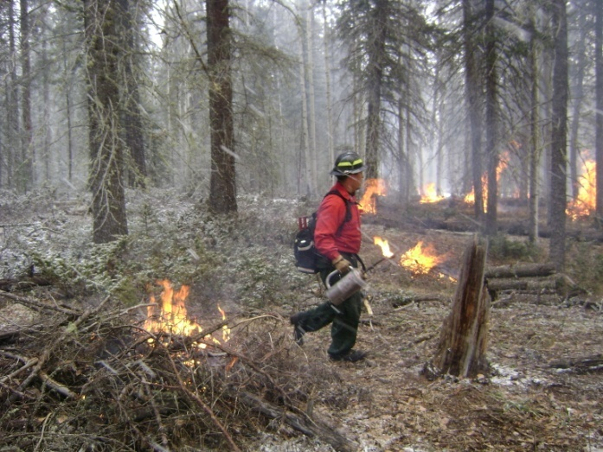
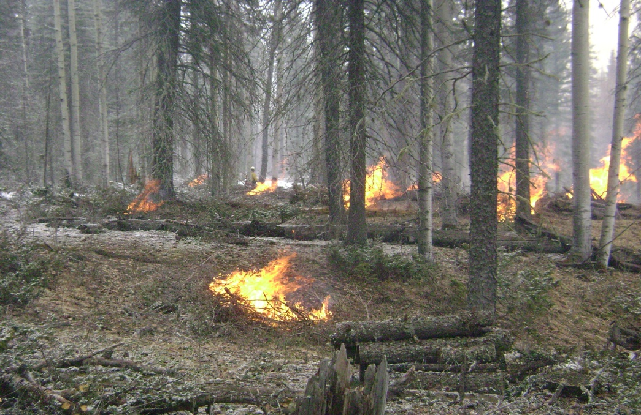
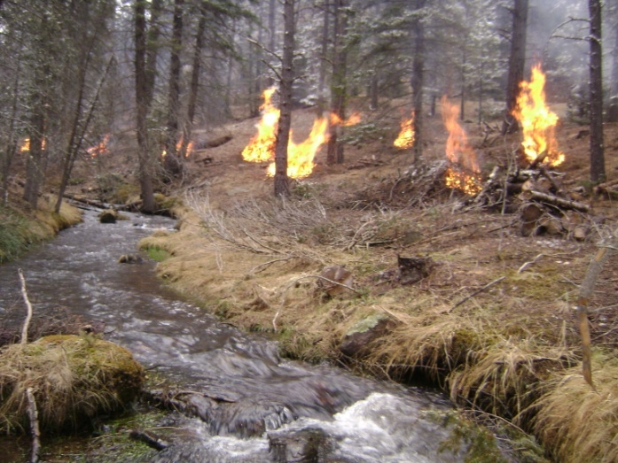
Upper Canyon II - HFR

Slide 19
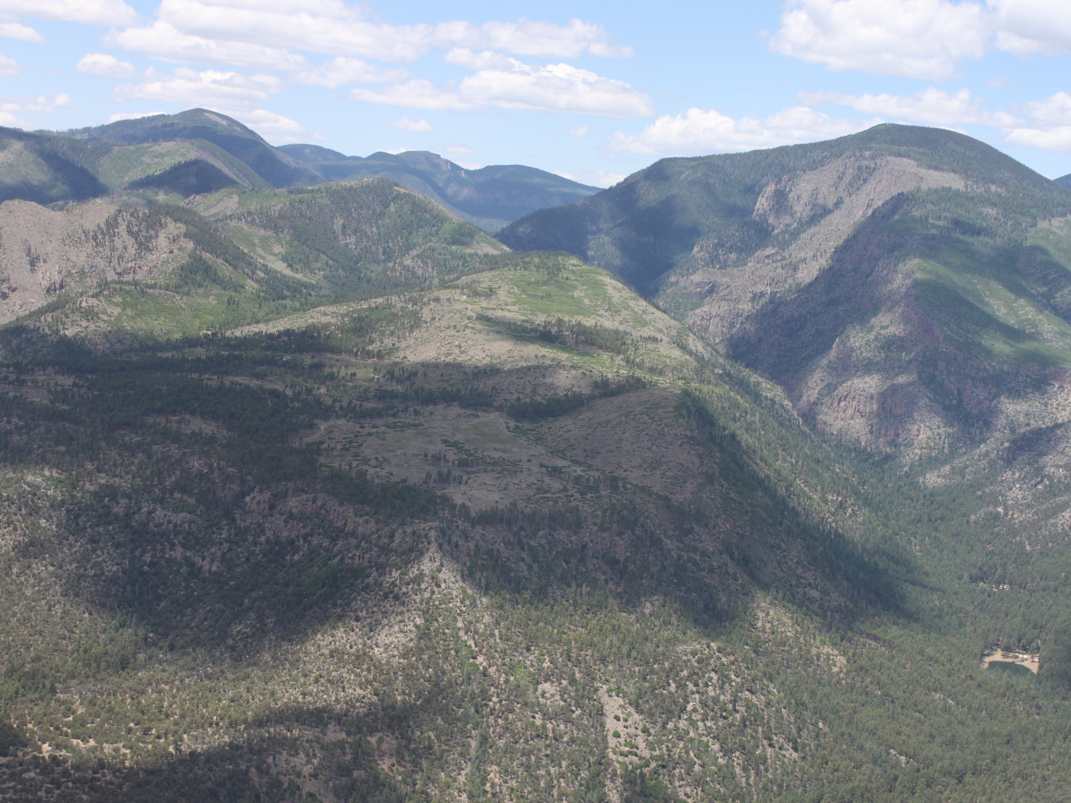
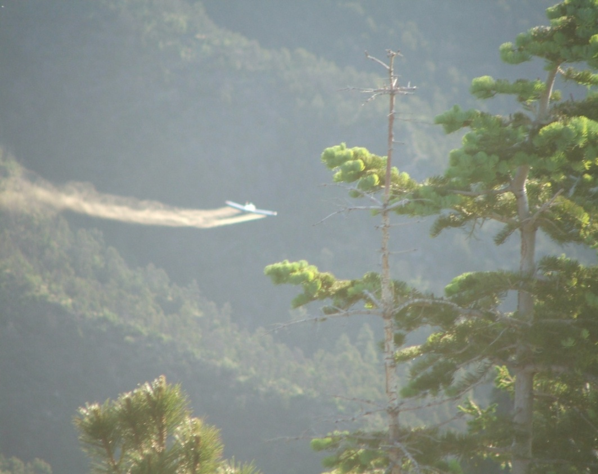
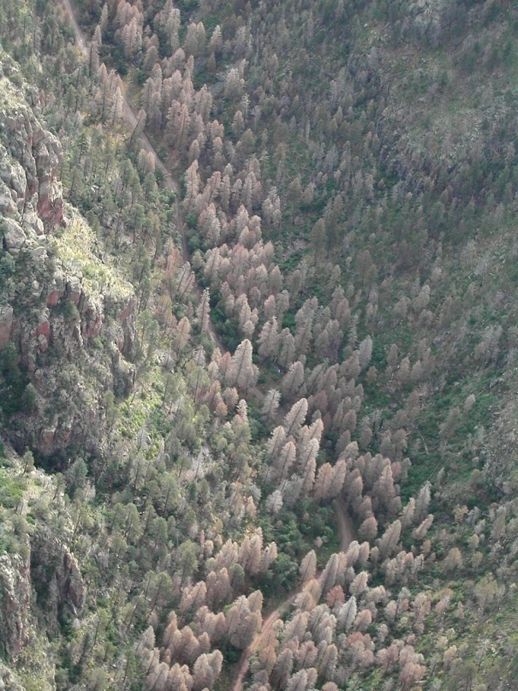
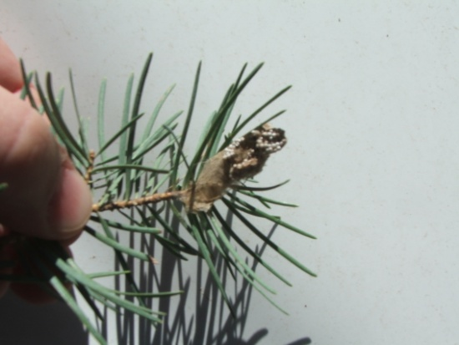
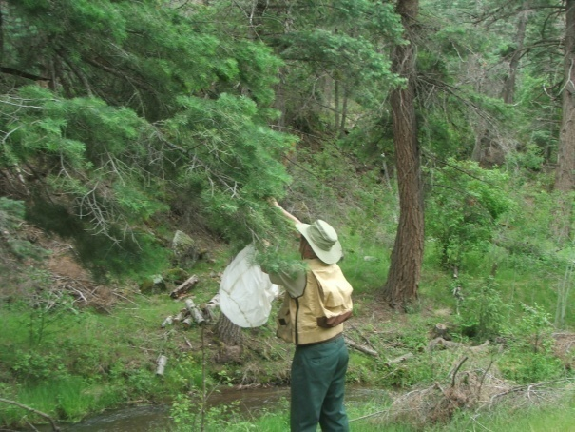
Past Projects – Tussock Moth – Tribal Funding

Slide 20
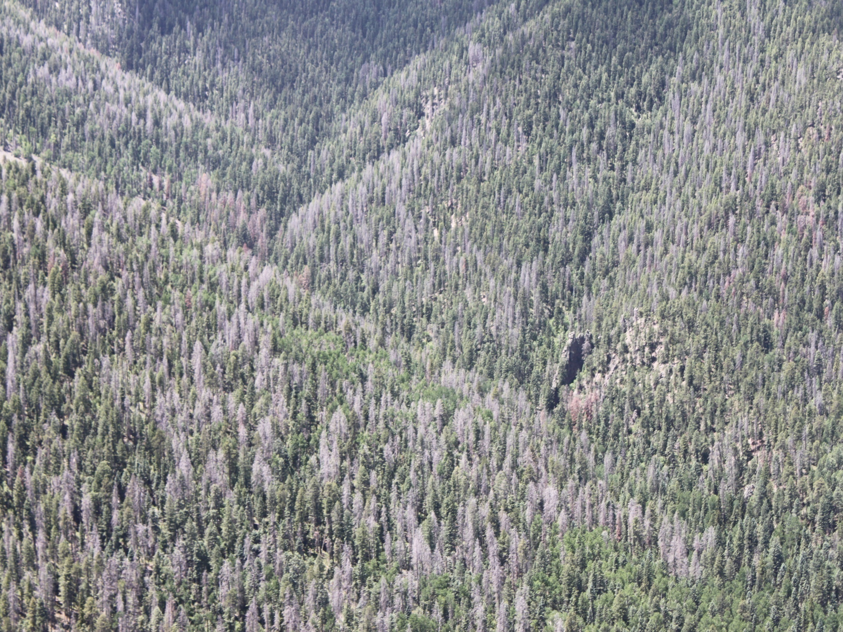
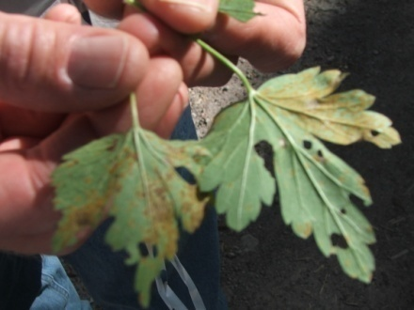
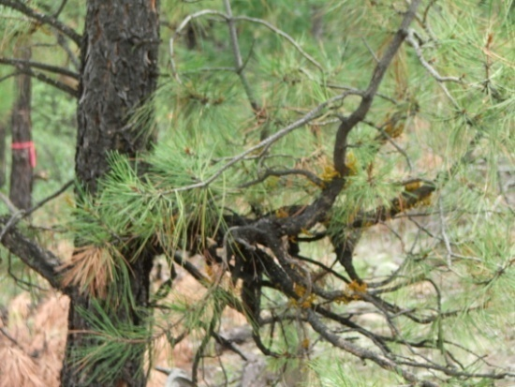


Forest Insect and Disease Projects
CFI Woodland Analysis and Pinion Mortality Assessment
Douglas-fir Bubble Cap Application
Douglas-fir Bark Beetle Timber Sale
Dwarf Mistletoe Control
White pine Blister Rust Study

Slide 21

Tribal and Agency Agreements

Slide 22




Tribal Forest Protection Act/SCP-USFS
Utilize Act to co-manage areas surrounding the Santa Clara Pueblo Reservation. Example Stewardship Contracts, HFR Projects, Watershed Protection, Insect/ Disease Mgt, Cultural Site Protection
Roughly 30,000 acres managed by the United States Forest Service

Slide 23

The Tribal Forest Protection Act (Public Law 108-278)
Authorizes the Secretaries of Agriculture and Interior to give special consideration to tribally-proposed stewardship contracting or other projects on Forest Service or BLM land bordering or adjacent to Indian trust land in order to protect the Indian trust resources from fire, disease, or other threat coming off of that Forest Service or BLM land.
These stewardship agreements are an important tool for fighting the ever-growing threat of wildfires in the West. In New Mexico, where the Santa Clara Pueblo has experienced devastating consequences from four wildfires over the last 20 years, all of which originated off of tribal lands, the wider use of such agreements could have greatly mitigated the impact of these fires. Empowering tribal governments as caretakers to protect tribal lands by managing adjacent federal lands is a smart policy.

Slide 24


Gallina Creek Unit - (4,413 Acres)
Proposed Management Measures:
Gallina Creek Unit:
This watershed is adjacent to Santa Clara lands to the north and is also very overstocked with fuels and insect and disease problems. Portions of this watershed are also on Santa Clara land. A portion of this unit was burned by the Oso Complex Fire of 1998.
Proposed Management Measures could include but not limited to:
· Ecological and Cultural Projects
· Reforestation
· Conduct Stream Restoration Work to reduce stream channel erosion to restore the hydrological functions
· Hazardous Fuels Reduction treatments (HFR)
· Timber Stand Improvement (TSI)
· Insect Disease Mitigation
· Aspen Enhancement Management
Insect and Disease - Overstocked Spruce/Fir Forest - Heavy Fuel Loading - Gallina Creek Units

Slide 25




SCP/VCNP Fuel Break

Slide 26

USFS - CFRP

Slide 27



USFWS
MEMORANDUM OF UNDERSTANDING
Between the
SANTA CLARA PUEBLO
and the
U.S. FISH AND WILDLIFE SERVICE
This Memorandum of Understanding (“MOU”), by and between Santa Clara Pueblo (“Pueblo”), a federally recognized Indian tribe and the United States Fish and Wildlife Service (“Service”), a bureau of the U.S. Department of the Interior.
To this end, both the Pueblo and Service have come together to create a better-coordinated, consistent approach to support mutual native fish, wildlife, natural resource conservation, and ecological projects, such as fisheries, Tribal Wildlife Grant program, Partners Program, Youth Conservation Corps. By cooperatively working on these projects, goals and objectives of aquatic and natural resource management can be accomplished. This approach will also build a long-term working relationship and help meet trust responsibilities
The primary focus of this MOU is to develop a meaningful, well-coordinated and mutually beneficial partnership that promotes the advancement of Tribal sovereignty, land management practices, and the protection and conservation of culturally sensitive ecosystems, flora and fauna, while safeguarding information sensitive to the Pueblo.
The Indian Self-Determination and Education Assistance Act of 1975, (Public Law 93.638), as amended is the authority for the participating parties to enter into and carry out this MOU.

Slide 28

Espanola General Investigation
203 Watershed Study Partnership Agreement
Technical Assistance Report (TAR)
USACE
FCCE – Flood Control & Coastal Emergencies (Advance Measures Program)
Section 205 – Flood Mitigation Measures
FEST TEAM
Greenhouse

Slide 29





Bureau of reclamation
Earthen Berm Construction/ sheet piling
Earthen Burn Construction – The BOR Socorro field crew completed construction of three earthen berms along the community. The estimated capacity of the creek channel is 5,000 cfs and the berms should safely allow close to 8,000 cfs to pass through the creek channel.
Sheet Piling Project – The BOR has identified funding to install sheet piling between the State Road 30 Bridge and Kee Street Bridge. This area was not feasible to construct the earthen berms as space is limited.
Sheet Piling Location

Slide 30

USDA - NRCS
USDA Natural Resources Conservation Service
New Mexico Burned Lands Initiative- Environmental Quality Incentives Program (EQIP)
Woody Residue Treatment (Mulching) of approximately 243 acres of burned forest in the upper Santa Creek Watershed to reduce runoff, promote vegetation recovery and provide hillslope protection.

Slide 31

Resilient LandScape
Program Overview: The Pueblo of Santa Clara forests are in need of hazardous fuels reduction treatments in the Santa Clara Mesa Resilient Landscape (RL) project area. Hazardous fuel treatments on 2,000 acres were developed and implemented in the Desert Grassland with Pinyon-Juniper, and Ponderosa Pine biophysical settings on mesa tops with the objective of changing the fire regime condition class 3, status to a condition class 1, on a landscape basis. Hazardous fuels in the form of lopped and scattered slash were distributed throughout the project area in varying degrees of decomposition.
The tribe proposes to reduce these hazardous fuels, by the use of prescribed burning through-out approximately 2,000 acres within the identified treatment areas. The treatment area is comprised predominately of pinyon/ juniper forests (Fuel Model 6) with mixed-pine stands, of which approximately 15-20% is Ponderosa pine forest cover (FM 9/FM11).

Slide 32

Reserve Treaty Rights
U.S. Department of the Interior
FY 2015 Reserved Treaty Rights Lands Program
Bureau of Indian Affairs, Office of Trust Services
Division of Forestry and Wildland Fire Management
Branch of Wildland Fire Management
Program Overview: Santa Clara’s highest off-reservation priority is the protection of Tribal Indian Trust Resources from fire, floods, insects, disease, or other threats coming off of United States Forest Service (USFS) National Park Service (NPS) and Bureau of Land Management (BLM) and other State and Private Lands adjacent to the reservation.
This extends into the areas identified adjacent to the reservation for the protection of the natural and cultural resources that exist in the identified areas and the maintenance for the continuation of their utilization by Santa Clara Pueblo Indians.
The projects were proposed to be implemented by the SCP Forestry Program, to improve forest health through thinning and insect and disease control work, implement fuel breaks, implement hazardous fuel reduction work, accelerate forest management activities in aspen stands, restore subalpine meadows, protect cultural resources and improve wildlife habitat.

Slide 33

Valles Caldera National Preserve:
With the transition of the Valles Caldera lands to a Park Service Unit, SCP must now utilize the authorities under the National Indian Forest Resources Management Act as contained in the Defense Authorization Bill (December 2014) to establish co-management and enter into cooperative agreements with the NPS.
To perform land and facility improvements, including forestry and other natural resources protection( Hazardous Fuels Reduction), fire protection, reforestation, timber stand improvement, debris removal, and other activities related to land and natural/cultural resource management.

Slide 34















COORDINATION
FS
DOE
BIA
NPS
ACOE
NOAA
Radar alerts
Gauging
State of NM
DOT
Dept. of Homeland Security
Local & SCP Volunteers
Pueblos
Counties
Cities
Notes:
USGS was instrumental in developing a more comprehensive early warning system.
As is demostrated here everyone that could be affected by post fire high flow events is represented.
34

Slide 35











Wildlife

Slide 36



QUESTIONS

