Slide 1
Who Are we?
Notes:
Our Operational Services are made up of over 40 contracts which deliver a suite of services ranging from Health, Social and Justice to Educational services.
As reflected in the structure we have placed our contracts regardless of the funder or whether it be a service, programme or coordination role into 3x Clustered streams, which consist of Pepi/Tamariki (Child Services), Rangatahi (Youth Services) or Matua (Family Services). Additionally we have a ‘Specialist Clinical Cluster’ which is made up of Registered Nurses and a Clinical Lead.
As a result and due to the number of contracts that we carry we require a practice tool which is going to support and enhance the integrated service delivery model that we work from… this tool is called Whanau Tahi.

Slide 2
Operational Structure
Notes:
Our Operational Services are made up of over 40 contracts which deliver a suite of services ranging from Health, Social and Justice to Educational services.
As reflected in the structure we have placed our contracts regardless of the funder or whether it be a service, programme or coordination role into 3x Clustered streams, which consist of Pepi/Tamariki (Child Services), Rangatahi (Youth Services) or Matua (Family Services). Additionally we have a ‘Specialist Clinical Cluster’ which is made up of Registered Nurses and a Clinical Lead.
As a result and due to the number of contracts that we carry we require a practice tool which is going to support and enhance the integrated service delivery model that we work from… this tool is called Whanau Tahi.

Slide 3
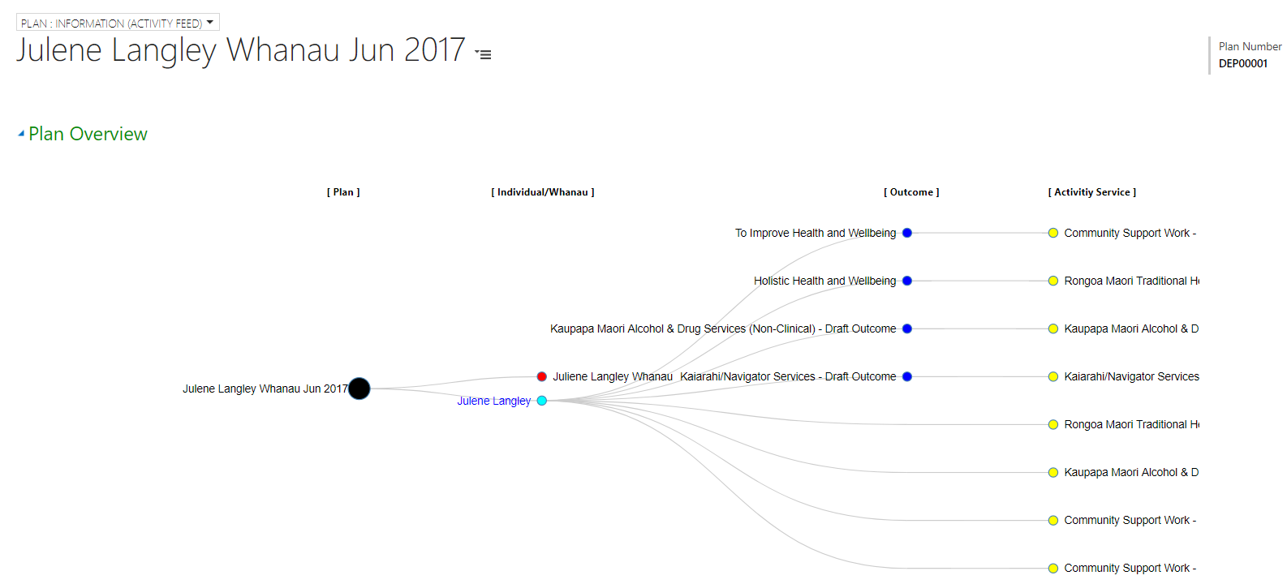
WT family tree
Notes:
Here is a dashboard example of how the practice tool supports integrated Health and Social services which facilitate the transformation of whanau health and wellbeing.
This whanau member originally came onto our Mental Health program for support due to becoming unwell. What was identified through the assessment was multi layered issues that needed services wrapped around the client in order to provide the best possible outcome. Drug and Alcohol Counselling was set up to support with addictions. A bit further down the track after some improvement and progress 2x other services were implemented Maori Rongoa which entails Traditional medicine and massage and a Social service programme called ‘Kaiarahi’ which enabled navigation to services, advocacy and intervention support to be provided.
Because in this example we had up to any 4x services working alongside this client the WT tool allows all the practitioners eg; Counsellor, Social worker, Mental Health worker and Traditional Healing service to view who is all on board working alongside the client . It mitigates overlapping and the client having to repeat her story in order to get support. Rather then having several cars arrive for appointment follow ups at the clients house from various workers it allows our workers to plan, case consult and review progress of the client by working more integrated and productively toward the goals and outcome of the client.

Slide 4
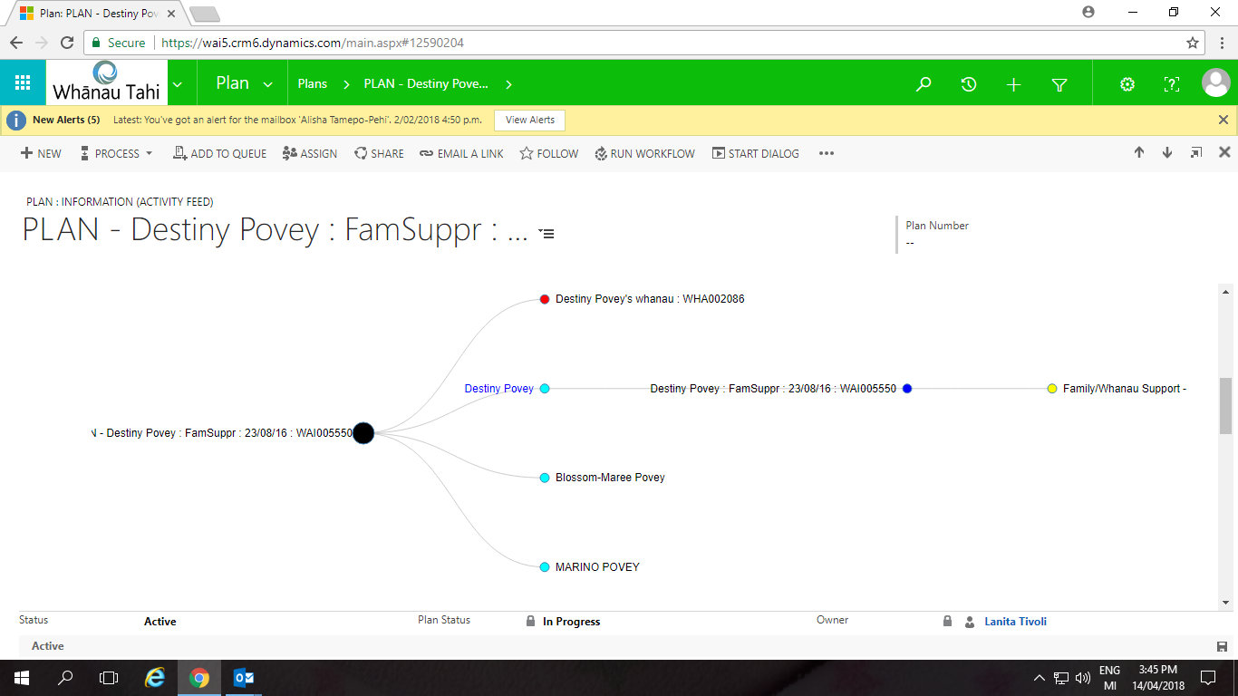
WT Family tree
Notes:
This is another example of how our practice tool is able to link the same members of a whanau. This is a screenshot of a client in the earlier stages of coming onto one of our clinical services for her baby. What your looking at the very top (red dot) is the overall whanau ‘mataora assessment’ which is the families overarching goals, dreams and cultural aspirations. The light blue dots are the identified whanau members which make up this whanau in this case a solo mother with 2x children. AS you move across to the right the respective service will be outlined. Again where identified additional services are required for other members of the whanau, with the clients consent our practitioners are able to make ‘internal referrals’ to these other services. By simply going to a drop box identifying the relevant service and clicking a button. The families information and details are then moved across to that service and the referral picked up and actioned. No need for the client to regurgitate names, DOB’s contact details and addresses. Whoever the new service is coming on-board, they will be able to view the original ‘Mataora Assessment’. There are business rules in place however which protect both the whanau members and the respective practitioners integrity of work being carried out. Obviously case notes from the various services are not open for everyone to read. Which is the importance of case consults. However, all workers can see if home visits, site appointments or phone calls are being made and it gives our workers a gauge on planning their own respective contacts or if appropriate going on home visits together.

Slide 5
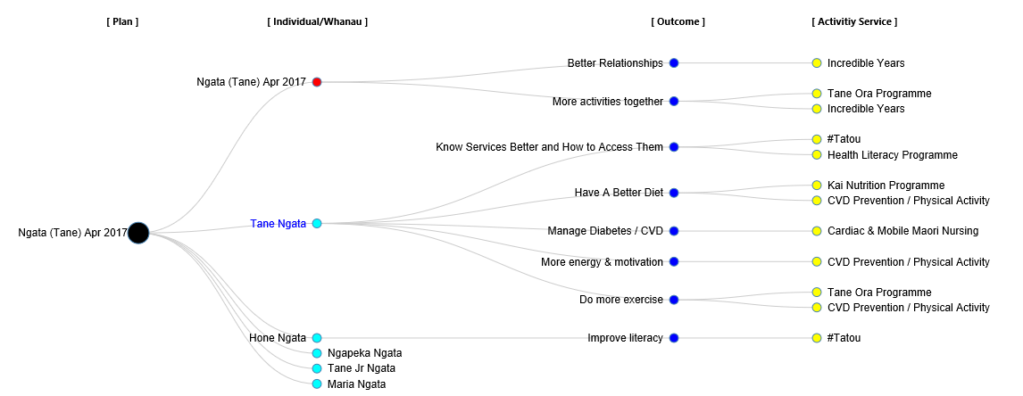
Integration of health and social services
Notes:
This dashboard example reflects 5x Multiple services attached to the family. Whanau Tahi is the enabler that support workers to begin informal conversations regarding the family in common they are working with eg; this could entail giving each other background information and context regarding the family and their roles.
Case consultations will occur with the multi disciplinary teams allowing a flow of synergy to occur and the sharing of multi plans coming together to achieve an overall outcome for the family.
Risks are identified and all workers on board are notified,
Safety plans can be implemented, monitored and updated as appropriate by the worker and supervisor.

Slide 6
Best practice
Notes:
The following dashboard is an example of how we utilise Whanau Tahi as a ‘platform’ which our Supervisors base the practice discussions from, when engaging with the respective worker.
A supervisor is able to drill down into the detail of support plans and
Monitor practice and accountability
Minimise risk, ensuring case notes are entered appropriately
Practice is Safe and Professional conduct is intact
If service specific outcomes are achieved, then clients can be pathwayed to exit safely with the supervisors approval. For those remaining services still on board the work will continue as planned.

Slide 7
Critical Success Factor’s
Enables Whanau Centred care
Integration of our Disciplines / Services
Embracing innovative technology by staff
Work flow efficiencies
Shared Care tool that is easy to use
WT captures all of the interventions and care plans
An integrated collective care is provided – Whanau Ora
Notes:
Work done with whanau is meaningful
Productivity is increased
Work flow is more efficient
Health and Social outcomes have been strengthened for us as an organisation due to Whanau Tahi.

