Slide 1




Indian Affairs
US Department of the Interior
Title
TRIBAL-INTERIOR BUDGET COUNCIL (TIBC)
Funding Streams/Tribal Payments
November 5, 2014
Washington, DC

Slide 2
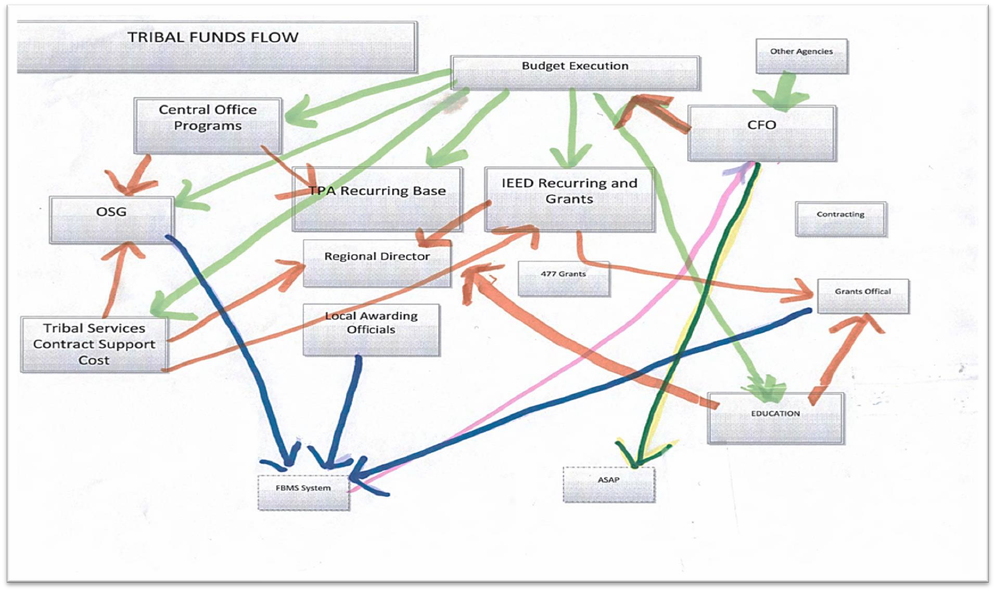
Triba_{Ti}l_{tle}Funds Flow Allocation Illustration

Slide 3
Strat^{T}e^{itl}g^{e}ic Statement
This project is not without challenges:
Number of protocols affecting funds Allocation
Training
Trust issues
Automation
Funding to tribes, offices, regions, agencies and schools.
Building from current processes in place
Stakeholder(s) acknowledgement for improvement
Congressional directives on fund(s).

Slide 4
^{T}O^{itl}b^{e}jective
The project will look across the entire enterprise to the great work that is happening across Indian Affairs and build from those best practices.
Actionable items will be created to :
Modernize the process
Reduce unnecessary/repetitive steps
Find ways to better manage resources (i.e., trust of system issue, streamline approvals, etc).
Training and Implementation of Actionable Items

Slide 5



Timeline f^{T}o^{it}r^{le}Developing Plan
Deadline: July 15
Deadline: September 19
Request for Proposal solicitation closes
Deadline: November/December;
Contract Award
January/February
Phase 1
(November 12)
and Phase 2
(December 29)
IA Fiscal Funding Stream Assessment project
TIBC Update
Deadline: March/April
IA will review, select and
implement preferred recommendation
Phase 3 implementation plan should be completed

Slide 6
Des^{T}i^{i}r^{t}e^{le}d Outcome
Develop a funding distribution process that:
Simplifies distribution of the funding streams
Streamlines the process to expedite distribution of funds
Makes use of automated processes, where possible
Defines and utilizes required rules, protocols, and distribution methodologies for each funding stream, consolidating where possible, and modernizing where appropriate
Provides process for making changes as funding streams evolve over time

Slide 7
Funding Stream
Title
Project Status Update – Phase I
Development of Assessment Database
  Contractors interviewed internal program Funding POCs
    Funding Stream Mechanism and Distribution Methods
      Direct Appropriations and other Funds
    Referenced Financial Documents (FY 2014); Comprehensive Funding Table; FY 2014 and FY 2015 President's Request Tables; 26 Indian Affairs Manual; FY 2014 and FY 2015 Budget Justifications
Data Flow Diagrams of Distribution Path
  Due Date: November 12, 2014

Slide 8
Project Status Update – Phase II
Title
Recommendations
  Based on Phase I findings and Assessment Database information, will develop funding stream process improvement(s) options (December 2014).
  Develop Plan of Action for implementation of accepted recommendations (March/April 2015).
  Implementation of recommended improvements (May 2015.)

Slide 10
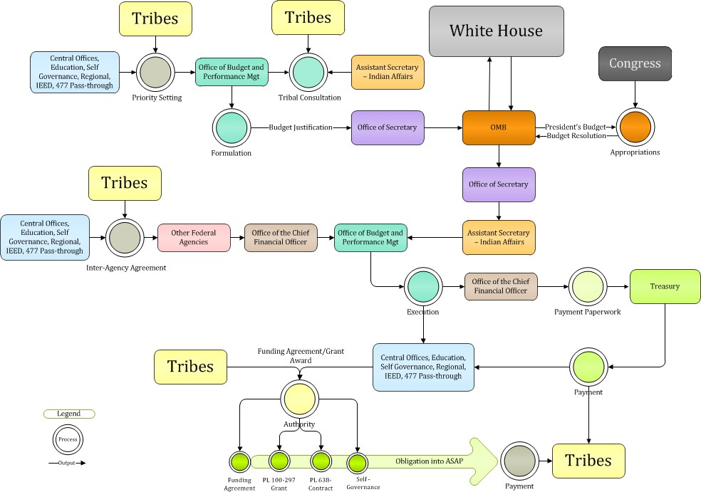
Federal Budg^{Ti}e^{tl}t^{e} Process Illustration

Slide 11
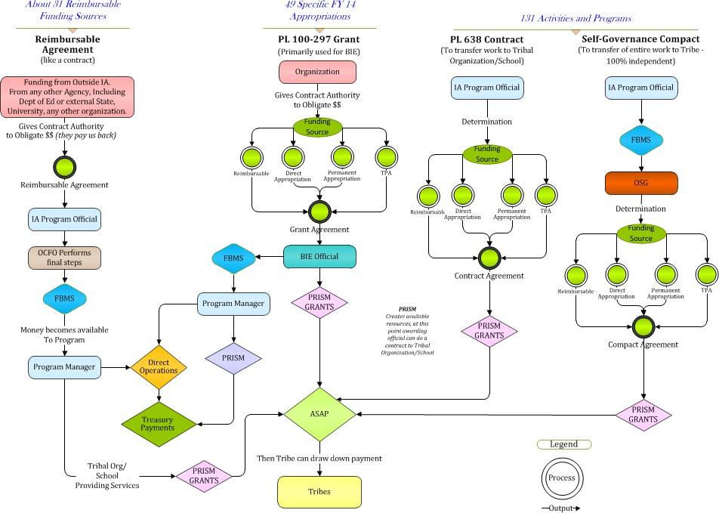
Title
Funding Method Processes Illustration

Slide 12
FY 2014 T^{T}ri^{it}b^{le}al Disbursements
Commitment | Sum of Debit/Credit Balance | How funds were allocated to the Tribes
252I00 : Contracts - Indian | 1,323,695,537 | PL 638 | Compacts: $411,987,961
413A00 : Indian Tribal Gov Grant | 797,722,497 | PL 100 – 297
411C00 : Cooperative Agreement | 28,392,720 | Forestry, Fire and Transportation
411G00 : Grants | 4,385,181 | Division of Energy and Mineral Development and Fire
252R00 : Contracts - Prof | 2,699,596 | Commercial Contracts
252S00 : Tuition | 1,133,540 | Sevier Richfield School (Utah)
252Z00 : Other | 1,114,185 | Corrections, Forestry and Fire | Corrections: $1,069,345
252U00 : Contracts - Studies | 600,900 | Div Economic Development and Facilities Management
233K00 : Utilities | 350,000 | Irrigation
252V00 : Contracts - Training | 280,176 | Education - Public School
253H00 : Reimbursable Agreement | 224,661 | Forestry and Fire
254B00 : Oper Maint&Repr-Othr | 57,671 | Irrigation
257E00 : Repairs&Maint-Other | 45,800 | Irrigation
255D00 : Private Sector-R & D | 45,000 | Tribal contract, standard obligation
257J00 : R&M-Radio Cmnctns | 32,905 | Facilities Management
Grand Total | $2,160,780,368

Slide 13
Desi^{T}r^{it}e^{le}d Outcome
To improve the distribution of funding streams to the stakeholder(s):
» More Effective
» More Efficient
» More Timely
» More Transparent

Slide 14

Title

