Slide 2
Best Practices in Healthcare Billing and Coding Integration of Medicare and Medicaid Eligibility Determination
Martha Ketcher
USET THPS Director, USET Tribal Health Solutions Group
John Marshall
USET Tribal Health Solutions Group Partner
President, Encompass Health Solutions, Inc.

Slide 3
What USET is doing
Recognized a need in their Tribal Communities
GAO report – funds left unclaimed
THSG created to support third party billing
I.e. Benefits of training to increase enrollment
Found third-party billing experts to partner with
Rapidly changing healthcare environment

Slide 4
Full Day Seminar in 20 Minutes – Get Ready

Slide 5
Key Elements to Change
Implement best practices
Institute KPI’s and reporting
Provide training and education
= Increase efficiency in billing, coding and collections
= Increase total billed and collected third-party dollars
= Increased capacity to provide Quality Health Care

Slide 6
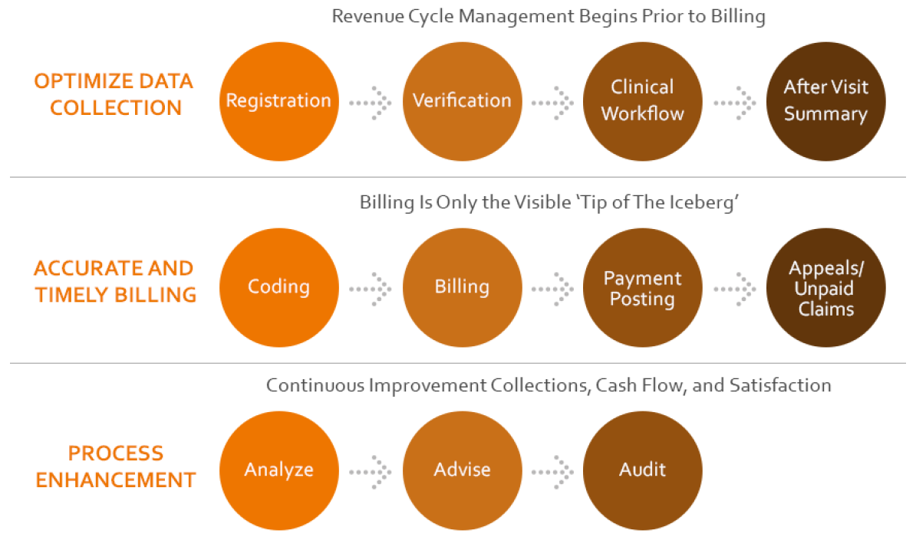
Defining Revenue Cycle Management - More Than Just Billing

Slide 7
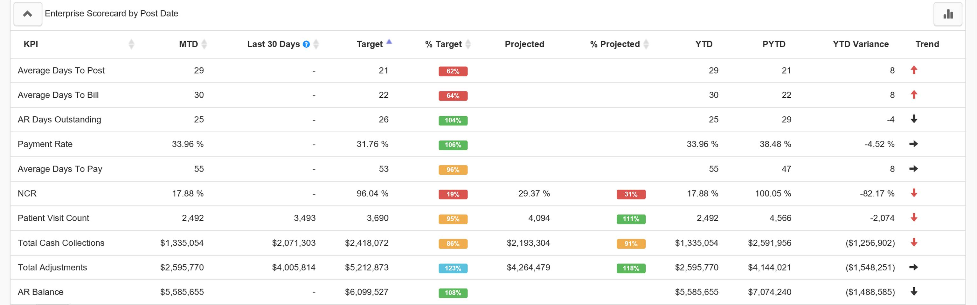
Key Performance Indicators (KPI’s)
Understanding and having confidence in your billing and collection numbers allows Tribal Leadership to track progress and identify areas of opportunity
Use real time data
Benchmark

Slide 8
For Each Key Metric
Plan
Do
Study
Act

Slide 9
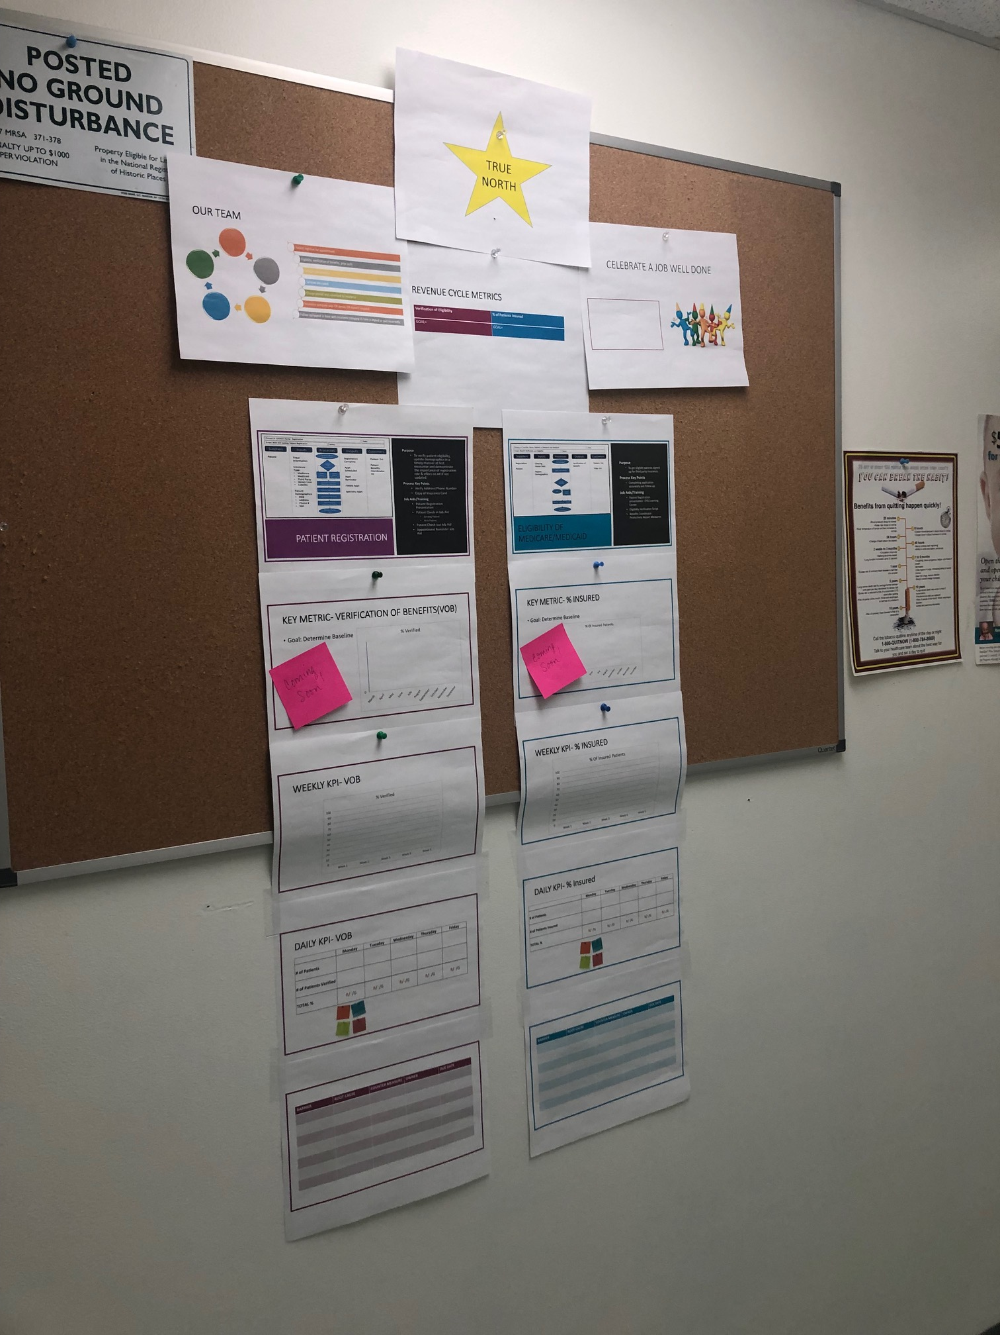
Visual Management Center

Slide 10
Continuous Training
Regular Training
Audit/Feedback
Benchmark

Slide 11
Change Management
To successfully maintain a long-term increase in receipts, change in all three areas must be identified, trained, and maintained
Leadership
Increased
Receipts
Staff
Processes

Slide 12
Communication to Staff and Tribal Members

Slide 13
Best Practices:
Eligibility and Verification
Verifying patient demographics and insurance information (scanned copy of card, front and back)
Clearinghouse access to verify eligibility for patients with insurance
Identify Medicare and/or Medicaid eligible patients / apply for coverage

Slide 14
Best Practices:
Coding
Certified Coder(s)
Knowledge of all specialty coding guidelines by payer
Identification of any services provided that are not documented and/or not documented sufficiently (provider education opportunity)
Timely processing

Slide 15
Best Practices:
Billing and Collections
Utilize a clearinghouse to send claims electronically
Timely follow-up on unpaid/denied claims
Automated posting of ERA payments

Slide 16
Importance of Patients Enrolling in Medicaid or Marketplace plans
Instead of Tribe paying for these services (on-site or PRC dollars)
Including this step as part of your patient registration process (Best Practices)

Slide 17
Medicaid/CHIP Eligibility
Programs named differently in each state
Medicaid Expansion in Some States
State Specific Guidelines
Eligibility determined primarily by income, size of household, disability

Slide 18
Marketplace Eligibility
Applying for Marketplace coverage –
www.healthcare.gov
Specific to AI/AN: can enroll at any time (versus just during annual open enrollment period)
May qualify for a “zero cost sharing” plan (no out of pocket costs)

Slide 19
Questions?

