Slide 2
TIWAHE (“Family” in Lakota)
and the
correlation to
2019 Program Formula Matrix Update Report
SGCE Technical Workgroup: Program Formula Matrix Update Report
Presenters:
Donna Swallows, Senior Accountant/Self-Governance Coordinator
Grand Traverse Band of Ottawa and Chippewa Indians
Vickie Hanvey, Program Policy Analyst
Office of Self Governance, DOI

Slide 3
Panel Two:
Implementation Challenges and Solutions
Purpose/Overview of Session:
Panelists will discuss the August 2018 DOI IG Report, “Poor Record Keeping and Coordination within Interior threaten the impact of TIWAHE”, including the challenges identified in the report, an overview of the seven recommendations, and planned actions to address the recommendations.
To the extent that planned actions from the Federal/Tribal Program Formula Matrix Update workgroup will assist to address implementation challenges, the workgroup will provide an update on their progress.
Notes:
This presentation is about a longstanding issue related to ensuring SG tribes are included in recurring BIA funding increases. The OIG report on Tiwahe recurring funding increases for Social Services and ICWA presents the opportunity to correct deficiencies in the process, which we’ve all been concerned about. But we want to make clear, this issue is not about the Tiwahe Initiative and its efforts to strengthen families, it is about making sure that going forward, when there are recurring funding increases in any BIA budget category, all tribes are treated equally in funding determinations

Slide 4
Background
2012 Program Formulas Matrix Report
January 2011 SGAC established Technical Workgroup
The Workgroup developed a program formula matrix outlining the issues and proposed recommendations on the following:
  how BIA funds are being distributed,
  identify areas where the formulas and methodologies currently used by the BIA for distribution can be improved and provide recommendations,
  confirm that Self Governance Tribes are being properly included in the formulas, and
  ensure that Self Governance Tribes are being treated equally as the rest of the Tribes.

Slide 5
Background
2012 Program Formulas Matrix Report
  Program type covered:
    Tribal Priority Allocations (TPA)
  Programs covered:
    Contract Support Cost (CSC)
    Welfare Assistance
    Criminal Investigations and Police Services
    Detention/Corrections
    Facilities Operations and Maintenance
    Johnson O’Malley
    Scholarships
    Adult Education
    Education Line Officers
    Pay Cost
    Indian Reservation Roads

Slide 6
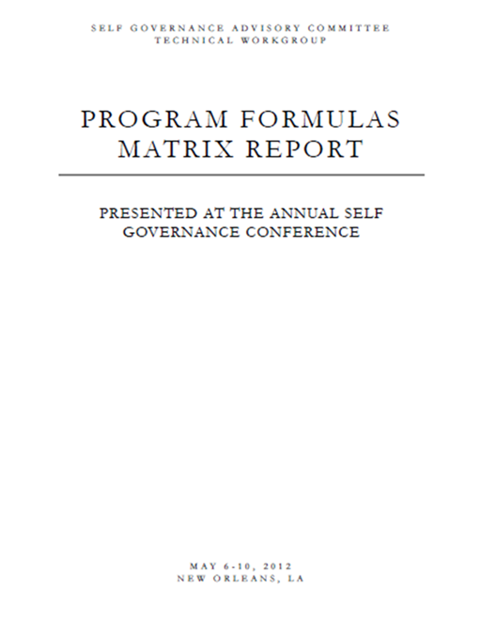
Background
2012 Program Formulas Matrix Report
Developed by the Workgroup
Approved by SGAC Tribal Leadership
May 2012 Issued Report of issues and recommendations
Presented at SG Conference
No official response was received from DOI
Most of the recommendations were not implemented by the programs.
Federal/Tribal Workgroup Members
  Danny Santiago, OSG
  Cyndi Ferguson, Jamestown S’Klallam
  Rhonda Butcher. Citizen Potowatomi Nation
  Vickie Hanvey, Cherokee Nation

Slide 7
Background
2019 Program Formulas Matrix UPDATE Report
SGAC established another Technical Workgroup in 2018
Update the issues and recommendations for program formulas
Federal/Tribal Workgroup Members
  Vickie Hanvey, OSG
  Danny Santiago, OSG
  Cyndi Ferguson, SENSE, Inc.
  Dave Conner, Red Lake
  Donna Swallows, Grand Traverse Band of Ottawa
  Jeremy Arnette. Citizen Potawatomi Nation
  Linda Austin, Ysleta del Sur Pueblo
  Robert Scabby, Salt River Pima-Maricopa Indian Community
  Melanie Fourkiller, Choctaw Nation
  Terra Branson, Muscogee (Creek) Nation

Slide 8
Background
2019 Program Formulas Matrix UPDATE Report
Phase 1: Programs which correlate with the recent OIG Report
  Tribal Priority Allocations (TPA)
  Consolidated Tribal government Program (CTGP)
  Aid to Tribal Government (ATG)
  Paycost Allocations
Phase 2: Other programs
  Contract Support Cost (CSC)
  Welfare assistance
  Law enforcement
  Facilities management
  Johnson O’Malley (JOM)
  Scholarships
  Adult education
  Roads

Slide 9
OIG Report No. 2017-ER-018
Indian Affairs Offices' Poor Recordkeeping and Coordination Threaten Impact of Tiwahe Initiative”
  Correlates to TPA Allocations issue addressed in 2012 Formula Matrix Report
  Other programs (i.e. Scholarships)
Tiwahe Initiative Components
  A recurring funding increase for all tribes that operate Social Services and ICWA programs (only component addressed in OIG report)
  Additional funding for a demonstration program at 6 tribal locations
Scope of the report
  "We primarily focused on the distributions of funds to Title IV tribes, examining the accuracy of the distributions, how the Office of Self Governance maintained tribal records, and the internal controls present."
Notes:
Notes: This presentation is about a longstanding issue related to ensuring SG tribes are included in recurring BIA funding increases. The OIG report on Tiwahe recurring funding increases for Social Services and ICWA presents the opportunity to correct deficiencies in the process, which we’ve all been concerned about. But we want to make clear, this issue is not about the Tiwahe Initiative and its efforts to strengthen families, it is about making sure that going forward, when there are recurring funding increases in any BIA budget category, all tribes are treated equally in funding determinations

Slide 10
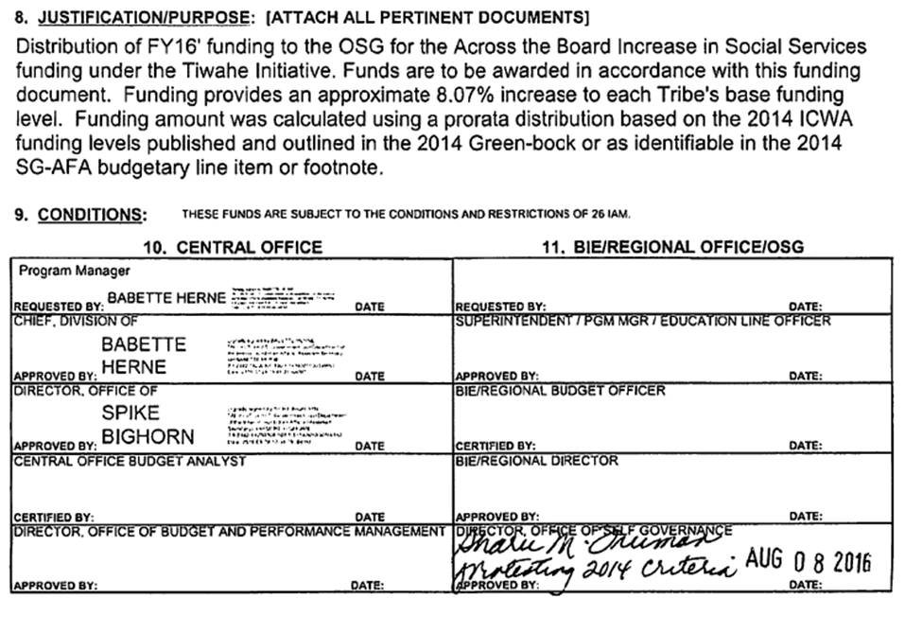
OIG Report No. 2017-ER-018
OSG processed initial distribution “protesting 2014 criteria”
Processed in August or one month prior to end of FY

Slide 11
Notes:
On a large screen this will be more visible

Slide 12
Program Formula Matrix correlation to OIG Report
Recommendation 1: We recommend that AS-IA:
  Direct the Office of Self Governance to work with tribes to track the components of the CTGP funding and publish these individual amounts each year in the BIA's Budget Justifications.
Recommendation 2: We recommend that AS-IA:
  Direct the Office of Self Governance to determine "appropriate levels" of Child Welfare and Social Services program funding that should have appeared in the FY 2014 Budget Justifications.
Recommendation 4: We recommend that AS-IA:
  Direct the Office of Self Governance to determine the actual funding levels of individual tribal programs and report them annually in the Budget Justifications.

Slide 13
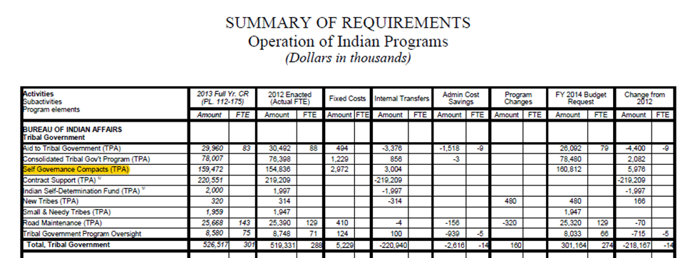
Program Formula Matrix correlation to OIG Report
Block grant type funding:
Self Governance Compacts
Transfers to/from various programs within OIP for Self Governance Compacts, pursuant to Title III of the Indian Self-Determination and Education Assistance Act (P.L. 103-413).
Reference 2014 Greenbook (IA-OIP-2)

Slide 14
TPA Allocations:
Issue 1: Base Funds
Title IV database system was jointly designed and created by tribal/federal staff
Approved with Tribal consultation almost 30 years ago
Operates in the same manner since inception in the 1990’s
While total funding amounts are displayed for Title IV tribes in the Budget Justification, these amounts are in aggregate.
Title IV tracks historical base amounts by individual program line item.
Congressional increases/decreases are recorded in non-program accounts in aggregate.

Slide 15
TPA Allocations:
Issue 1: Base Funds
Non-program accounts
Decreases:
(T9240) Self Governance Compacts-
  There is a negative amount in this line which represents the cumulative across the board (ATB) rescission or decreases that Congress has enacted for all years that the Tribe has been under Self Governance. [Conversely, under Title I, the particular program line is reduced for the rescission.]
Increases:
(T9901)- TPA General Increase
(T9902)- Pay Cost
(T9903)- Retirement Adjustment
  Display the increases that Congress has enacted for all years that the Tribe has been under Self Governance. [Conversely, under Title I, the increase is applied to the corresponding program line associated with the increase.]

Slide 16
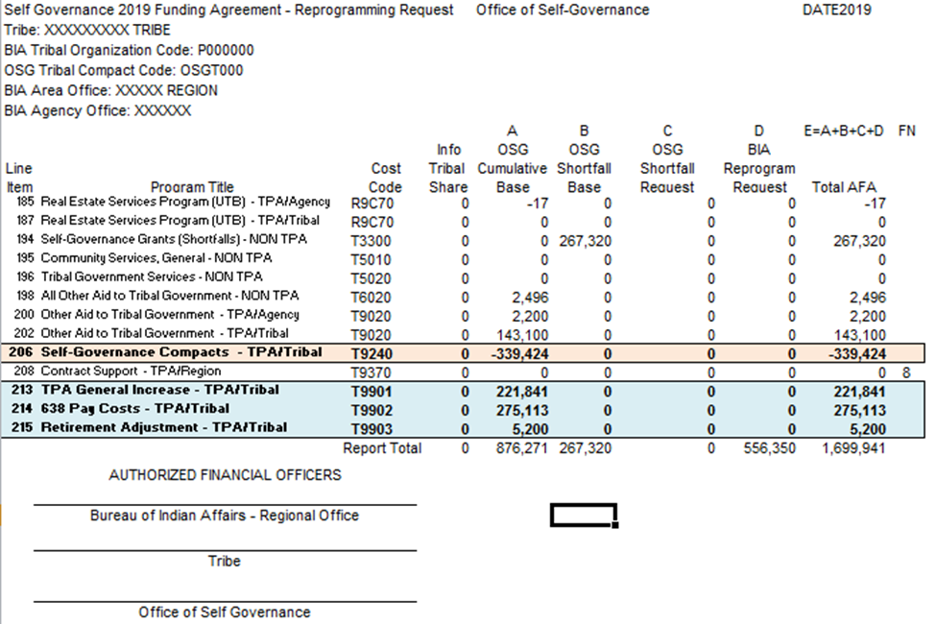
TPA Allocations:
Issue 1: Base Funds

Slide 17
TPA Allocations:
Issue 1: Base Funds
Option A: Perform a Historical Forensic Analysis
Previous Years:
A forensic analysis would be performed for each SG tribe since inception (or when the tribe entered SG) to determine the actual increases/decreases FOR EACH PROGRAM LINE.
Future Years:
The congressional increases/decreases currently recorded in non-program accounts in aggregate would no longer be used.
  Decreases: (T9240) Self Governance Compacts
  Increases: (T9901)- TPA General Increase
  (T9903)- Retirement Adjustment
(T9902)- Pay Cost
Future increases/decreases would be posted to the individual program lines.

Slide 18
TPA Allocations:
Issue 1: Base Funds
Option A: Perform a Historical Forensic Analysis
Advantages/Disadvantages:
Hypothetically the actual amounts could be verified by individual programs.
Difficulty in researching the congressional increases and decreases since inception of SG over the past 30 years.
  Over 280 tribes that entered SG at various periods of time as well as compacted and/or returned programs at various intervals.
  Over 100 program lines to be researched per tribe.
  Very labor and cost intensive and could take a considerable amount of time to complete.
  Reality that paycost salary data has never been reported by program and that data would not be available.

Slide 19
TPA Allocations:
Issue 1: Base Funds
Option B: Prorated Allocation
Previous Years:
The congressional increases/decreases currently recorded in non-program accounts in aggregate would be distributed on a prorated allocation basis.
Future Years: (Same as Option A)
The congressional increases/decreases currently recorded in non-program accounts in aggregate would no longer be used.
  Decreases: (T9240) Self Governance Compacts
  Increases: (T9901)- TPA General Increase
  (T9903)- Retirement Adjustment
(T9902)- Pay Cost
Future increases/decreases would be posted to the individual program lines.

Slide 20
TPA Allocations:
Issue 1: Base Funds
Option B: Prorated Allocation
Advantages/Disadvantages:
Would not be an “actual” or “to the dollar” accounting of each program line.
It would be a fair approximation or estimate.
Would be less labor intensive, less costly and would be easier to implement.

Slide 21
TPA Allocations:
Issue 1: Base Funds
Option C: Continue current operations
  Current operations since the inception of SG would continue
  Funding or approval to implement recommendations are at the discretion of administration.
Advantages/Disadvantages:
  Easiest path but does not address the Tribal issues and recommendations nor would it sufficiently address the OIG recommendations.

Slide 22
TPA Allocations:
Issue 1: Base Funds
Recommendation: Option B Prorated Allocation
Consensus of the workgroup due to the cost benefit comparison
Forensic analysis would be a futile exercise as Title IV tribes have the authority to consolidate and reprogram certain funds.
The tribal representatives would rather forensic analysis funds be used in a manner to best serve tribes, including but not limited to updating the SGDB which tribes access on a daily basis.
Previous Years: perform a prorated allocation of congressional increases and decreases to individual program lines
Future Years: increases/decreases would be posted to the individual program lines once the prior years’ prorated allocation is complete.
Non-program accounts would no longer be utilized.
  (Self Governance Compacts, TPA General Increase, Pay Cost and Retirement Adjustment)

Slide 23
TPA Allocations:
Issue 2: Paycost
Title IV tribes do NOT submit salaries by individual program, rather one salary amount for all base funding
Paycost increases are posted in aggregate to a non program line (T9902)- Pay Cost, rather than individual programs
Title IV Tribes have reported this way for 30 years.
In order for increases/decreases to be posted to individual program line items, the way paycost is allocated will need to be addressed.

Slide 24
TPA Allocations:
Issue 2: Paycost
Option A: Report by Individual program
  Once prior years’ increases have been prorated, SG tribes would have to report salaries by individual program and pay cost would be applied to the corresponding program associated with the increase for future years.
Option B: Continue to Report in aggregate
  Under this option Title IV tribes would continue to submit one salary amount for all base funding.
  This option would require OSG to prorate each paycost increase to individual program line items on an annual basis.

Slide 25
TPA Allocations:
Issue 2: Paycost
Recommendation: Option B Report in Aggregate
Consensus of the workgroup was to continue to submit one salary amount for the calculation of the paycost allocation.
OSG staff would then be required to either manually prorate the paycost increase to individual programs or to upgrade SGDB to electronically perform the function of allocating to individual programs.

Slide 26
TPA Allocations:
Issue 3: CTGP
BIA implemented exercise that encouraged tribes to transfer programs into Consolidated Tribal Government Programs
Reduce the number of contracts and modifications
Consolidate “like-programs”
Precursor to Self Governance
Title I and Title IV tribes transferred a number of programs into CTGP
Title IV funding agreements and/or footnotes should specify the historical individual program amounts consolidated into CTGP.
The breakout of programs included in CTGP has not been published in the Budget Justifications (Greenbook) for Title IV since 2005
Programs included in CTGP may not be included in program increase calculations by program staff.

Slide 27
TPA Allocations:
Issue 3: CTGP
Option A: Publish CTGP breakout in the Green Book.
This option was a recommendation in the recent OIG Report which stated, “Direct the Office of Self Governance to work with tribes to track the components of the CTGP funding and publish these individual amounts each year in the BIA’s Budget Justifications.”
Option B: Zero out CTGP line item
Under this option the CTGP line item would be zeroed out and those programs that were once consolidated would be broken out into the original individual programs.
NOTE: Tribal budgets may still be consolidated as determined by Tribal priorities within the authorities of Self-Governance.

Slide 28
TPA Allocations:
Issue 3: CTGP
Recommendation: Option B: Zero out CTGP line item
Consensus of the workgroup
Zero out the CTGP line item and breakout the individual program amounts to the actual program line item.
Eliminates the need for footnoting the program breakout in FAs
Eliminates the need to produce a separate CTGP breakout for the Budget Justifications (Greenbook)
Facilitates program increase/decrease calculations by individual programs.
Requires tribal agreement

Slide 29
TPA Allocations:
Issue 4: ATG
Some tribes have program funds contained within the Aid to Tribal Government (ATG) line item.
Title IV funding agreements and/or footnotes specifies the historical individual program amounts consolidated into ATG.
These programs may not be included in program increase calculations by program staff.
However, unlike CTGP there are true ATG account funds.
Program funds contained in the ATG line items was not addressed in the recent OIG Report and a recommendation was not made regarding ATG program funds.

Slide 30
TPA Allocations:
Issue 4: ATG
Recommendation:
Breakout Only Program funds from ATG
Consensus of the workgroup
Breakout into individual programs line items ONLY program amounts, not true ATG funds which would remain in that account.
Eliminate the need for footnoting the program breakout in the funding agreements.
Eliminate the need to produce a separate ATG breakout for the Budget Justifications (Greenbook)
Facilitate program increase/decrease calculations by individual programs.

Slide 31
TPA Allocations:
Issue 5: SGDB
In order to implement the recommendations for prorating increases/decreases to individual line items, a process for calculations and posting of the results to Self Governance Data Base (SGDB) for transparency to tribes is necessary.
Option A: No SGDB Upgrade; Manual calculation
Under this option SGDB upgrades are either not approved or not funded.
Manual calculations utilizing excel would be required with results posted utilizing the current SGDB structure.
Option B: SGDB Upgrade with Electronic calculation
Allows the SGDB upgrade to incorporate electronic calculations and posting.
Would require an initial cost but would likely be more cost effective and time efficient than performing manual calculations on an annual basis.

Slide 32
TPA Allocations:
Issue : SGDB
Recommendation 1: SGDB Upgrade
Consensus of the workgroup
Upgrade the SGDB which would allow electronic calculations.
The workgroup considers that tribes would be better served to update the SGDB which tribes access on a daily basis rather than expend funds for a forensic analysis of past congressional increases and decreases.
Recommendation 2: Funding of SGDB Upgrade
DOI should find other sources to pay for the upgrade and not out of program or OSG budget.
Tribal workgroup members pointed out that in 2004 an ATB rescission of .24% was applied to every tribe for IT services. (i.e. Red Lake had $11,419 taken each year, or $182,704 to date)
Notes:
CY 2004 ATO # 1, and appears as follows:
"39240 TPA/Tribal Self-Governance Compacts 2004 Information Technology Reduction -$11,419"
since CY 2004 is $11,419 X 16 = $182, 704.

Slide 33
Summary of Phase 1 Recommendations
To Re-Cap, the Workgroup has completed Phase I of its work and consensus was reached on the following recommendations:
TPA Allocation: Implement a prorated allocation of congressional increases and decreases to individual program lines for previous years.
PayCosts: Continue to submit one salary amount for the calculation of the paycost allocation.
CTGP: Zero out the CTGP line item and breakout the program amounts to the actual program line item.
ATG: Breakout into individual program line items ONLY program amounts.
SGDB Update: Request an upgrade to the SGDB which would allow electronic calculations.
SGDB Funding: The Department should utilize other sources of funding rather than program or OSG funds to support the SGDB system.

Slide 34
Request
OSG and the SGAC Technical Workgroup
are requesting tribal feedback
on the draft recommendations
outlined in this presentation.
Contact: Vickie Hanvey, CPA, CFE, MBA
Program Policy Analyst, OSG
vickie.hanvey@bia.gov
918-931-0745

