Slide 2
Expanding Dental Therapy in Tribal Communities
Brett Weber, National Indian Health Board
Christina Peters, Northwest Portland Area Indian Health Board
Andrew Shogren, Suquamish Tribe

Slide 3
Oral Health Crisis in Tribal Communities
Oral health disease in AI/AN children is four times as high as in white children nationwide.
Often requires treatment under general anesthesia
Costs over $6,000 per child
2016 IHS survey found AI/AN children age 6-9 were 5x more likely than average to have untreated cavities in permanent teeth.
46% of AI/AN adults aged 65+ had untreated dental caries
Compared to 19% of non-native adults age 65+.
Lack of oral health care services in Tribal communities has impacted generations!

Slide 4
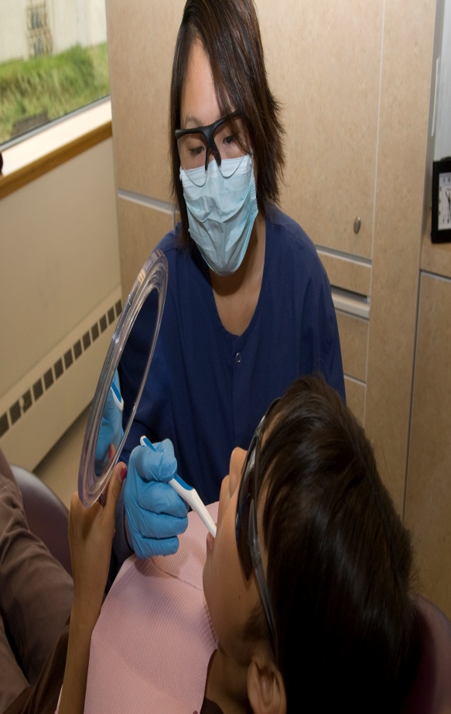
A Solution: Dental Therapy
Model began in the 1920s
Dental therapists practice in 54 countries, including the US, Canada, England, Australia, New Zealand and The Netherlands
Under supervision of dentists, dental therapists can practice in remote settings where there is need for additional provider capacity
Evidence shows care provided by dental therapists is high quality, cost effective and safe
History of providing routine and preventive care in community settings

Slide 5
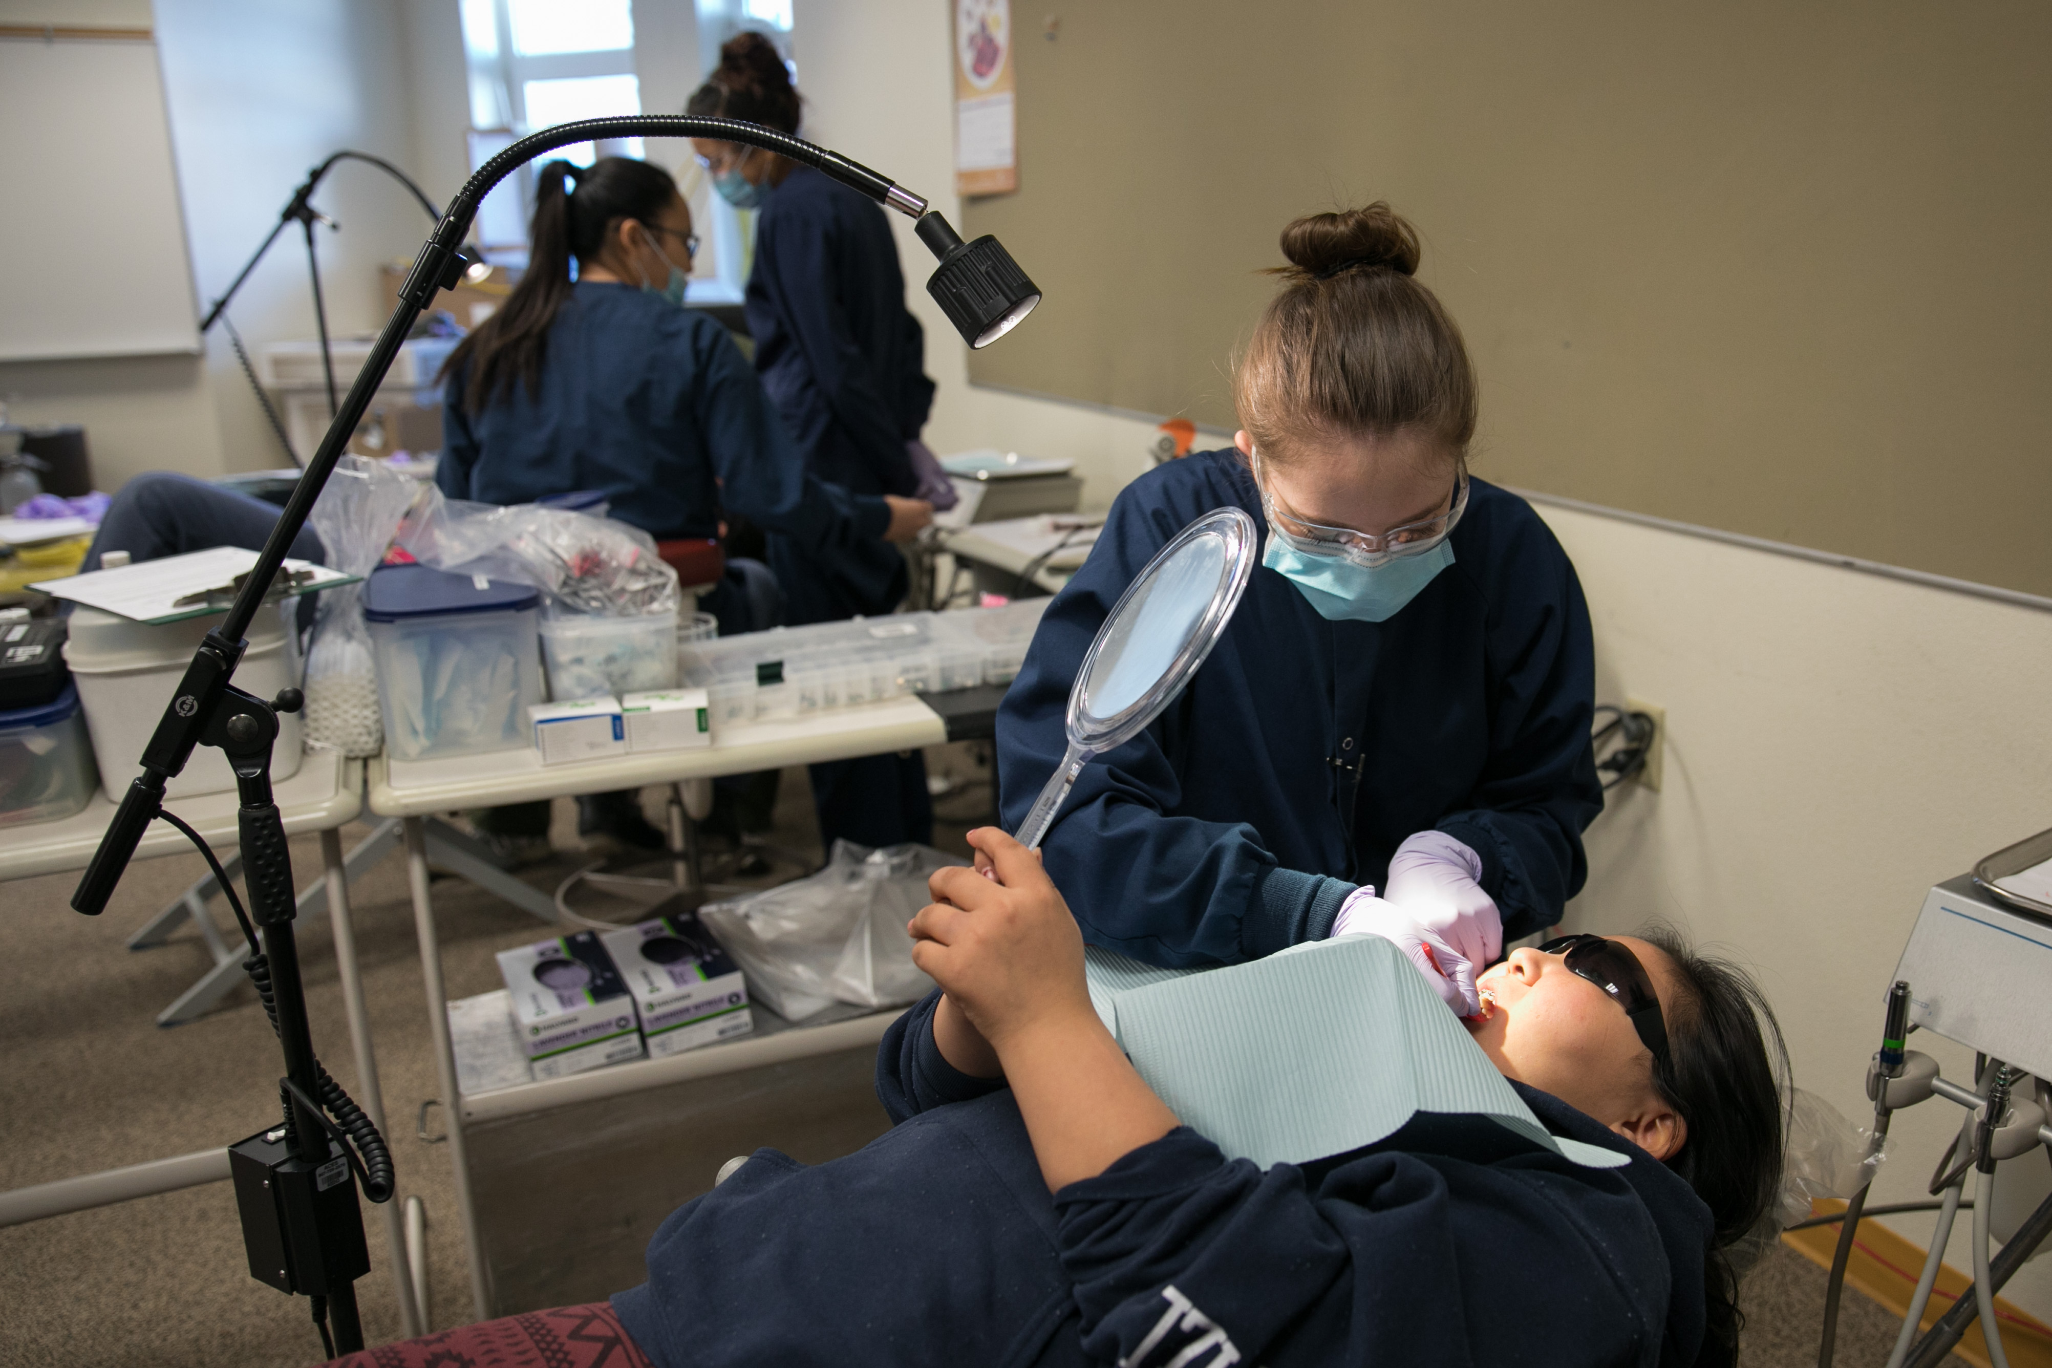
What Exactly are Dental Therapists
Midlevel, focused providers
NPs and PAs of dentistry
Dentists can do ~500 procedures,
DTs can do ~50 procedures
But those 50 are the most commonly needed
Meets between half and two thirds of patient need
DTs focus on preventative and restorative services
Practice under the general supervision of a dentist
Dentist is available for consultation

Slide 6
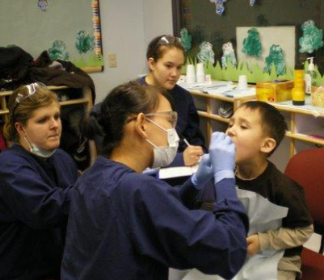
Alaska’s Dental Therapists
Community Health Aide Program provides frontline health care services to Alaska Native communities
CHAP is a federal program operated by Tribes and is unique to Alaska
IHS has begun expanding CHAP to Tribes nationwide
As part of CHAP, ~40 Dental Health Aide Therapists (DHATs) serve over 45,000 Alaska Natives in 81 communities
Provide culturally competent care with high patient satisfaction rates
78% of DHATS practice in their home village or region
Increase preventive care and reduce amount of emergency care

Slide 7
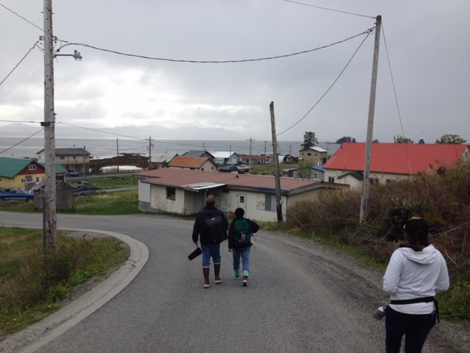
Hub and Spoke Model
DHAT’s are based in larger towns that also have dentists (Bethel, Sitka, Nome)
Travel to smaller Alaska Native communities on a regular schedule
Dentist follows up if necessary
Many of these communities did not have any dental care at all prior to DHATs
NIHB went to Kake, Alaska to document DHATs’ impact on the community’s children in May 2017

Slide 8
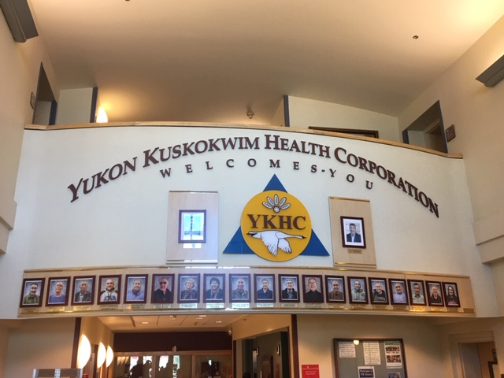
Certification—“Growing our Own”
Commission on Dental Accreditation (CODA) reviews and approves education programs for oral health professionals
In 2015, CODA approved standards for dental therapy education programs
3 academic years, no degree requirements
DHATs trained in Alaska complete the program in 3 academic years/2 calendar years
One year of classroom learning in Anchorage
One year of clinical learning in Bethel
Preceptorship under direct supervision of a dentist
Recertification required every two years
More than 90% of students are AI/AN

Slide 9
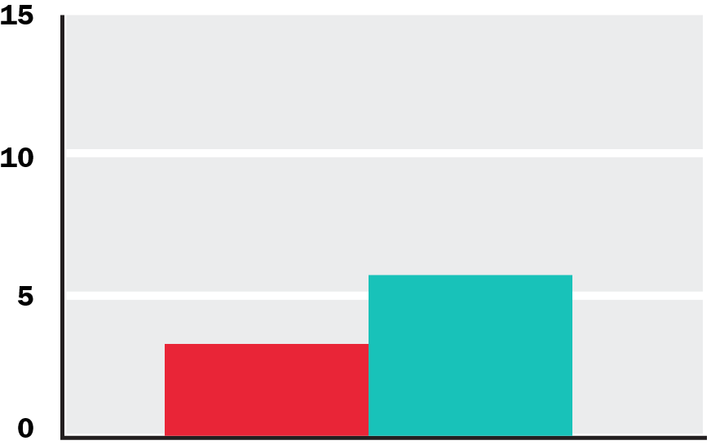
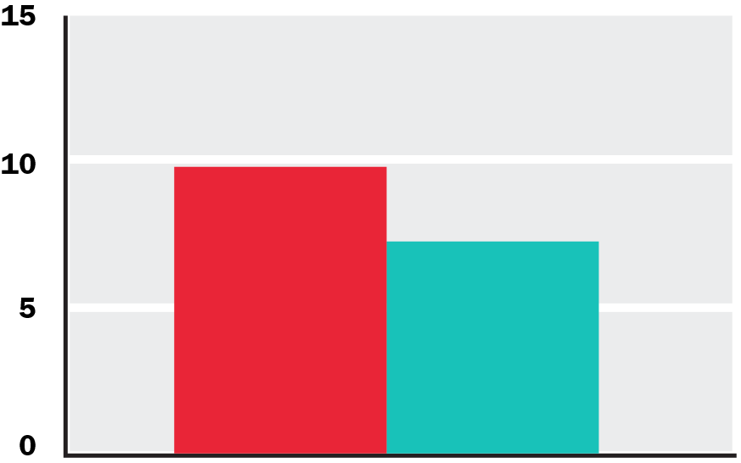
In High-DT Communities
More adults get preventative care.
Adults need fewer teeth extractions.
9.6%
7.1%
5.6%
3.2%
Adult Preventative Care
Adult Extraction Rate
No DT Communities
High DT Communities

Slide 10
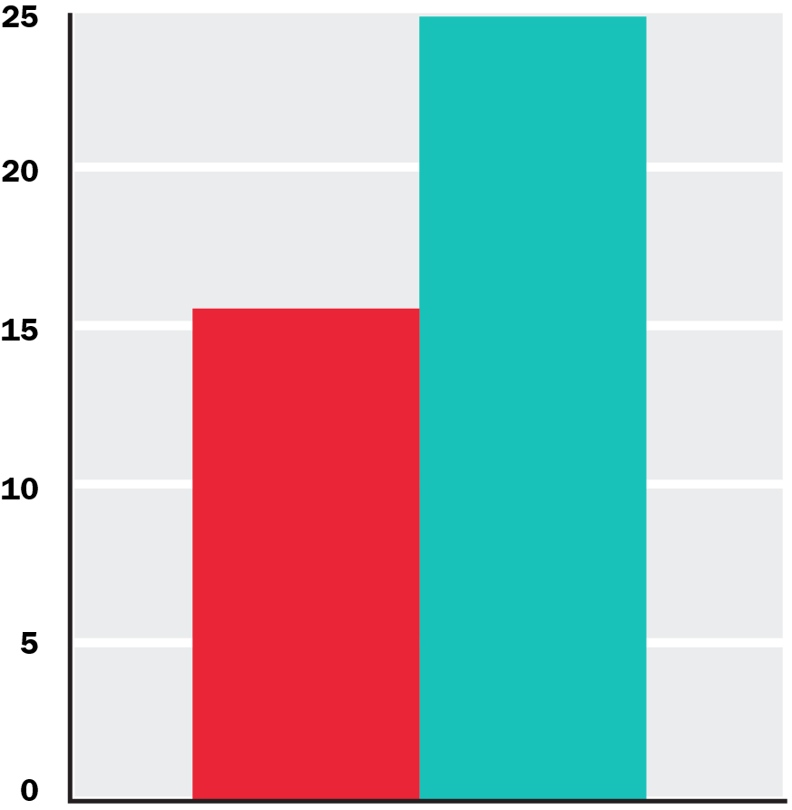
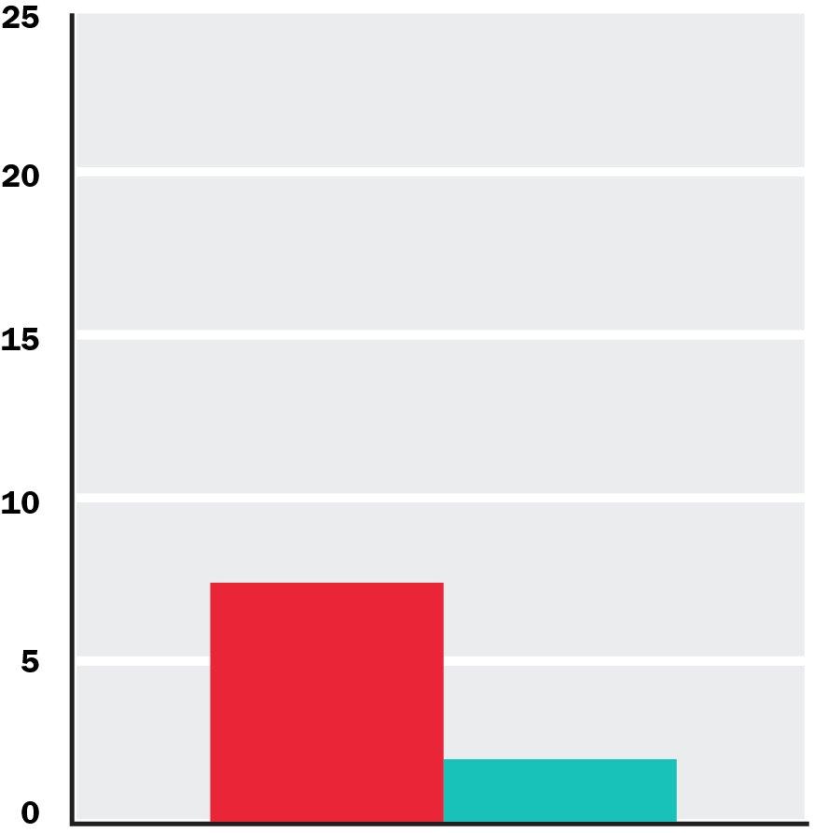
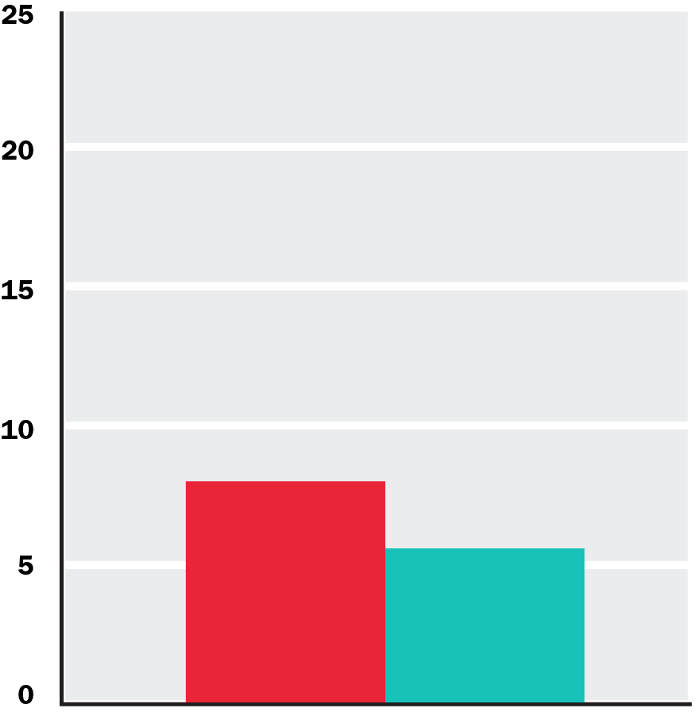
In High-DT Communities
More kids get preventative care.
Kids need fewer front teeth extractions.
Fewer kids need general anesthesia.
24.8%
15.5%
7.3%
7.9%
5.5%
1.9%
Child Preventative Care
Child Extraction Rate
Child General Anesthesia Rate
No DT Communities
High DT Communities

Slide 11
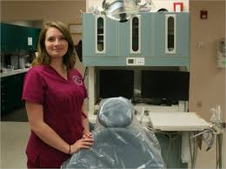
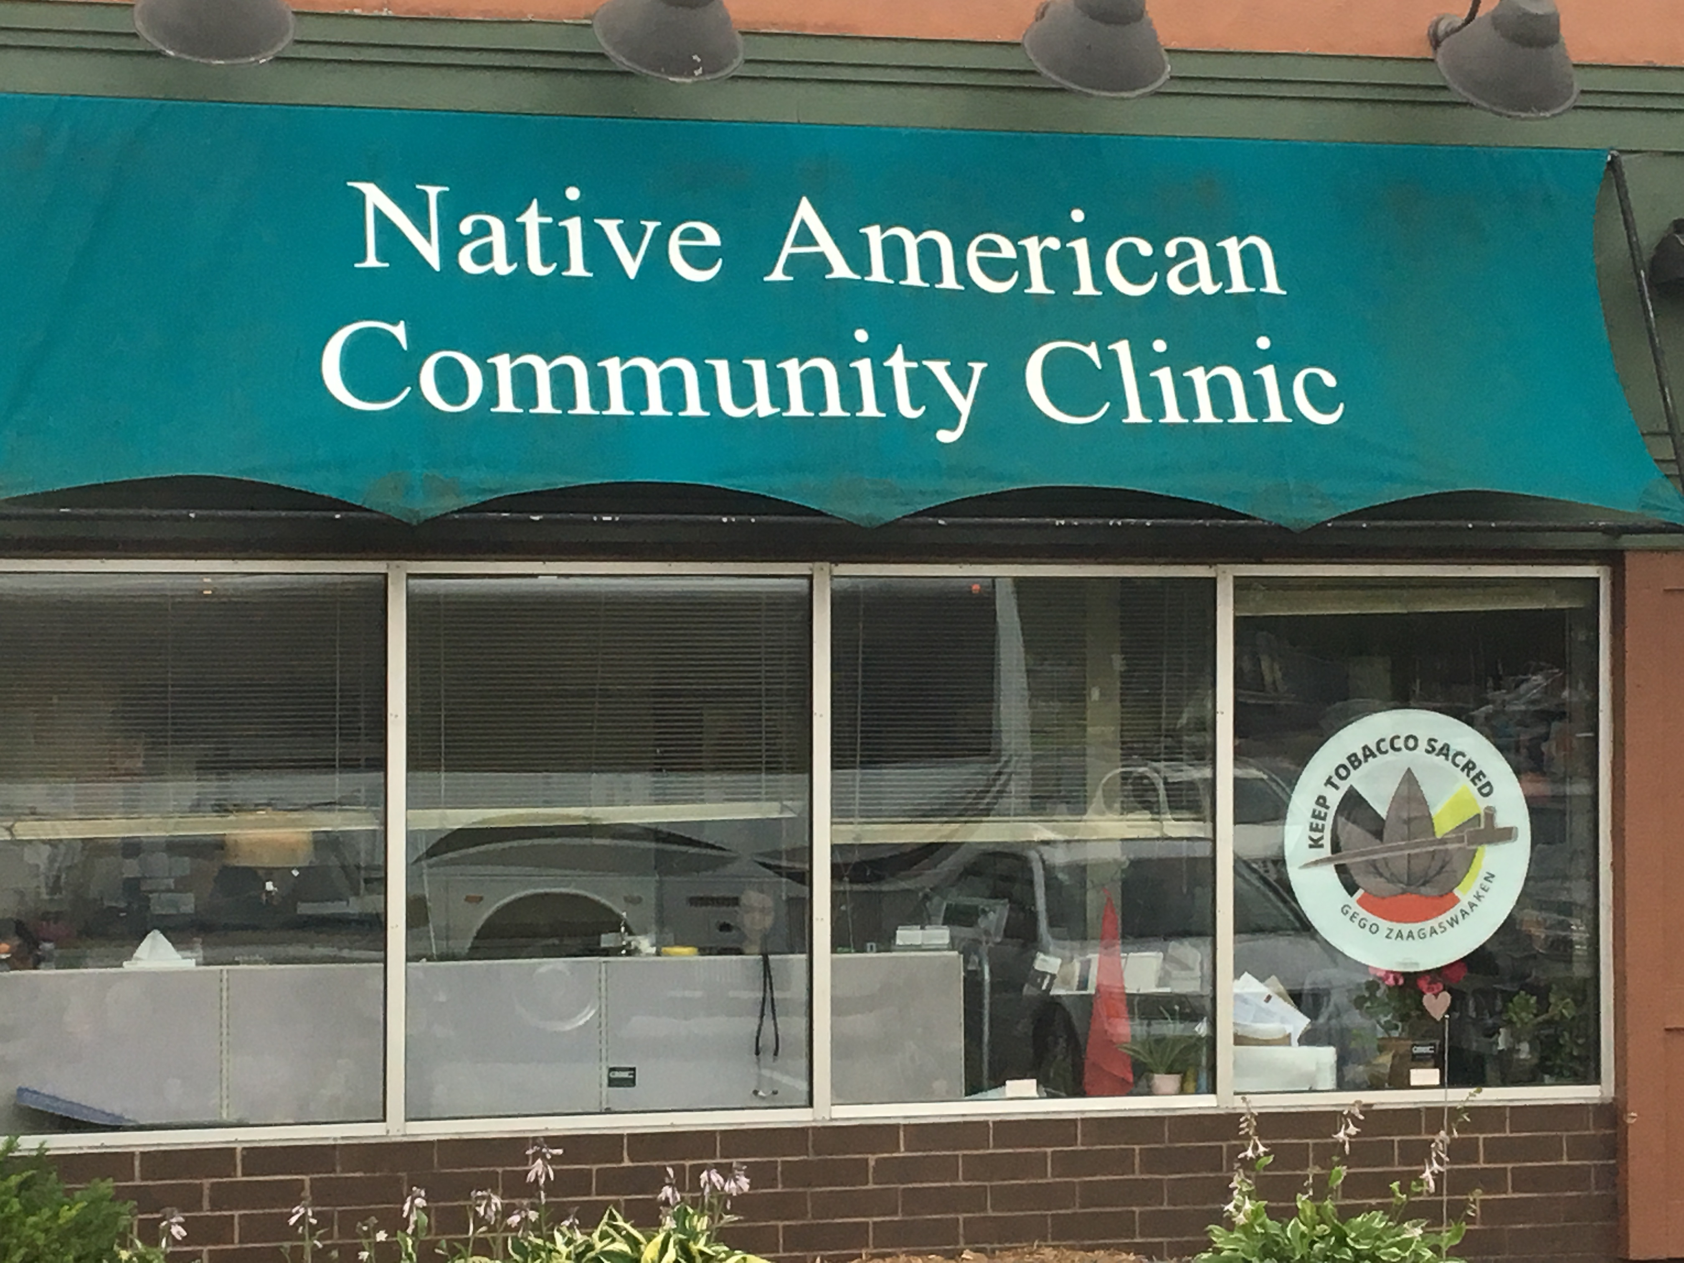
Misinformation: DTs are Unsafe
Strong record of quality care in Alaska and in states that license DTs to practice, such as Minnesota
Liability insurance for DTs in MN is $93/year!
Average for a dentist is $775/year
Education program for DTs provides more time on the procedures they will perform than dentists receive in their education
Notes:
Ok so this all sounds great. Who could be against this? Lots of oral health organizations are in favor of dental therapy, but the main opposition has engaged in scare tactics for years. I’ll give you three quick examples and offer some data that goes against their arguments.

Slide 12
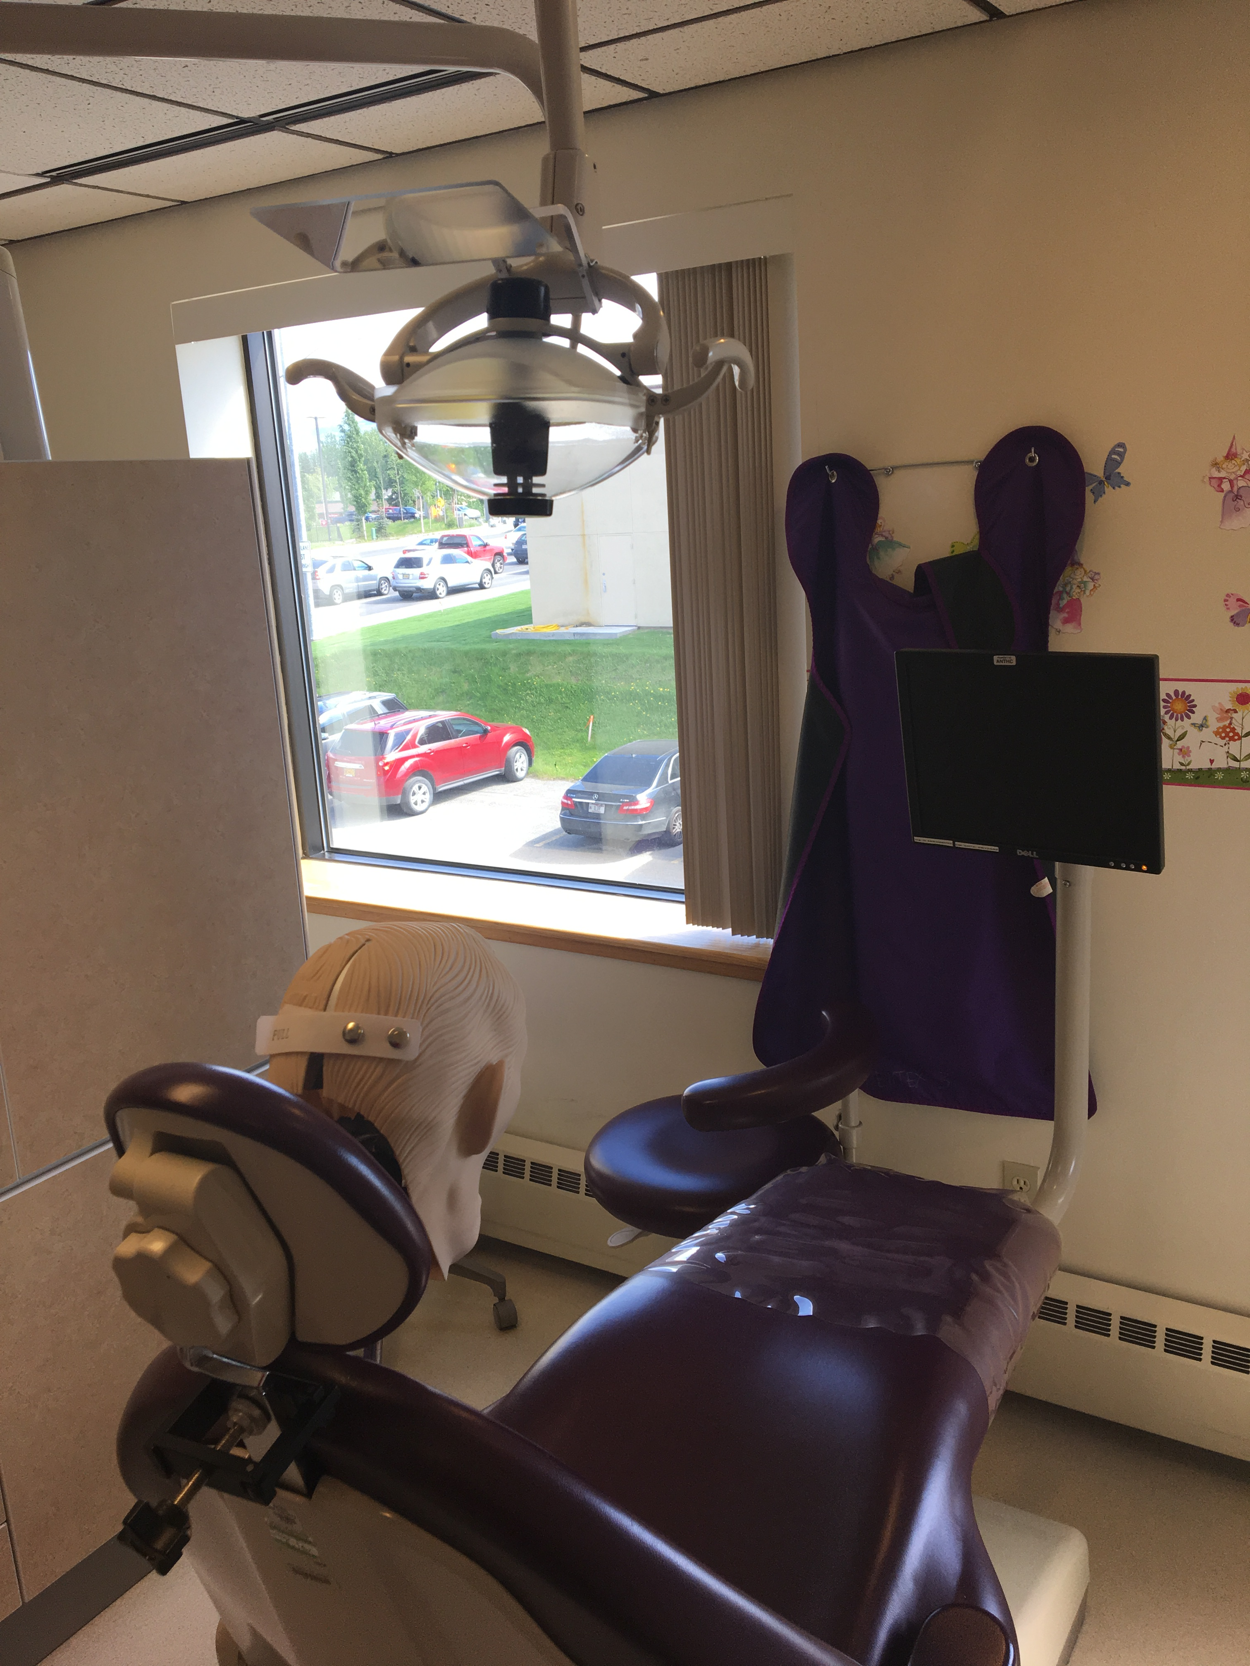
Misinformation: Only Hygienists are Qualified to Become DT’s
Some states have required DTs to have a hygiene license
Not required by CODA
Political compromise
Not only unnecessary, but counterproductive
DT education program is accessible to AI/ANs
Historically, colleges and medical schools have not actively recruited AI/AN students
Few AI/ANs are hygienists or in hygiene school
Pool of DT employees goes from >90% AI/AN to >90% white
Rural Tribes struggle to hire providers
Notes:
Ok so this all sounds great. Who could be against this? Lots of oral health organizations are in favor of dental therapy, but the main opposition has engaged in scare tactics for years. I’ll give you three quick examples and offer some data that goes against their arguments.

Slide 13
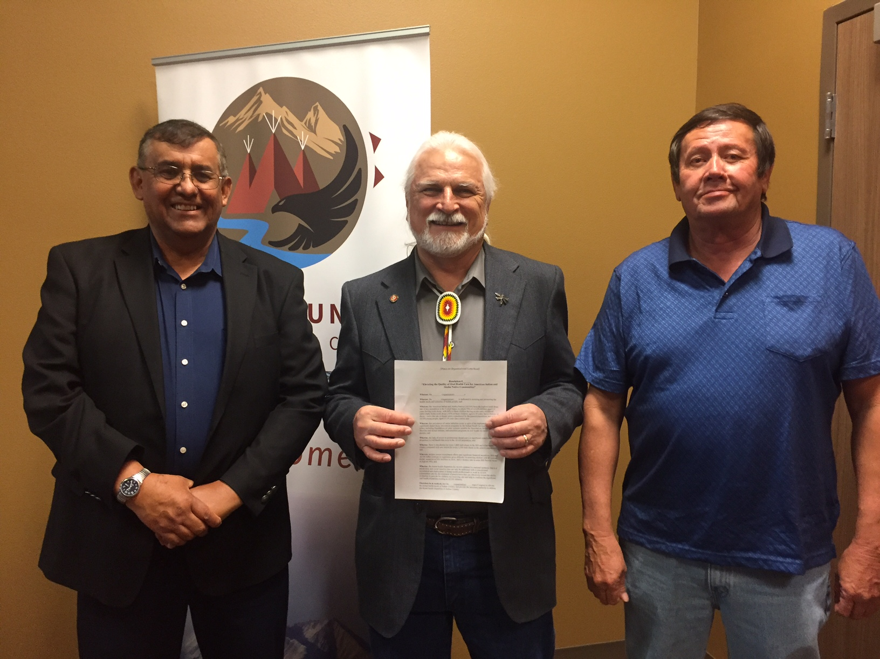
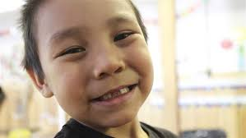
Misinformation: DT’s create a Two-Tiered System
Dental therapists are finally reaching communities that have never had adequate oral health care services
Many communities have had traumatic experiences with dentists that make it difficult for oral health care providers to build trust
Dentists in Alaska visited irregularly and when they did arrive, often just pulled teeth
Some people have access to regular oral health care, and some do not
The two-tiered system is what we have now!
Notes:
Ok so this all sounds great. Who could be against this? Lots of oral health organizations are in favor of dental therapy, but the main opposition has engaged in scare tactics for years. I’ll give you three quick examples and offer some data that goes against their arguments.

Slide 14
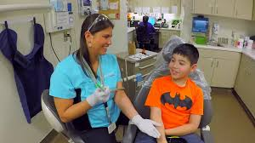
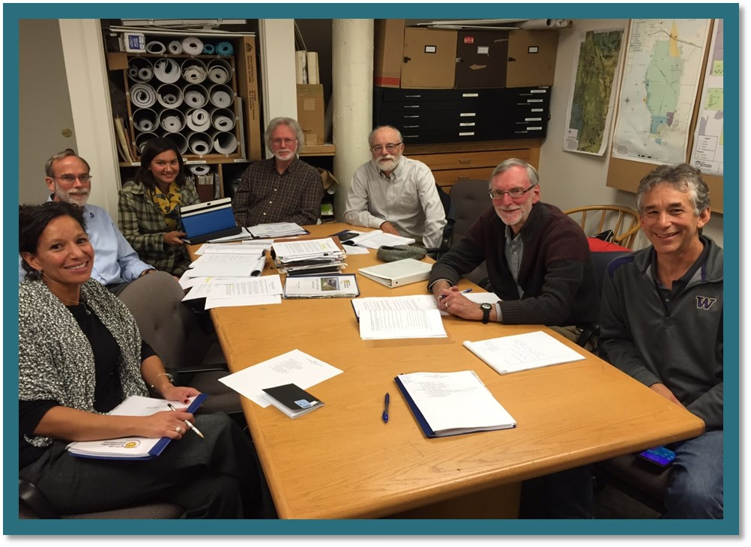
How Can Tribes Hire Dental Therapists?
Three Avenues:
Swinomish Route: Licensing DTs at the Tribal level
State Legislation: Complying with state requirements for DTs
Only because of IHCIA Restriction
CHAP Implementation: Employing federally certified providers
Indian Health Care Improvement Act (25 USC §1616l(d))
Once CHAP expands to Lower 48
Tribes cannot use DTs under national CHAP unless their state gives them permission
Extremely problematic!
Notes:
The federal government has the responsibility to provide health care to Tribes.
Tribes also have inherent sovereignty that lets them govern themselves.
Adding the states into the mix is detrimental to both of these dynamics.

Slide 15
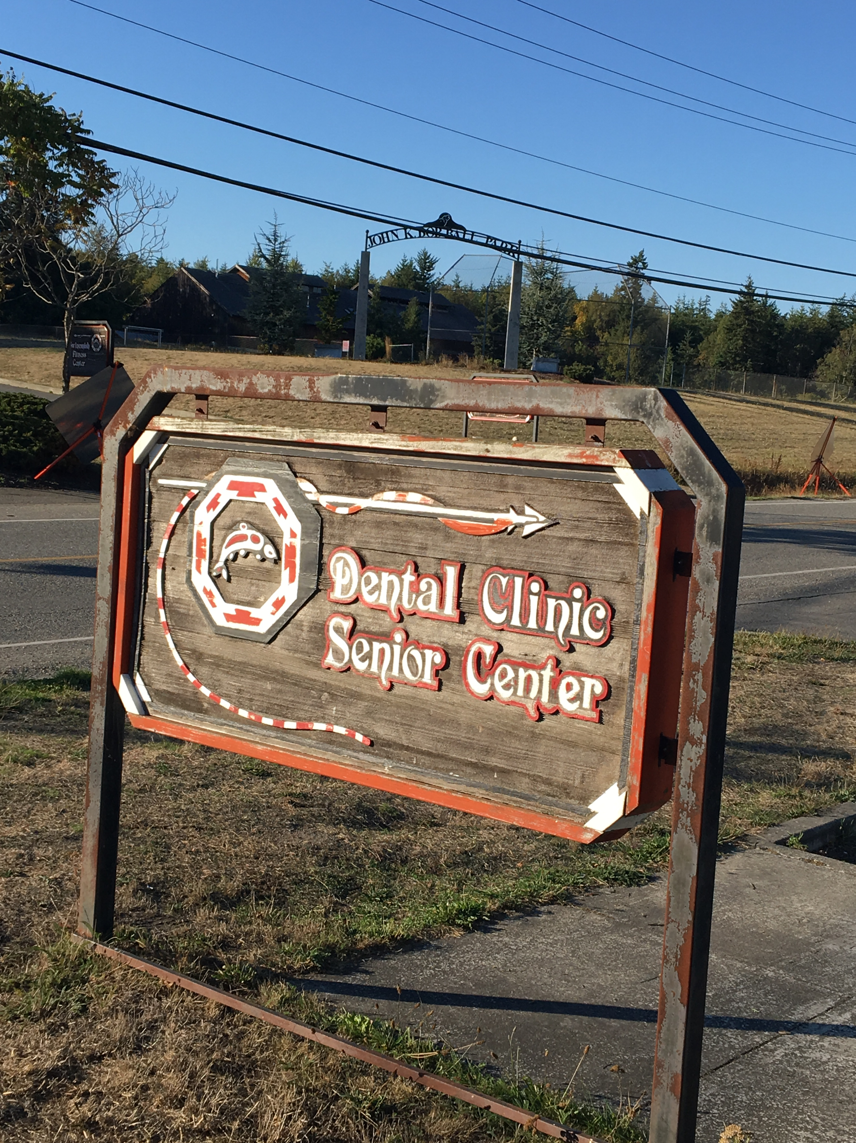
How Swinomish Did It
In January 2016, Swinomish hired a Dental Therapist using its sovereignty
The Tribe decided to create its own licensing board with processes and standards outside of CHAP
Developing this process took years of sustained Administrative support
Three years later, dental therapy has brought in revenue to support the expansion of the Tribe’s dental clinic
Reciprocity agreements may make Swinomish licensed DTs able to practice at other Tribes
Notes:
The federal government has the responsibility to provide health care to Tribes.
Tribes also have inherent sovereignty that lets them govern themselves.
Adding the states into the mix is detrimental to both of these dynamics.

Slide 16
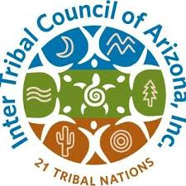
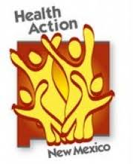
Advocating in State Legislatures
Many Tribes have begun advocating to their state legislatures to license DTs or at least allow DHATs to practice
Washington State, Arizona, Maine, Minnesota, Idaho, New Mexico, and Michigan allow DTs on Tribal land
Oregon has Tribal pilot projects
Active Tribal campaigns in Wisconsin, Montana, & North Dakota
Notes:
According to Sarah Wovcha, ED of Children’s Dental Services in Minnesota

Slide 17
New State Dental Therapy Laws: Currently in Rules Making Phase
Arizona
Michigan
DTs can practice in certain settings
Tribal and Urban Indian programs, federal programs, FQHCs and Look-Alikes, nonprofits serving underserved populations
Requires DTs to have a hygiene license
Tribal exemption
Preceptorship is 1000 hours
State Medicaid agency reimbursement issue
DTs can practice in certain settings
Tribal and Urban Indian programs, FQHCs, schools, clinics and mobile programs serving underserved populations, and any setting in a dental shortage area
CODA-based, no hygiene requirement
Preceptorship is 500 hours

Slide 18
New State Dental Therapy Laws: Passed in 2019
Idaho
New Mexico
DTs can practice in federal or Tribal health programs
Settings include schools and long term care facilities
CODA-based
No Hygiene license requirement
DTs work for 500 hours under direct supervision
DTs can practice in certain settings statewide
FQHCs, Tribal and IHS facilities
Hygiene Requirement
But Tribes can follow CODA standards

Slide 19
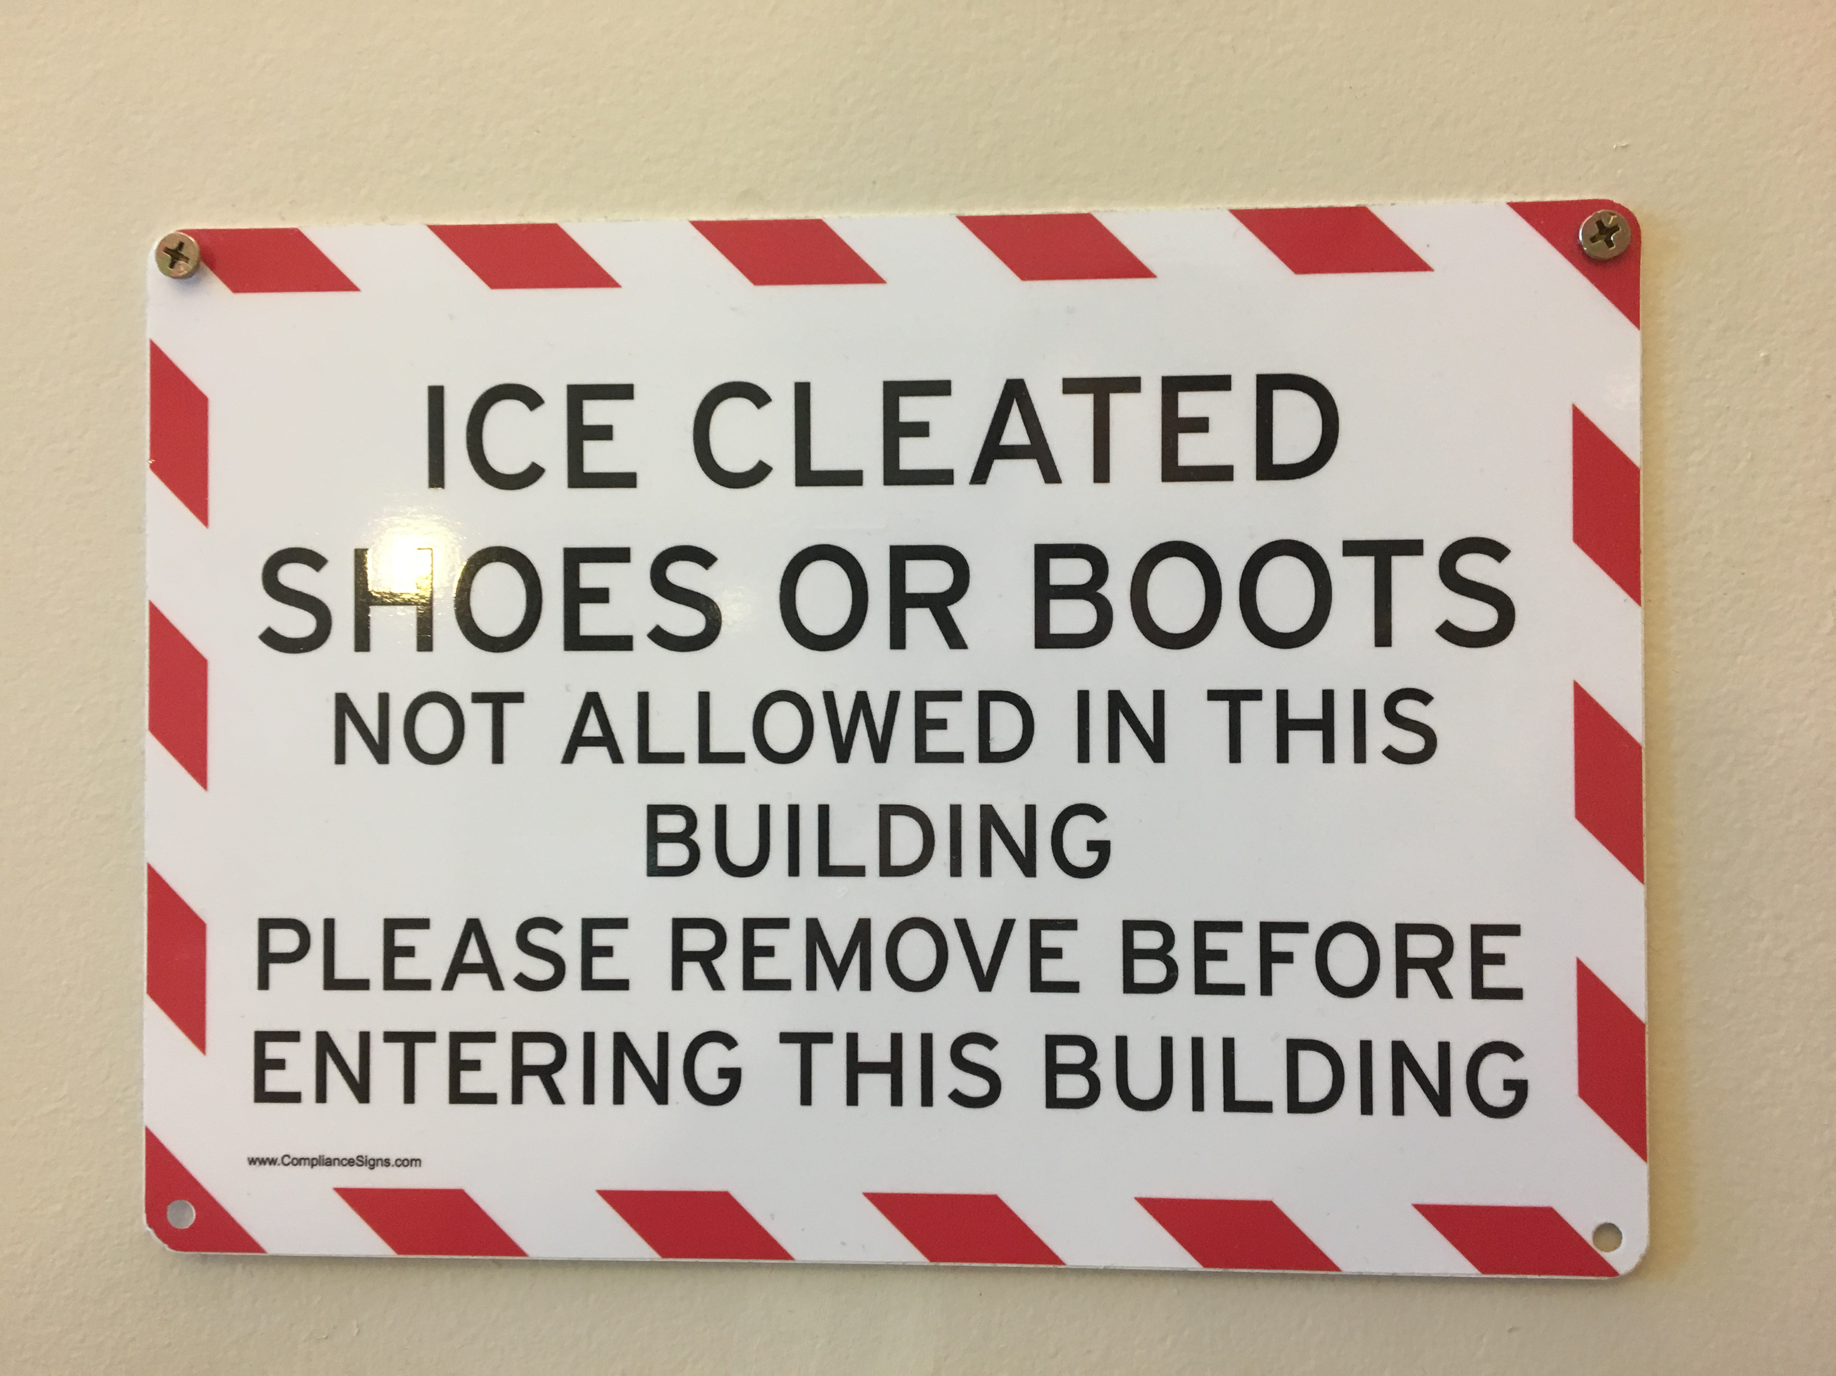
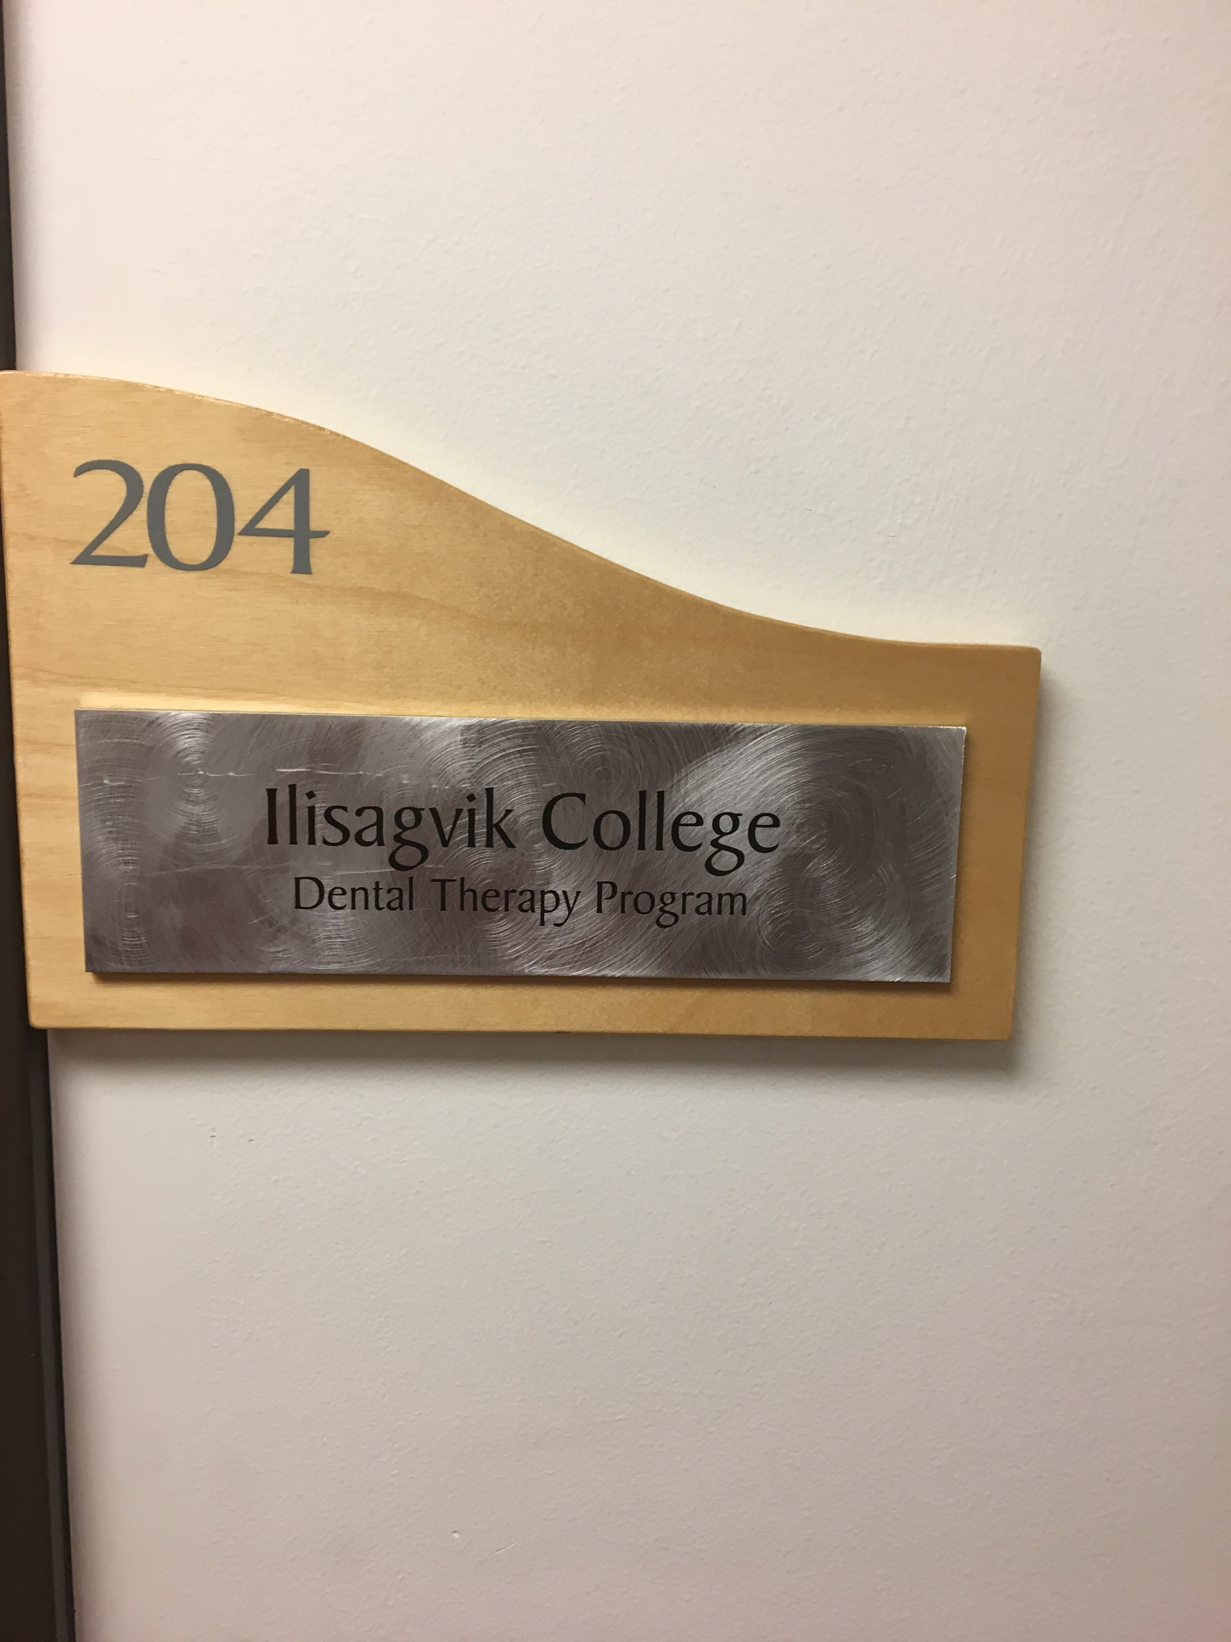
Tribal Colleges and Universities
Community Colleges are a good fit for dental therapy education programs
Many are beginning to look at DT programs in states that passed legislation
Many TCU’s offer Associate’s degrees on a two calendar year track
Natural fit for Alaska DT model
NIHB is working with AIHEC to ensure TCUs are aware of DT and its potential
Developing a TCU specific DT curriculum with ANTHC

Slide 20
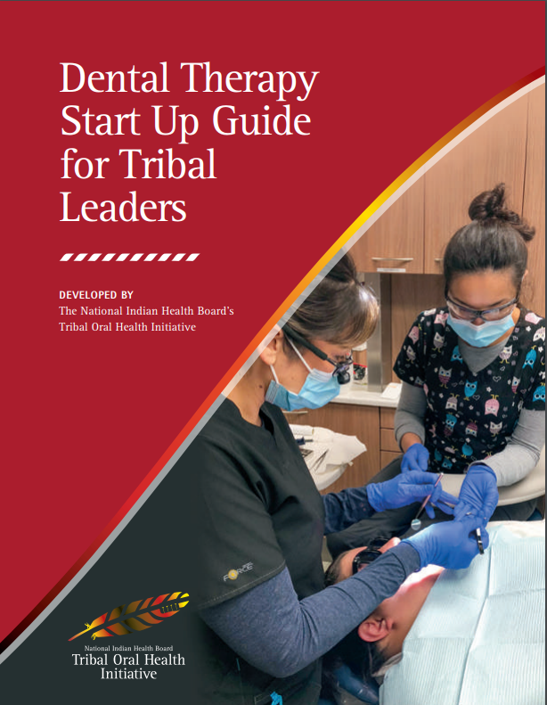
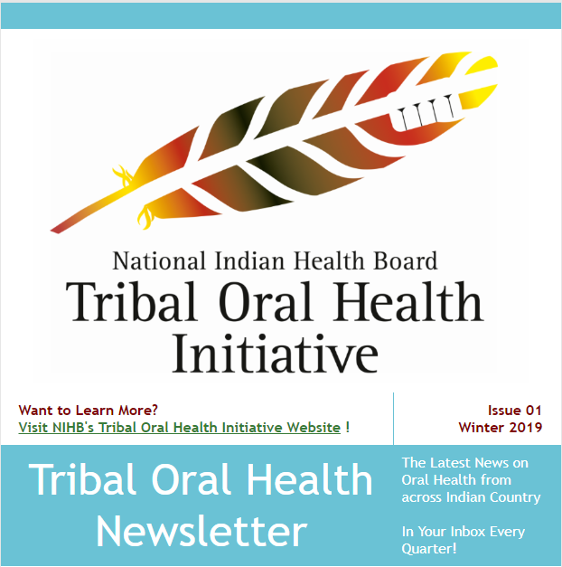
Resources for Getting Started at the Tribal Level
www.nihb.org/oralhealthinitiative

Slide 21
Contact information
Brett Weber
Congressional Relations Coordinator
bweber@nihb.org
www.nihb.org/oralhealthinitiative

