Slide 1
The Anatomy of a Cyber Attack Pokégonek Bodéwadmik April 4, 2019

Slide 2
Outline
A little bit about the Pokagon Band
Our IT environment
Our incident timeline
Questions

Slide 3
A Bit About the Band
10 county service area:
4 in MI
6 in IN
5,600 citizens
Government headquarters in Dowagiac, MI with 300 team members
4 casinos – employing 2,600 team members
New Buffalo
Hartford
Dowagiac
South Bend
Federal reaffirmation
September 21,1994

Slide 4
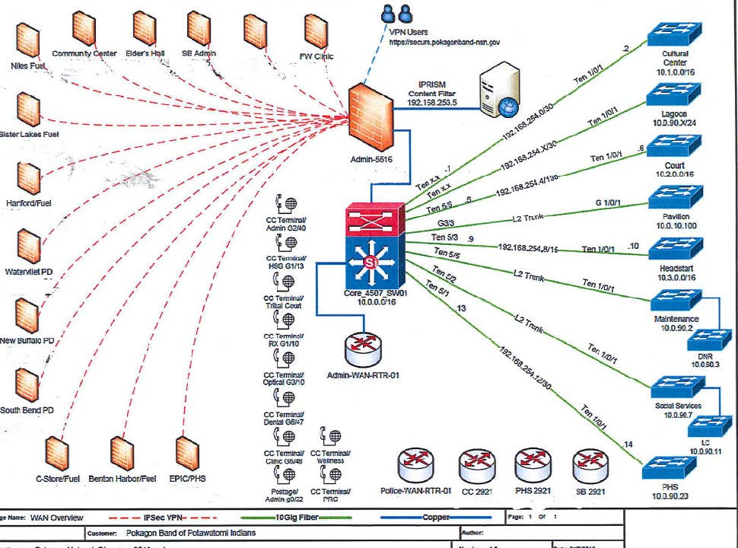
Our IT Environment
Notes:
What do these symbols mean and where is the link from PD to Admin on this page?

Slide 5
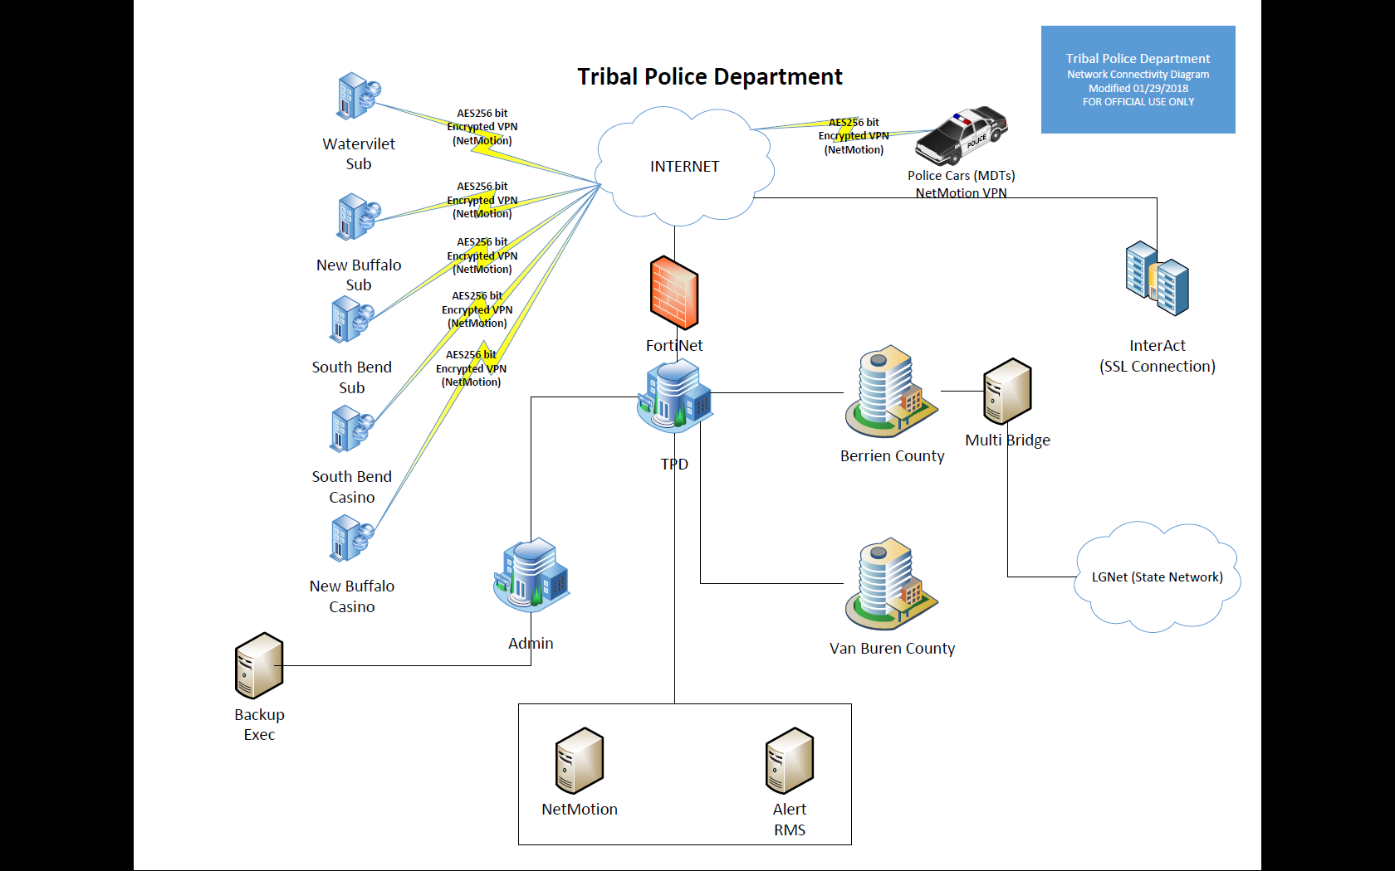
Notes:
Penetration occurred at the Alert RMS (Records Management System). This system was installed by a vendor, without the involvement of IT. When IT caught wind of it, they indicated the structure would not work in our environment and would require an overhaul of the project. This was a grant funded project to tie in 4 counties with the ability to share information. The vendor proceeded anyway no firewalls were established and therefore penetration occurred providing direct access to our internal assets.
Since The RMS was tied to the PD, which is tied to Admin, then through Admins physical location of the switches from the previous page, they got into our entire system. Including the backups.

Slide 6
“We shall rise from the ashes stronger.”
Saturday February 11, 2018 – Discovered ransomware attack had affected our environment. It was determined to be a new variant to the SAMSAM malware. We implemented our incident response plan and gathered the team (GM, AGM, IT, and Chief of Police). From there we notified FBI, Homeland Security and IT vendors.
The ransom request was for 5.5 bit coin, or approximately $55,000 at that time.
Notes:
An attacker can use a number of tools and techniques to retrieve credentials without triggering Anti-Virus programs and other alerts. In our attack the intruder used built-in Windows Operating System commands and used “brute force” to gain access.
The security team has been conducting a complete analysis to identify the type of artefacts that were discovered in the File System along with a Memory Analysis to identify malicious activity to aid in the investigation.
SamSam Variant
According to the FBI case agent, this ransomware has been observed across multiple industries but the recent target has been Healthcare. Regarding our environment, he said “ I wanted to let you know we have not seen data exfiltration, just encryption.”

Slide 7
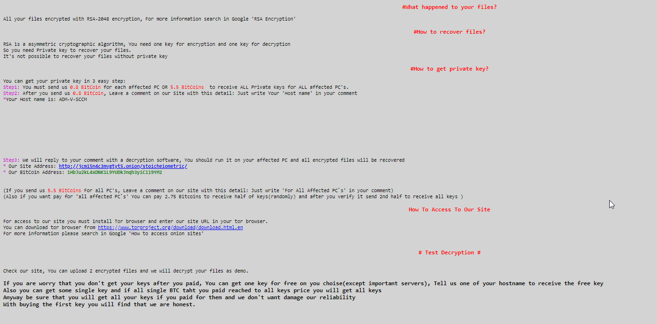

Slide 8
Initial Impact
98% servers infected and non-recoverable
100% backups destroyed
76% workstations infected
Notes:
How many servers???
How many actual work stations??

Slide 9
Event + 2 - 18 (February 12 – March 1)
Our IT vendors started arriving within 24 hours: Truesec, Netech, SharePoint Frontier, Microsoft, Cisco.
Computers were classified into 3 categories:
Tier 1; took computer home over the weekend
Tier 2; turned off the computer, left in office docked to system
Tier 3; computer remained on and open in the office
ALL workstations, servers, network components and connectivity were taken off-line and locked down/out.
ALL computers were tested/scanned/backed up for any type of malware or variant of SAMSAM.
Hotspots were provided to allow departments minimal service to have the ability to see citizens.
Notes:
Tier 1 – took computer home over the weekend – you were the least impacted for your hard drive
Tier 2 - turned off in the office, but docked
Tier 3 – remained on and open in the office – you were toast.

Slide 10
Event + 2 - 18 (February 12 – March 1)
No data was taken, but everything was double encrypted.
Our Health department was deemed the 1st priority, then Finance.
Server rebuilds began.
Password policy implemented, requiring 15 character pass phrase.
We set up one fund to capture all cyber attack related costs for insurance purposes.
Notes:
FBI did not believe we would have been able to get our data restored even if we had paid them the ransom. This is the same malware that hit Atlanta a few weeks later.

Slide 11
Finances, long and winding road…
Platforms used by Finance
What happened to our software
Steps taken
Audit concerns both for 2017 wrap-up and 2018 implications

Slide 12
Platforms Used by Finance
Finance uses GP Dynamics to process all accounting functions:
Payables/Expenses
Receipts/Revenues
Deposits
General Ledger
Budgets
Per Capita (run in a second instance of GP at the time)

Slide 13
Platforms Used by Finance
We also use Papersave for our Payables workflows
GP interfaces with CRM for accurate citizen addresses
Sharepoint – PokagonNet, was not impacted by the cyber attack, other than some files being put in the “Trash” that had to be restored to their proper place
Notes:
Papersave allows us to scan documents directly into GP, to have at our fingertips any supporting document for invoices, deposits, checks paid, etc. It also allows us to set up workflows for AP approvals, that help ensure payables are processed properly.
SharePoint - Anything that was maintained in the cloud was fine. You could access and keep working without any problems. Just had to make sure all your files were in their original place.

Slide 14
What Happened to Our Software
Last day of GP was February 8th
The cyber attack impacted not only our active data, but encrypted our backups as well
Finance lost access to our server drives that housed all our working files (spreadsheets, documents and programs)
Notes:
We had a snow day on the 10th and the notice of the attack came on the 11th. Apparently the perpetrators had been in our system for at least two weeks prior setting up the attack.

Slide 15
What Happened to Our Software
If data could be seen as a tablecloth…then…..
before the cyber attack our data was nicely organized, where each red row was our Financial data, and there were specific blocks of data, then…….
after the attack, the tablecloth was bleached and our data rows scrambled with everyone else’s data and rewoven into a new tablecloth

Slide 16
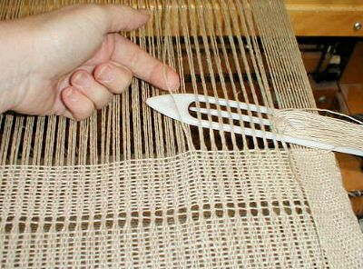
What Happened to Our Software
If data could be seen as a tablecloth…Then…..
IT and our consultants had to tweeze out every strand that was Finance related, and weave it back together to create a complete picture of the Finance programs, particularly GP.

Slide 17
Steps Taken
My awesome team developed a way to continue to process payables, so our vendors/citizens could continue to be paid:
We used spreadsheets, mail merge and a box of unused checks from our storeroom for nearly 3 months to keep the payments going
For Per capita payments we worked in excel and with the Bank to create files to send them so that citizens would continue to be paid as well

Slide 18
Steps Taken
Directors provided their approvals on spreadsheets, and via email sent over batches of transactions to process, along with invoices and other supporting documents to show need for request of payment
Payroll was not impacted, since that is processed by our vendor ADP

Slide 19
Steps Taken
The week of April 2 we were informed that our “tablecloth” was re-woven and IT was able to locate all our data up through the 8th of February, 2018
However we still did not have per capita history from mid May 2017-May 2018
The week of April 16th, we got our Papersave functionality back
The RSM auditors were coming to work on the 2017 audit the week of May 30 after being rescheduled at least twice
Notes:
RSM came out the first time the week of February 19th to work on compliance and other areas they could accomplish without the need of GP and related supporting documents.

Slide 20
Steps Taken
May 1st – May 3rd our Arctic IT consultant were on-site to assist with pushing our receivables transactions into GP
May 7-10, we pushed the accounts payable transaction into GP
May 7th started processing AP in GP, the “old” way with Papersave approvals, through email
We were able to complete the 2017 audit with a clean report issued on June 29, 2018

Slide 21
Steps Taken
We had to scan all our attachments to the “pushed” AP transaction for audit purposes to have all the support in GP as if the attack never occurred. This we accomplished in December 2018.
We pushed all the 2018 Per Capita data into the same instance of GP to be able to process 1099’s by 1/31/2019, abandoning the second instance of GP. Also done in December 2018.
We had incorporated the Per Cap processing by June, 2018 into the one instance of GP, meaning we had to push January-May.
Notes:
2018 Per Cap was Jan-May.

Slide 22
Steps Taken
RSM has been out to complete field work in February for our 2018 audit
Increased testing around the Feb-May time frames
We have been able to provide them with every document requested, proof of approvals, and other supporting documents to complete the audit
The audit is not complete but is 95% there, as we wait for our component unit to wrap-up and to clear any final open items
I am expecting a “clean” audit, no journal entries, and no material weaknesses.
Notes:
We will have the obvious didn’t perform timely reconciliations, did present financial statements, housekeeping type items that were completed by year end.

Slide 23
E + 127 (June 18, 2018)
June 18 was the last entry in our cyber attack blog…. We are still finding issues, still replacing servers, still updating security, performing necessary upgrades, but things are returning to a new normal.
Atlanta is into their attack for $11M and have not resolved their issues.
Finally, working with our insurance carrier has been grueling, painful and disruptive.
So bad that they even cancelled us “due to adverse claim experience” right in the middle of all of this. No settlement has been finalized as of yet, but we have incurred over $2M, and received about $550K from insurance.

Slide 24
The Silver Lining….
We got to fast track many upgrades to security and IT infrastructure
We got to test our Emergency Preparedness procedures and update those from lessons learned
Solidified new policies
Increased our use of SharePoint as cloud based technology

