Slide 2
BIA Contract Support Costs
Title IV Award Formulation Process with the Office of Self Governance
Miles Reader, Financial Specialist

Slide 3
Public Law 93-638
Section 106(a)(2): CSC shall consist of reasonable costs for activities to ensure compliance with terms of the contract and prudent management
Section 106(a)(3): authorizes reimbursement of reasonable and allowable Contract Support Costs which may be either direct or indirect in nature, so long as they do not duplicate costs which are funded through program allocations
Section 106(a)(5) and (a)(6): authorizes startup and pre-award costs to be provided as a part of CSC

Slide 4
Startup Contract Support Cost Awards
Startup costs consist of the reasonable costs that have been incurred or will be incurred on a one-time basis pursuant to the contract necessary to plan, prepare for, and assume operation of the PSFA that is the subject of the contract; and to ensure compliance with the terms of the contract and prudent management.
Examples:
Administrative computer and hardware
Training necessary to operate the program
Systems development
Equipment & furniture (Administrative staff)
Travel to participate in contract negotiations

Slide 5
OSG’s Annual Contract Support Data Request
August 1 Deadline to submit data!!

Slide 6
The Budgetary Data Components
Budgeted BIA Program Salaries Expense (Excluding Fringe)
Budgeted Indirect Cost Exclusions (Per Terms of Indirect Cost Rate)
Pertains to Tribes with IDC rates applicable to Total Direct Cost
BIA Programs ONLY! Do NOT Include Data Pertaining to:
Federal Highway Tribal Transportation Program
Department of Health and Department of Labor 477 Programs
Wildland Fire Preparedness
Construction Funds
Etc. – If you’re unsure, ask us!

Slide 7
Understand Tribes IDC Agreement Complete Data Request Accordingly
Data Request Section 1 – Modified Total Direct Cost – Report Exclusions!
Data Request Section 2 – Direct Salaries and Wages Including Fringe
Data Request Section 3 – Direct Salaries and Wages Excluding Fringe

Slide 8
The Calculation Process Modified Total Direct Cost Example
Budgeted Program Salaries $ 50,000
National DCSC Rate 18.00%
Direct CSC Requirement $ 9,000
Total OIP Awarded $200,000
Less: IDC Exclusions $ (20,000)
Add: Direct CSC Award $ 9,000
Direct Cost Base $189,000
Indirect Cost Rate 50.00%
Indirect CSC Requirement $ 94,500

Slide 9
The Calculation Process Continued...
Combined Award Calculated for Tribe: $103,500

Slide 10
CSC Analysis Form – Optional Tool Guide
Choose Column Pertaining to Your IDC Rate
Follow Directions for Each Row
Aided with Self Governance Database Reports

Slide 11
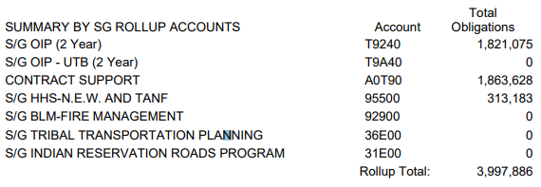
CSC Analysis Form Continued… Self Governance Database Reports
Cumulative Obligations Report
$XXX,XXX
$XXX,XXX
$XXX,XXX
$XXX,XXX
$XXX,XXX
$XXX,XXX
$XXX,XXX
$XXX,XXX
$X,XXX,XXX
Contract Support Account is a New Feature in 2019

Slide 12
Common Issues/Errors to be Mindful Of
Outdated indirect cost rate
May not be greater than 4 years old
Untimely initiation of IDC rate negotiations
If new lower rate approved during FY, over payment situation may exist
If rate for current FY not approved until after FY end, will NOT re-calculate award, per policy
Salary/exclusion data includes info pertaining to non-BIA programs in Funding Agreement
May cause over payment issue.
Unresponsive to annual CSC data request
There are no dumb questions – Ask!

Slide 13
Office of Self Governance CSC Team
Thomas Gubatayao
(360) 699-1010
thomas.gubatayao@bia.gov
Miles Reader
(360) 699-1004
miles.reader@bia.gov

