Slide 2
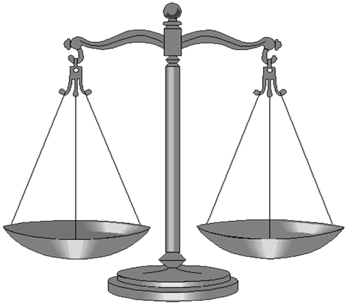
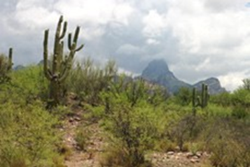
“Public Safety & Justice – Strong Tribal Court Systems Strengthen Tribal Sovereignty and Self-Governance: Tribal Court Assessments”
Alfred “Fred” Urbina, Esq.
Assistant Attorney General –Tohono O’odham Nation
Alfred.Urbina@tonation-nsn.gov

Slide 3
Why Do This Now?
“By submitting to the overriding sovereignty of the United States, Indian tribes therefore necessarily give up their power to try non-Indian citizens of the United States except in a manner acceptable to Congress. This principle would have been obvious a century ago when most Indian tribes were characterized by a "want of fixed laws [and] of competent tribunals of justice." It should be no less obvious today, even though present-day Indian tribal courts embody dramatic advances over their historical antecedents.”
Oliphant v. Suquamish Indian Tribe, 435 U.S. 191, 209-10 (1978)
Notes:
Change, Legitimacy, etc.
ARTICLE VIII.
If any citizen of the United States, or other person not being an Indian, shall settle on any of the Cherokees' lands, such person shall forfeit the protection of the United States, and the Cherokees may punish him or not, as they please.
ARTICLE XI. Cherokee Treaty of Holston 1791
If any citizen or inhabitant of the United States, or of either of the territorial districts of the United States, shall go into any town, settlement or territory belonging to the Cherokees, and shall there commit any crime upon, or trespass against the person or property of any peaceable and friendly Indian or Indians, which if committed within the jurisdiction of any state, or within the jurisdiction of either of the said districts, against a citizen or white inhabitant thereof, would be punishable by the laws of such state or district, such offender or offenders, shall be subject to the same punishment, and shall be proceeded against in the same manner as if the offence had been committed within the jurisdiction of the state or district to which he or they may belong against a citizen or white inhabitant thereof.

Slide 4
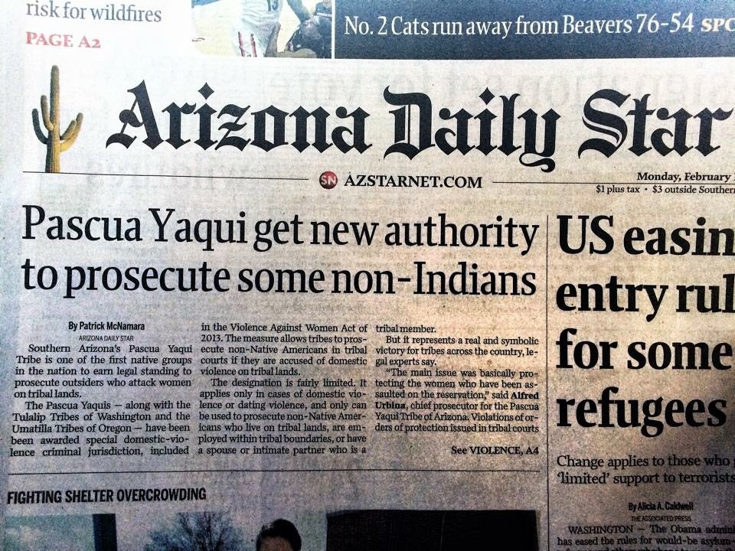
Restored Jurisdiction - Tribal Sovereignty
Tribes possess all powers of self government, except those relinquished under treaties, those that Congress has expressly extinguished, and those that federal courts have ruled are subject to existing federal law or are not consistent with national policies.

Slide 5
Oliphant v. Suquamish Indian Tribe
“In the absence of affirmative withdrawal by treaty or statute, I am of the view that Indian tribes enjoy, as a necessary aspect of their retained sovereignty, the right to try and punish all persons who commit offenses against tribal law within the reservation. Accordingly, I dissent.”
~Justice Thurgood Marshall
1978
Notes:
435 U.S. 191 (1978). 1973, Suquamish (127 Courts, 71 Tribal Courts, 33 Extended Jurisdiction to Non-Indian offenders (45 years)

Slide 6
VAWA 2013
Nature of SDVCJ criminal jurisdiction
Notwithstanding any other provision of law, in addition to all powers of self-government…the powers of self-government of a participating tribe include the inherent power of that tribe, which is hereby recognized and affirmed, to exercise special domestic violence criminal jurisdiction over all persons.
25 U.S. Code § 1304 (b)(1)

Slide 7
SDVCJ Implementing Tribes
Pascua Yaqui Tribe (AZ)
Exercising jurisdiction since February 20, 2014.* 40 Arrests. 20 Convictions.
Tulalip Tribes of Washington
Exercising jurisdiction since February 20, 2014.* 25 Arrests. 16 Convictions.
Confederated Tribes of the Umatilla Indian Reservation (OR)
Exercising jurisdiction since February 20, 2014.* 13 Arrests. 8 Convictions.
Sisseton-Wahpeton Oyate (SD/ND)
Exercising jurisdiction since March 6, 2015.* 8 Arrests. 7 Convictions.
Assiniboine & Sioux Tribes of the Fort Peck Reservation (MT)
Exercising jurisdiction since March 6, 2015.* 18 Arrests. 6 Convictions.
Little Traverse Bay Bands of Odawa Indians (MI)
Exercising jurisdiction since March 7, 2015. No Arrests.
Alabama-Coushatta Tribe of Texas
Exercising jurisdiction since March 7, 2015. 2 Arrests. 1 Conviction.
Choctaw Nation of Oklahoma
Exercising jurisdiction since May 9, 2015. 3 Arrests. 3 Convictions.
Eastern Band of Cherokee Indians (NC)
Exercising jurisdiction since June 8, 2015. 25 Arrests. 12 Convictions.
Seminole Nation of Oklahoma
Exercising jurisdiction since July 6, 2015. No arrests.
Sac and Fox Nation (OK)
Exercising jurisdiction since March 1, 2016. No arrests.
Kickapoo Tribe of Oklahoma
Exercising jurisdiction since March 15, 2016. No arrests.
Nottawaseppi Huron Band of Potawatomi (MI)
Exercising jurisdiction since March 18, 2016. No arrests.
Muscogee (Creek) Nation (OK)
Exercising jurisdiction since March 28, 2016. 1 Conviction
Standing Rock Sioux Tribe (SD/ND)
Exercising jurisdiction since May 1, 2016. 1 Arrest. 1 Conviction.
Sault Ste. Marie Tribe of Chippewa (MI)
Exercising jurisdiction since December 13, 2016. 8 Arrests. 2 Convictions.
Chitimacha Tribe of Louisiana
Exercising jurisdiction since February 1, 2017. No arrests.
Lower Elwha Klallam Tribe (WA)
Exercising jurisdiction since June 5, 2017. No arrests.
Cherokee Nation (OK)
Port Gamble S’Klallam Tribe (WA)
Gila River Indian Community (AZ)
1 arrest.
* Denotes Pilot Project Tribe

Slide 8
Other MILESTONE: EXTRADITION
2 VAWA Offenders with Post-Conviction Tribal Warrants
Probation Absconders
Warrant Domesticated and Executed by State (Comity), pursuant to state statute.
Offenders Extradited by State of Arizona (Pima County) to Tribal Court
***Along with Orders of Protection Tribal Jurisdictional reach is expanded into state. (DOJ TAP Program NCIC Access)

Slide 9
2019 VAWA Reauthorization
Domestic violence;
dating violence;
Stalking;
Sex trafficking;
Sexual violence;
Missing and murdered Indians;
DV against a child or elder;
Obstruction of justice;
Assault of a law enforcement or correction officer;
Tribal Access Program (TAP) funding; and
Alaska Pilot project to allow up to five tribes in Alaska to implement special tribal criminal jurisdiction

Slide 10
D.O.J. TRIBAL ACCESS PROGRAM (the TAP)
TRIBAL ACCESS TO THE CRIMINAL JUSTICE information SYSTEM (NCIC) (CJIS)
The T.A.P. is a special Department of Justice program designed to provide Tribes access to national criminal databases known as the Criminal Justice Information System (CJIS).
CJIS is administer by the Federal Bureau of Investigation pursuant to federal law. Access to CJIS is regulated by federal law and FBI regulations.
It was created to address the lack of access to criminal justice information by many tribes and to expand access to the tribal courts and civil agencies.
Examples of civil agencies are: Child Welfare, Housing, and Human Resources.

Slide 11
What is the Real Life Effects of CJIS Access?
Access enables a user to perform criminal background checks based on a name or set of prints.
Allows law enforcement to check for outstanding criminal warrants
It also allows some users to upload information regarding DV orders of protection and sex offender information.
It permits background checks of applicants whose jobs involve contact with Indian Children.
It enables the Court (or Police) to upload disposition information, warrants, sex offender info, & orders of protection.

Slide 12
Why Do This Now?
Sovereignty, Self-Governance
Expanded Criminal jurisdiction, Enforce Laws (TLOA, VAWA, SORNA, ICWA, TAP, MMIW)
Civil rights, due process, equality, (ICRA)
Justice, deterrence, social order, rehabilitation.
Governmental, Legitimacy, trust, fairness, conflict resolution.
Incorporate cultural values, history, traditions.

Slide 13
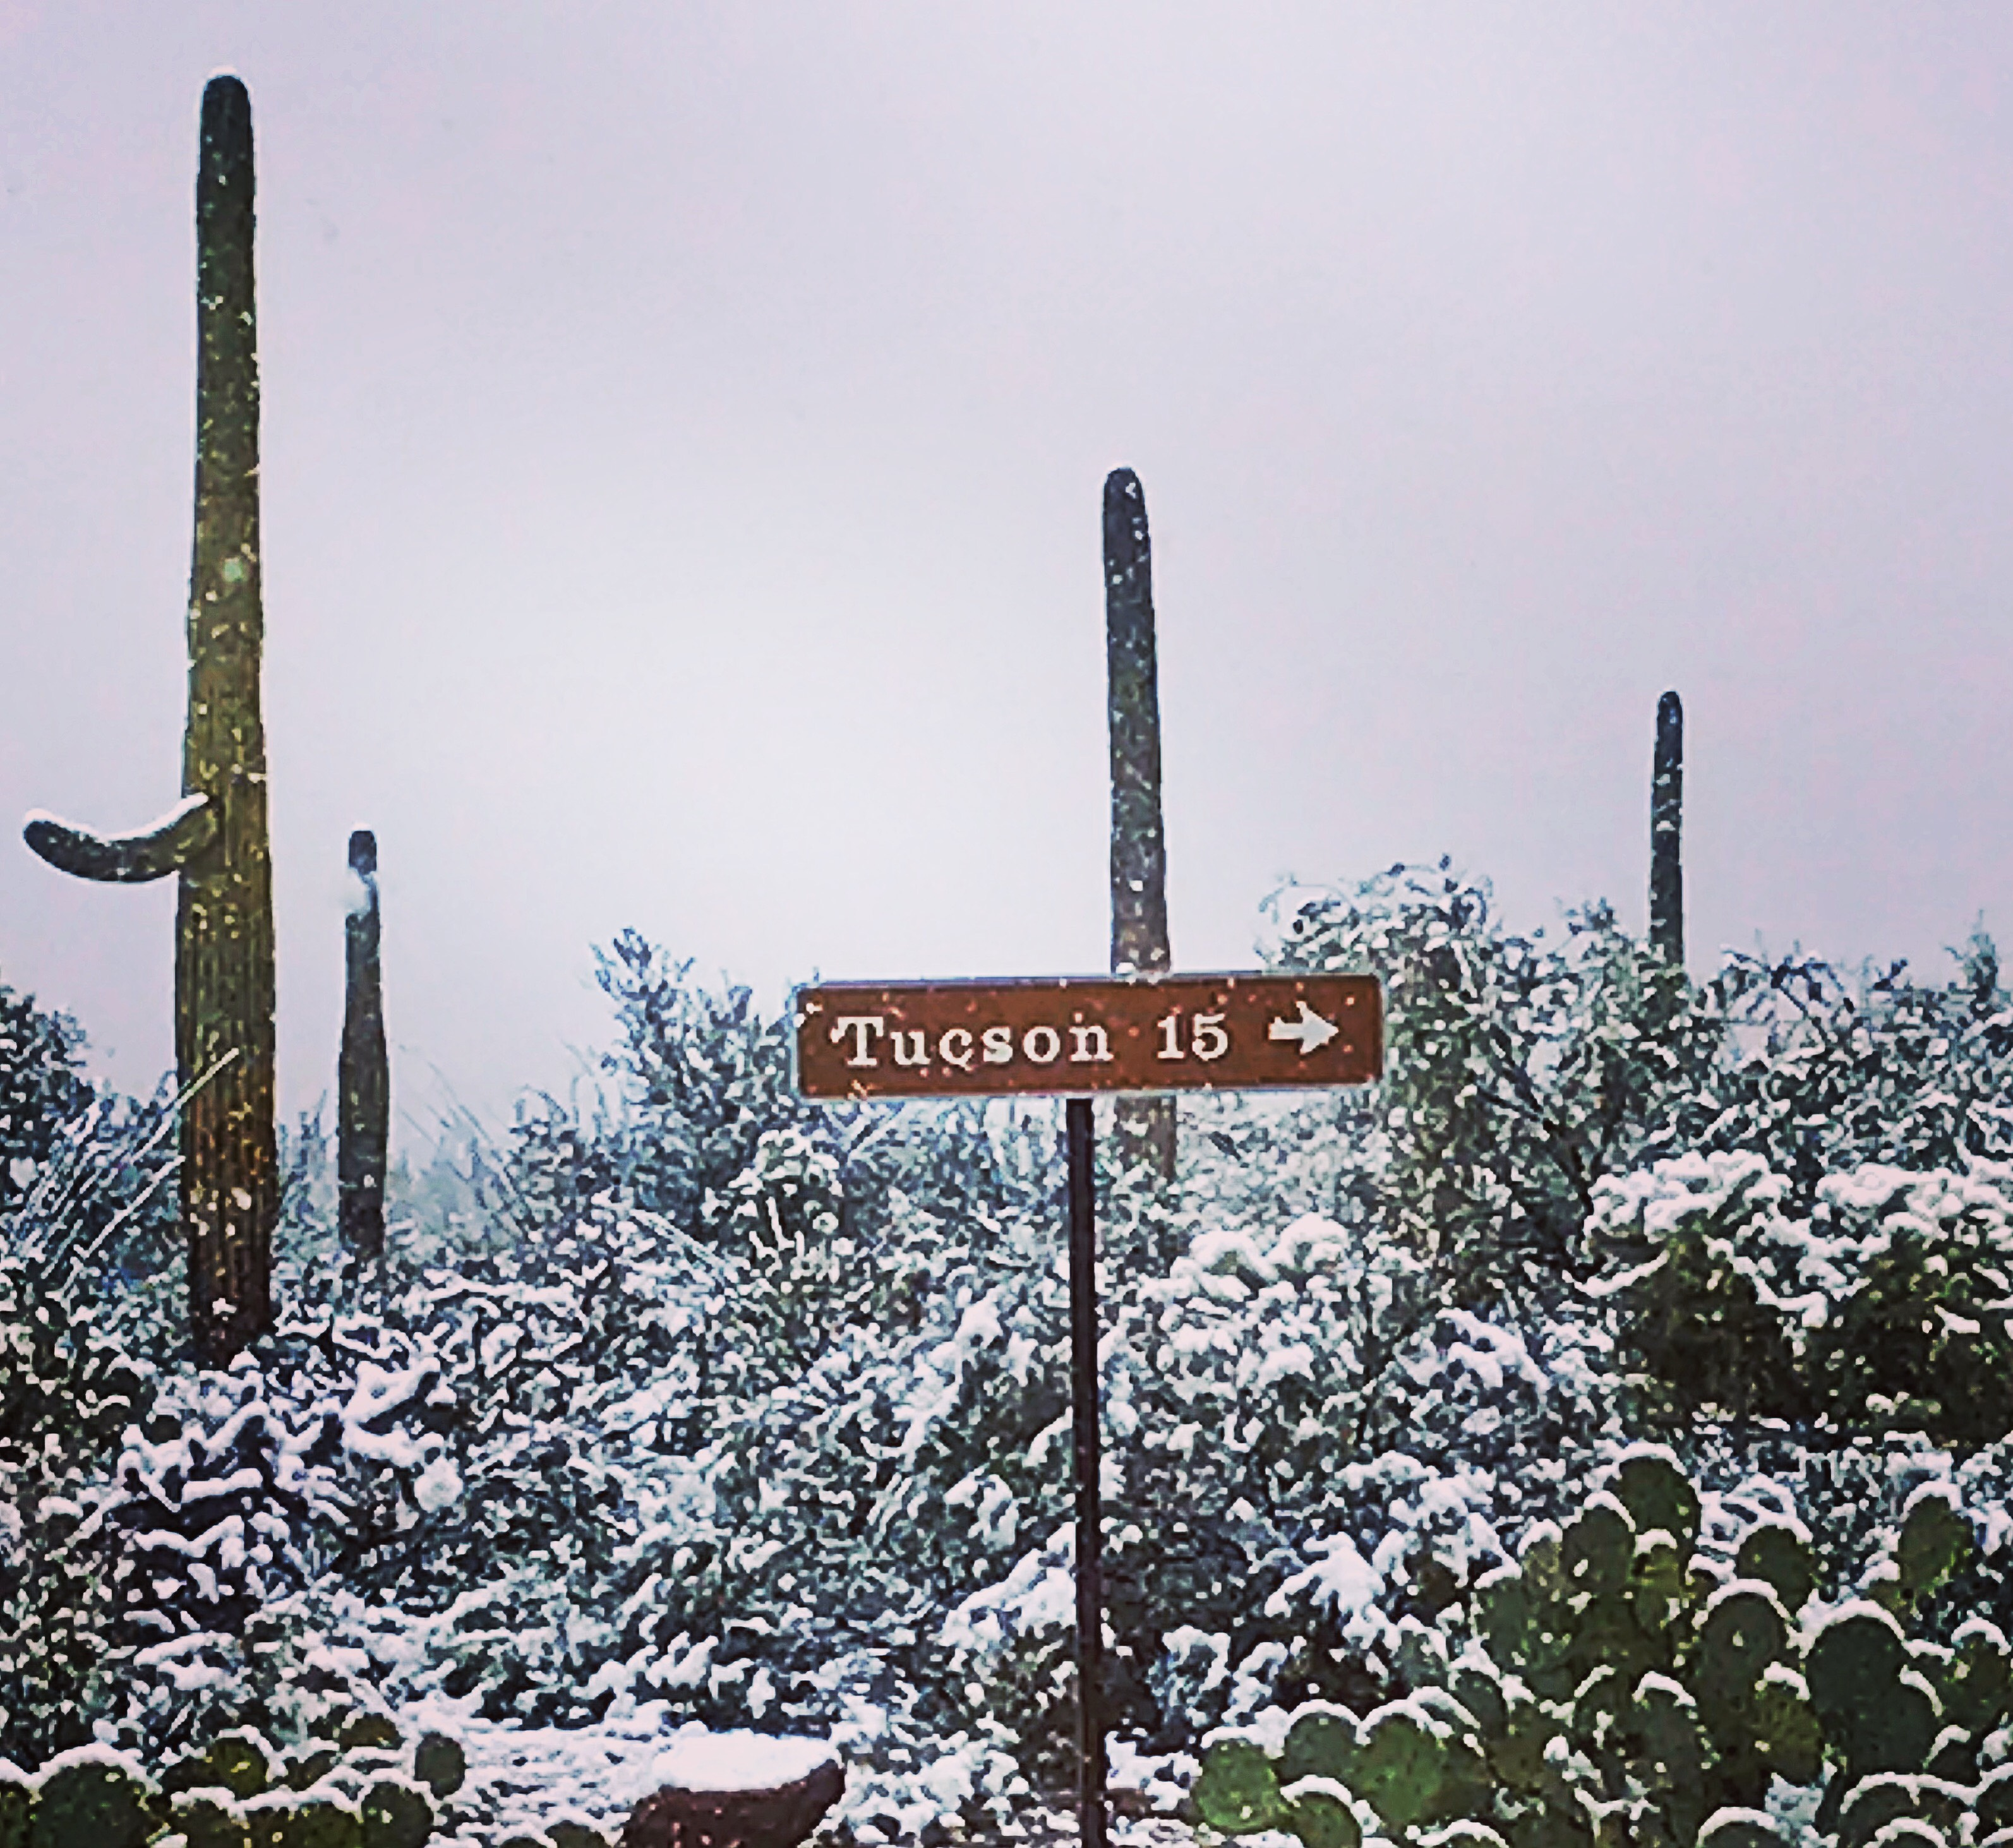
Inflection Point
Tribal Courts 3.0
1.0 CFR Courts
2.0 IRA/ICRA/Self-Determination Era
-------------------------
Information Era (21st Century)
Renaissance “rebirth”
Opportunity
Challenge
Data/Technology Centered
Increased Criminal/Civil Jx

Slide 14
Pokagon Band Court house under construction. Set to be open in late fall 2019. (Sheldon Spotted Elk FB)
Notes:
Chief Judge Michael Petoskey (Grand Traverse)

