Slide 1
NIHB Legislative Update to The Tribal Self-Governance Advisory Commitee April 25, 2019
Caitrin Shuy, Director of Congressional Relations

Slide 2
Presentation Overview
IHS Advance Appropriations
Special Diabetes Program from Indians
FY 2020 Appropriations for IHS and other HHS agencies
VA Tribal Advisory Committee Act
Upcoming Conferences

Slide 3
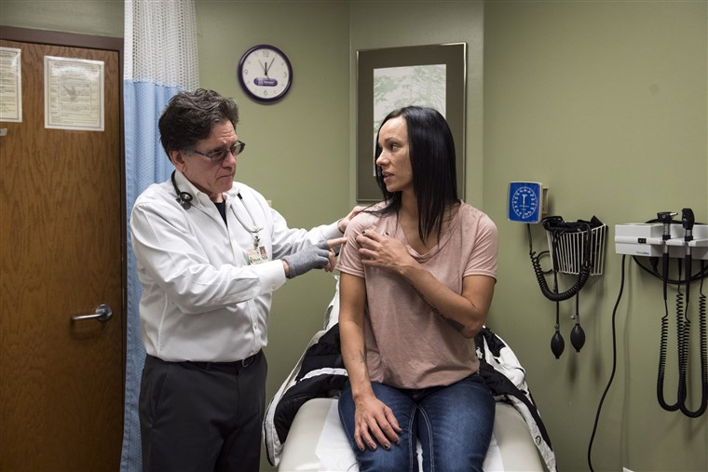
Government Shutdown Impacts
During the 35-day government shutdown
NIHB held 2 national calls on this effort and we learned of serious impacts including:
Clinic closures
Nurses and doctors leaving for the private sector
Administrative staff going without pay
Difficulties in PRC reimbursement
Bottom line: the shutdown destabilized Native health delivery and health care provider access; as well as Tribal Governments, families, children and individuals
Notes:
The government shutdown in early 2019 was devastating for Tribal communities. NIHB held two national calls on the effort to learn the impacts that tribes were having from the shutdown. I am sure you know full well what those impacts ar.e
Bottom line – it destabilized Native health delivery and entire communities in Indian Country. We must find another alternative.

Slide 4
IHS Advance Appropriations
What is Advance Appropriations?
Funding that becomes available one year or more after the year of the appropriations act in which it is contained.
The appropriations law is passed, but funds cannot be used until the FY year in which they are allocated for arrives
Notes:
NIHB has been working very hard this year to get IHS advance appropriations. This would mean IHS gets its funding passed into law a year before it would be spent, so that there would be no impacts from government shutdowns or sequestration cuts. NIHB has had a resolution on this since at least 2011, but with the recent 35 day shutdown in close memory, it is a good time to get Congress to move on this.
It would create parity with other federal health providers like Veteran’s Administration who already have advance appropriations.
It is also a good time to get Congressional support for this effort because the Government Accountability Office came out with a report last fall that identified a lot of strong arguments from Tribes and the IHS on why advance appropriations would be helpful in the delivery of health care. Among other things, it cited the extra costs that go along with continual CRs and shutdowns.

Slide 5
IHS Advance Appropriations
What advance appropriations IS NOT:
“forward funding” allows funds to become available beginning late in the budget year and is carried into at least one following fiscal year. Forward funding is counted against the same budget year. i.e.- it has a cost score!
“Mandatory appropriations” is funding that is automatic when Congress passes an authorization law, such as Medicare, Medicaid, or SDPI
Notes:
It is important to remember that we use the right words when talking about “advance appropriations.”
Forward funding is funding that is actually given early so it has a cost score. Some parts of tribal schools get this.
Mandatory appropriations is definitely a goal we want to see for IHS, but we do not have an idea of what a mandatory appropriations funding and distribution would look like. There needs to be more tribal consultation and determinations before Congress could do it. Advance appropriations can be an interim step until we are able to achieve mandatory appropriations.

Slide 6
IHS Advance Appropriations
How to we get Advance Appropriations?
Budget Resolution – exemptions list
House Rules – Budget Committee Chairman must comply
Enacting law – S.229/ H.R. 1128/ H.R. 1135
In the first year, there must be a double appropriation – one for FY 2020 and on for FY 2021
Notes:
Because it is so rare, there is not one specific pathway to achieving IHS advance appropriations.
However, we do know several things. That should (or must) happen before IHS advance appropriations can be achieved.
Each year the Budget Resolution – which sets forth the rules by which Congress can write the budget each year – contains a prohibition on advance appropriations EXCEPT for a few program explicitly listed. (these exemptions include certain VA programs as well as the Corporation of Public Broadcasting)
Under the House rules, the Chairman of the Budget Committee must sign off
If we get enacting legislation passed by both Chambers it makes it easier to do the appropriation that would be required in advance.
If all these things happen the Appropriations Committee will be able to make 2 appropriations. The second appropriation will not count against the current fiscal year, 2021. So, it does not have a cost.
This year – FY 2020 – is especially interesting because it is not likely that either chamber will advance a budget resolution. That means, there is an opening for Advance Appropriations to take hold.

Slide 7
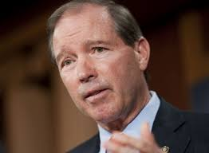
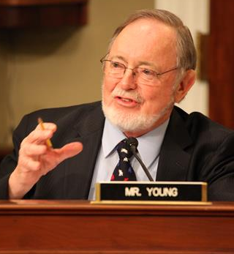
IHS Advance Appropriations
Three bills introduced for Advance Appropriations
Legislation Introduced
S.229 / H.R. 1128 – Indian Programs Advance Appropriations Act
Sponsors: Sen. Udall (D-NM)/ Rep. McCollum (D-MN)
IHS Services and CSC as well as BIA
H.R. 1135 – IHS Advance Appropriations Act
Sponsor: Rep. Don Young (R-AK)
All of IHS, not BIA
Senate bill coming soon
Notes:
Three bills have been introduced so far. The first is S. 229 / HR 1128 and would provide advance appropriations for both IHS and the BIA. There is bipartisan support for this bill in the House. There are no Republicans on this bill in the Senate. Many have expressed concerns over the BIA.
HR 1135 has been introduced by Don Young in the House. It would provide advance appropriations for IHS. It also has bipartisan house support. It is expected that Senator Murkowski will introduce the senate version of HR 1135 soon.

Slide 8
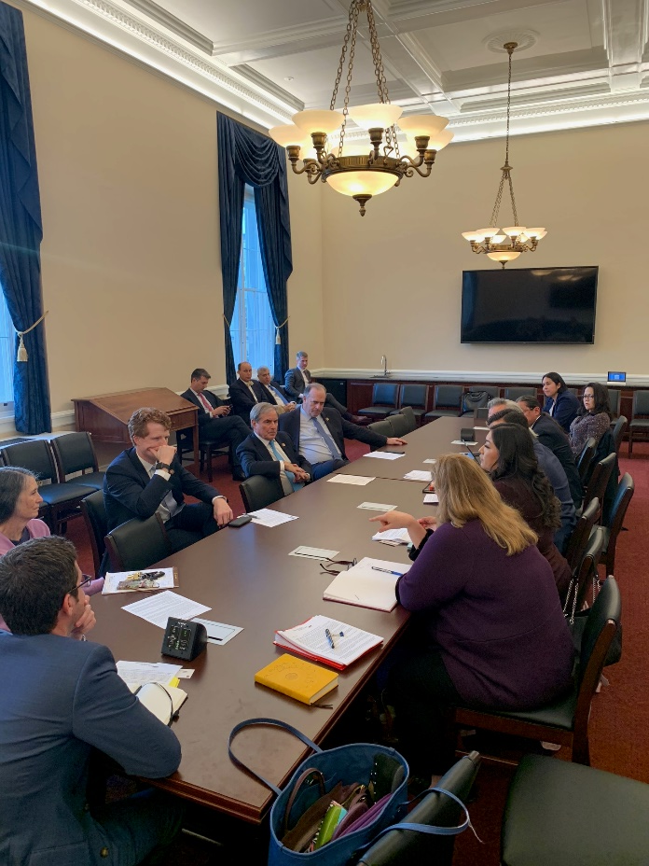
IHS Advance Appropriations
Activities:
Letter to Appropriations Committee on Hearing
Meeting with Chairman of the Budget Committee and Reps. Kennedy and Kildee
Meeting with Senate Budget Committee Democratic Staff
Sign on Letter to House Budget Committee
60 Signatures
Actions needed!
Legislation Co-sponsorship!
Support with “at risk” members
IMPACT STORIES!!
View NIHB’s Website for resources at:
https://www.nihb.org/legislative/advance_appropriations.php
Notes:
NIHB has been working to move this forward in 2019, given the momentum in Congress due to the 35 day partial government shutdown. NIHB wrote a letter to the Appropriations committee earlier this year asking for a hearing on the GAO report that came out in September. The appropriations Committee was the one who asked for that report to be written.
NIHB chair and other tribal leaders met with the Chairman and other members of the House Budget Committee to educate them on the need for advance appropriations for BIA and the IHS. We have also met with Democratic staff in the Senate budget committee.
But this week we NEED YOUR HELP!!
Please ask for members to sign on as co-sponsors to S. 229/ H.R. 1128 and H.R. 1135. and senator Murkowski’s forthcoming bill. There are many resources on our website which is listed on this slide.
Ask risk members include:

Slide 9
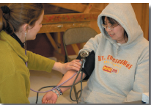
Special Diabetes Program for Indians
SDPI expires on September 30, 2019
Senate HELP Committee leaders introduced a 5 year renewal for SDPI at the current $150 million/ year
House will take separate legislation for each program – 5 years likely, hopefully funding increase.
Rep. O’Halleran (D-AZ) to introduce SDPI bill.
Working with partners at American Diabetes Association, Juvenile Diabetes Research Foundation and the Endocrine Society to increase funding to $200 million
Congressional Sign on letter is open– Congressional Outreach needed
Notes:
For Dem signers for the SDP Letter, I have:
Shaheen, Warren, Casey, Cortez Masto, Wyden, Blumenthal, Markey, Booker, Brown, Tester, Klobuchar, Peters, Van Hollen, Leahy, Rosen, Stabenow, Hirono, Gillibrand, Reed, Bennet, Udall, Jones, Duckworth, and King.
R’s include: Collins, Wicker, Hyde-Smith, Capito, Cramer, Fischer, Grassley, Moran, Hoeven and Inhofe

Slide 10
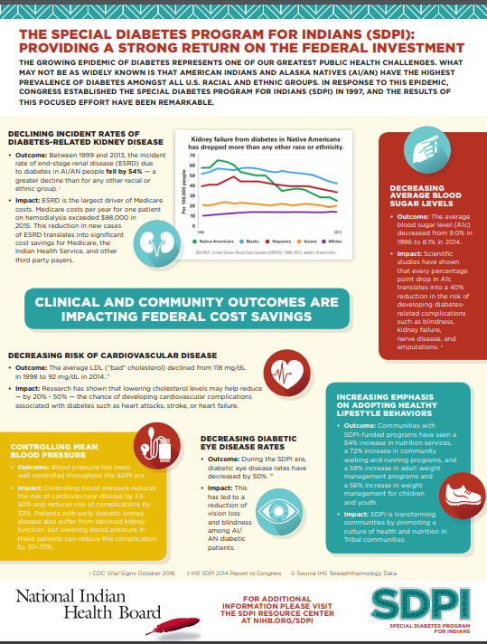
Special Diabetes Program for Indians
More resources Available at www.nihb.org/sdpi
Notes:
There are also state specific fact sheets on SDPI.
They are available on our website www.nihb.org/sdpi

Slide 11
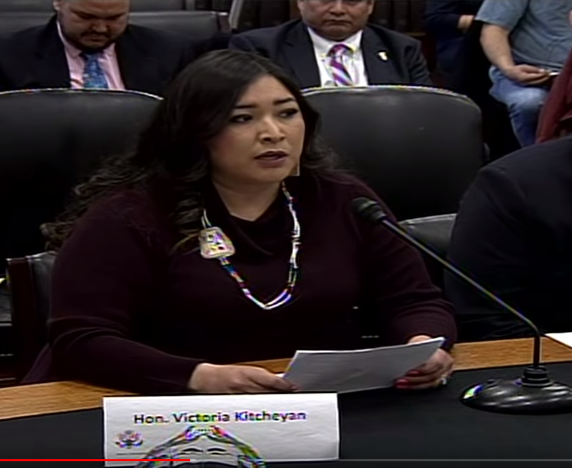
Indian Health Service Appropriations FY 2020
President’s budget was released March 11
IHS funded at $5.9 billion
Increases in H&C; Behavioral Health; Health IT
Decreases to facilities, CHRs; and Health Education
$25 million for HIV/HCV prevention
NIHB testified on March 6 – House Interior Appropriations Subcommittee
Advance Appropriations
End to Sequestration
TBFWG request of $7.1 Billion for IHS
Notes:
The president proposed a total budget of $5.9 billion for IHS in FY 2020. This includes increases for services like hospitals and clinics, behavioral health and $25 million investment in Health IT. The budget also proposes to eliminate funding for Health education and cut funding dramatically for CHRs. This would be accompanied by an increase of $20 million for the nationalization of the CHAP program.
It includes $25 million for IHS to treat and prevent HIV and Hepatitis C. This is much more than IHS is currently getting, but it is a drop in the bucket when taking need into account. We – as tribes – need to come to a conclusion on where we see the need, where the money should be spent. Tribal direct funding, would be one important aspect for this. They have recommended it go to TECs.
Increase proposed is very nominal. It would not keep up with inflation, population growth, CSC need, or 105(l) lease need.
There are also deep cuts proposed to the Medicaid program which would propose block grants to the states instead of the current system where all care is reimbursed as it is used. This would be VERY problematic for the IHS and Tribes which rely heavily on Medicaid funding.
Administration also proposed to eliminate the Good Health and Wellness in Indian Country program. They did the same thing last year, but NIHB was successful in getting the program increased by $5 million (DOUBLED in the House bill).

Slide 12
Other HHS Agencies’ Appropriations - FY 2020
President’s CDC budget – Zeroed out Good Health and Wellness in Indian Country
NIHB submitted testimony for the record to House Labor H on April 9
CDC Recommendations:
GHWIC funding at $32 million
Preventive Health and Health Services Block Grant tribal set aside of 5%
Tribal funding for HIV, Viral Hepatitis and STIs
SAMHSA Recommendations
Tribal set aside funding for the Substance Abuse Block Grant
Tribal behavioral health grants funded at $40 million
10% set aside for Tribes in opioid funding
House Subcommittee Markup on n April 30

Slide 13
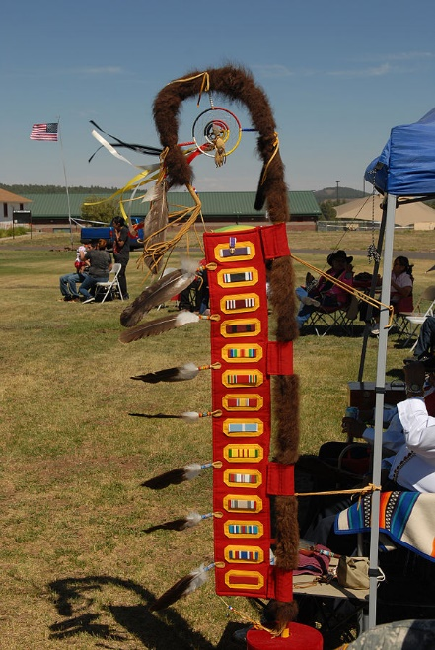
VA Tribal Advisory Committee Act
February 21 – Senators on Tester (D-Mont.), Dan Sullivan (R-Alaska), Tom Udall (D-N.M.), and Lisa Murkowski (R-Alaska) introduced legislation to create a VA TAC (S. 524)
15 member committee – one from each IHS area + 3 at large members
½ of members are veterans
Subcommittees allowed, Technical advisors on subcommittees (like TTAG)
Committee will have a yearly report to Congress on activities

Slide 14
GAO Report on IHS/VA MOU
On April 22, GAO released a report on the IHS / VA MOU
Overall, the IHS and Tribal facilities contacted by GAO saw reimbursement agreements as beneficial (some had concerns noted in the report);
The number of reimbursement agreements with VA has increased, showing an increase of Tribal facilities entering reimbursement agreements, claims reimbursed, and veterans served;
IHS facilities accounted for a larger percentage of veterans receiving services reimbursed by VA compared to Tribal facilities;

Slide 15
GAO Report on IHS/VA MOU
Recommendations:
VA should establish measurable targets for performance measures
VA should establish written policy or guidance on how referrals from IHS and THP facilities to VA facilities for specialty care can be managed
IHS should establish measurable targets for performance measures
Agencies concurred with these recommendations

Slide 16
Medicaid Legislative Initiative
Holding off on legislative language until CMS decision on Washington State DT program
A few productive meetings, eager for text. Senator Udall and Rep. Lujan are interested
Seeking Senate Republican Lead on Finance committee
Daines (MT), Thune (SD), Enzi (WY), Roberts (KS), Lankford (OK)?
Notes:
Create an optional eligibility category under federal Medicaid law providing authority for states to extend Medicaid eligibility to all AI/ANs with household income up to 138% of the federal poverty level (FPL).
This would universally implement Medicaid expansion for all American Indians and Alaska Natives, regardless of the state where they reside.
2. Authorize all providers in the Indian health system, in all states to receive Medicaid reimbursement for the services they are authorized to provide under the Indian Health Care Improvement Act (IHCIA)—referred to as Qualified Indian Provider Services—when delivered to AI/ANs.
Currently, IHS and Tribes can only receive reimbursement for QIPS services that are authorized through the state Medicaid agency. This reinforces the direct relationship between Tribes and the federal government, rather than relying on state authority.
3 Extend full federal funding (through 100% FMAP) to Medicaid services furnished by urban Indian providers to AI/ANs, in addition to services furnished by IHS/Tribal providers to AI/ANs.
Under current law, only services provided at IHS-operated and Tribal facilities are reimbursed by the federal government at 100%. If services are received outside an IHS and Tribal facility –including an Urban Indian Health Program – services are reimbursed by both the state and the federal government.
4 In addition, the following items are included in the proposed Medicaid Indian Amendments Act:
Clarify in federal law and regulations that—
State Medicaid programs are permitted to implement policies limited to AI/ANs and/or IHCPs (through waivers or State Plan Amendments). This is in recognition of the unique health needs of AI/ANs as well as IHCPs. This would permit states and Tribes with increased flexibility to create special services specific to AI/ANs under the Medicaid program.
State Medicaid programs are prohibited from over-riding (through waivers or State Plan Amendments) Indian-specific provisions in federal Medicaid law.
These provisions are both intended to ensure that AI/ANs are not negatively impacted by state requirements under Medicaid such as work requirements or adding co-pays and monthly premiums.
5. Address the “four walls” limitations on IHCP “clinic” services by removing the restriction that prohibits billing for services provided outside a clinic facility.
Under the current system, Tribes and IHS can only get reimbursed for services provided inside the facility. This restricts reimbursements for services like home visits, or services referred outside the IHS or Tribal facility. It will expand the type of services that 100% FMAP can be used for and offset limited purchased/referred care appropriations.

Slide 17
NIHB Conferences: TPHS & Behavioral Health

Slide 18
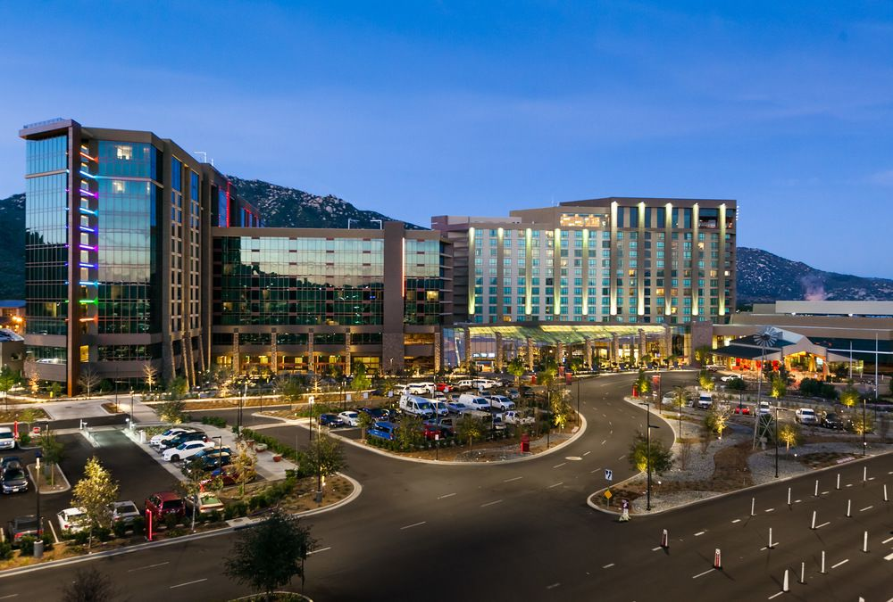
SAVE THE DATE: National Tribal Health Conference
The National Tribal Health Conference will be September 16-20, 2019 at Pechanga Resort and Casino

Slide 19
Thank you! For more information please contact: Stacy A. Bohlen sbohlen@nihb.org NIHB Chief Executive Officer

