Slide 2

Presented by:
Theresa Galvan, Co-Chair
Representing the Navajo Area

Slide 3
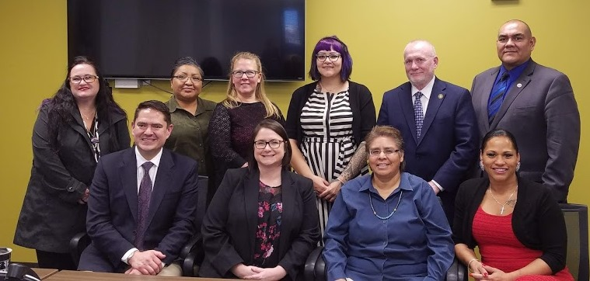
NTAC Purpose
An advisory body to the Division of Behavioral Health and to the IHS Director, with the aim of providing guidance and recommendations on programmatic issues that affect the delivery of behavioral health care for American Indian and Alaska Natives.

Slide 4
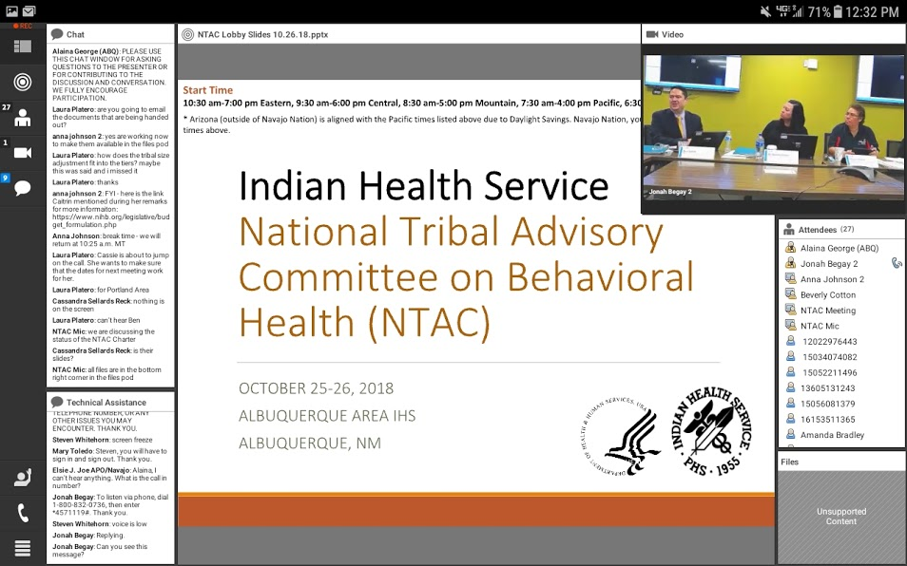
Meetings
NTAC
October 25-26, 2018
Albuquerque, New Mexico
December 20-21, 2018
Albuquerque, New Mexico
March 13, 2019
Alpine, California
NTAC and SAMHSA Joint Tribal Advisory Committee Meeting
March 12 - 14, 2019
Alpine, California

Slide 5
IHS Dear Tribal Leader Letter – May 18, 2018
The Consolidated Appropriations Act, 2018 Explanatory Statement encourages the Indian Health Service (IHS) to transfer behavioral health initiative funding through Indian Self-Determination and Education Assistance Act (ISDEAA) contracts and compacts rather than through grants.
$59.2 million Total funding amount.
$51.9 million through grants and Federal awards
$5.9 million for Urban Indian Organizations.
$7.3 million supports IHS National Management.

Slide 6
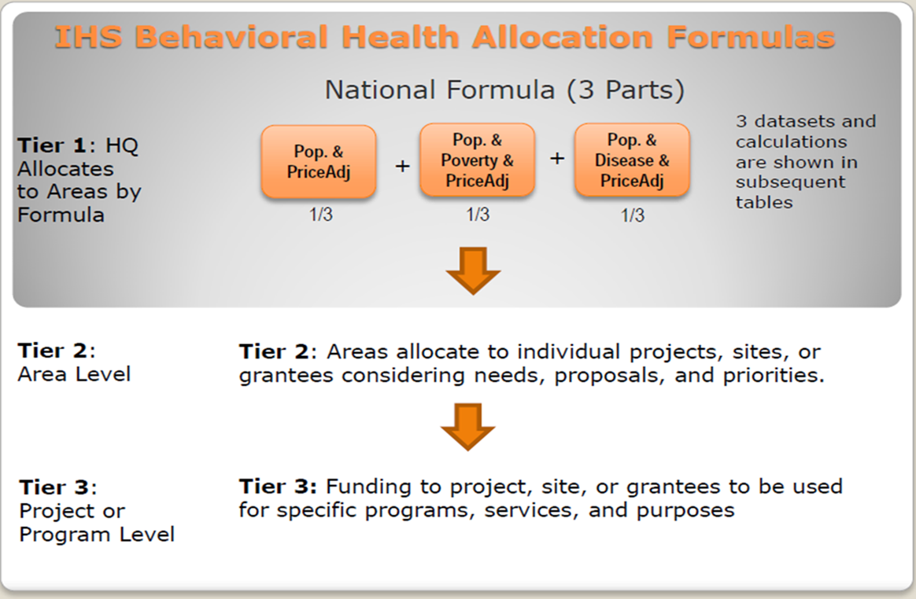
IHS Dear Tribal Leader Letter – May 18, 2018
Distribution methodologies
Funding formulas
Funding for Urban Indian Organizations;
Impact on current grantees;
Funding mechanism
Demonstrating effectiveness data collection, evaluation, establishing national outcomes;
Advocacy and raising national awareness and visibility

Slide 7
NTAC Recommendations to Principal Deputy Director
NTAC identified that the numbers described in the DTLL included congressional set asides (i.e. City of Gallup, YRTC, PARD, and BH2I) totaling $10.7 million that is not eligible for Tribal Consultation. NTAC recommendations are based on the remaining $48.5 million.
Continue national distribution methods of allocating funds to all 12 IHS areas using the current funding formula, permitting Areas to determine distribution methodology appropriate to that area through fiscal year 2020.Funding formulas and mechanisms
  Allow current grantees to continue as is through 2020 (current funding cycle) and make any changes to funding effective in the new funding cycle beginning in 2021.

Slide 8
NTAC Recommendations to Principal Deputy Director - continued
Funding for National Management
  Review of all IHS behavioral health funding designated for national management with the intent to transfer all non-essential expenditures for distribution through the new funding methodology.
  SASPP – NTAC recommended $610,677 budget to fund the Suicide Prevention Coordinator, the National SASPP Coordinator and the Education Development Center for Zero Suicide. $758,000 to be reinvested into Tribal Epidemiology Centers (TECs). $328,230 to be reinvested into Tribal Grants and Program Awards.
  DVPP - NTAC recommended a decrease to the number of APOs from 4 to 0. This will decrease National Management funding by $667,862 leaving $1,123,578. The $667,862 should be moved to Tribal Grants and Program Awards.
  ZSI – NTAC recommended we set aside no funds and the funding should be reallocated to Tribal Grants and Program Awards.

Slide 9
NTAC Recommendations to Principal Deputy Director - continued
Funding for National Indian Health Board
Funding for Urban Indian Organizations (UIO)
  Continue funding UIO grantees at the current level through grants, cooperative agreements, annual contracts and any other funding mechanism; Update definition of UIO.
NTAC understands that any changes to the current distribution of funding would have an impact on current grantees and may decrease funding in some cases so that more Tribes can receive funding.

Slide 10


National Behavioral Health and Suicide Strategic Plans
The Strategic Plans were released in August 2011 during the Action Summits for Suicide Prevention.
NTAC supported the development of the plans and will be monitoring the implementation of the national strategies described in each plan.
http://www.ihs.gov/MedicalPrograms/Behavioral/index.cfm?module=BH&option=Strategic_Plans

Slide 11


