Slide 2
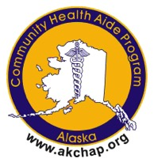
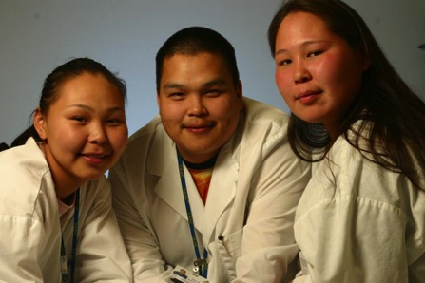
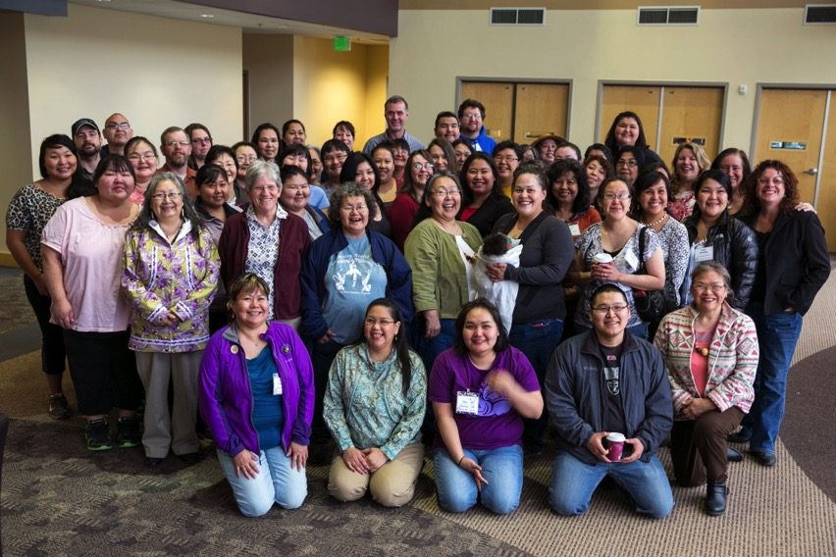
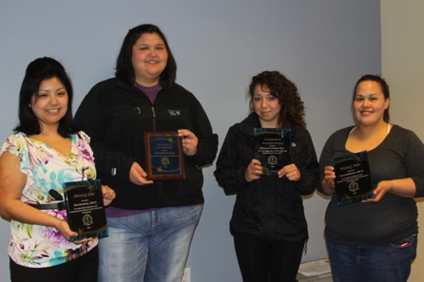
The Alaska Community Health Aide Program
Alaska Native Tribal Health Consortium
web: www.akchap.org |www.anthc.org

Slide 3
CHAP History
1950s Chemotherapy Aides (Volunteers)-Direct Observed Therapy for TB patients
1960s Formal Training/Federal Funding 1968
1976 Indian Health Care Improvement Act (IHCIA) (PL 94-437)
1992 IHCIA amended to add § 119 that provided for the Alaska Community Health Aide Program under authority of the 25 U.S.C. § 13 popularly known as the Snyder Act and require a Certification Board (PL 102-573)
Notes:
WALTER: A key time event in the evolution of the Community Health Aide Program, I would say, was the February 1964 meeting of the area service unit directors in Anchorage. That is, those individuals, in this case, physicians, that would be responsible for the various service units in Alaska having a -- you had a meeting in Anchorage.
The thrust of this meeting was how to get the community involved. And I actually have the letter that was sent out by the area director, Dr. Holeman Warrick, to those of us who participated to talk about getting more community involvement.
The idea of training local people came up at the meeting, and it was a very animated discussion.
A number of the Public Health nurses who had carried this burden as itinerants, going to the villages, instructing people in midwifery and -- and giving immunizations and all the other things they did, always came back with a list of medical problems and would sit down with us physicians and try to resolve them. These problems that they had encountered in the villages.
Pilot programs from 1964-1968
Congress did then approve and budget, in 1968, funds to support 185 health aide positions in 157 villages. That being the official beginning of the funded Community Health Aide Program.
As a little sidelight, these folks were called -- were referred to as medical aides, usually, but because of all this emphasis on community was sort of the buzz word at the time, that's switched over.
And also, it took -- in retrospect, that took a little of the sting out of the -- out of the threat to the -- the medical hierarchy, probably. And because they were “health” rather than “medical” was less of a hot button.

Slide 4
CHAP History
1998 Alaska Area Director appoints a CHAP Certification Board (CHAPCB) with a majority of tribal representatives. CHAPCB Standards and Procedures adopted and CHA/Ps formally certified.
2002 Standards amended to address dental health aides (including threrapists).
2005 First Dental Health Aides Certified
2008 Standards amended to address behavioral health aides/practitioners
2009 First Behavioral Health Aides Certified
Notes:
WALTER: A key time event in the evolution of the Community Health Aide Program, I would say, was the February 1964 meeting of the area service unit directors in Anchorage. That is, those individuals, in this case, physicians, that would be responsible for the various service units in Alaska having a -- you had a meeting in Anchorage.
The thrust of this meeting was how to get the community involved. And I actually have the letter that was sent out by the area director, Dr. Holeman Warrick, to those of us who participated to talk about getting more community involvement.
The idea of training local people came up at the meeting, and it was a very animated discussion.
A number of the Public Health nurses who had carried this burden as itinerants, going to the villages, instructing people in midwifery and -- and giving immunizations and all the other things they did, always came back with a list of medical problems and would sit down with us physicians and try to resolve them. These problems that they had encountered in the villages.
Pilot programs from 1964-1968
Congress did then approve and budget, in 1968, funds to support 185 health aide positions in 157 villages. That being the official beginning of the funded Community Health Aide Program.
As a little sidelight, these folks were called -- were referred to as medical aides, usually, but because of all this emphasis on community was sort of the buzz word at the time, that's switched over.
And also, it took -- in retrospect, that took a little of the sting out of the -- out of the threat to the -- the medical hierarchy, probably. And because they were “health” rather than “medical” was less of a hot button.

Slide 5
Certification
CHAP Certification Board
Federal Authority, 12 members
Standards and Procedures
Individuals, Training Centers, Curricula
511 individuals certified (12/2018)
405 CHA/Ps certified
52 Dental Health Aides certified
54 Behavioral Health Aides certified
Notes:
The Community Health Aide Program Certification Board sets standards for the community health aide program and certifies individuals as community health aides and practitioners, dental health aides (including primary dental health aides, dental health aide hygienists, expanded function dental health aides, and dental health aide therapists), and behavioral health aides and practitioners. Each of these individuals is subject to specific requirements and engages in a specific scope of practice set forth in these Standards. For historical reasons, these various health aides are often referred to generically as “community health aides.”

Slide 6
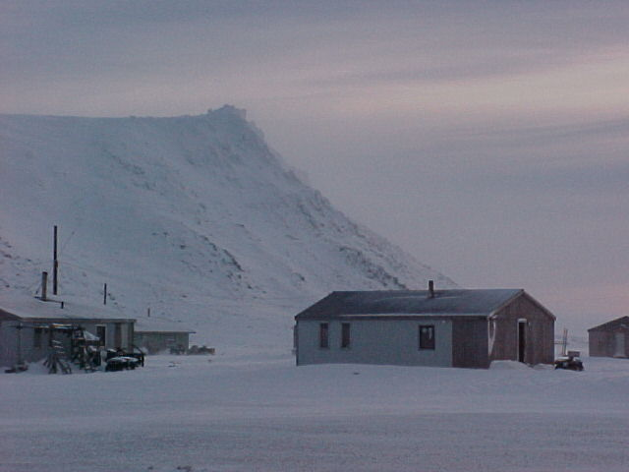
Health Aide Program Key Components
Community’s Role in Selection
Culturally Competent Care and Curriculum
Competency base curriculum
Part of a team
Gambell

Slide 7
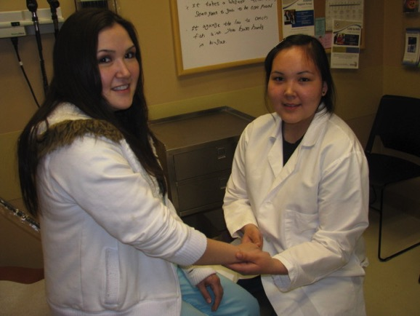
Community Health Aides and Community Health Practitioners (CHA/Ps)
Local people
Initially described as “the eyes, ears and hands of the physician”
300,000 encounters per year
Includes emergency, acute, chronic, and preventive health components
Does not include differential diagnosis
Under medical supervision of a licensed physician

Slide 8
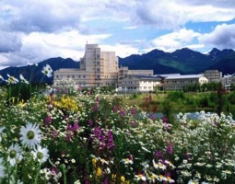
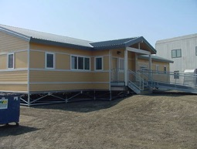
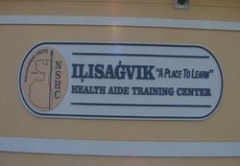
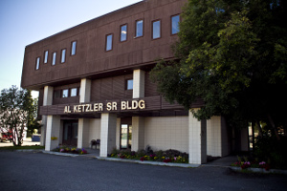
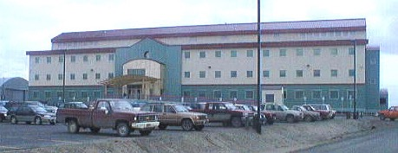
CHA Training Centers
ANTHC,
Anchorage
ANTHC,
Anchorage
Norton Sound Health
Corporation, Nome
Tanana Chiefs Conference, Fairbanks
Yukon-Kuskokwim Health
Corporation, Bethel

Slide 9
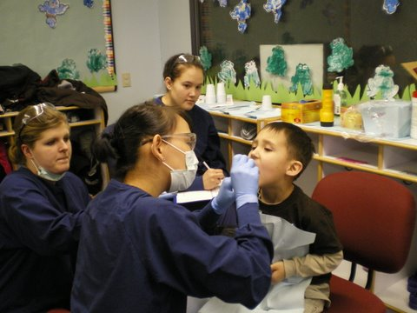
Types of Dental Health Aides (DHA)
Primary DHA (CDHC)
Oral Health Educators
Expanded Function DHA
Restorations, cleanings, temporary fillings
DHA Hygienist
Local anesthesia
DHA Therapist (DHAT)
Prevention, operative, urgent
Supervised providers
Teams led by Licensed Dentists
Chelsea Shoemaker, Bonnie Johnson, Corrina Cadzow (DHAT students) providing fluoride varnish treatment for a Head Start student.

Slide 10
Different Providers Different Education
DHAT
Limited scope, 46 procedures
DENTIST
NEED to know+ nice to know
Large scope, 500+
Supervised
Prevention oriented team approach
Accessible to students in target populations
Culturally competent
Patient centered
Team leader
Surgically oriented
Education is difficult to access, especially for minorities
Struggling to address cultural competency
Practice centered
NEED TO KNOW

Slide 11
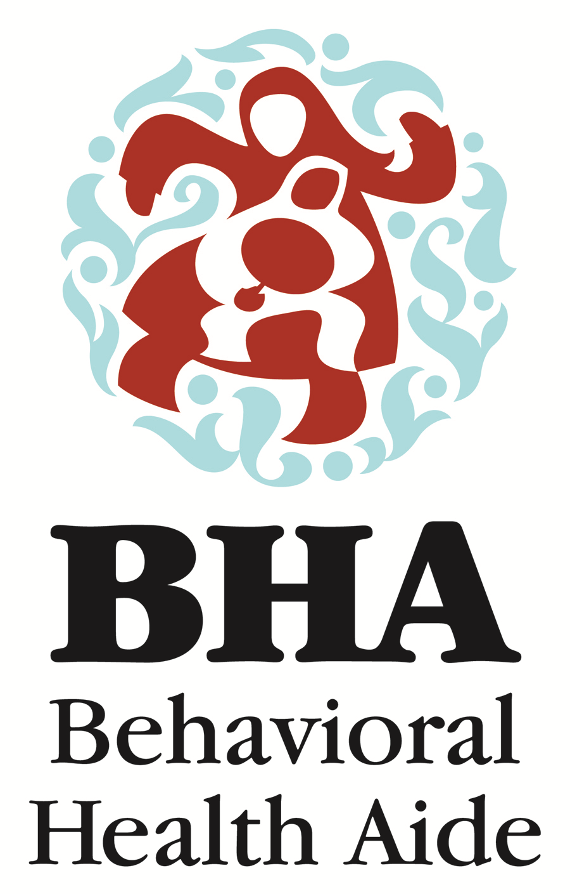
Behavioral Health Aide Program
Village-based counselors to provide culturally-informed, community-based, clinical services
Provide behavioral health prevention, intervention, aftercare, and postvention
Training and practicum requirements
On-the-job training
Four levels of certification

Slide 12
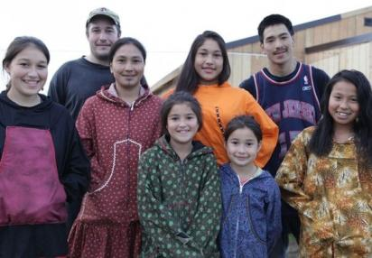
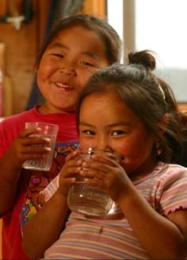
Who do BHAs provide services to?
The Blues & the News
National Geographic
Families
Elders
Individuals
Youth
Alaska Native Tribal Health Consortium
Notes:
Individual (grief and loss, case management, substance abuse assessment and treatment, skills building)
Elder (case management, welfare checks, community luncheons, appointments, housing or other resource applications, psychoeducation)
Youth (IEP meetings, skill development, anti-bullying activities, youth groups, presentations, culture camps)
Family (case management, resource identification and coordination, referrals, ICWA, WIC assistance, disability and Medicaid applications)

