Slide 1
Legislative and Litigation UPDATE tribal self-governance advisory committee meeting September 30, 2019
Stacy A. Bohlen, Chief Executive Officer, National Indian Health Board

Slide 2
Presentation Overview
Fiscal Year (FY) 2020 Appropriations
105(L) Leases
Advance Appropriations
Special Diabetes Program for Indians
AI/AN Medicaid Legislation
Broken Promises Legislation
Native Veterans
Texas v. Azar (Affordable Care Act Litigation)

Slide 3
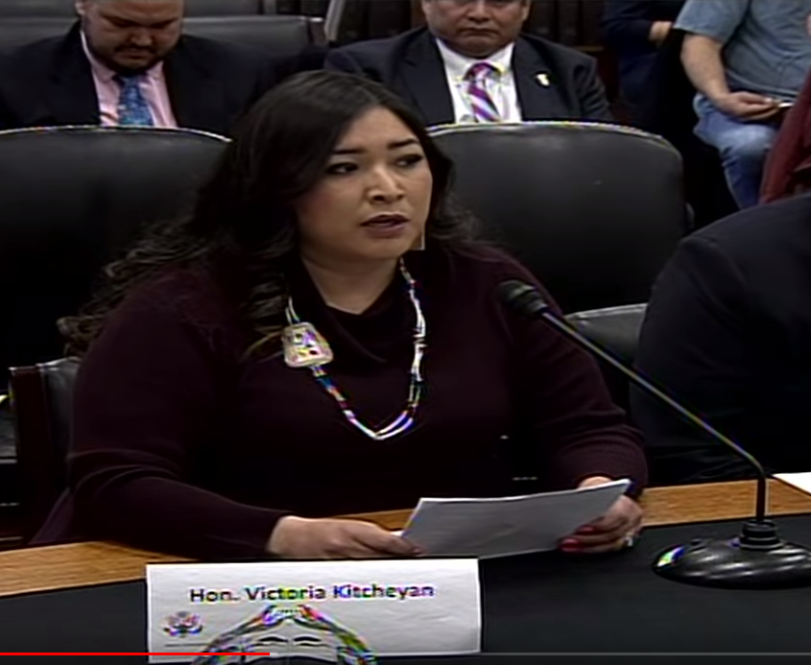
FY 2020 House Appropriations
2 of 12 Appropriations Bills are immediately relevant to Tribal health (I/T/U)
Interior and Labor-HHS
House passed both bills in June
Interior
IHS Funded at $6.3 billion
Hospitals and Clinics: increased to $2.42 billion overall
$53 million to help address 105(l) leases
$62.9 million for Community Health Representatives
Labor-HHS
Good Health and Wellness funded at $21 million
Tribal Behavioral Health Grants funded at $40 million
Notes:
The House bill includes significant increases for IHS, including a $537 million overall increase above the 2019 enacted level, bringing the total to $6.3 billion.
The House package includes an increase to $2.42 billion overall for Hospitals and Clinics, including the $20 million for a national CHAP; $25 million for HIV/AIDs and Hepatitis C prevention; and $25 million for modernization of EHRs included in the President’s budget.
Other notable increases include $53 million for 105(l) leases, which is $17 million above the 2019 enacted level;
$125.3 million for Mental Health (+ $20 million);
$280 million for Alcohol and Substance Abuse (+ $34.4 million);
$81 million for urban Indian health (+ $29.6 million);
$90.6 million for Indian Health Professions (+ $33.2 million);
and $304.2 million for Health Care Facilities Construction (+ $60.8 million).
The House package also rejected the proposed cuts to Community Health Representatives (CHRs) and Health Education, instead giving them a slight boost to $62.9 million and $20.6 million respectively.
NIHB At-Large Member and Portland Area Representative, Chairman Joseph, testified before the Senate Committee on Indian Affairs on May 8 on the FY 2020 IHS budget, highlighting the same priorities shared with the House Appropriations Committee.

Slide 4
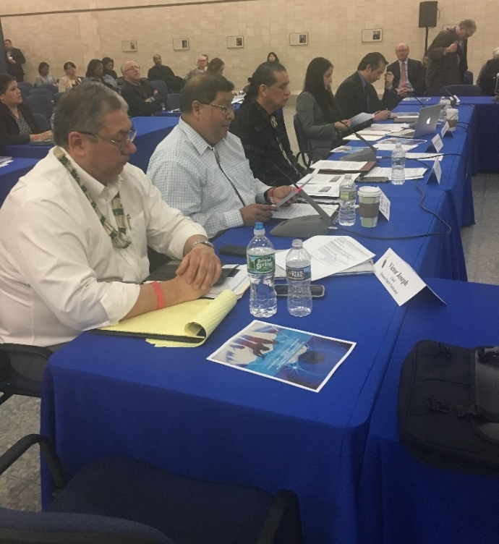
Budget Deal & FY 2020 Appropriations Cont.
Senate did not begin work on 2020 appropriations until September: Why?
Did not know how much money would be available
Budget deal passed August 1 set spending levels for 2020 and 2021
Bipartisan Budget Act of 2019:
Raises defense & non-defense spending caps
Raises the debt limit through at least July 2021
Ends discretionary sequestration through July 2021!
$77 billion in offsets
With budget deal in place, Senate Appropriators began work

Slide 5
FY 2020 Senate Appropriations
Senate subcommittee spending allocations (302b) released
Interior allocation only about $200 million over 2019
Labor-HHS allocation roughly $1.9 billion over 2019
Continuing Resolution (CR) voted out of Senate Thursday 9/26 and signed by President Friday 9/27
Keeps government open through November 21, 2019
Special Diabetes Program for Indians is included!
Notes:
Interior and Labor-HHS bills must both pass Senate
Conference Committee negotiates differences
Bills pass House and Senate again, signed by President
Basically impossible to do this by September 30
Some sort of Continuing Resolution is most likely

Slide 6
FY 2020 Senate Appropriations
Senate FY 2020 Interior bill passed Committee 9/26
Includes $97 million for 105l leases
Includes language directing IHS to work with DOI and OMB to determine if 105l should be an appropriated entitlement like contract support costs
Increases to Hospitals and Clinics (+$192 million); dental health (+$5.6 million); alcohol/substance use (+$2.2 million); etc.
No cuts to Community Health Representatives or health education
$92.6 million for public health nursing (+ $3 million)
$5.8 million for Self-Governance
$902 million for facilities (+ $24 million over FY 19 enacted)
$820 million for Contract Support Costs
$53 million for urban Indian programs
Notes:
Interior and Labor-HHS bills must both pass Senate
Conference Committee negotiates differences
Bills pass House and Senate again, signed by President
Basically impossible to do this by September 30
Some sort of Continuing Resolution is most likely

Slide 7
FY 2020 Senate Appropriations
Senate FY 2020 Labor-HHS bill released 9/18
Maintains funding levels for Tribal Behavioral Health, Tribal Opioid Response, AI/AN Suicide Prevention
Committee report language on need for greater direct public health funding to Tribes (esp. infrastructure) and issues with CDC Tribal Advisory Committee
Zeroes out Good Health and Wellness in Indian Country (GHWIC)
GHWIC is single largest investment into public health for Tribes from the Centers for Disease Control and Prevention ($21 million)
NIHB fighting to make sure it is reinstated as Senate and House appropriators negotiate on the final bill
Notes:
Interior and Labor-HHS bills must both pass Senate
Conference Committee negotiates differences
Bills pass House and Senate again, signed by President
Basically impossible to do this by September 30
Some sort of Continuing Resolution is most likely

Slide 8
Appropriations: 105(l) Leases
Currently funded through IHS Services line item – both House and Senate maintain this mechanism
House Interior report requests IHS to examine whether 105(l) leases should be a separate line item funded similarly to CSCs
House-passed bill included $53 million for 105(l) leases ($42 million above budget request and $17 million above 2019 enacted level)
Senate Interior appropriators bill includes $97 million for 105(l)
IHS must report level of funding needed to Congress
Notes:
Interior and Labor-HHS bills must both pass Senate
Conference Committee negotiates differences
Bills pass House and Senate again, signed by President
Basically impossible to do this by September 30
Some sort of Continuing Resolution is most likely

Slide 9
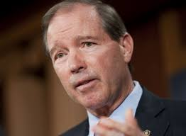
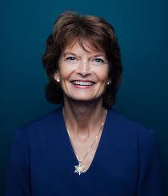
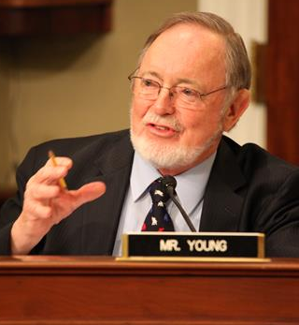
Advance Appropriations
Four bills introduced for Advance Appropriations
S.229 / H.R. 1128 – Indian Programs Advance Appropriations Act
Sponsors: Sen. Udall (D-NM)/ Rep. McCollum (D-MN)
IHS Services and CSC as well as BIA
H.R. 1135/S.2451 – IHS Advance Appropriations Act
Sponsors: Rep. Don Young (R-AK)/Sen. Murkowski (R-AK)
Young: IHS Services and Facilities
Murkowski: IHS Services, Facilities, and CSCs
Notes:
Three bills have been introduced so far. The first is S. 229 / HR 1128 and would provide advance appropriations for both IHS and the BIA. There is bipartisan support for this bill in the House. There are no Republicans on this bill in the Senate. Many have expressed concerns over the BIA.
HR 1135 has been introduced by Don Young in the House. It would provide advance appropriations for IHS. It also has bipartisan house support. It is expected that Senator Murkowski will introduce the senate version of HR 1135 soon.

Slide 10
Advance Appropriations
Newest bill: S.2541: Indian Health Service Advance Appropriations Act of 2019
Amends Indian Health Care Improvement Act to authorize advance appropriations for IHS Services, Facilities, and CSCs
Referred to Senate Committee on Indian Affairs
Bipartisan (currently 12 co-sponsors)
Next steps:
Secure more GOP support
Republicans on Senate Interior Appropriations and Senate Committee on Indian Affairs
Request hearing before Senate Committee on Indian Affairs
Notes:
Three bills have been introduced so far. The first is S. 229 / HR 1128 and would provide advance appropriations for both IHS and the BIA. There is bipartisan support for this bill in the House. There are no Republicans on this bill in the Senate. Many have expressed concerns over the BIA.
HR 1135 has been introduced by Don Young in the House. It would provide advance appropriations for IHS. It also has bipartisan house support. It is expected that Senator Murkowski will introduce the senate version of HR 1135 soon.

Slide 11
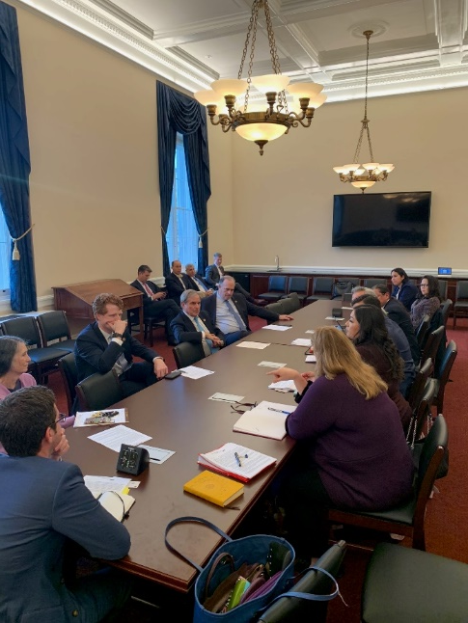
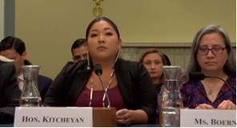
Advance Appropriations
Activities:
March letter to House Budget Committee with 60 bipartisan signatories
House Natural Resources Subcommittee on Indigenous Peoples hearing on Advance Appropriations held 9/25
NIHB Chair Victoria Kitcheyan testified
Outreach & education with members on relevant committees (Budget, Natural Resources, Energy & Commerce, SCIA)
Actions needed!
Request that your member co-sponsor H.R.1135/H.R. 1128/S.229/S.2541
Government shutdown/continuing resolution impact stories
Notes:
NIHB has been working to move this forward in 2019, given the momentum in Congress due to the 35 day partial government shutdown. NIHB wrote a letter to the Appropriations committee earlier this year asking for a hearing on the GAO report that came out in September. The appropriations Committee was the one who asked for that report to be written.
NIHB chair and other Tribal leaders met with the Chairman and other members of the House Budget Committee to educate them on the need for advance appropriations for BIA and the IHS. We have also met with Democratic staff in the Senate budget committee.
Please ask for members to sign on as co-sponsors to S. 229/ H.R. 1128 and H.R. 1135. and senator Murkowski’s forthcoming bill. There are many resources on our website which is listed on this slide.
Ask risk members include:
One thing that we should discuss is that it is a far easier lift to get IHS Advance Appropriations alone than it is to get IHS and BIA at the same time. Obviously we want both, but we think it might make more sense to work for IHS alone this year, and in the future work with other Tribal partners for BIA.

Slide 12
Advance Appropriations
How do we get Advance Appropriations?
Budget Resolution – exemptions list
House Rules: Budget Chairman must consent
Senate Rules: 2/3 of Senators must vote in favor
House/Senate rules on advance appropriations sunset upon passage of FY 2021 resolution
Enacting law – S.229/ H.R. 1128/ H.R. 1135
Notes:
NIHB has been working very hard this year to get IHS advance appropriations. This would mean IHS gets its funding passed into law a year before it would be spent, so that there would be no impacts from government shutdowns or sequestration cuts. NIHB has had a resolution on this since at least 2011, but with the recent 35 day shutdown in close memory, it is a good time to get Congress to move on this.
It would create parity with other federal health providers like Veteran’s Administration who already have advance appropriations.
It is also a good time to get Congressional support for this effort because the Government Accountability Office came out with a report last fall that identified a lot of strong arguments from Tribes and the IHS on why advance appropriations would be helpful in the delivery of health care. Among other things, it cited the extra costs that go along with continual CRs and shutdowns.
It is important to remember that we use the right words when talking about “advance appropriations.”
Forward funding is funding that is actually given early so it has a cost score. Some parts of tribal schools get this.
Mandatory appropriations is definitely a goal we want to see for IHS, but we do not have an idea of what a mandatory appropriations funding and distribution would look like. There needs to be more tribal consultation and determinations before Congress could do it. Advance appropriations can be an interim step until we are able to achieve mandatory appropriations.
Because it is so rare, there is not one specific pathway to achieving IHS advance appropriations.
However, we do know several things. That should (or must) happen before IHS advance appropriations can be achieved.
Each year the Budget Resolution – which sets forth the rules by which Congress can write the budget each year – contains a prohibition on advance appropriations EXCEPT for a few program explicitly listed. (these exemptions include certain VA programs as well as the Corporation of Public Broadcasting)
Under the House rules, the Chairman of the Budget Committee must sign off
If we get enacting legislation passed by both Chambers it makes it easier to do the appropriation that would be required in advance.
If all these things happen the Appropriations Committee will be able to make 2 appropriations. The second appropriation will not count against the current fiscal year, 2021. So, it does not have a cost.
This year – FY 2020 – is especially interesting because it is not likely that either chamber will advance a budget resolution. That means, there is an opening for Advance Appropriations to take hold.
Arrow: NIHB has really been focusing on getting legislation enacted to make this happen.

Slide 13
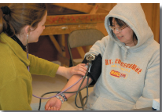
Special Diabetes Program for Indians
SDPI attached to continuing resolution through Nov. 21, 2019 - continued fight for long-term renewal
Working with partners at American Diabetes Association, Juvenile Diabetes Research Foundation and the Endocrine Society to ensure long-term renewal
Senate introduced a 5-year renewal for SDPI at the current $150 million/ year
Voted out of Committee without amendment
Rep. O’Halleran (D-AZ) introduced House bill
H.R. 2680: $200 million/year for 5 years
BUT: House amended to $150 million for 4 years
H.R. 2328 includes SDPI renewal in public health extenders package

Slide 14
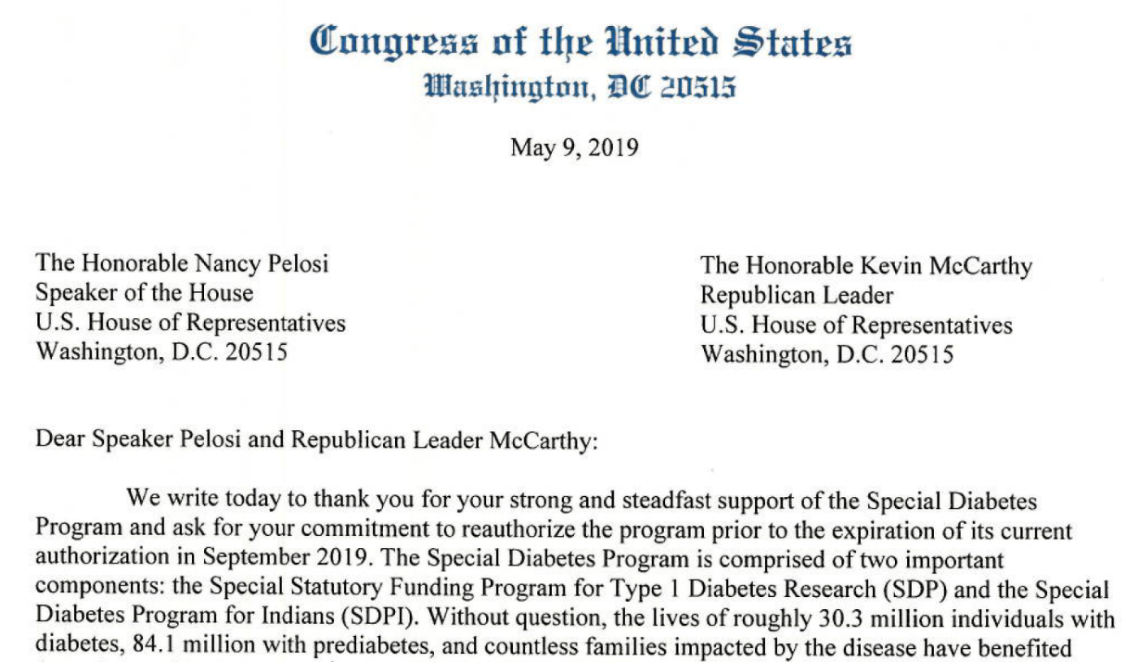
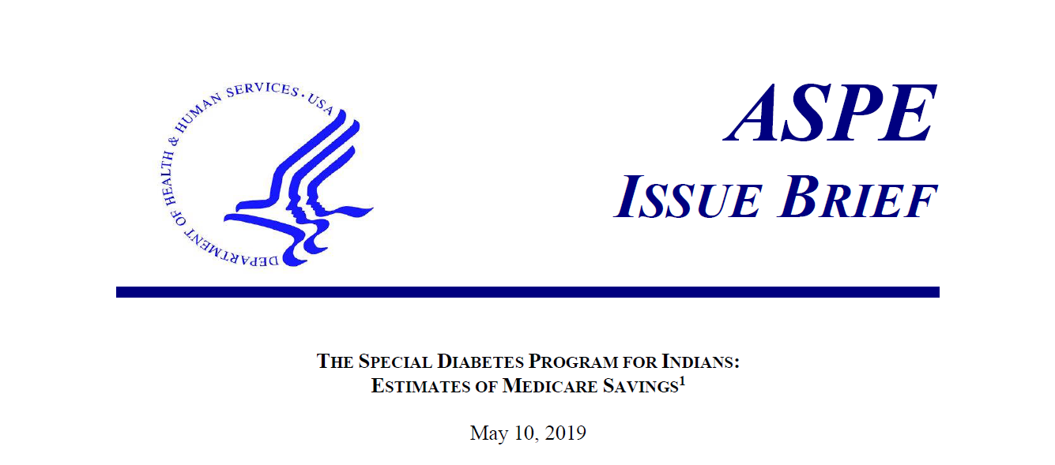
SDPI Developments in 2019
NIHB helped draft and circulate letters from House and Senate Diabetes Caucuses
Letters showed support for SDP and SDPI
Members could choose to sign on
379 House members (85%) signed the letter!!
68 Senators!!
HHS issued report showing SDPI’s impact
2,200-2,600 people avoided needing dialysis over 10 years
Medicare cost savings are up to $52 million/year
Notes:
Congressional members representing Indian Country were even more likely to sign on!

Slide 15
NIHB Efforts to Renew SDPI
Both House and Senate flat funding SDPI
Increase impossible without a way to pay for it
Medicare savings (up to $52 million/year) don’t count
Tribes wanted funding increase as a priority
NIHB identified the fourth year of funding in the House as the payfor
Asked House to consider amendment $200 million for 3 years
Unfortunately, House allies told NIHB that deal was probably too fragile to reopen
$150 million for 4 years most likely outcome
Timely renewal is not assured; time is running out!

Slide 16
Reforming SDPI’s Structure/NIHB Summit
NIHB held SDPI Summit on 9/19
Significant support for contracting/compacting SDPI
How would data be collected?
Moving away from grant structure?
How would Direct Service Tribes and Urban programs be impacted?
Current SDPI legislation does not address this issue

Slide 17
Medicaid Legislative Initiative
Allow states to extend Medicaid eligibility to all AI/ANs under 138% of the federal poverty level.
Authorize all providers in Indian health system to receive Medicaid reimbursement for services authorized under IHCIA.
Extend 100% FMAP to Medicaid services furnished by Urban Indian providers to AI/ANs.
Establish restrictions on state Medicaid waiver authorities to protect Indian-specific provisions within federal Medicaid law
Address the “four walls” limitations on IHCP “clinic” services by removing restriction prohibiting billing for services provided outside a clinic facility.
Notes:
Create an optional eligibility category under federal Medicaid law providing authority for states to extend Medicaid eligibility to all AI/ANs with household income up to 138% of the federal poverty level (FPL).
This would universally implement Medicaid expansion for all American Indians and Alaska Natives, regardless of the state where they reside.
2. Authorize all providers in the Indian health system, in all states to receive Medicaid reimbursement for the services they are authorized to provide under the Indian Health Care Improvement Act (IHCIA)—referred to as Qualified Indian Provider Services—when delivered to AI/ANs.
Currently, IHS and Tribes can only receive reimbursement for QIPS services that are authorized through the state Medicaid agency. This reinforces the direct relationship between Tribes and the federal government, rather than relying on state authority.
3 Extend full federal funding (through 100% FMAP) to Medicaid services furnished by urban Indian providers to AI/ANs, in addition to services furnished by IHS/Tribal providers to AI/ANs.
Under current law, only services provided at IHS-operated and Tribal facilities are reimbursed by the federal government at 100%. If services are received outside an IHS and Tribal facility –including an Urban Indian Health Program – services are reimbursed by both the state and the federal government.
4 In addition, the following items are included in the proposed Medicaid Indian Amendments Act:
Clarify in federal law and regulations that—
State Medicaid programs are permitted to implement policies limited to AI/ANs and/or IHCPs (through waivers or State Plan Amendments). This is in recognition of the unique health needs of AI/ANs as well as IHCPs. This would permit states and Tribes with increased flexibility to create special services specific to AI/ANs under the Medicaid program.
State Medicaid programs are prohibited from over-riding (through waivers or State Plan Amendments) Indian-specific provisions in federal Medicaid law.
These provisions are both intended to ensure that AI/ANs are not negatively impacted by state requirements under Medicaid such as work requirements or adding co-pays and monthly premiums.
5. Address the “four walls” limitations on IHCP “clinic” services by removing the restriction that prohibits billing for services provided outside a clinic facility.
Under the current system, Tribes and IHS can only get reimbursed for services provided inside the facility. This restricts reimbursements for services like home visits, or services referred outside the IHS or Tribal facility. It will expand the type of services that 100% FMAP can be used for and offset limited purchased/referred care appropriations.

Slide 18
Medicaid Legislative Initiative
Senate Republican Lead on Finance committee
Daines (MT), Thune (SD), Enzi (WY), Roberts (KS), Lankford (OK)
Resolutions of Support from Area Indian Health Boards and Tribal Nations
Cortez Masto (NV) interested in being lead in Senate
Lujan (NM) lead in House
Meetings with Senate Finance Committee and numerous congressional offices to build support
Meetings also arranged with external stakeholders (Families USA, National Health Law Center, Center on Budget and Policy Priorities)

Slide 19
Broken Promises Report and Legislation
December 2018 report from U.S. Commission on Civil Rights detailing “Broken Promises” of federal government to Tribal Nations and Native Peoples
Report is in follow-up to 2003 “Quiet Crisis” report
Highlights continued abrogation of Treaty and Trust obligations across wide swath of policy areas, with health being one of them
Offices of Senator Elizabeth Warren (D-MA) and Representative Deb Haaland (D-NM) have requested the feedback of NIHB and other national Tribal orgs on legislation addressing the findings of “Broken Promises” report

Slide 20
Broken Promises Report and Legislation
Legislative Proposal from Senator Warren/Rep Haaland released in early August, 2019
Originally intended to release formal draft legislation – ultimately chose a more measured and collaborative approach after feedback from Tribes and Tribal organizations including NIHB
Current proposal includes many outstanding Tribal health priorities including:
Advance appropriations of Indian programs
Full funding and mandatory appropriations for IHS
Public health infrastructure development
10-year reauthorization and needs-based funding for Special Diabetes Program for Indians

Slide 21
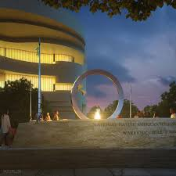
Native Health Priorities at VA
Working with House VA Committee on legislation -
Exempting Native Veterans from copays and deductibles in the VA system;
Including Tribal Nursing Homes in definition of U.S.C. that outlines Veterans’ benefits – introduced 9/26 by Sen. Sinema and Sen. Cramer
Clarifying the VA’s reimbursement requirement to the IHS for Purchase Referred Care (PRC) services.
House VA Committee hearing on Native Veteran issues
October 30, 2019 at 10:00am EST
Notes:
This bill would include Tribal Nursing Homes under the State Nursing Homes definition in the U.S. Code that outlines Veterans’ Benefits thus requiring the VA to compensate tribes for the care they provide in nursing homes.
Memorial to Native American veterans on national mall. The National Native American Veterans Memorial, Warriors' Circle of Honor, Harvey Pratt (Cheyenne/Arapaho)

Slide 22
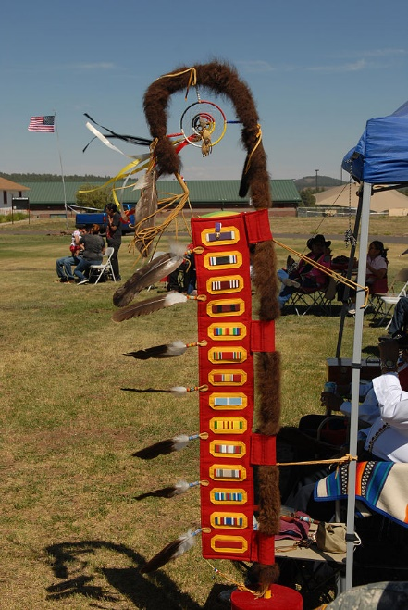
VA Tribal Advisory Committee Act
S. 524 introduced in February
Tester (D-MT), Sullivan (R-AK), Udall (D-NM), Murkowski (R-AK)
House companion bill H.R. 2791 (Rep. Haaland)
Introduced last year in different form, current bill more strongly reflects NIHB’s asks:
15 members– one from each IHS area + 3 at large
½ of VA TAC membership is comprised of Native Veterans
Subcommittee membership extended to Technical Advisors
Provides recommendations to VA on Native Veteran issues, including behavioral health challenges
Bi-annual Committee reports to Congress on activities
Replicates success of Tribal Technical Advisory committee (TTAG) to CMS and other committees

Slide 23
Texas v. Azar
December 14th, 2019 – United States District Court of Texas rules that the Patient Protection and Affordable Care Act (ACA) is unconstitutional
Tax Cuts and Jobs Act of 2017 zero’s out Individual Mandate Penalty
Elimination of Tax renders the entire ACA unconstitutional
January 3, 2019 – Coalition of States led by California, appeals decision to 5th Circuit Court of Appeals
January 4, 2019 - Department of Justice (DOJ) joins the appeal, agreeing that individual mandate was unconstitutional but that this provision was severable from the rest of the ACA
March 25, 2019 – DOJ reverses itself and instead agrees with the District Court that entire ACA is unconstitutional and no parts are severable
April 1, 2019 – NIHB and Coalition of 483 Tribes file Amicus Brief in 5th Circuit
July 5, 2019 – Oral Argument is heard in 5th Circuit

Slide 25
Texas v. Azar
Post Oral Argument
NIHB engaged with the Department of Justice, and Indian Health Service to ensure all Parties knew what was at stake with the Indian Health Care Improvement Act
Wait and See Approach for ruling by 5th Circuit
No matter what the decision – likely appeal to the Supreme Court
ACA is still the law of the land
In the event the ACA goes, Snyder Act still in place
NIHB is continuing to track the case and follow up with Federal Agencies on possible impacts of the Court decision

Slide 26
Thank you! Stacy A. Bohlen sbohlen@nihb.org

