Slide 1
FEDERAL COMMUNICATIONS COMMISSION (FCC) – 2.5 GHZ EDUCATIONAL BROADBAND SERVICE (EBS) – TRIBAL PRIORITY WINDOW
WILL MICKLIN, 3RD VICE PRESIDENT
CENTRAL COUNCIL OF TLINGIT AND HAIDA INDIAN TRIBES OF ALASKA
PRESENTATION TO TRIBAL SELF-GOVERNANCE ADVISORY COMMITTEE
JANUARY 2020

Slide 2
LACK OF BROADBAND IN TRIBAL LAND AREAS
In 2017, 98.4% of Urban, non-tribal households had broadband (25/3 Mbps) access 58.4% rural non-tribal areas. For rural tribal areas that number is 28.9%, and that is based on data that overstate actual coverage on tribal lands.
In many Tribal communities anchor institutions such as schools (BIE, E-Rate, Library Fund) and SIHC clinics enjoy exclusive access to broadband.
NEED
Tribal communities need a wireless last mile to the home solution that is affordable, protected, quickly deployed, easily maintained and available now.

Slide 3
SOLUTION
Equipment is easy, a wireless solution requires spectrum.
Educational Broadband Spectrum (EBS) spectrum is the perfect band for starting a rural wireless Internet network. A signal in this range has great propagation and penetration characteristics throughput. Since licenses are required, the networks have a guarantee of reliable operations without worry of interference that unlicensed spectrum has. And licenses are free for schools and nonprofits.
Citizens Broadband Radio Service (CBRS) spectrum in the 3.5 GHz would be available soon, however, physics and power limitations meant it only traveled half as far as EBS. CBRS is used when EBS is unavailable or for expansion of existing radio spectrum service (within buildings). Low band TV whitespace is great for traveling long distances, but it supports only a fraction of what EBS band networks can do.
Open EBS licensing has been frozen since the mid-nineties.

Slide 4
FCC TRIBAL PRIORITY WINDOW
The FCC is transforming the 2.5 GHz licensing rules by opening a tribal priority window for unassigned spectrum [and then auctioning off the remaining spectrum].
The tech is trivial [save for internet service backhaul]
The challenge is spectrum acquisition
On July 10, 2019, the FCC adopted a Report and Order that authorized applications by federally recognized Indian tribes for available and unassigned spectrum in the 2.5 GHz band in rural areas with use requirements.
The Tribal Priority Window is a unique opportunity for Tribes in rural areas to directly access unassigned spectrum over their Tribal lands, subject to buildout requirements. The 2.5 GHz band is suitable for both mobile coverage and fixed point-to-point uses, and is currently used to provide broadband service by legacy educational licensees and commercial providers that lease the spectrum.
Depending on your needs, it can play an important role in the deployment of broadband and other advanced communications services on your Tribal lands.

Slide 5
BACKGROUND
The 2.5 GHz band (2496 – 2690 MHz) constitutes the single largest band of contiguous spectrum below 3 GHz. Of the available 194 megahertz of spectrum,
116.5 megahertz is allocated to the EBS [formerly known as Instructional Television Fixed Services (ITFS)], and the remaining 77.5 megahertz is allocated to the commercial Broadband Radio Service (BRS).
EBS licenses reflect their origins as TV licenses by their circular area with a 35- mile radius from the center point.
Significant portions of the EBS spectrum currently are unlicensed in approximately one-half of the United States, primarily in rural areas. Incumbent EBS licenses cover only about 50% of the geographic area of the country on any given channel. In the rest of the country, mostly rural areas, and mostly west of the Mississippi River, the 2.5 GHz spectrum remains largely unassigned.

Slide 6
At present, eligibility to hold an EBS license is limited to educational institutions, government organizations engaged in the formal education of students, and nonprofit organizations whose purposes are educational.
Examples: State universities; local school boards; Hispanic Information and Telecommunications Network
However, EBS licenses are rarely used for educational purposes, except to the limited extent required by the FCC’s rules. EBS licensees are permitted to lease “excess” capacity to commercial wireless providers.
It is estimated that over 90% of the 2190 active EBS licenses are currently leased, mostly to Sprint. Sprint holds substantial BRS spectrum across the country, and it leases EBS spectrum from educational entities, giving it an average of 120 megahertz of 2.5 GHz spectrum in 90 of the top 100 markets. Leases for assigned EBS spectrum will not be affected by the FCC Report and Order.

Slide 7
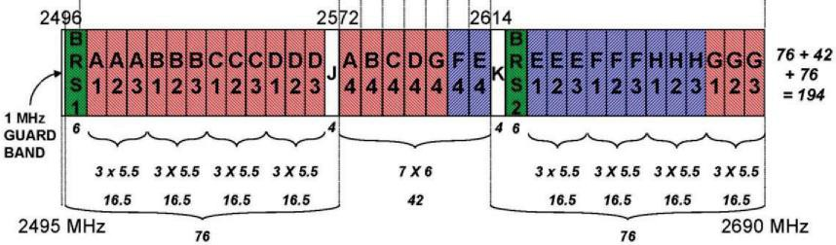
Technology
Available 2.5 GHz spectrum per license will vary between 5.5 and 73.5 MHz bandwidth. Optimally, a typical license offering would be 22.5 MHz. A single
22.5 MHz license allows for a sophisticated, high-bandwidth network. Additional bandwidth in multiple licenses would allow for additional and contiguous spectrum.
The 2.5 GHz band plan is shown below. Channels 1, 2 and 3 of each channel block occupy the upper and lower portions of the 194 MHz reserved for this band. Channel 4 of each channel block is located in the middle band. Channels J & K serve as guard band spectrum between the lower, middle and upper bands.

Slide 8
Channel Profile Analysis
Commercial BRS licenses, mostly held by commercial operators, are located on Channels E, F, H and BRS1-2. The EBS channels are located on A, B, C, D, & G adjacent to the BRS licenses. EBS licenses are reserved for educational institutions and can only be held by qualifying educational institutions such as schools, colleges, and non-profits. Generally, schools and colleges don’t have the funds, expertise or need to operate a wireless broadband network, most have entered into excess capacity leases allowed by FCC regulations. FCC rules require lessees to reserve a portion of the license for educational use.
Currently, most operators on the BRS & EBS bands are using 4G LTE protocols compatible with 3GPP standardized LTE band 41 for channel sizes ranging from 5-20 MHz in a Time Division Duplex (TDD) configuration. The band, which also allows for WiMAX, is supported by a wide variety of equipment manufacturers. However, the spectrum can also be used to support more specialized networks including utility applications, government organizations, and public safety, etc.

Slide 9
Unassigned EBS Spectrum Will Be Made Available by Auction for Commercial Use
The FCC Tribal Priority Window will make available by application from a federally recognized Indian tribe or tribally owned or controlled entity or consortium of federally recognized tribes, the available unassigned EBS spectrum in rural areas where there is a local presence (demonstrated by US
Census American Indian Reservation (AIR) or Tribal Designated Statistical Area (TDSA), and in Alaska by Alaska Native Village Statistical Area
(ANSVA) [federally recognized Indian tribes not affiliated with an ANVSA are: Metlakatla Indian Community, which is an AIR; and Inupiat Community of the North Slope and Central Council of Tlingit and Haida Indian Tribes of Alaska, which are regional Indian tribes]. The US Census’ Other Tribal Reservation Lands (OTRL) are not depicted in the FCC Mapping Tool.
The FCC will accept license applications only where non-rural, unassigned spectrum is available in each channel 1, 2, or 3. An overlay right will exist for the remaining spectrum in each channel that is assigned and not available. In the event the assigned license is forfeited or expires, the tribe with assigned spectrum within the channel will have primary status for assignment.

Slide 10
Mapping Unassigned EBS Spectrum
The FCC Mapping Tool is available on the FCC Tribal Priority Window or MuralNet.org websites as the database to map the geographic scope of the unassigned EBS spectrum. MuralNet can help map the spectrum profile.

Slide 11
2.5 GHz TRIBAL PRIORITY WINDOW APPLICATION PROCEDURES On Jan. 9, 2020, Today, the FCC Wireless Telecommunications Bureau released a Public Notice providing detailed license application procedures and guidance for the upcoming 2.5 GHz Rural Tribal Priority Window. This license application window for Tribal entities will open at 9 am Eastern Time on Monday, February 3, 2020, and will close at 6 pm Eastern Daylight Saving Time on Monday, August 3, 2020. Prospective applicants are strongly advised to closely review the Public Notice, which is available at: https://www.fcc.gov/document/25-ghz-tribal-window-procedures-pn.
The livestream of the 2.5 GHz Rural Tribal Window Workshop held at FCC Headquarters on January 14, 2020 is available at: https://www.fcc.gov/news- events/events/2020/01/25-ghz-rural-tribal-window-workshop.

Slide 12
FCC Assistance
The Wireless Telecommunications Bureau is available to assist prospective applicants interested in applying for eligible 2.5 GHz spectrum licenses during the Rural Tribal Priority Window (RuralTribalWindow@fcc.gov).
Please provide the following information in your inquiry: name and contact information for the person making the inquiry; name of potential applicant, nature of Tribal affiliation, Tribal land(s) for which the applicant is interested in applying, whether they are a federally recognized Tribe or majority owned and controlled entity, and complete contact information for the applicant, including, at a minimum, the senior official of the applicant.
Alternatively, potential applicants may call Cecilia Sulhoff, Wireless Telecommunications Bureau, at (202) 418-0587. During the Rural Tribal Priority window, applicants will be able to call the ULS Licensing Support Hotline for assistance at (877) 480-3201 (TTY: (717) 338-2824, ASL Videophone: (844) 432-2275). The ULS Licensing Support Hotline is available Monday through Friday, from 8:00 A.M. to 6:00 P.M. Eastern Time.

Slide 13
FCC Tribal Priority Window Webpage
Further information about the Rural Tribal Priority Window is available
at http://www.fcc.gov/RuralTribalWindow, including detailed background information which Tribes can use to evaluate their eligibility, a mapping tool to help Tribes better understand and prepare for taking advantage of the Window, and dates and locations of any upcoming workshops.

Slide 14
License Requirements
Successful applicants in the Rural Tribal Window will receive a license from the FCC to use their spectrum. This license comes with certain conditions and requirements.
First, licensees must put their spectrum to use. Two years after the license is granted, licensees must submit evidence that they are providing service coverage to 50% of the population in their license area (the interim deadline). This means that 50% of the population must be able to access the service if they choose; it does not require a 50% adoption rate. Five years after the license is granted, licensees must show that they are providing service coverage to 80% of the population (the final deadline).* Failure to meet the interim deadline will advance the final deadline by one year, to four years after the license grant.
Failure to meet the final deadline will result in the license being automatically cancelled. If the license is cancelled, the spectrum will revert to the overlay license holder for the relevant county.

Slide 15
Second, licensees may not sell or transfer their licenses until after the above buildout requirement is met. However, licensees may lease their spectrum, and the service provided by a lessee will be counted towards the buildout requirement.
At the interim deadline, a licensee building point-to-point links must operate one link for each 50,000 people in the license area. At the final deadline, the requirement is one operating link for each 25,000 people in the license area.

Slide 16
MAPS
To assist in determining if spectrum is available each tribal land area, maps of each Eligible Rural Tribal Land have been created. These maps depict the general availability of spectrum within the respective area.
This mapping tool can be used by Tribal entities to help them assess whether and to what extent there is unassigned 2.5GHz spectrum available over their eligible Tribal lands. The mapping tool provides a high-level view of spectrum availability and allows users to link to the FCC’s Universal Licensing System (ULS) to confirm the exact amount of eligible spectrum available.

Slide 17
Band Plan for Tribal Window Applicants
The 2.5 GHz Band Plan for both Tribal Window Applicants is as follows:
One channel of 49.5 MHz (New Channel 1);
One channel of 50.5 MHz, adjacent to the above (New Channel 2);
One channel of 17.5 MHz, not adjacent to the first two channels (New Channel 3).
Tribal Applicants may apply for one, two, or all three of these channels, as long as some part of each channel for which they apply is available over the requested license area on their Rural Tribal Land. In the figure below, this band plan is labeled below the diagram.

Slide 18
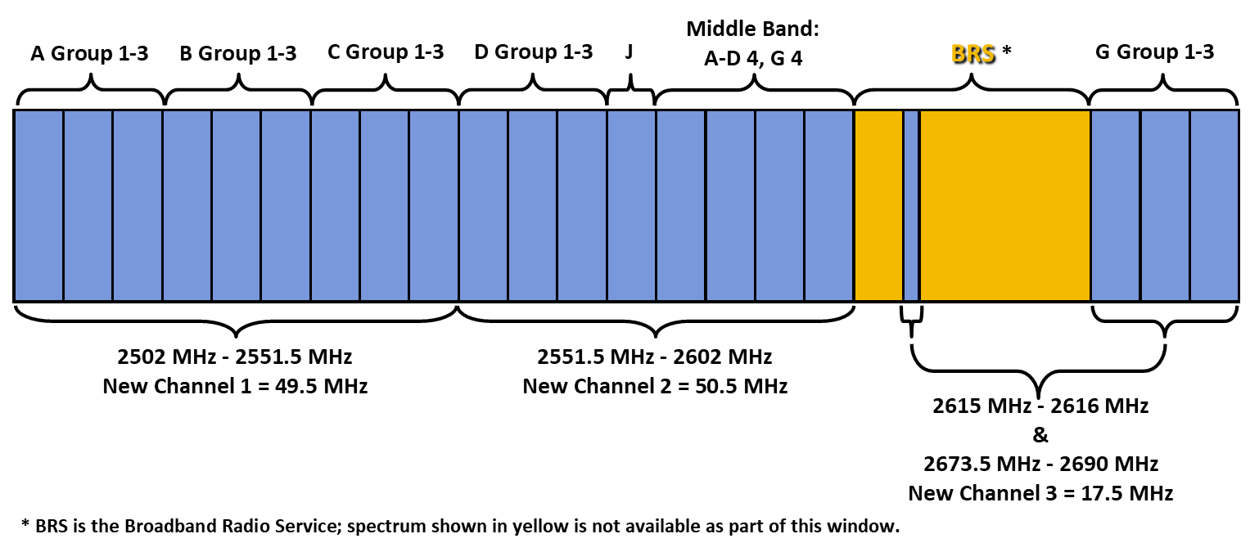

Slide 19
Legacy Band Plan for Incumbents
Prospective Rural Tribal Window Applicants should be aware that incumbent licenses follow a different band plan. The legacy band plan is divided into five channel groups: the A Group, the B Group, the C Group, the D Group, and the G Group.
The differences between the legacy band plan and the new band plan mean that in some areas, channels may be only partially available. For example, if an incumbent licensee in a Tribal area holds only the A Group, the Tribe would still be able to apply for Channel 1 of the new band plan, even though that channel overlaps with the incumbent license, because the rest of Channel 1 is available.
However, the spectrum covered by the incumbent licensee would NOT be available for use by the Tribal Applicant, even if it is currently unused.
Spectrum is only available for Tribal Applicants where it is unassigned/unlicensed over Rural Tribal Lands.

Slide 20
APPLICATION PROCEEDURES
The Rural Tribal Priority Window will open on Monday, February 3, 2020, and will close on Monday, August 3, 2020.
The application process will use the Universal Licensing System (ULS), the Wireless Bureau’s online application and licensing portal.
Applicants will need an FCC Registration Number (FRN) to apply. If you do not currently have an FRN, instructions on obtaining one are below. FCC staff will be available to assist applicants throughout the application process, including with technical or logistical issues. Please contact the FCC at RuralTribalWindow@fcc.gov for application process questions or assistance.
PLEASE NOTE: if two eligible tribes submit applications for the same spectrum, both applications will be deemed ineligible for the Tribal Priority Window and the spectrum will be allocated in the subsequent auction of unassigned 2.5 GHz spectrum remaining after the Tribal Priority Window allocations.

Slide 21






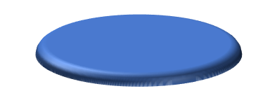



Backhaul
The greatest challenge for many tribes will be the Distribution Backhaul, which is the connection that brings the Internet Exchange Point (IXP) [backbone] through the Distribution Backhaul [middle mile] to the Access Points [last mile].
BROADBAND ARCHITECTUREBASICS
Commonoptions and architecture across various platforms below
Best option depends on the requirements and budget
i.e., fiber has lots of capacity, but expensive to deploy in rural areas where fixed microwave may be best).
WiFi
Wireless Interne
Cell towers
Gateway
Head-end
Data center
Central Office
Routing center
Fiber
node
Coax
amp
t Service Providers
IXP
(Internet Exchange Point)
Fiber node
Fixed wireless
Aggregation Point
Distribution, Backhaul
Access points
“last mile”
7

Slide 22
Backhaul Criteria
The backhaul will be determined by: AVAILABILITY (is an IXP available within a reasonable distance?); COST (is the backhaul available at a reasonable cost?); TECHNOLOGY (is the backhaul technology – fiber, microwave, satellite – feasible for the route available? or if satellite – is the latency tolerable?); LICENSING (for microwave is the spectrum available?); PERMITTING (are right of way or easement permits available for the fiber or microwave route available?).

Slide 23

Backhaul spectrum availability is determined by licensing regimes.
SPECTRUM ACCESS
Licensed service, License-by-rule, Unlicensed
Geographic area licensing
Exclusive assignment of a block of spectrum over a defined geographic area.
Generally assigned by auction, but secondary market process is very flexible.
Coordinated site based licensing (fixed backhaul (aka microwave or links), some satellite and narrowband land mobile)
Can be shared or exclusive, but coordination used to prevent interference.
License-by-Rule – shared, but with somestatus: Citizens Broadband Radio Service and Part 95 (CB,FRS,Medradio)
Unlicensed – UNII, WiFi
Free access, flexible rules, low power, but no protection orrights

Slide 24
Spectrum considerations will determine the feasibility of the proposed backhaul.
SPECTRUM CONSIDERATIONS
Lower frequencies travel farther, but higher frequencies have more bandwidth. Lower frequencies tend to penetrate buildings better than higher frequencies Are you looking for mobile broadband or service to a fixed location?
Spectrum availability and cost. Varies between urban and rural deployments. Equipment availability and cost, established bands have more equipment options.
Scope of deployment and whether you need exclusivity.
SEPTEMBER23 – 24, 2019 | WASHINGTON, DC
8

Slide 25
ALASKA NATIVE OPPORTUNITIES
The entire 2.5 GHz spectrum is unassigned in Alaska, and the urban exclusions (rural requirement) only exist around Anchorage and Fairbanks. Therefore, the opportunity for eligible tribes and tribal entities or consortiums is:
Apply for the entire 2.5 GHz EBS spectrum;
Form consortiums of tribes to form regional networks and a state-wide network, or interconnect tribal license-holder networks to form regional networks and a state-wide network.

Slide 26
Alaska Regional and State-wide Networks
Regional networks and a state-wide network would permit the allocation of channels to specific purposes, including government, public safety, health care, education, and economic development. Networks would also enable greater
efficiencies to reduce the cost of administration and improve network operations and maintenance.
The benefits of a 2.5 GHz EBS spectrum network in each eligible Alaska Native village is extraordinary, and so extensive as to be beyond the scope of this high level introduction to the FCC Tribal Priority Window.

Slide 27
RECOMMENDATION
Alaska Native leaders of eligible Alaska Native tribes, entities and consortiums should convene meetings as soon as possible to plan strategies for applications that envision the desired long-term outcomes. The application procedures are
not difficult, but the consequences of ill conceived applications cannot be undone.

Slide 28
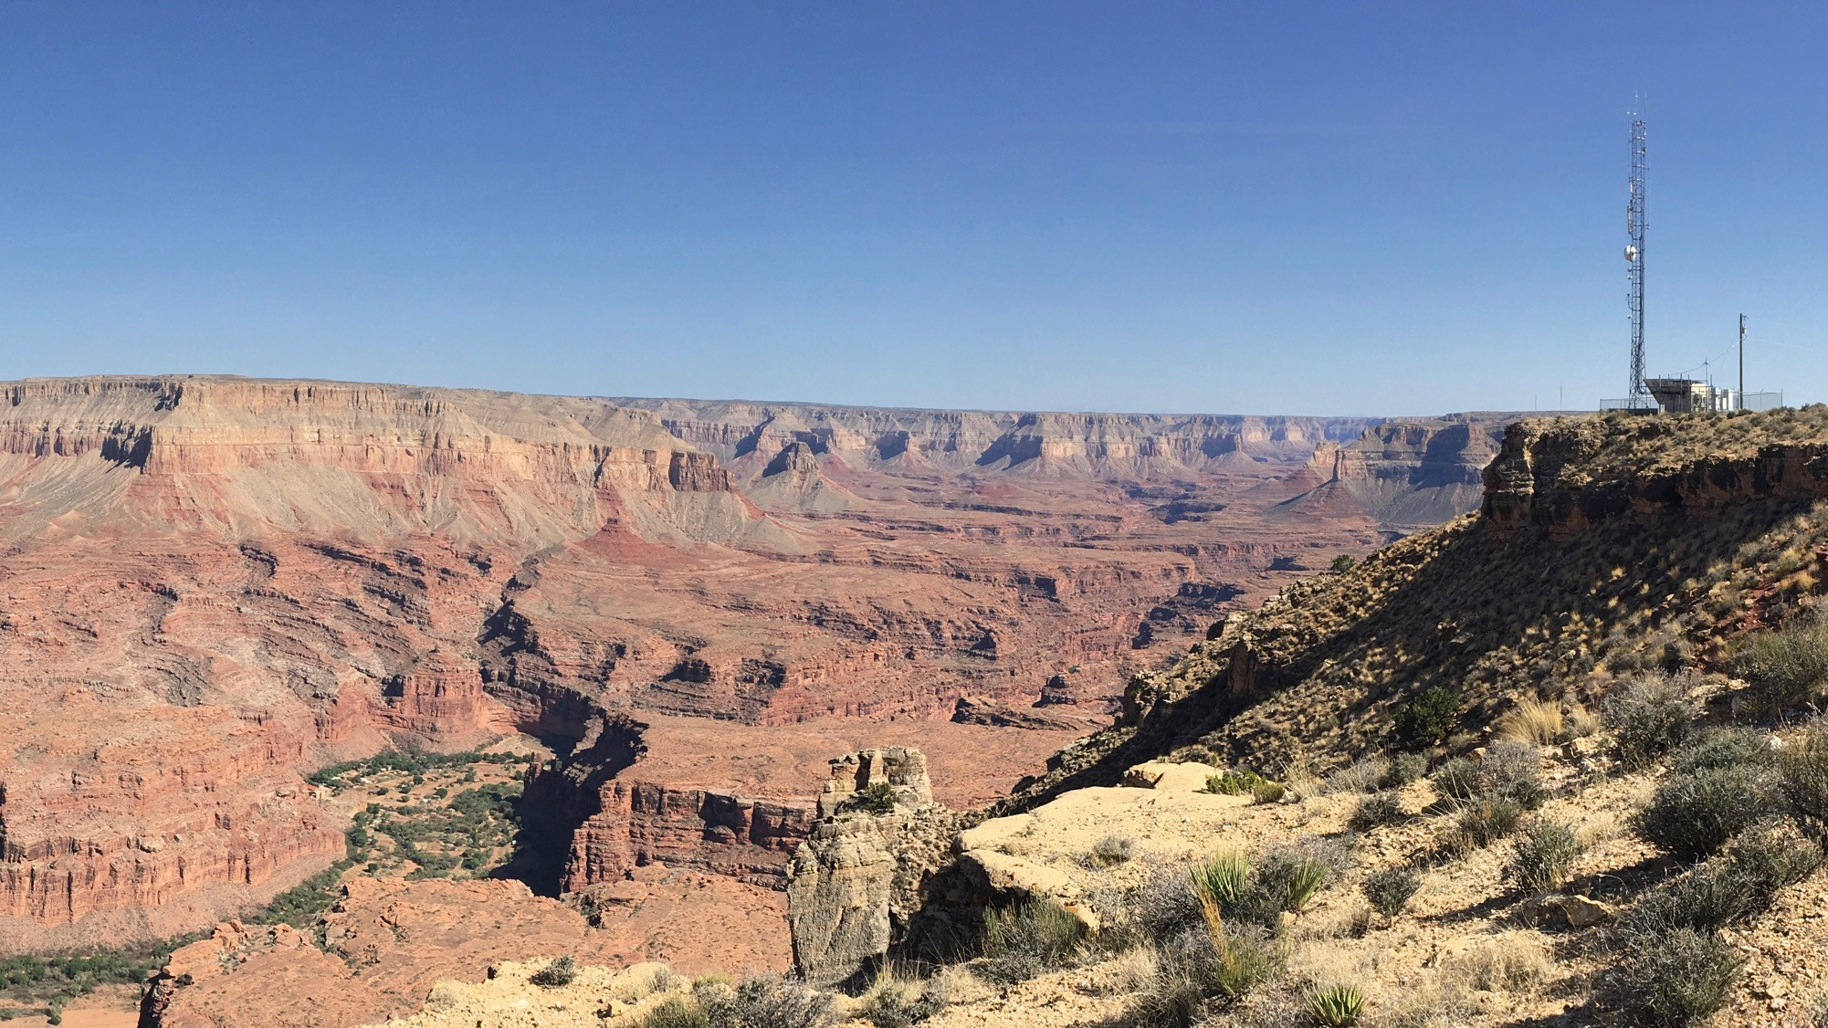
CASE STUDY – HAVASUPAI DEPLOYMENT
Bridging the Homework Gap on Tribal Lands
Mariel Triggs CEO,MuralNet

Slide 29


Bridging the Homework Gap
Mural’s goal is to develop and execute a strategy for bringing broadband to under-connected people on tribal lands on a grand scale.
We provide legal help, equipment, installation and network management training for our tribal community partners to self-deploy their own high-speed Internet networks at no cost to them.
© MuralNet 2019

Slide 30
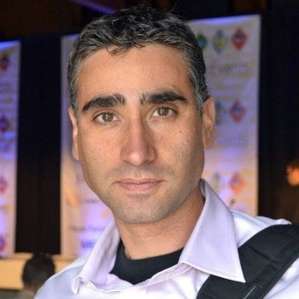

History of Mural - Founded March 2017
Martin Casado, Founder & CFO
Martin is a Silicon Valley entrepreneur, investor and
technologist who was deeply involved in the development of software defined networking as a co- founder of Nicira Networks. Currently he is a GP at Andreessen Horowitz. He grew up near Four Corners and has a deep affinity for the region.
Brian Shih, Founder & President
Brian specializes in designing ICT infrastructure solutions and has built networks of all sizes across the globe. Now his focus is America’s rural underserved communities. Through his work with EducationSuperHighway, he helps K-12 schools optimize E-rate to upgrade their broadband.
© MuralNet 2019

Slide 31
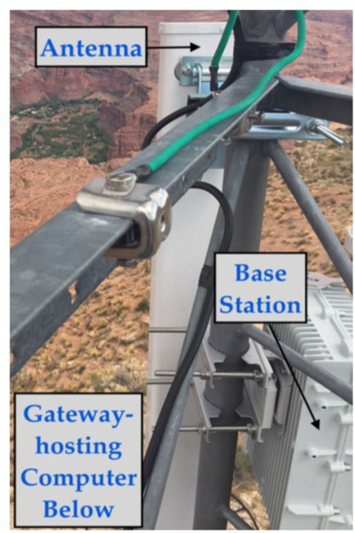
Why Self-deployed and Managed Networks Now
Reliable and Free Tech Stack
Affordable Off-the- shelf Equipment
Available Backhaul
Government Subsidized Fiber
Major Providers
Local WISPs
Vigilant tribally- affiliated people and organizations
Facebook’s MAGMA
Open-source
Distributed LTEcore
Can be run on AWSor their own servers
Network operators
need to be techsavvy but not highlyskilled
© MuralNet 2019

Slide 32
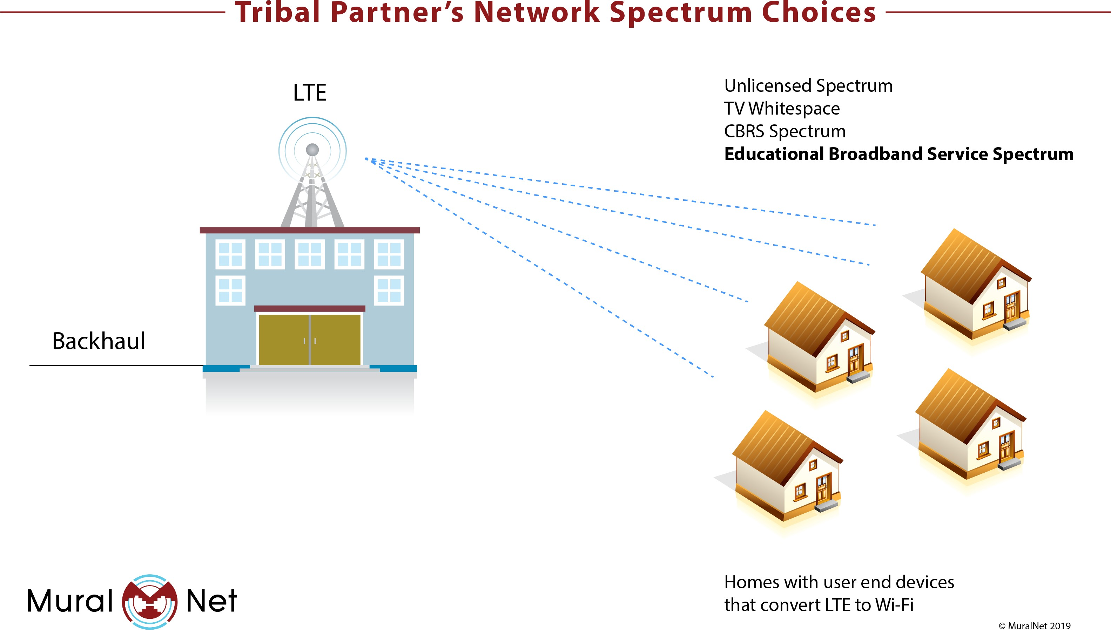

Slide 33
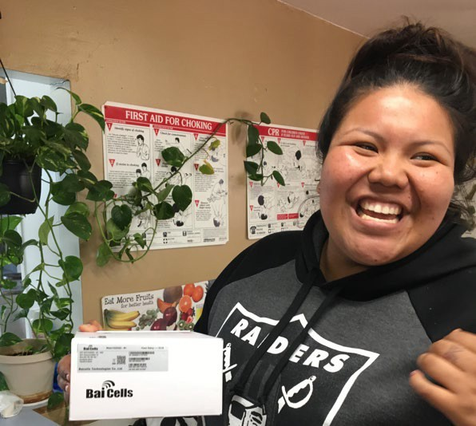
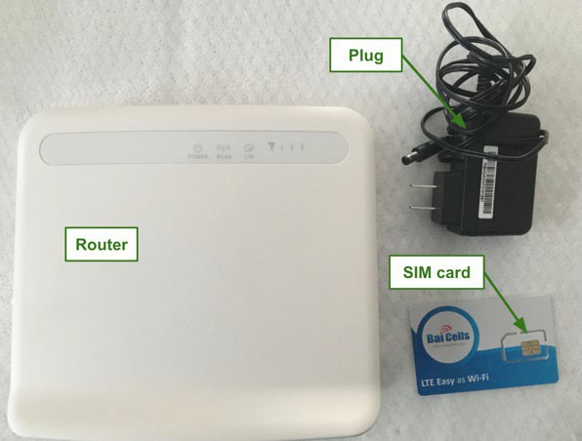
Situation 1: EBS Available Havasupai Deployment
9/27/2017 Tribal resolution approving proposal
11/2/2017 Emergency STAapplication submitted
11/17/2017 Cell mounted
2/28/2018 FCCtemporary license granted to The Havasupai Tribal Council
3/5/2018 First end-to-end connection by Armando Marshall, Facilities & Maintenance Supervisor capable of broadband speeds
Permanent connection to 16 homes and offices and 24 more routers available for checkout from the tribal offices
Future Expansion pending approval of permanent application
© MuralNet 2019

Slide 34
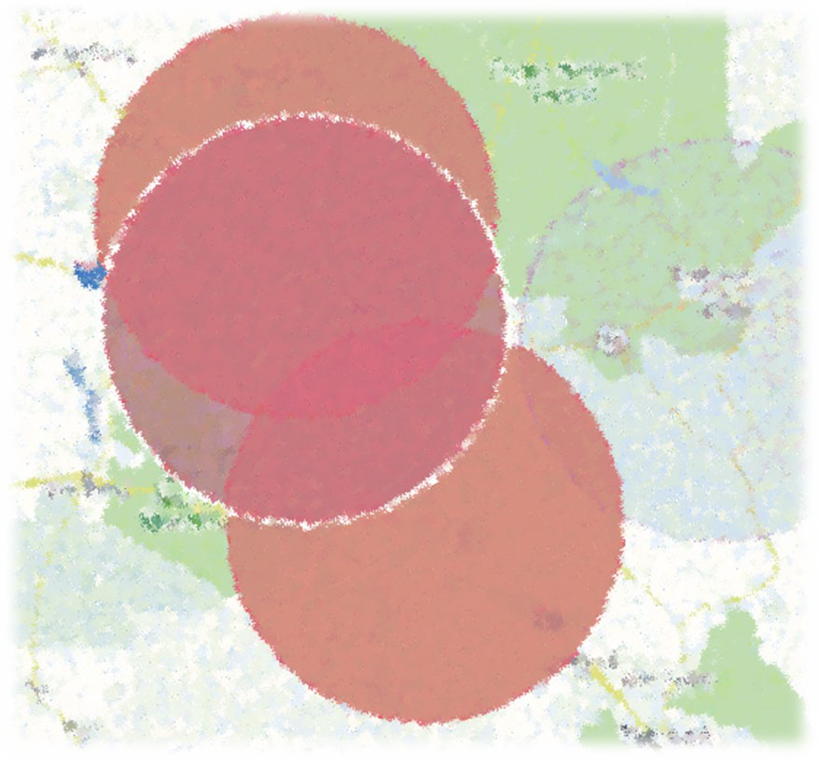
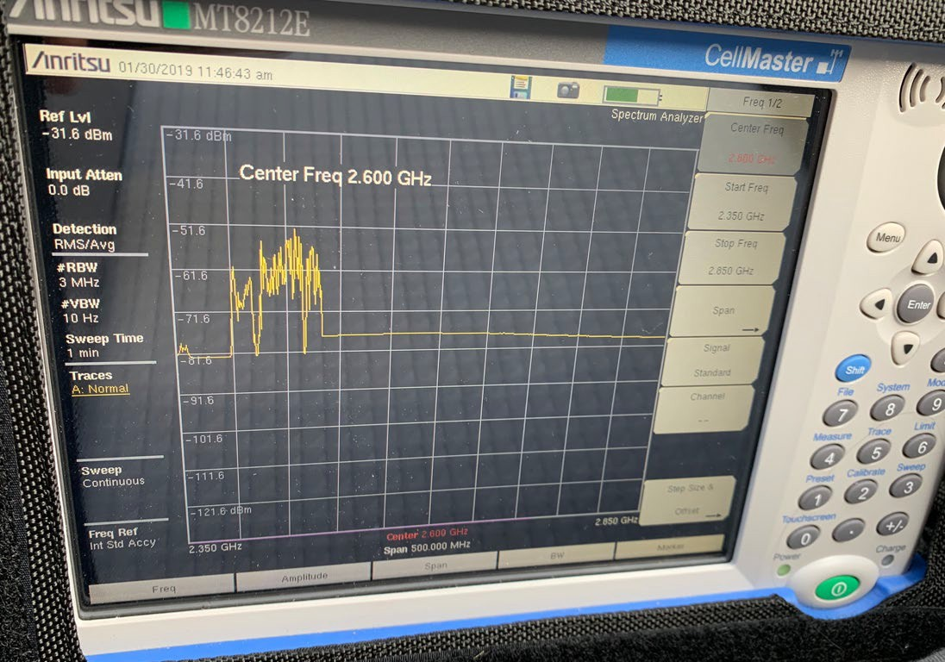
Situation 2: All Spectrum Allocated But Not Used
C4channel of NMPBS WHR756 available for lease and talks with SFIS already started
All other spectrum controlled by Sprint, but they are willing to negotiate
© MuralNet 2019

Slide 35
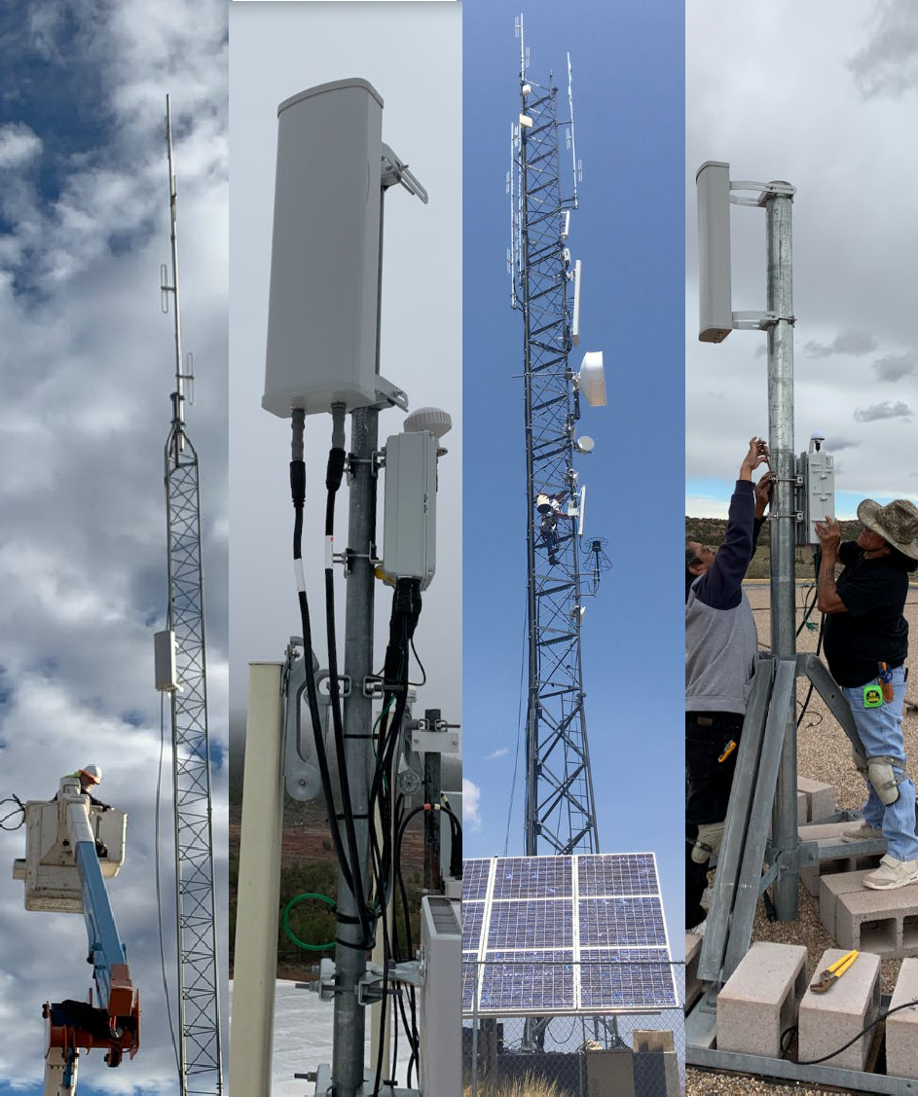

We need EBSfor the public good
Tribal priority windows Access to major telecoms’licensed
but unused spectrum on tribal
lands
Mariel Triggs, mariel@muralnet.org
© MuralNet 2019

