Slide 1
GOVERNMENT ACCOUNTABILITY OFFICE TRIBAL ADVISORY COUNCIL Insights How Congress Uses GAO Reports and Information
Rhonda Harjo (MBCI/MCN), TAC Member
September 28, 2022

Slide 2
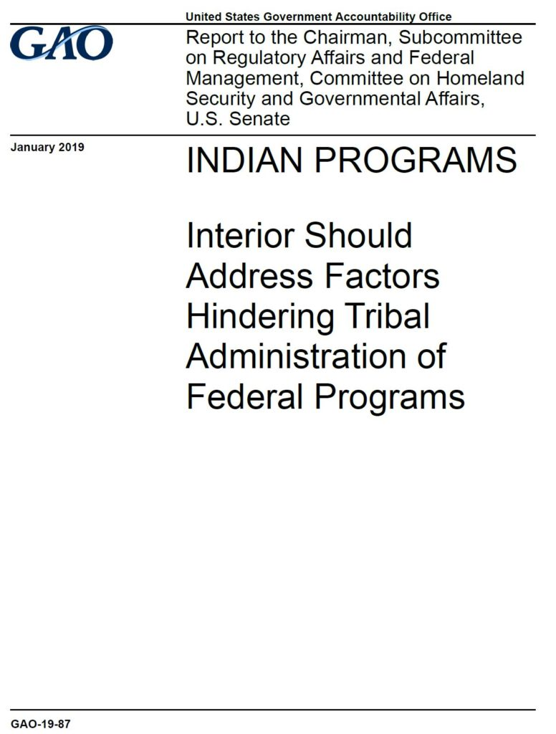
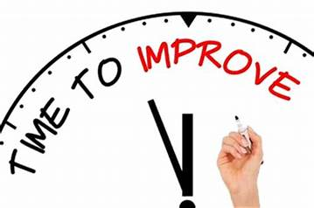
Relationship
The Government Accountability Office (GAO) is known as "the investigative arm of Congress" and "the congressional watchdog." GAO supports the Congress in meeting its constitutional responsibilities and helps improve the performance and accountability of the federal government for the benefit of the American people.

Slide 3
Oversight
What is the problem with the program
Money spent properly or how was it spent or allocated
Program administered according to statute
Recommendations for improvement, changes, additional oversight, hearings, or reports

Slide 4
Process
How does the process begin or get triggered
Priorities
Steps
Involvement during review
What happens at the end of the review
Follow-up

Slide 5
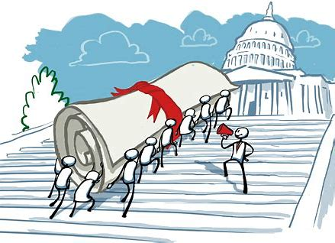
Process - Getting Started
Problem gets attention of Congress
~~Constituents, news articles, reports,
hearings, etc.
Issues in legislative process
~~Examine before action (stall, more information, gain support, etc.)

Slide 6
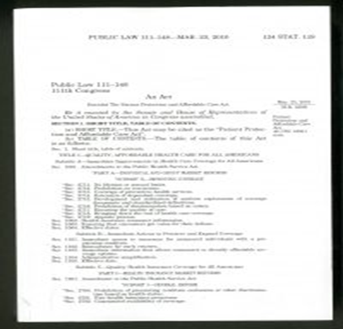
Process - Steps
Request to GAO
~~Statutes, letters
Priority of requests
~~Statutory mandates
~~Committees – Chair, Ranking Member
~~Individual Member

Slide 7
Process – Involvement During Review
Adding requesters
Scoping
Follow-up meeting

Slide 8
Process – Post-Review
Draft
Agency response
Hold

Slide 9
Process – Follow-up
Final Report
Press Release
Hearing
Secondary Report(s) – Phases
Legislative Action

Slide 10
GAO Reports – Purpose, Use, Development
Examine, study,
understand, solve
a problem
Strategy in legislative process or oversight activity
~~Examine before action (stall, more information, gain support, etc.)
Scoping, Tribal consultation, generate interest and information

Slide 11
Examples
IHCIA – Contract health services (CHSDAs)
Indian Tribal Energy and Self-Development Act
Telecommunications and Broadband Reports
Indian Education Reports
Juvenile Justice Reports
Advance Appropriations

Slide 12
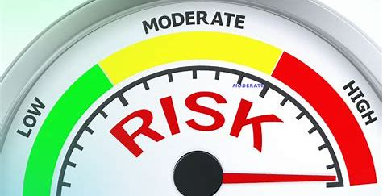
Follow-up
ATTENTION
OPEN RECOMMENDATIONS
~~https://www.gao.gov/reportstestimonies/reco mmendations-database
HIGH RISK
ACTION

Slide 13
THANK YOU!

