Slide 1
Community Health Aide Program development outside of Alaska
Christina Friedt Peters
Tribal Community Health Provider Program Director
Northwest Portland Area Indian Health Board
cpeters@npaihb.org
Martha Ketcher, MBA, HCA
Sr. Advisor for Health, Cherokee Nation
Martha-ketcher@Cherokee.org

Slide 2
Community Health Aide Program Development
What is the Community Health Aide Program (CHAP)
Why CHAP matters
CHAP Providers – Community Health Aides (CHA), Behavioral Health Aides, (BHA), and Dental Health Aides (DHA)
National Policy
Area Certification Boards (ACB) and National Certification Board (NCB)
CHAP TAG
Challenges
Inherently Federal Function

Slide 3
What is the Community Health Aide Program
CHAP is a system of health provider education
CHAP provides regulatory oversight for providers through the Area CHAP Certification Board which are federal boards and outside of state regulatory requirements
The CHAP solution is to train local people who are familiar with and likely to stay in their communities.
Initially "the eyes and ears of the physician", Health Aides now provide primary care services, and have helped meet rising expectations for health care.
The primary care model used in the Community Health Aide Program has always included:
      Emergency
      Acute
      Chronic care
      Preventive health components
Notes:
CHAP is a self contained program, it is a system of health provider education that provides regulatory oversight for providers educated by the CHAP and it generally sits outside of state regulatory authority and within IHS. CHAP started as a program in Alaska in the 60s to train village women to help quell a tuberculosis epidemic and has grown to a sophisticated wraparound health care system that expands access to primary care, emergency, acute, chronic, and preventive health care in rural and frontier Alaska native villages

Slide 4
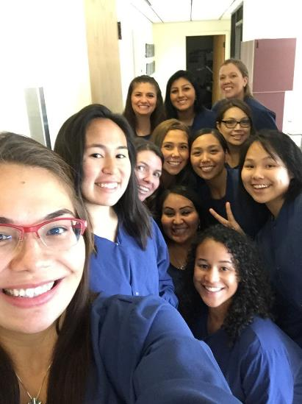
Why?
Dental Health Aide Therapist Class of 2019 Selfie
Our Board is interested in supporting long term sustainable solutions that build up our communities, create opportunities for our youth and tribal members, educate our healers and train the next generation of healthcare work force.
Dental Health Aide Therapist Graduation, 2019
Notes:
Not just about improving access
Social determinants of health
Providing for the health and well being of your citizens doesn’t mean just bringing more dentists or doctors to Indian country, it means creating educational pathways and employment opportunities that will also improve access to care as well as address other issues that will strengthen the community.

Slide 5
Social Determinants of Health
Education Attainment
Plays a significant role in shaping employment opportunities
Can increase capacity for better decision making regarding one’s health
Provide scope for increasing social and personal resources that are vital for physical and mental health
Economic Stability
Creates Jobs in your community
Employment Attainment
Living Wage
Access to insurance and other resources
Notes:
Opportunity to address social determinants of health

Slide 6
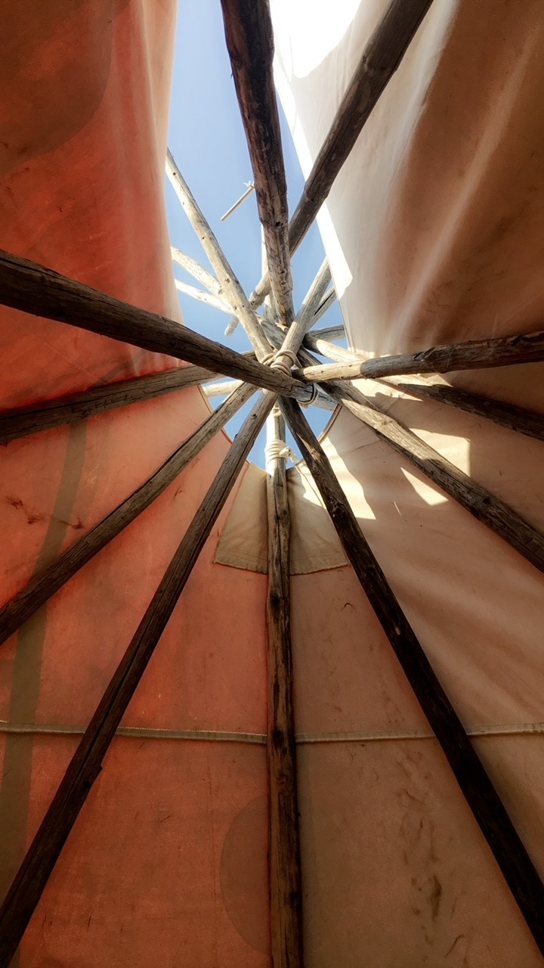
Why CHAP Matters
Proven history of safe, quality care in Alaska for over 50 years
Uniquely developed for American Indians/Alaska Natives by American Indians/Alaska
Tribes can tailor their programs to fill healthcare gaps and meet their needs
Increases AI/AN Providers and local workforce
Decreases travel for routine or non emergency care
Home grown, culturally knowledgeable and respected providers
Competency based, skilled providers who increase access to care
Extend the reach of services into hard to access areas
Creates wrap around care and referral services for Tribes
Creates an education and career pathway for AI/AN providers
It’s flexible and creative
Notes:
This work is important especially in light of COVID-19. Increased access to behavioral health services is critical for our tribes. Our needs assessment from 2018 indicated that our WA tribes need a minimum of two BHA each. Idaho tribes would benefit from much the same.
CHAP IS SUPPOSED TO SIT OUTISDE OF STATE REGULATORY ENVIRONMENTS AND OTHER ACCREDITATION AUTHORITIES IN ORDER TO ALLOW FOR THE TRIBAL HEALTH SYSTEM TO BE NIMBLE AND RESPONSIBE TO THE NEEDS OF THE TRIBAL HEALTH PROGRAMS THAT HAVE BEEN LET DOWN BY THOSE EXITING SYSTEMS

Slide 7
CHAP Implementation Timeline
1960s – CHAP Developed in Alaska
1976 – CHAP added to IHCIA
1992 – IHCIA amended to require CHAP Certification Board
1998 – Alaska CHAP Certification Board Circular Published (98-150)
2010 – CHAP Nationalized as part of the IHCIA permanent reauthorization
2015 – Tribal leaders from the Portland Area through NCAI, Tribal Self Governance, and NIHB advocate for CHAP implementation to begin
2016 – IHS initiated tribal consultation and tribes across the US overwhelming support establishing a national CHAP
2018 – IHS forms the CHAP Technical Advisory Group (CHAP TAG)
  IHS told Tribes through the CHAP TAG in 2018 that once the underlying national CHAP policy was complete, that they would be able to move forward with adding CHAP to AFAs and Area Certification Board could certify providers

Slide 8
CHAP Implementation Timeline
2020 IHS Circular No. 20-06 published to implement, outline, and define a National CHAP Policy
2021 – Portland Area CHAP Certification Board (PACCB) is established and begins work to approve Portland Area Standards and Procedures, design forms and build a secure data storage plan
2021 PACCB forms Academic Review Committees
2021 IHS informs PACCB that it is required to use federal forms that have gone through a federal approval process to collect and store data because the collection and storage of data for the purpose of certifying providers is an inherently federal function.

Slide 9
What is a Tribal Community Health Provider?
Tribal Community Health Providers trained through the Community Health Aide education Programs are an integral part of the I/T/U system of care

Slide 10
What is the Tribal Community Health Provider Project?
Dental Health Aide (DHA)
Behavioral Health Aide (BHA)
Community Health Aide/Practitioners (CHA/Ps)
DHAs are primary oral health care professionals that can provide clinical dental treatment, patient education and preventative services.
BHAs are counselor’s, health educators, and advocates. BHAs help address individual and community-based health needs such as alcohol, drug and tobacco abuse and mental health. BHAs use a combination of Western and traditional-based practices to provide care.
Community Health Aide Practitioners (CHA/P) are certified primary and emergency care clinicians who have close cultural ties and connections to the communities they serve.
Notes:
I use CHAP and Tribal Community Health Provider Project interchangeably, the TCHP is the project at the board we set up to implement CHAP to recognize that health aides are not aides but actually providers in tribal communities

Slide 11
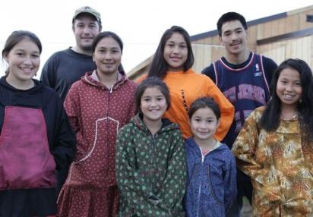

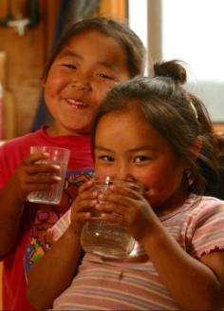
Who do CHAs, BHAs, and DHAs provide services to?
National Geographic
The Blues & the News
Families
Elders
Individuals
Youth
Alaska Native Tribal Health Consortium
Notes:
Tribal health practititioners called Community Health Aides, Behavioral Health Aides, and Dental Health Aides provide care to their communities through the entire life cycle. They provide care to individuals, families, and communities in a variety of settings.

Slide 12
What is a Community Health Aide/ Practitioner (CHA/P)?
CHA/Ps are local mid-level primary care and emergency care providers. In the Pacific Northwest, CHA/Ps are American Indian/Alaska Native people who attend training and work in tribal health clinics.
Like other providers in the care team, a CHA/P is under the supervision of a state licensed clinical provider, such as a physician or physician assistant.
CHA/P basic training is focused on didactic class, skills practice, and clinical time seeing patients with guidance of an advanced practice provider. Between basic training sessions CHA/Ps return to their tribal health clinics to see patients and practice under the scope within the Portland Area CHAP Certification Board Standards and Procedures.
CHA/Ps use a Community Health Aide Manual as a guide for every patient encounter to guide the patient history, exam, and determine assessments and follow medical plans.
(Health Care reform in Indian Country. 9/27/2021)
Notes:
As I said in the beginning, Community Health Aide providers are primary care providers, they work under the supervision of a state licensed clinical provider and their training is focused on didactic classes, skills practice, and clinical time. It is a competency based medical education with a strong apprenticeship style model.

Slide 13
CHA Education and Scope of Practice
CHA I
Body Systems approach
Focus on medical history & basic exams-problem specific & complete history and physical
Intro to basic anatomy, physiology, and function
Vital Signs
Skills including specimen collection for labs and sutures
CHA II
Acute Care
Physical exams
Medication Management
Wound Care
Adolescent health, Sick child care
Mental health, substance abuse
CHA III
Reproductive Health and family planning, STI, prenatal visits, emergency delivery
Well child and newborn care
Mental health, substance abuse
CHA IV
Chronic care of major systems
Clinic management
Chronic wound care
Tobacco cessation, mental health, substance abuse prevention, elder care
CHP
Provides mentorship and leadership to other levels of CHAs
Team leadership
*All levels include emergency technician training (ETT) review
Notes:
Put this up so that you can see a summary of the typical education and scope of practice of the community health aide provider

Slide 14
BHA Education & Scope of Practice
BHA-I
  Screening
  Initial intake process
  Case management
  Community education, prevention, early intervention
BHA-II
  Substance abuse assessment and treatment
BHA-III
  Rehabilitative services for clients with co-occurring disorders
  Quality assurance case reviews
BHP
  Team leadership
  Mentor/support other levels of BHA
Notes:
All education is in an online environment with no more than 3 one-week in person intensives per academic year. The intensive is an opportunity for students, instructors, mentors and clinical instructors to come together to know one another better, practice skills and complete program planning.

Slide 15
DHA Education and Scope of Practice
Primary DHA
  Oral Health Educator
  Preventative Procedures
  Dental Assisting
Expanded Function DHA
  PDHA scope
  Places simple and complex restorations
DHA Hygienist
  Dental Hygiene Scope – typically educated in existing hygiene program
  Local Anesthetic
DHAT
  Dental Exams (Diagnose and treatment plan)
  Removes Decay
  Cleanings (not subgingival)
  Restores Teeth
  Extractions
  Preventative
  Oral Health instruction
  Team Leader

Slide 16
Area Certification Boards (ACB) are important
Area Certification Boards act as the regulatory board for CHAP providers – like a state licensing board
Area Certification Boards act as the accrediting body for CHAP education programs – like national accreditation organizations
  Discipline specific Academic Review Committees seated with experts in the field of medicine/dental/behavioral health, and educators to ensure that the curriculum is up to date and state of the art
Area Certification Boards are foundational to the ability for the Areas to tailor CHAP to their specific needs, are nimble and responsive to the needs of their communities, and are an important for collecting and utilizing data about CHAP providers.
Notes:
ACCOUNTABILITY

Slide 17
What do Area Certification Boards Do?
Area Certification Boards collect information about the potential CHAP provider and determine whether or not they have met the qualifications for certification
Once that determination is made, the Area Certification Board makes a recommendation to the Area Director for certification.
Area CHAP Certification Boards also maintain the Academic Review Committees which are responsible for ensuring that CHAP education programs meet the qualifications for certification, examine requests for approving CE, ensure that the education programs are current and state of the art
Area Certification Board represent a broad representation of the provider types, the supervising provider types, tribal health programs in the Area, and other necessary expertise to ensure that the CHAP in that specific Area is responsive to the health system needs of that Area.

Slide 18
National Policy on CHAP
The Purpose of the National Policy on CHAP
To permit those Areas, that do have Resources and Infrastructures to Implement CHAP, to move forward with CHAP expansion at their own expense
This Policy does not require Tribes or Areas to implement CHAP or hire CHAP providers
This policy does not affect CHR program or its funding
Congress has provided $5 million per year since 2020 for this policy implementation
Notes:
The comment period was extended to July 8, 2019.

Slide 19
Policy
Introduction
Definitions
Responsibilities
Effective Date
Notes:
Policy itself is pretty straight forward and leaves a lot up to the separate areas. There are areas of disagreement between the CHAP TAG and IHS and those are noted in the footnotes.
Basic sections:
Introduction – outlines the purpose, scope, background, authorities and policy – the policy section is pretty bare bones. It covers the areas that were most important to both IHS and the TAG – portability, the requirements to be certified by a federal board, instructions for funding agreements, reiteration of a few points of the law, mostly around DHATs, direction for which position descriptions currently exist for BHAs and the need for position descriptions for DHAT and CHAP and the ability for areas to work together for the purposes of certification of providers.

Slide 20
Definitions
Academic Review Committees (ARC)
  Specialized body of practitioners, representing the behavioral, primary, oral health, and other relevant fields, that reports and makes recommendations to ACB regarding the training standards for all CHAP provider types.
Certification Boards – National and Area (NCB and ACB)
  CHAP National Certification Board (NCB). The NCB is a federal board chaired by the IHS Chief Medical Officer (CMO) or his or her delegate and may be comprised of Federal and Tribal representatives from each ACB. Functions of the NCB and board composition are addressed in the Standards and Procedures.
  CHAP Area Certification Boards (ACBs). The ACBs are federal certification boards located in the contiguous 48 states and may be comprised of Federal and Tribal representatives. Their membership must include at least one federal representative appointed by the respective IHS Area Director. The ACB establishes board composition in its standards and develops the procedures of each respective board to certify individuals as their respective provider types.
CHAP Providers (CHA, BHA, DHA/T)
Standards and Procedures (National and Area)
  At a minimum, the Area Standards and Procedures must include the National CHAP Standards and Procedures and may have additional supplemental requirements above and beyond the national standards that are specific to the cultural considerations of the region, community specific needs, as well as the health care delivery system.
Notes:
Specialized body of practitioners, representing the behavioral, primary, oral health, and other relevant fields, that reports and makes recommendations to ACB regarding the training standards for all CHAP provider types.
Standards and Procedures.
1. National CHAP Standards and Procedures. Adopted in part from the Alaska CHAPCB Standards and Procedures to outline the minimum program standards for all CHAP provider types operating outside of Alaska. The National CHAP Standards and Procedures include, but are not limited to, the minimum training, training equivalency, supervision, and scope of practice requirements.
2. Area Standards and Procedures. At a minimum, the Area Standards and Procedures must include the National CHAP Standards and Procedures and may have additional supplemental requirements above and beyond the national standards that are specific to the cultural considerations of the region, community specific needs, as well as the health care delivery system.

Slide 21
Responsibilities
Since the policy was published, IHS has put together the National Certification Board charter.
  The CHAP TAG has reviewed that document and we expect that it will be sent out for consultation in the next couple of months.
IHS has designed certification forms and is sending them through different federal approvals processes
IHS has formed SME work groups the CHAP TAG to work with IHS staff to draft National Standards and Procedures
IHS has written and approved position descriptions for DHATs, and BHAs, and is now working on CHA position description.
From 20-06
Provide some guidance of who does what at national and area level.
Directs IHS CMO to work with the CHAP TAG on the initial membership of the NCB
Directs Area Directors to work with Tribes to appoint members to ACB and NCB and to develop charters and procedure for each respective board
Provides some guidance for NCB, ACBs, and ARCs about their duties
Notes:
The current CHAP policy is in the formof a charter and will need to migrated to be a permanent part and chapter. This does not change the policy or its contents. It is standard agency practice to avoid holding policy longer than three years as a circular which are used for temporary changes or decisions. The DRPC will indicate whether this can be done now. This does not preclude any other major implementation activities.

Slide 22
CHAP Technical Advisory Group
Formed in 2018, since 2022 has met monthly (previously, CHAP TAG met quarterly)
The Community Health Aide Program (CHAP) Tribal Advisory Group (TAG) will provide subject matter expertise, program information, innovative solutions, and advice to the Indian Health Service (IHS) to establish a National CHAP. (circular 18-01)
Open seats in many regions
  Albuquerque Area
  Bemidji Area
  Tucson Area
  DSTAC
CHAP TAG meets monthly on the 4th Tuesday of each month via zoom.
Notes:
The CHAP TAG remains committed to self governance and self determination and the long term success of CHAP. At the rescheduled September meeting, the CHAP TAG requested IHS provide a list of available funding mechanisms for FY 2023 funds in order to inform the CHAP TAG's recommendations.​
IHS has been working to staff CHAP implementation and has hired CHA, DHA, and BHA leads​
The CHAP TAG continues to explore options for the eHAM​
The Portland Area CHAP Certification Board is still unable to certify CHAP Providers in our area due to asserted inherent federal function around the collection and storage of data – in this case information such as name, address, education, etc. . . necessary to certify providers. IHS is claiming that is an inherent federal function so the PACCB cannot collect that information until the forms and data storage plans have gone through a series of federal processes and approvals. The CHAP TAG does not agree in the assertion of inherent federal function in this area and continues to advocate for self governance in this area.​

Slide 23
Inherent Federal Function – Collection and Storage of Data?
IHS is asserting that the collection and storage of data for the purpose of certifying providers in an inherent federal function
Data in this instance is the personal information like name, birth date, education, etc. . .
Under the ISDEAA, an inherent federal function is something that cannot legally be delegated to an Indian Tribe. See 25 U.S.C. § 5381(a)(4). Typical examples include the approval of an ISDEAA contract, compact, and funding agreements, or putting a budget together for a federal agency.
The term does not normally include—
  gathering information for or providing advice, opinions, recommendations, or ideas to Federal Government officials;
Notes:
Policy Letter 11-01: Performance of Inherently Governmental and Critical Functions Sec 3(b)(1)

Slide 24
Assertion of inherent federal function for the collection and storage of data represents a misunderstanding of how CHAP certification boards work
In Alaska the CHAP Certification Board collects and stores all of the data for the purpose of making a recommendation to the Area Director for an individual to be certified.
The Portland Area CHAP Certification Board was set up to mirror the Alaska process.
The final decision to certify is the decision of the Area Director
The recommendation from the Area Certification Board does not preempt the Federal officials’ decision-making process, discretion or authority

Slide 25
Challenges – Asserted Inherent Federal Function
The Portland Area CHAP Certification Board has been in a holding pattern in terms of ability to certify providers since its inception because IHS has asserted inherent federal function around the collection and storage of data for the purpose of certifying providers
Without being able to certify providers, those providers cannot work within their scope of practice for CHAP and have had to rely on similar state provider types to provide some of their scope of practice
The Portland Area will have over 50 providers eligible for certification by the end of 2022.
Existing providers are burnt out and there is a shortage of providers in Indian country – we need our CHAP Providers to be serving their communities NOW.

Slide 26
Challenges - Funding
Current Funding
Current Funding Mechanism
Proposed Funding Mechanism
Sustainability – Proposed Budget Formulation Language

Slide 27
Requests
Please identify the specific legislation that IHS used to make the decision that collecting data is an inherently federal function
Please put in writing that Area Certification Boards can Operate without the National Certification Board being in place
Separate the two functions of 1) collecting data to make a recommendation and 2) issuing the certification from the IHS Area Office so that Area Certification Boards can move forward with certification
Utilize program formula funding to add to ISDEAA instruments and grants for CHAP expansion

Slide 28
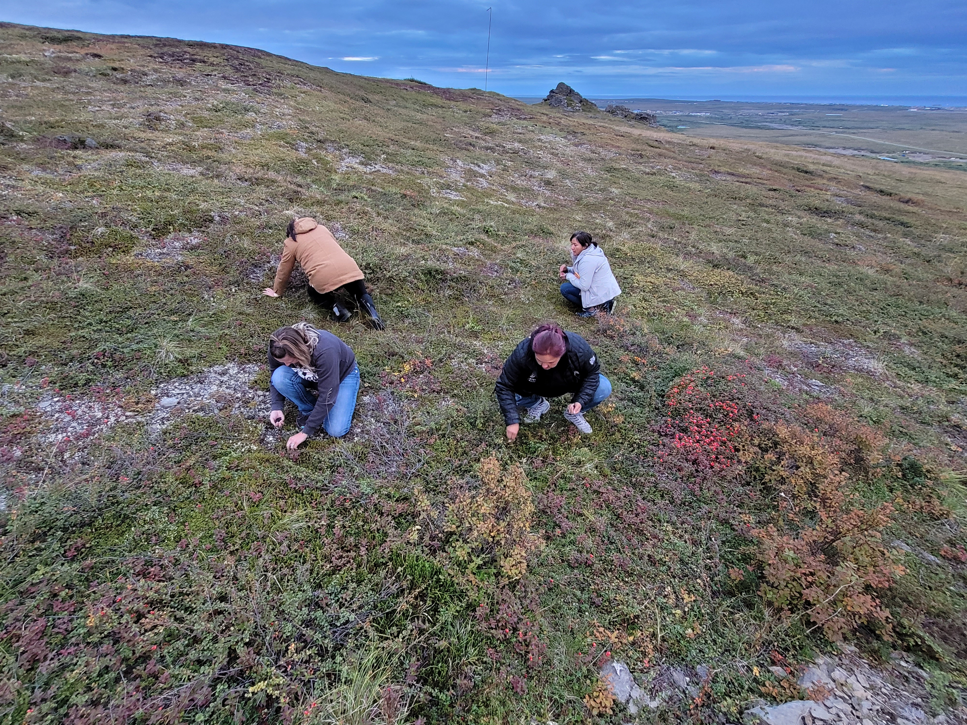
Questions?

Slide 29

Tribal Community Health Provider Project
Northwest Portland Area Indian Health Board
Christina Peters, Tribal Community Health Provider (TCHP) Director cpeters@npaihb.org
Carrie Sampson-Samuels, Community Health Aide (CHA) Project Director csampsonsamuels@npaihb.org
Miranda Davis, Native Dental Therapy Initiative (NDTI) Director mdavis@npaihb.org
Sarah Cook-Lalari, Behavioral Health Aide (BHA) Project Director scook-lalari@npaihb.org
Tanya Firemoon, TCHP Manager tfiremoon-contractor@npaihb.org
Sasha Jones, CHAP Manager sjones@npaihb.org
Pam Ready, Dental Health Aides (DHA) Education Manager pready@npaihb.org
Lisa Griggs, TCHP Specialist lgriggs@npaihb.org
Katie Hunsberger, BHA Student Support Coordinator khunsberger@npaihb.org
Kari Kuntzelman, DHA EducationSpecialist kkuntzelman@npaihb.org
Laura Palomo, NDTI Coordinator lpalomo@npaihb.org
www.tchpp.org
#DentalTherapyThursday
Notes:
the education program later.

