Slide 1
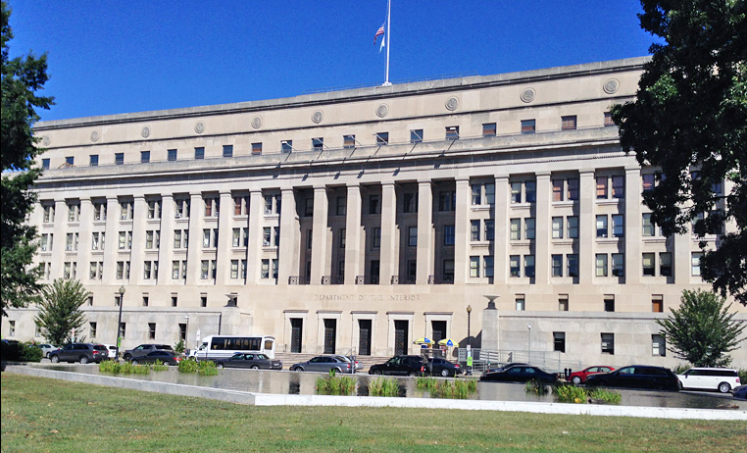
Office of Self Governance Update
March 7-8, 2023

Slide 2
OSG Personnel Changes
Janelle Naranjo
Program Analyst
Based in HQ, D.C.
Member of Santa Ana Pueblo (Tamaya)
United States Marine Corps - Administrative Specialist
Secondary Military Occupational of Mortuary Affairs.
Department of State Office of the Executive Director Consular Affairs Bureau - Executive Secretary

Slide 3
Personnel Changes
Robert "Gabe" Morgan (Acting)
Acting BIA Southern Plains Regional Director

Slide 4
Office of Self Governance
Director
Sharee Freeman
Compact Negotiator
Vickie Hanvey
Administrative Specialist
Tyvin Whittaker
Financial Manager
Rufina Villicana
Program Analyst CN
105(L)
Janelle Naranjo
NW Field Office Manager
Matt Kallappa
Financial Specialist
Celeste Engles
PROGRESS Act Assistant
(Vacant)
Compact Negotiator
Gordon Smith
Financial Specialist
Lance Fisher
Financial Specialist/CSC
Jacob Aguilar
Compact Negotiator
(Vacant)
Financial Specialist
Douglas Dan
Financial Specialist
Miles Reader
Financial Specialist/Audits
Cheryl Barnaby
Financial Specialist
Maggie Smith

Slide 5
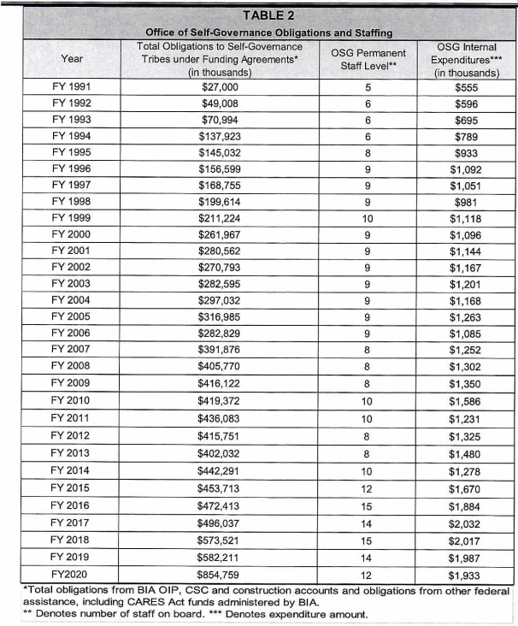
OSG Budget & Staffing History
Positions requested:
HQ Deputy Director - D.C.
Compact Negotiator (Vice Ken) - D.C.
Other Funding requested:
SGCE – $500,000
SGDB Maintenance -
PROGRESS Act – FY2024 – $500,000
Implementation Grants – $70,000

Slide 6
OSG Budget
Positions to be advertised:
Compact Negotiator - NWFO
Program Assistant (D.C. Progress Act)
Other Funding requested:
HQ Deputy Director - D.C.
Compact Negotiator D.C.
SGCE – $500,000
Implementation Grants – $70,000

Slide 7
Number of SG Tribes (288)* by Region FY 2023
Alaska – Tribes
35 Funding Agreements
10 Consortium Funding Agreements
Northwest – 27 Tribes
Pacific – 23 Tribes
Rocky Mountain – 1 Tribe
Western – 8 Tribes
Eastern – 2 Tribes
Eastern Oklahoma – 12 Tribes
Great Plains – 1 Tribe
Midwest – 13 Tribes
Southern Plains – 9 Tribes
Southwest – 6 Tribes
*Possible AK divorce adjustments

Slide 8
Fiscal Year 2023 OSG has:
138 Funding Agreements
11 Consortia
162 Tribes in Consortia
New Tribe for Fiscal Year 2023:
Spirit Lake Tribe (Great Plains Region)

Slide 9
Office of Self Governance – Finance (2022)
To date, OSG has received and obligated approximately $734,477,015 in FY 2022
funding to Self Governance Tribes

Slide 10
Office of Self Governance – Finance (2023)
To date, OSG has received approximately $526,122,560 in FY 2023 funding for Self Governance Tribes

Slide 11
Contract Support Cost (CSC)
FY 2022 and 2023 Update
FY 2022 CSC distributed by OSG to Date: $99,901,891.
FY 2023 CSC distributed by OSG to Date: $28,519,902 to Tribes who have reported FY 2022 CSC data.

Slide 12
Contract Support Cost (CSC)
FY 2019 – 2022 Update
FY | Amount Distributed | Tribes Unresponsive
2019 | $ 108,522,309 | 5
2020 | $ 115,203,893 | 7
2020 – CARES | $ 27,866,064 | 36
2021 | $ 111,266,852 | 10
2021 – ARPA | $ - | 29
2022 | $ 99,901,891 | 39

Slide 13
Contract Support Email
OSG-CSC@bia.gov
Self Governance Tribes are requested to please email all correspondence and documentation regarding Self Governance Contract Support to this email address, including CSC Data.

Slide 14
FASSR Group Email
OSG-FASSR@bia.gov
Self Governance Tribes are requested to please email all correspondence and documentation regarding Self Governance Financial Assistance & Social Services Report (FASSR) to this email address

Slide 15
PROGRESS Act Negotiated Rulemaking Update
The next in-person and virtual Committee Meeting dates are:
March 27, - March 30, 2023
April 17, 2023, - April 20, 2023
The meeting information for the March meeting can be found in the Federal Register Notice at this link: https://www.federalregister.gov/documents/2023/02/03/2023-02205/self-governance-progress-act-negotiated-rulemaking-committee-notice-of-meeting

Slide 16
ATO Information
If a Tribe is awaiting an ATO, please contact:
Doug Dan by email Douglas.Dan@bia.gov or
Maggie Smith by email at Maggie.Smith@bia.gov
Once contacted, a FBMS print screen and a SGDB print screen with information on the pending payments in ASAP can be provided. If funding is in ASAP, it is available for tribal drawdown.

Slide 17
The End

