Slide 1
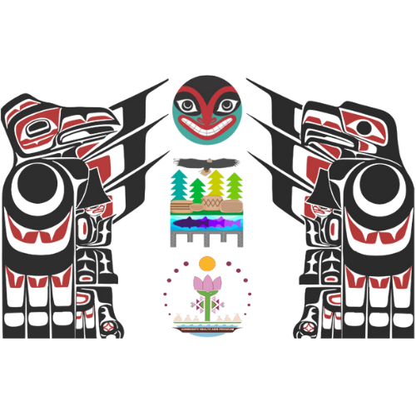
Northwest CHAP Implementation By: NPAIHB Tribal Community Health Provider Program
Tribal Self Governance Webinar Sept 28, 2023

Slide 2
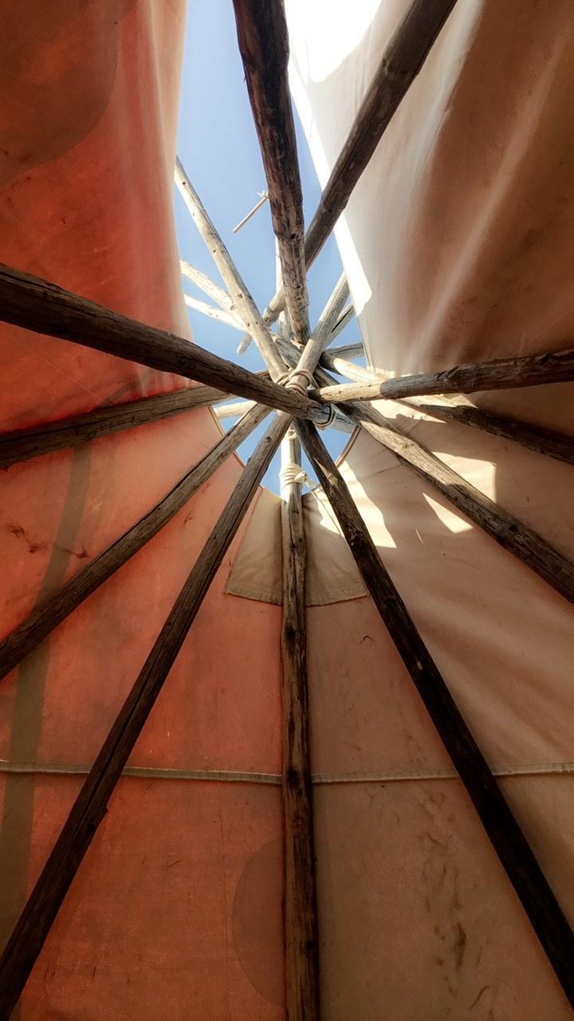
• Established in 1972
• Non-profit tribal advisory organization serving the 43 federally recognized tribes of Oregon, Washington, and Idaho.
• Each member tribe appoints a Delegate via tribal resolution, and meets quarterly to direct and oversee all activities of NPAIHB.
• NPAIHB Delegates create and update a strategic plan, which contains four main functional areas:
Health promotion and disease prevention
Legislative and policy analysis
Training and technical assistance
Surveillance and research
• NPAIHB houses a tribal epidemiology center (EpiCenter), several health promotion disease prevention projects, and is active in Indian health policy.

Slide 3
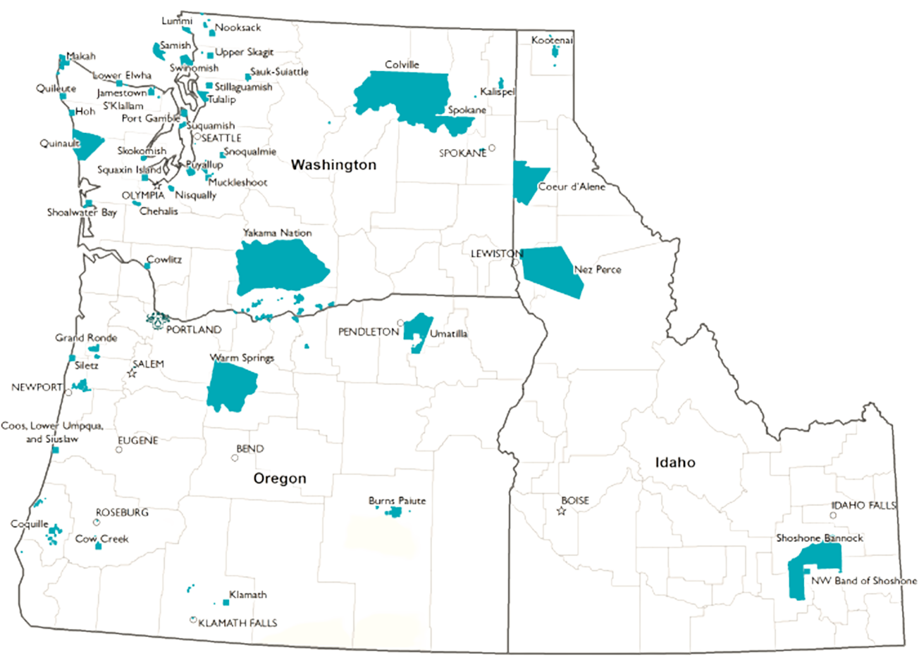

Slide 4
Tribal Community Health Provider Program Team
TCHPP Director
Christina Friedt Peters
TCHPP Manager
Lisa Griggs
CHA Director
Carrie Sampson Samuels
BHA Director
Open
DHA Director
Miranda Davis
TCHP Education Director
Stephannie Christian
CHA Manager
Sasha Jones
CHA Specialist
Danni Dearing
BHA Student Support Coordinator
Katie Hunsberger
DHA Manager
Pam Ready
DHA Specialist
Kari Kuntzelman
TCHP Education Data Coordinator
Morning Rose Tobey

Slide 5
Subject Matter Expert Team
Community Health
Rebecca Pazdernick, Physician Associate
CHAP Certification Board
Behavioral Health
Jenece Howe
BHA/P candidate
Tanya Firemoon, PACCB Lead
Jim Ferguson, Physician Associate
Linda Curda, Nurse Midwife
Danni Dearing, MD/MPH Candidate
Dolores Jimerson, Clinical Supervisor
Dr. Danica Brown, Behavioral Health Director/Expert
Torie Heart, CHAP CB Expert
Dr. Jeff King, Clinical Supervisor
Ellie Barber, PACCB Specialist

Slide 6
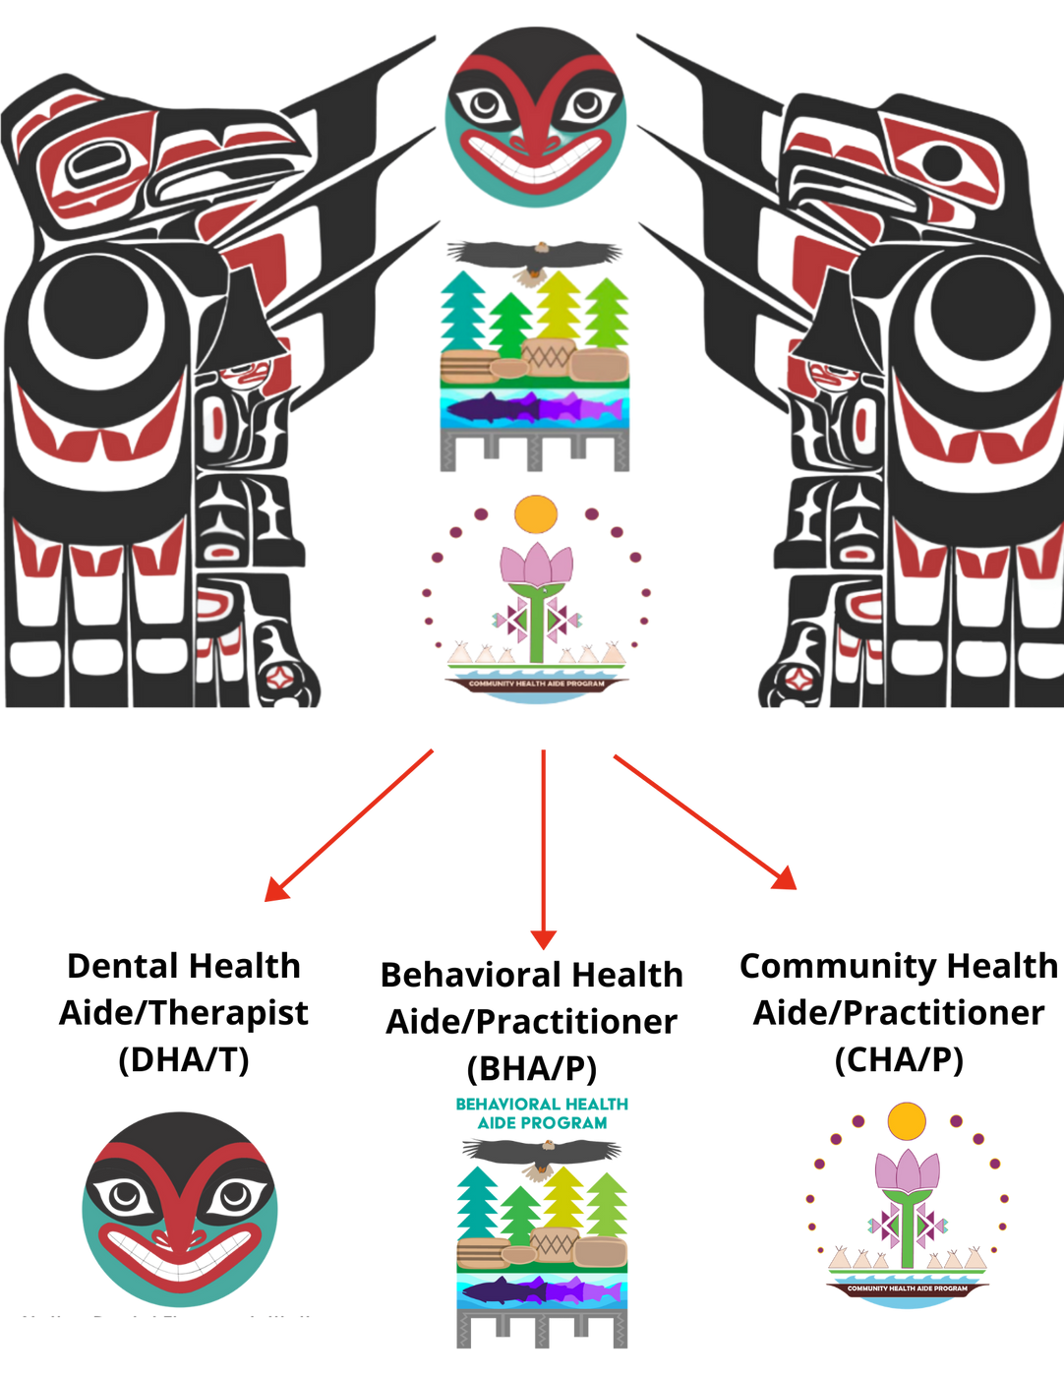
NORTHWEST CHAP:
Tribal Community Health Provider Project (TCHPP)
ESTABLISHED IN 2015

Slide 7
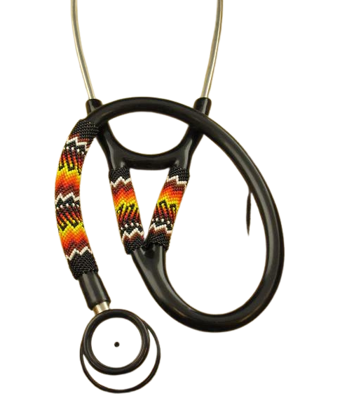
Why do we need Health Aide Providers?
EXISTING HEALTHCARE SYSTEM FAILS
CLINICS ARE UNDERSTAFFED AT ALL LEVELS
UNIQUE OPPORTUNITY FOR TRIBES TO IMPROVE CURRENT HEALTH AND EDUCATION SYSTEM
AI/AN CITIZENS PROVIDING CARE FOR THEIR OWN PEOPLE IN THEIR OWN COMMUNTIES
Notes:
The existing healthcare system was not designed with the needs of American Indian and Alaska native communities in mind. There are multiple barriers to care and to health provider education.
CHAP was developed to sit outside state regulatory environments to give tribes and tribal health programs the ability to tailor both the education and regulation of providers in their communities
The current system of health care has been failing tribal citizens for centuries – CHAP is an opportunity for tribes to shape a system of provider education and regulation to truly meet their needs
CHAP addresses important social determinants of health such as education attainment and financial security
CHAP was designed to circumvent structural barriers to education and care that tribal communities have worked hard to overcome
CHAP works best with federal support (not gratuitous management)

Slide 8
Why CHAP
CHAP was developed to sit outside state regulatory environments to give tribes and tribal health programs the ability to tailor both the education and regulation of providers in their communities
The current system of health care has been failing tribal citizens for centuries – CHAP is an opportunity for tribes to shape a system of provider education and regulation to truly meet their needs
CHAP addresses important social determinants of health such as education attainment and financial security
CHAP was designed to circumvent structural barriers to education and care that tribal communities have worked hard to overcome
CHAP works best with federal support (not gratuitous management)
Notes:
Works best with federal support – as we saw in Alaska over the last 60 years. It was a tribally run and tribally regulated program
CHAP in its best version is an expression of self governance and self determination – Tribes collectively deciding what they want their health care system to look like.

Slide 9
Historical Trauma and Lack of Culturally Competent Providers
Out of the estimated 5.2 million American Indians and Alaska Natives (AI/ANs) in the U.S., about 3,400 are physicians, just 0.4% of the physician workforce, according to a 2018 AMA Council on Medical Education report, “Study of Declining Native American Medical Student Enrollment.”
Dentists in the US by Race
Native American | 0.1%
Asian/Pacific Islander | 7%
Black/African American | 3.5%
Hispanic/Latino | 3.5%
White/Caucasian | 86%
Source: American Dental Association, Bureau of Health Professions, HRSA
Therapists in the US by Race | Percentages
White | 76.4%
Asian | 10.6%
Hispanic or Latino | 6.3%
Black or African American | 4.1%
Unknown | 2.2%
American Indian and Alaska Native | 0.4%
Source: https://www.zippia.com/physician-assistant-jobs/demographics/
Source: https://www.crossrivertherapy.com/therapist-statistics
Notes:
Dentistry in native communities is evolving but in many of our communities, dentistry has historically meant an itinerant dentist coming for a week or two per year to pull diseased teeth. And we all know that this historical trauma still affects tribal communities today in the health and oral health disparities in Native communities.
These lasting effects of a health system that doesn’t work for native communities requires us to support innovative initiatives that bring more native providers into the system.
There is a real lack of culturally competent providers – Native providers make up around 0.1% of dentists in the US

Slide 10
What are the components of CHAP? (a summary)
Community outreach and engagement
Tribal leadership
Tribal Health Programs
Advocacy (federal, state, tribal)
ECHO
Student and Supervising provider support
Support for students through the education program
Support for providers as they integrate a new provider type into their health programs
Regulatory Infrastructure
Federal/State advocacy
Working with states on integration of CHAP providers into Medicaid programs
CHAP TAG
Certification Boards
Standards and Procedures
Academic Review Committees
Administrative Support
Clinic Implementation Support
Support for tribal administrators as they integrate the program into their health organizations
Education Programs
Development and ongoing support of education programs
Curriculum Development
Health Aide Manuals
Partnerships with education institutions
Providers
Community Health Aides
Dental Health Aides
Behavioral Health Aides
Community Health Representative Programs as gateways to CHAP careers
Implementation Funding
Grants, grant administration
Long-term Program Sustainability
Federal/State Advocacy for funding
State Medicaid Program Collaboration
State Medicaid Billing Infrastructure
Area Office Collaboration
Notes:
Each one of these bullet points is a major body of work – this is just a summary of the categories of work that NPAIHB, the Area Tribes, and PAIHS are engaged in.
On the next handful of slides – many of these elements are discussed in more detail as related to the CHAP Infrastructure development steps as identified by IHS HQ
Clinical Implementation Support
Providing sample Job Descriptions
Supervising Provider technical assistance
Tribal Health Org policy and Procedures
Credentialing and Privileging
NPI numbers

Slide 11
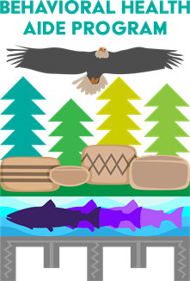
CHAP DISCIPLINES
DENTAL HEALTH AIDE /THERAPIST (DHA/T)
BEHAVIORAL HEALTH AIDE/PRACITIONER (BHA/P)
COMMUNITY HEALTH AIDE/PRACITIONER (CHA/P)
DHATs are highly-trained primary oral health care providers that have a narrow scope of practice, focusing on routine and preventive services which include simple extractions and restorations. DHAs focus on outreach and prevention and work with advanced providers to provide restorative care.
BHAs are counselor’s, health educators, and advocates. BHAs help address individual and community-based health needs such as alcohol, drug and tobacco abuse and mental health. BHAs use a combination of Western and traditional-based practices to provide care.
CHA/Ps are certified primary and emergency care clinicians who have close cultural ties and connections to the communities they serve. They work within the tribal health and human systems and practice under the supervision of a licensed clinical provider.

Slide 12
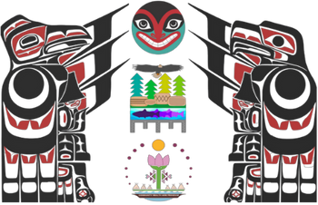
Portland Area Dental Health Aide Program

Slide 13
The Dental Health Aide Program
Below gumline prophylaxis
Periodontal therapy
Periodontal maintenance
Local anesthetic
Dental Health Aide Hygienist DHAH
Dental Health Aide Therapist/Practitioner DHAT/P
Dental exams
Removes decay
Restores teeth
Extractions
Training accredited DH Program
Training accredited or PACCB Board approved DT Program
A series of accessible oral health careers
Working in Indian Health Service and Tribal Communities
All types of DHAs are supervised by a dentist or DHAT
Federally certified dental providers
Expanded Functions Dental Health Aide II EFDHAII
EFDHA I duties plus placement of complex restorations ~
Class II amalgams
Class II and IV composite
Training in tribal communities or central training site
Expanded Functions Dental Health Aide I EFDHA I
PDHA II duties plus placement of
Simple restorations ~
Class I, II, V amalgam placement
Class I, III, V composite placement
Primary Dental Health Aide II – PDHA II
Can perform PDHA I duties plus ~
Dental Assisting duties
Above gumline prophylaxis
Sealants
Primary Dental Health Aide I - PDHAI
Prevention focused
Oral health instructions
Diet/nutrition support
Fluoride treatments

Slide 14
Dental Therapy timeline in WA, OR, ID
2016
Washington State passes Dental Therapy Legislation
2018
Dental Therapy Education Program Feasibility Study and Advisory Committee
2019
Idaho passes Dental Therapy Legislation
2017
First Dental Therapist hired by Swinomish Tribe
2021
Oregon Dental Pilot Project #100 approved
Oregon passes Dental Therapy Legislation
2022
dəxʷx̌ayəbus
DT Education Program receives CODA Accreditation, enrolls first class
2023
Washington State passes statewide DT legislation

Slide 15
Academic Institutions

Slide 16
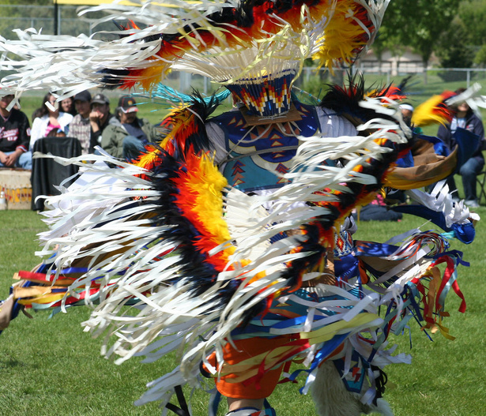
Portland Area Dental Health Aide Program Goals
Provide DHA training in Tribal communities
Identify local tribal members to train as DHA instructors to deliver the DHA Program in their own communities
Develop a DHA training center in each state for training of all types of DHAs
Integration of all types of DHAs into the dental team
Increase the number of AI/AN dental providers in communties
This Photo by Unknown Author is licensed under CC BY-SA-NC
Increase oral healthcare access tribal communities

Slide 17
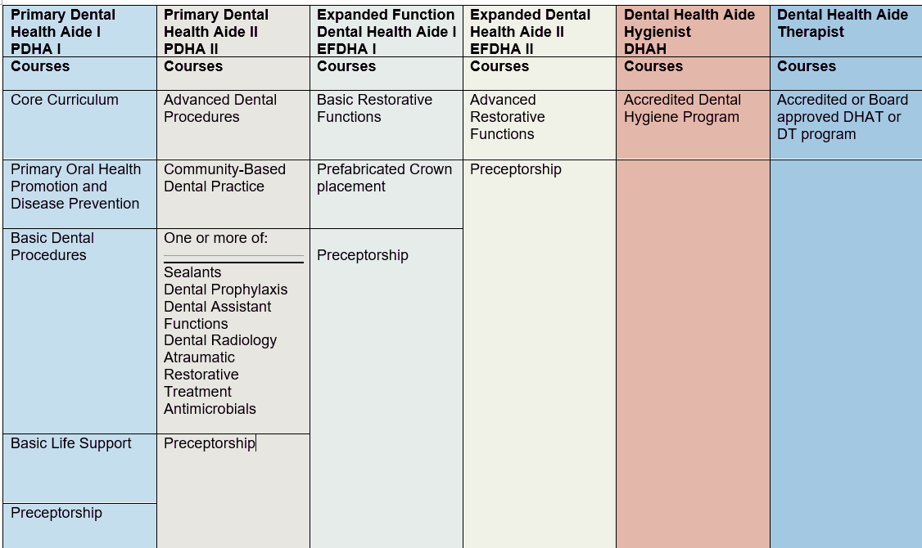
DHA skills overview
Notes:
These are all the courses listed in the PASP for each level of Dental Health Aides, we will have a meeting dedicated to each of these columns in the future, today’s meeting will focus on the requirements for the first level, PDHA I These courses are: core curriculum, primary oral health promotion and disease prevention, basic dental procedures, basic life support and a preceptorship. We are going to look closer at each course, but first a quick review of what the PASP are…

Slide 18
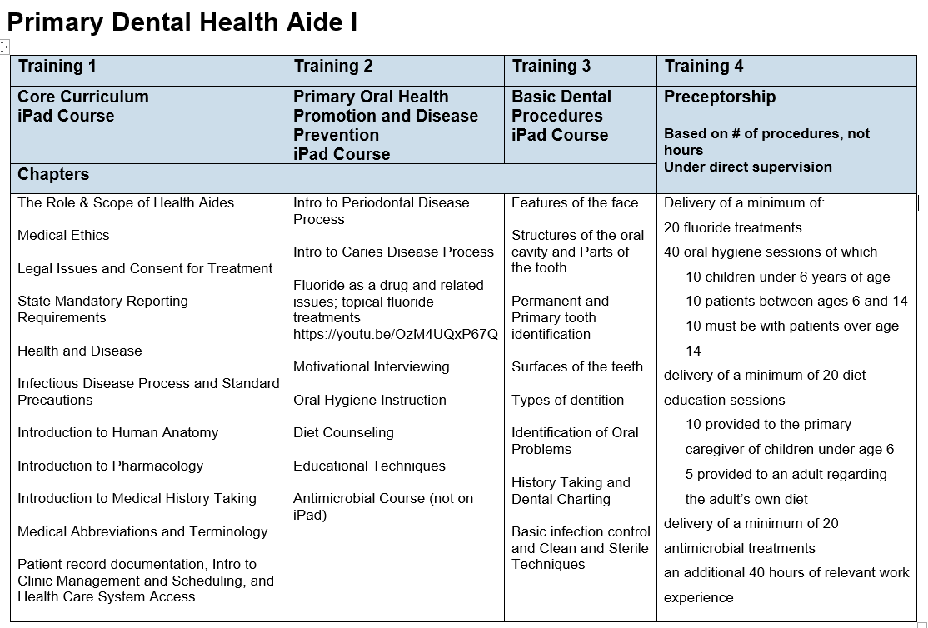
PDHA-I training outline
Notes:
This is a chart of the curriculum we currently have for the PDHA I didactic portion of the training. We are in the process of organizing, developing and updating the curriculum – this is the subject matter being taught in the courses (read topics). Is there any additional topics you would like your PDHA I s to learn? If you were to hire a PDHA I to begin working tomorrow in your clinic, what would you want them to know? Is cleaning removable appliances included in the curriculum?

Slide 19
DHA Timeline
2/2022
3/2022
4/2022
8/2022
9/2022
2/2023
4/2023
Curriculum
Dental Careers Course for H.S.
DARC
Chief Leschi
Nixyaa'wii Community School
dəxʷx̌ayəbus
DARC
DARC in process of reviewing DHA curriculum; partnership development continues; curriculum development continues;
Begin curriculum development for NW DHAP
Careers in dentistry taught @ Chief Leschi Puyallup
dəxʷx̌ayəbus-Dental Therapy Program @ SKV
PACCB accepted Iḷisaġvik ADTEP Curriculum
Dental Academic Review Committee Established
PDHA Core Curriculum Pilot
Careers in Dentistry course developed for Tribal HSs
Notes:
2

Slide 20
NW Tribes are involved in DHA Program development
DHA CHAP Analysis:
Outreach conducted with Area Tribes and clinics to explore familiarity with CHAP, offer information, and ensure that DHA Program development is meeting their needs
Dental clinics interested in DHA program to enhance exiting DAs skills and train new DAs
DHA Program Advisory Workgroup
All tribes and staff welcome to participate
Guiding development of DHA Program
Next meeting: June 7th, 12pm-1pm Pacific Time
Notes:
2

Slide 21
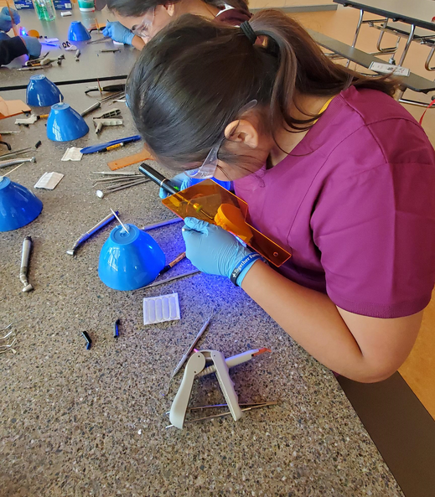
Outreach: Tribal Schools
Nixya’awii Community School - CTUIR Charter School
June 2022: Educational dental unit to capture interest in the core curriculum course
August - November 2023: Core Curriculum course
Chief Leschi Schools - Puyallup Tribe
Dental careers information
High School Career and Technical Ed
Elementary STEM Enrishment
2022 and 2023
Notes:
2

Slide 22
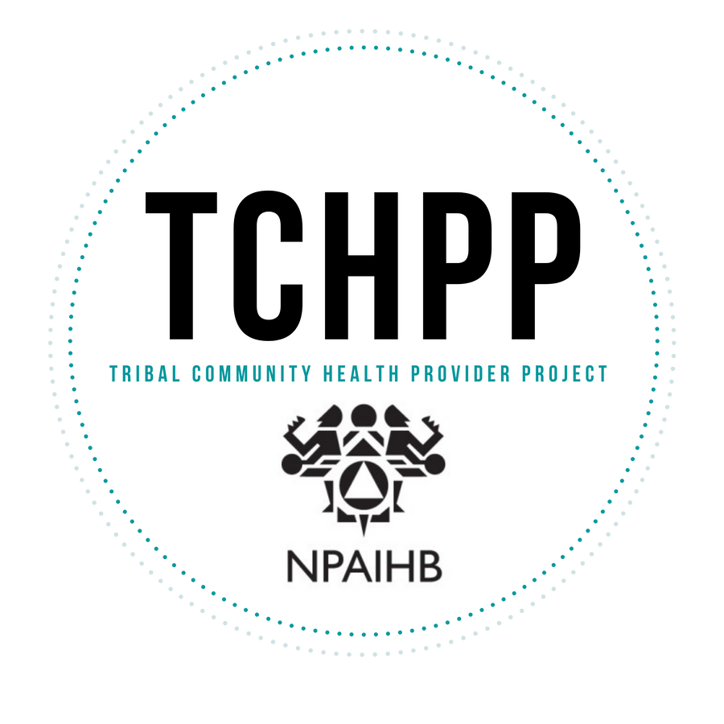
NORTHWEST PORTLAND AREA INDIAN HEALTH BOARD
BEHAVIORAL HEALTH AIDE (BHA) EDUCATION PROGRAM

Slide 23
What is a Behavioral Health Aide?
A Behavioral Health Aide (BHA) is an advocate, health educator, teacher, community resource and counselor working in a Tribal community to provide culturally appropriate care and behavioral health support. BHAs are a homegrown collective supporting their communities through healing, counseling, and incorporating Traditional knowledge into practice.
WHO CAN BE A BHA?
NATURAL HELPERS & ADVOCATES
COMMUNITY/TRIBAL MEMBERS
that crave to tie in cultural activities into their day to day work
homegrown collective committed to serving a Tribal community
HOLISTIC CAREGIVERS/HEALERS
COUNSELORS
good listeners, empaths, aunties/uncles, storytellers
who would like to utilize Tribal traditional practices
Tribal BHA Education Program

Slide 24
2016
NPAIHB established a BHA Advisory Workgroup tasked with initiating the development of the BHA program for the lower 48.
2019
HRSA, grant received to aid in the funding of the BHA development tasks
2020
BHA Student Support Coordinator hired.
2018
2021
2022
NW BHA Cohort 1 commences at NWIC and HU
Community Health Aide Program expanded to include other HIS areas.
First two BHA students begin academic journey.
HU and NWIC begin accreditation process.
Yakama Nation cohort begins program at ANTHC
2023
NW BHA Cohort 2 begins at NWIC and HU
PACCB approves to recommend the approval of Alaska’s curriculum

Slide 25
ACADEMIC INSTITUTIONS
https://heritage.edu/
Dr. Maxine Janis
Associate Professor/BHA Coordinator
janis_m@heritage.edu
www.nwic.edu
Yakaiyastai Gorman-Etl
Behavioral Health Program Coordinator
yngorman@nwic.edu
Private university in Toppenish, Washington near Yakama Nation
Behavioral Health Aide Certificate
Semester-Based
Mostly in-person classes with some online sessions
2 year program
Tribal College on Lummi Nation in Bellingham, Washington
Associate in Technical Arts in Behavioral Health Aide
Quarter/Term-based
Mostly online courses
2 year program
Tribal BHA Education Program

Slide 26
Notes:
Currently recruiting for next BHA cohort

Slide 27
BHA Education & Scope of Practice
BHA-I
Screening
Initial intake process
Case management
Community education, prevention, early intervention
BHA-II
Substance abuse assessment and treatment
BHA-III
Rehabilitative services for clients with co-occurring disorders
Quality assurance case reviews
BHP
Team leadership
Mentor/support other levels of BHA
Notes:
All education is in an online environment with no more than 3 one-week in person intensives per academic year. The intensive is an opportunity for students, instructors, mentors and clinical instructors to come together to know one another better, practice skills and complete program planning.

Slide 28
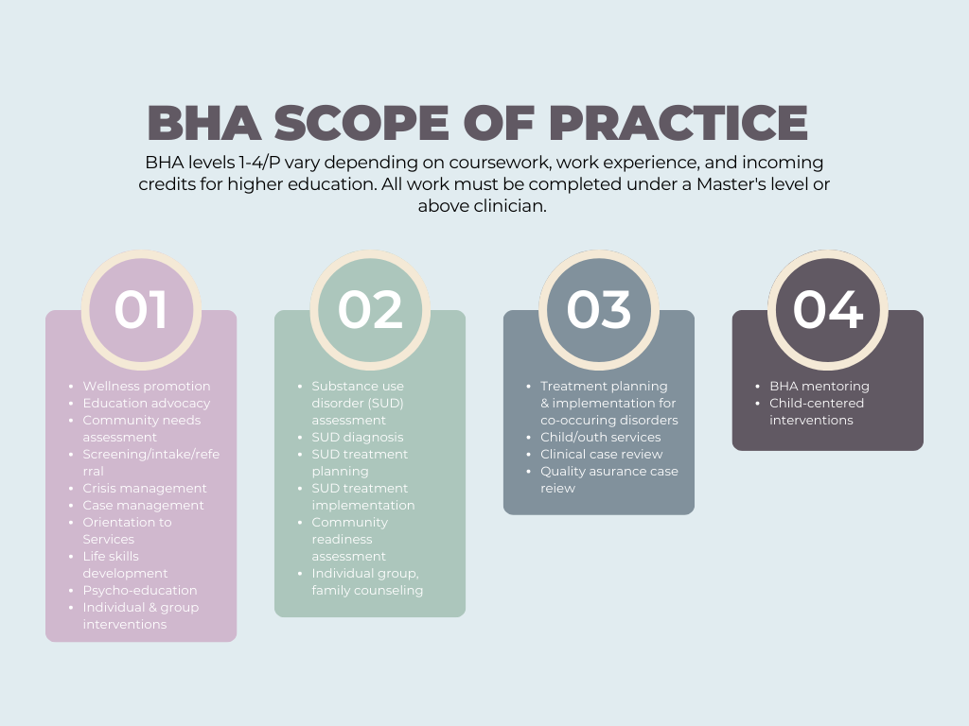

Slide 29
The Vision for Community Health Aide/Practitioners Serving NW Tribes
INTIATED 2022

Slide 30
COMMUNITY HEALTH AIDE/PRACTITIONER
Community Health Aide Practitioners (CHA/P) are certified primary and emergency care clinicians who have close cultural ties and connections to the communities they serve. In Oregon, Washington, and Idaho, they are community members of American Indian/Alaska Native communities who attend CHA/P educational programs approved by the Portland Area CHAP Certification Board and work within the tribal health and human systems. A CHA/P practices under the supervision of a licensed clinical provider, such as a physician or advanced practice provider (PA,NP). Basic education for a CHA/P includes didactic learning, skills practice, and clinical time providing patient care with the guidance of an advanced practice provider or physician.

Slide 31
Levels of CHA/P

Slide 32
2021
TCHP Advisory Workgroup established
2023
Curriculum and eCHAMP development
2024
2022
Community Health Aide/Practitioner funding received through IHS CHAP TPI
Training implementation, student completion of CHA I/II training
Staff onboarded
CHA/P sections of Standards and Procedures review
Curriculum experts onboarded, curriculum development initiated
Tribal Training pilot sites identified
Seating of academic review committee
Training Site preparation
Finalize CHA/P sections of S&P
Development of CHA/P degree track
Training site quality assurance review
NW CHA/P needs assessment

Slide 33
Community Health Aide

Slide 34
Fundamental Pieces of CHA/P Development
Funding
Tribal Interest
Curriculum & Training
Supervision & Practice
Regulatory Structure
Obtaining funding is necessary to begin CHA/P
NPAIHB utilized CHAP TPI grant to initiate this work
Identifying Tribes and Tribal clinics whom have interest in providing this training on-site and implementing providers
NPAIHB initiated CHA/P training with 4 Tribes/Tribal clinics
2-year CHA/P curriculum and Electronic Community Health Aide Manual for Practice (eCHAMP) is necessary for training
Creating a training design – in person, virtual, hybrid, instructors, supplies, clinic training space
Development of CHA/P sections of the Standards & Procedures
Community Health Aide Academic Review Committee
Clinical oversight by MD, PA, NP and supervisor training
Integrating CHA/P into health system, identifying role or specialty in organization, continuing education

Slide 35
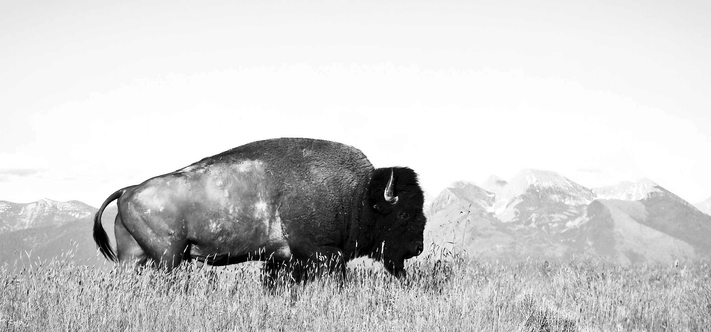
STEPS TO CHA/P DEVELOPMENT

Slide 36
CHA/P Development Timeline
2021
TCHP Advisory Workgroup established
2023
Curriculum and eCHAMP development
2024
2022
Community Health Aide/Practitioner funding received through IHS CHAP TPI
Training implementation, student completion of CHA I/II training
Staff onboarded
CHA/P sections of Standards and Procedures review
Curriculum experts onboarded, curriculum development initiated
Tribal Training pilot sites identified
Seating of academic review committee
Training Site preparation
Finalize CHA/P sections of S&P
Development of CHP degree track
Training site quality assurance review
NW CHA/P needs assessment

Slide 38
Community Health Representatives and Community Health Aide Programs are Complementary Programs
CHR
CHRs fill critically important roles to the health of their communities
Longstanding presence in some communities
Trained from the community
May include indigenous knowledge informed systems of care
Experience navigating patients to care and services in that specific community
Deep understanding of culture, community, and existing health care infrastructure
CHAP
Broad scope of practice, provides routine, preventative, and emergent care
Respects the knowledge and resources in the tribal community and grows providers from that source.
Trains AI/AN community members who speak the native languages and provide culturally appropriate care
Breaks down barriers to care and barriers to training;
Training minimizes time away from communities and families.
Brings care to communities;
Fosters a team approach to delivering health care services.
Notes:
Not an exhaustive list of CHR or CHAP characteristics

Slide 39
CHR and CHAP
NPAIHB TCHP program has been working with are CHR programs to build a curriculum that will incorporate CHAP core curriculum so that CHRs are ready to start Community Health Aide, Behavioral Health Aide, or Dental Health Aide Training if they choose that for their next career step.

Slide 40
NPAIHB Community Health Representative Program
The Community Health Representative (CHR) Program is a unique concept for providing health care, health promotion, and disease prevention services. CHRs have demonstrated how they assist and connect with the community, and their work has become essential to the spectrum of Tribal community-oriented primary health care services. CHRs are great advocates, in part, because they come from the communities they serve and have tribal cultural competence. Their dedicated work has assisted many to meet their healthcare needs. The health promotion and disease prevention efforts that CHRs provide have also helped people from the community improve and maintain their health.

Slide 41
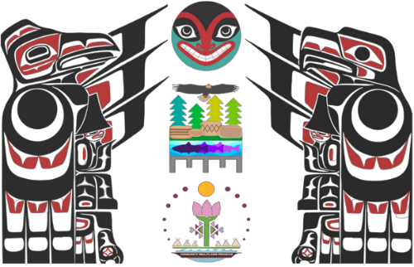
Portland Area (OR, ID, WA) Community Health Aide Program (CHAP)
Community Outreach/Care
Community Outreach/Care
CHR/CHW TRAINING (Core Curriculum)
Dental Health Aides (DHA/T)
Community Health Aide
Behavioral Health Aide
PDHA I
CHA
BHA I
PDHA II
CHAP
EFDHA I
BHA II
EFDHA II
BHA III
DHA/Hygienist (DHAH)
DHA/Therapist (DHAT)
BHA/Practitioner

Slide 42
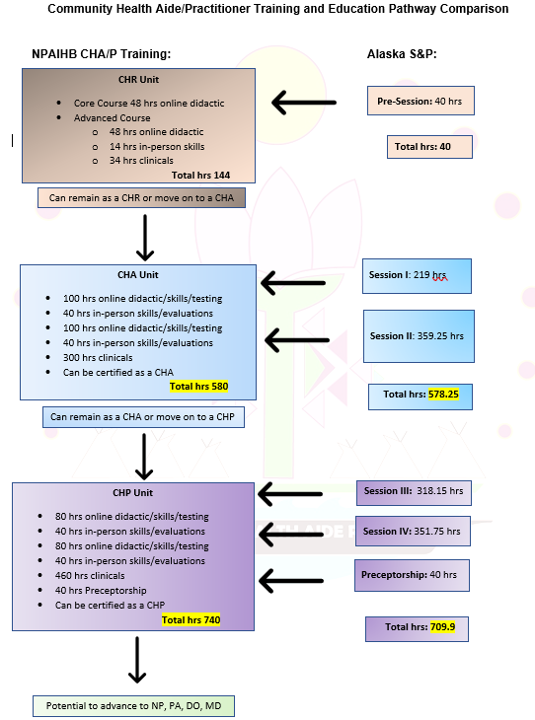
Levels of Community
Health Aide Training
1)
Community Health Representative (CHR)
Community Health Aide (CHA)
Community Health Practitioner (CHA/P)
2)
3)

Slide 43
Notes:
Will begin recruiting for next cohort

Slide 44
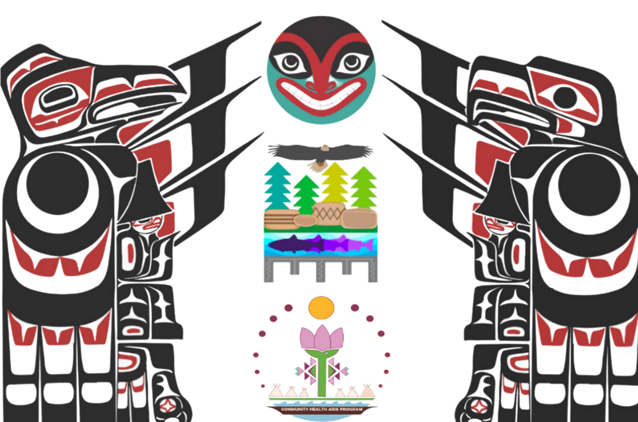
PORTLAND AREA Community Health Aide Program (CHAP) CERTIFICATION BOARD

Slide 45
Indian Health Care Improvement Act (IHCIA)
Circular 20-06
CHAP Nationalization
National Certification Board
Area Certification Board
Area Standards & Procedures
National Standards & Procedures
The cornerstone legal authority for the provision of health care to American Indians and Alaska Natives, was made permanent when President Obama signed the bill on March 23, 2010, as part of the Patient Protection and Affordable Care Act.
https://www.ihs.gov/sites/ihcia/themes/responsive2017/display_objects/documents/home/USCode_Title25_Chapter%2018.pdf
To implement, outline, and define a National Community Health Aide Program (CHAP) policy for the contiguous 48 states. The policy encompasses community-based provider selection, culturally tailored care and curriculum, and competency-based education. The policy is also inclusive of health aides as part of a team of healthcare providers focused on providing effective, efficient, and patient- centered care, consistent with the structure of the Alaska CHAP. This policy implements the statutory requirements of the Indian Health Care Improvement Act (IHCIA) that apply to CHAPs operated by the Indian Health Service (IHS) and Indian Self-Determination and Education Assistance Act (ISDEAA) contractors outside of Alaska. https://www.hhs.gov/guidance/document/indian-health-circular-20-06
The NCB is a federal board chaired by the IHS Chief Medical Officer (CMO) or his or her delegate and may be comprised of Federal and Tribal representatives from each ACB. Functions of the NCB and board composition are addressed in the Standards and Procedures.
The ACBs are federal certification boards located in the contiguous 48 states and may be comprised of Federal and Tribal representatives. Their membership must include at least one federal representative appointed by the respective IHS Area Director. The ACB establishes board composition in its standards and develops the procedures of each respective board to certify individuals as their respective provider types.
Adopted in part from the Alaska CHAPCB Standards and Procedures to outline the minimum program standards for all CHAP provider types operating outside of Alaska. The National CHAP Standards and Procedures include, but are not limited to, the minimum training, training equivalency, supervision, and scope of practice requirements.
At a minimum, the Area Standards and Procedures must include the National CHAP Standards and Procedures and may have additional supplemental requirements above and beyond the national standards that are specific to the cultural considerations of the region, community specific needs, as well as the health care delivery system.

Slide 46
System of CHAP Content Development
Area Standards& Procedures
National S&P
Curriculum
Health Aide Manuals
Training

Slide 47
Definitions
Academic Review Committees (ARC)
Specialized body of practitioners, representing the behavioral, primary, oral health, and other relevant fields, that reports and makes recommendations to ACB regarding the training standards for all CHAP provider types.
Certification Boards – National and Area (NCB and ACB)
CHAP National Certification Board (NCB). The NCB is a federal board chaired by the IHS Chief Medical Officer (CMO) or his or her delegate and may be comprised of Federal and Tribal representatives from each ACB. Functions of the NCB and board composition are addressed in the Standards and Procedures.
CHAP Area Certification Boards (ACBs). The ACBs are federal certification boards located in the contiguous 48 states and may be comprised of Federal and Tribal representatives. Their membership must include at least one federal representative appointed by the respective IHS Area Director. The ACB establishes board composition in its standards and develops the procedures of each respective board to certify individuals as their respective provider types.
Standards and Procedures (National and Area)
At a minimum, the Area Standards and Procedures must include the National CHAP Standards and Procedures and may have additional supplemental requirements above and beyond the national standards that are specific to the cultural considerations of the region, community specific needs, as well as the health care delivery system.
Notes:
Specialized body of practitioners, representing the behavioral, primary, oral health, and other relevant fields, that reports and makes recommendations to ACB regarding the training standards for all CHAP provider types.
Standards and Procedures.
1. National CHAP Standards and Procedures. Adopted in part from the Alaska CHAPCB Standards and Procedures to outline the minimum program standards for all CHAP provider types operating outside of Alaska. The National CHAP Standards and Procedures include, but are not limited to, the minimum training, training equivalency, supervision, and scope of practice requirements.
2. Area Standards and Procedures. At a minimum, the Area Standards and Procedures must include the National CHAP Standards and Procedures and may have additional supplemental requirements above and beyond the national standards that are specific to the cultural considerations of the region, community specific needs, as well as the health care delivery system.

Slide 48
IHS Circular 20-06 Sec 6(E) National Certification Board (NCB)
Establishes National CHAP Standards and Procedures and approves the CHAP minimum training standards for all CHAP provider types outside of Alaska, for ACBs to utilize to ensure consistency across IHS Areas.
1. Specifies baseline requirements and scope of practice for all CHAP provider types, including community health aides and practitioners, dental health aides (including primary dental health aides, expanded functions dental health aides, dental health aide hygienists, and DHATs), and behavioral health aides and practitioners.
2. Conducts review of CHAP operations every three years to ensure consistency across all IHS Areas.
3. Convenes ACBs at a minimum of every three years to review National CHAP Standards and Procedures.
4. Determines what will constitute equivalent training of providers as authorized in the IHCIA.
5. Maintains annual records of ACB actions regarding certification of CHAP providers. The IHS will maintain a database and make it accessible to tribal contractors and compactors to encourage them to extend reciprocity in appropriate circumstances.
Our understanding of the NCB function is to provide a national baseline of training requirements and scope of practice for CHAP providers and ensure portability between areas
DOES NOT certify providers OR provide any input into the certification of providers
DOES NOT collect or maintain independent data or records but gets that data from ACBs
Notes:
What we do need from the federal government – minimum scope of practice and training requirements to support portability between areas
What we don’t need – is for them to create a giant federal program

Slide 49
Area Certification Boards (ACBs).
1. Maintains records of certifications of individuals certified by the Alaska CHAPCB or other ACB who work in the Area or Areas under the jurisdiction of the local ACB, and maintain a record of all CHAP providers certified, denied, recertified, revoked, and approved after appeal who work in the Area or Areas under the jurisdiction of the local ACB.
2. Creates procedures that detail terms, chairmanship, quorum, meetings, duties, and transition functions.
3. Ensures National CHAP Standards and Procedures established by the NCB, as well as any additional requirements set forth by the ACB for its applicable provider type(s), are met before certifying individuals for all CHAP provider types identified in 6D.
4. Certifies CHAP providers. Certification is approved and executed when an IHS Area Director or their federal designee signs an individual's certification document. Once signed, a copy of the certification is sent to the NCB.
5. Adopts Area-specific curriculum, consistent with the National CHAP Standards and Procedures established by the NCB, as needed, to ensure Area-specific needs are met.
6. Ensures the National CHAP Standards and Procedures and the respective Area curriculum are culturally tailored and accessible to Area Tribal members.
7. Ensures the portability of health aide certification across Areas.
8. Reviews and approves the Area Standards and Procedures curriculum for each CHAP provider type on at least a three-year recurring cycle.
Tribally operated boards with one federal representative to provide connection to Area Office
Responsible for certification of individual providers
Responsible for adopting and maintaining area specific standards and procedures
Adopts (recommends for certification) Curricula that meet the Area Standards and Procedures
Nimble
Responsive to the community served
Aligned with the goals and culture of the communities served
IHS Circular 20-06 Sec 6(F)

Slide 50
IHS Circular 20-06 Sec 6(G) Academic Review Committees (ARC).
1. Conducts an independent review of the curriculum to ensure its alignment with the current health needs of American Indians and Alaska Natives.
2. Develops recommendations to the NCB through the ACB on curriculum.
ARCs in the Portland Area
Subject Matter Experts responsible for all things curriculum
Provide subject matter expertise and support for development and maintenance of S&Ps
Provide subject matter expertise and support to ACB for certification (as required)
Workgroup to ACB for forms and other board related activities as required (during start up)

Slide 51
JOIN THE CHAP TAG
AREAS THAT NEED A PRIMARY OR ALTERNATE REPRESENTATIVE:
Albuquerque
Bemidji
Billings
Nashville
Navajo
Oklahoma City
Phoenix
Portland
Tuscon
DSTAC

Slide 52
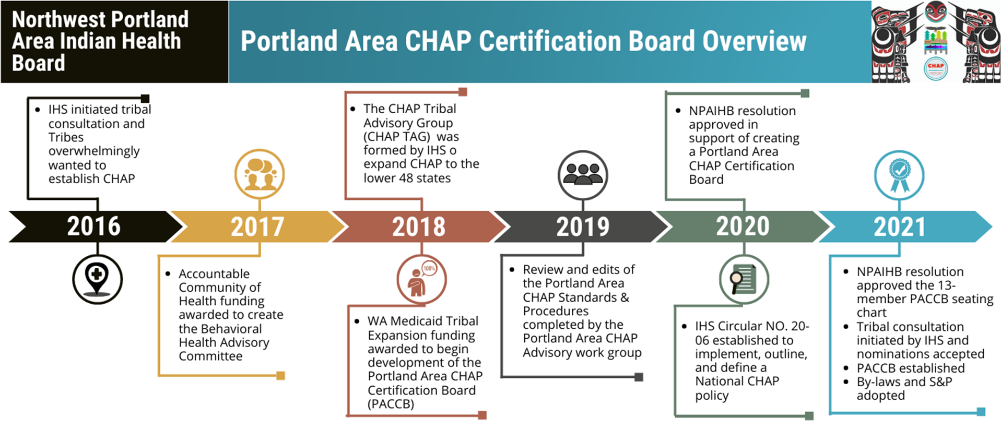

Slide 53
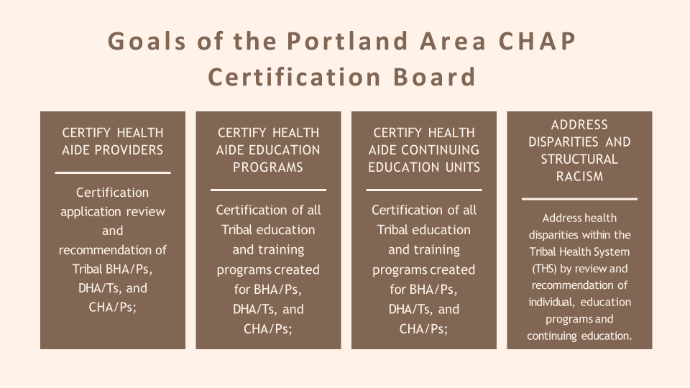

Slide 54
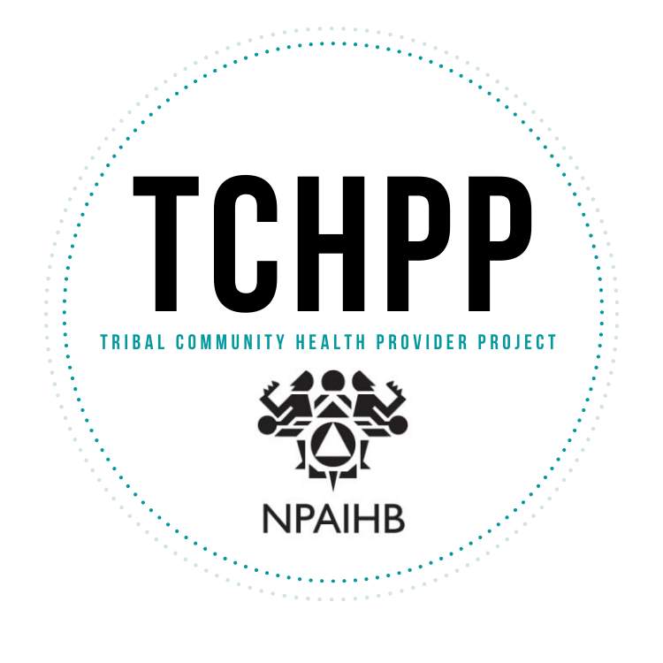
Lifecycle of the Portland Area CHAP Certification Board (PACCB)
Strive to be Transparent and Inclusive in the Initiation and Planning
Weave Circular Guidelines in the Quality and Delivery
Assurance of Tribal Input in the Development and Implementation

Slide 55
Countless hours invested by many.
Here are some examples of the collaboration and expertise contributing to our programs:
CHAP Advisory Workgroup
BHA Advisory Workgroup
dəxʷx̌ayəbus – Dental Therapy Education Program Advisory Committee
DHA Advisory Workgroup
TCHP Advisory Workgroup

Slide 56
Dental Academic Review Committee
Behavioral Health Academic Review Committee
Community Health Academic Review Committee
Portland Area CHAP Certification Board
(PACCB)

Slide 57
Medicaid Reimbursement
Working with Oregon, Washington, and Idaho on State Plan Amendments
Representatives from each State’s Medicaid agency

Slide 58
OUR COMMON GROUND
We can and should “grow our own” providers, create jobs in our communities, and establish and support an education system that breaks down barriers to training health professionals from tribal and other underrepresented communities.
CHAIRMAN CLADOOSBY, SWINOMISH TRIBE

Slide 59
Addressing structural racism and Tribal sovereignty in all levels of the work
Proven history of safe, quality care in Alaska for over 50 years
Uniquely developed for NW Tribes using the Alaska model
Tribes can tailor their programs to fit their needs
Increases AI/AN local workforce and creates career paths
Home grown, culturally knowledgeable and respected providers
Competency based, skilled providers who increase access to care
Extend the reach of services into hard to access areas
Creates wrap around care and referral services for Tribes
WHY CHAP MATTERS

Slide 60
For Ongoing, Updated Information
VISIT OUR WEBSITE
www.TCHPP.org

