Slide 1
Indian Health Service CFO Updates
Tribal Self-Governance Advisory Committee
Jillian Curtis, Chief Financial Officer
December 13, 2023

Slide 2
Agenda
FY 2024 Appropriations and Possible Sequestration
Mandatory Funding Workgroup
CSC Workgroup Update
CRRSAA Reporting
Section 105(l) Lease Program
Unobligated Balances
Notes:
CSC
Meeting with the Department Scheduled for December 15th.
CSC-calculations (next week) get this scheduled

Slide 3
FY 2024 Appropriations
The current Continuing Resolution (CR) provides funding for the federal government through early 2024. The CR does not affect advance appropriations.
Funded through January 19: Special Diabetes Program for Indians.
Funded through February 2: Electronic Health Record, Indian Health Care Improvement Fund, Health Care Facilities Construction, Sanitation Facilities Construction, Contract Support Costs, and Payments for Tribal Leases,
Apportionments: The apportionments for CSC and Payments for Tribal Leases are approved, and the IHS is obligating these funds for performance periods under the period of the CR. The IHS is seeking an exception apportionment for the Indian Health Care Improvement Fund to fully fund the recurring base amounts for Tribal Health Programs.

Slide 4
Possible FY 2024 Sequestration
The Fiscal Responsibility Act (FRA) would trigger an automatic 1% discretionary sequester if the government is still operating under a partial-year continuing resolution past April 30. There is a similar provision that applies to FY 2025.
It is possible that Congress could override the sequester or use other scorekeeping methods to avoid sequester. Congress also has flexibility to turn off the sequester for certain activities in subsequent legislation.
Under the FRA, the default application of the sequester would be across the board. It is not yet clear whether the sequester would apply to the advance appropriation.
OMB will issue guidance if the sequester goes into effect.

Slide 5
Mandatory Funding Workgroup
The IHS hosted the third mandatory subgroup session virtually on November 30, 2023.
NIHB provided a presentation on the study they are conducting with Mathematica to produce an IHS full funding estimate.
The FY 2026 National Tribal Budget Formulation Work Session is scheduled for February 13-14 with the goal of finalizing the FY 2026 National Tribal Budget recommendations.
The National Work Session will include a discussion regarding the mandatory sub-group.

Slide 6
CSC Advisory Group Update
Given the current status of litigation in the CSC program, the work of the Contract Support Cost Advisory Group is paused.

Slide 7
CRRSAA Reporting Guidance and System
The IHS provided information about the financial reporting requirements associated with the CRRSAA funding
Link for reference: Coronavirus Response & Relief Supplemental Appropriations Act Public Law (P.L.) 116-260 - At-a-Glance Guide (ihs.gov)
The IHS continues work to identify an efficient mechanism for central collection of this information, and has had to re-evaluate efforts in light of the rescissions implemented by the Fiscal Responsibility Act.

Slide 8
Status of 105(l) Lease Program Transition
The IHS is nearing completion of the steps necessary to transition section 105(l) activities to the Office of Finance and Accounting (OFA). The new Division of Tribal Lease Payments will:
Establish a section 105(l) lease policy through Tribal Consultation;
Create public-facing guidance to support Tribes in applying for section 105(l) leases; and
Enhance technical assistance available to Tribes by supporting Area negotiations.
Once the transition is complete, the IHS will issue a Dear Tribal Leader Letter.
Notes:
Background
Director’s Decision Memo – we are optimistic that it will be signed in the next week or so.
Rollout Plan – we will be coordinating with OHR and PAS on the rollout plan, which will include informal Congressional appropriations notifications, per ASFR.
Human Resources
Union notification of impacted staff. This will begin once the memo is signed. Currently there are only 3 impacted staff - two in CSC and one in 105(l).
Recruitment – We have been working with HR to establish classified PDs for the new 105(l) division. All but two PDs are established and the two pending PDs will done next week.
We plan to post the Deputy Director of Business Operations, the Tribal Lease Program Director, and the staff analyst positions within two weeks of the Directors signature. When paired with the transfer of Paula Poncho from the Alaska Area to OFA, this will give us a small but mighty team to begin the heavy lift that is building the tribal lease program.
Once OFA takes over the administration of the program we will begin making strategic program improvements to enhance the tracking, oversite, and management of the program. These include:
We are working on an updated delegation of authority for signing 105(l) leases. This item will require a collaborative approach with OEHE. Our goal is to hold on routing the update for signature until the Deputy Director of Business Operations and the Tribal Lease Division Director are hired (or, alternatively, a suitable detail is identified). This will avoid a backup in lease approvals until key staff are on board. We anticipate that the updated delegation of authority will be ready to execute, and OFA will be prepared to take of signatory authority, within a few weeks of the Director’s approval of the decision memo.
As far as tracking goes, Paula Poncho has an Access Data Base that she is currently using to track all the incoming leases. She will continue business as usual for the near term with the current business process. However, we are already working with the web development team here in IHS to develop a 105(l) lease proposal portal that will be similar to what Bemidji developed for Title I contracts. We are currently preparing the scope of work. In concept, the data base will be a singular web based solution for the submission, negotiation, and award of 105(l) leases. It will also host a management dashboard to give HQ an at a glance overview of current, pending and paid leases.
Thanks to Mr. Weaver, Paula Poncho and Luke Vanderwagen we have a draft policy and FAQ document draft. It will need some work and consultation but it was a step in the right direction. The policy is a result of the joint (BIA / IHS) tribal consultation held Aug 27, 2021. Once reviewed through IHS, OFA will present the policy to the FAAB for their review and consideration, before national consultation. We are targeting FY 2024 Q1 for these activities.
We have been reviewing the BIA Lease Technical Assistance guide. We may model as closely as we can to that manual since congress directed in the Consolidated Appropriations Act of 2021 (P.L. 116-260), which directed the secretaries establish as consistent and transparent an approach as possible in their administration of 105(l) leases.” We feel considering the BIA manual will be important in the development and formalization of the program overall. Both the website and the web based data base are going to be essential upgrades to the current process. The system will be a centralized source of information for tribes and agency staff as well. Based on feedback we’ve heard from the TSGAC, we may consider consultation on this guide before publishing.

Slide 9
105(l) Lease Policy & Guidance
The IHS is developing a draft Section 105(l) Leases policy, based on the joint consultation that the IHS conducted with DOI in 2021.
The draft policy is in the early stages of the review process within the Agency.
The IHS plans to begin briefing the draft policy to Tribal Leaders at the next Facilities Appropriations Advisory Board meeting in March.
The IHS will continue to brief Tribal Leaders on the draft policy, and conduct national consultation in 2024.

Slide 10
Unobligated Balances at IHS
IHS unobligated balances stay “on the books” longer because the Agency provides direct health care.
75% of IHS unobligated balances are for project-based activities that obligate over a longer period of time by design, and care that is referred outside the IHS.
The IHS is taking concrete actions to address misconceptions and reduce unobligated balances, and reduced unobligated balances by 15% over FY 2023.

Slide 11
Unobligated Balances at IHS (Cont.)
IHS unobligated balances stay “on the books” longer because the IHS provides direct health care services.
Unobligated balances = operating budgets for IHS-operated hospitals and health clinics in most of the Agency’s funding lines.
Funds are obligated as they are needed for specific purposes over time like payroll, supply purchases, support contracts, etc.

Slide 12
Unobligated Balances at IHS (cont.)
75% of prior year unobligated balances at IHS are for project-based activities, and Purchased/Referred Care (PRC).
$1.1 billion of prior year unobligated balances are for Health Care Facilities Construction projects that must be fully funded by Congress before they can be obligated.
Maintenance & Improvement and EHR Modernization activities obligate over time as project plans are completed and contracts are awarded.

Slide 13
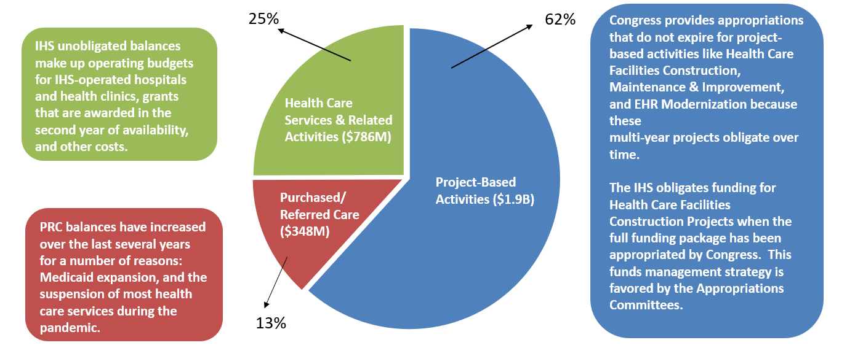
Prior Year Unobligated Balances ($3 billion)

Slide 14
Actions to Reduce IHS Unobligated Balances
Identifying the root causes of unobligated balances and creating targeted solutions.
Determining appropriate carryover levels in light of advance appropriations.
Holding all levels of the Agency accountable for maintaining appropriate carryover levels through metrics and measures.
Changing IHS fiscal culture now that Advance Appropriations are in place.

