Slide 1
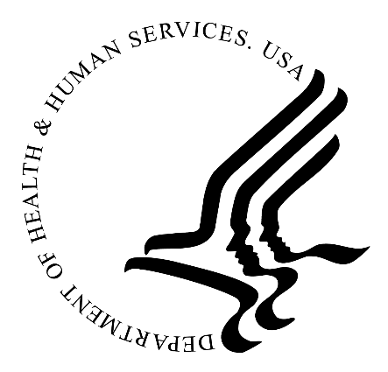
Tribal Self Governance Advisory Committee Medication Update
Loretta Christensen
Chief Medical Officer
12-13-2023

Slide 2
STI Outbreak
Multi-regional Outbreak
Capacity to investigate cases was limited in some areas
Congenital Syphilis was 10X higher
Initial relative shortage of Bicillin for treatment due to manufacturing issues
Priority Protocol was issued

Slide 3
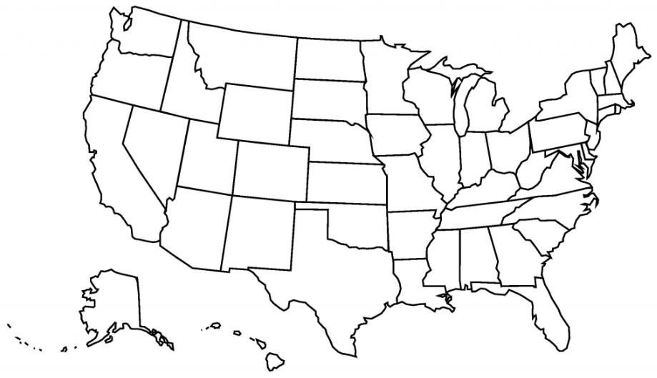
Trends in Positive Syphilis Tests, IHS, 2020-2022
Legend
>700% increase
>100% increase
11%-99% increase
Less than 10% change
Decrease >10%
(only states with 10 or greater positive tests in 2022)
Notes:
The trends are concerning. Looking solely at IHS data, we can see that many states are seeing rapid increases in the number of positive tests. This map gives a quick overview of trends by state from 2020 to 2022. Ten states had a 100% increase or more significant in positive tests in this time frame. Several states, including South Dakota, Montana, Washington, Oregon, and Nebraska, had gains of over 700%.

Slide 4
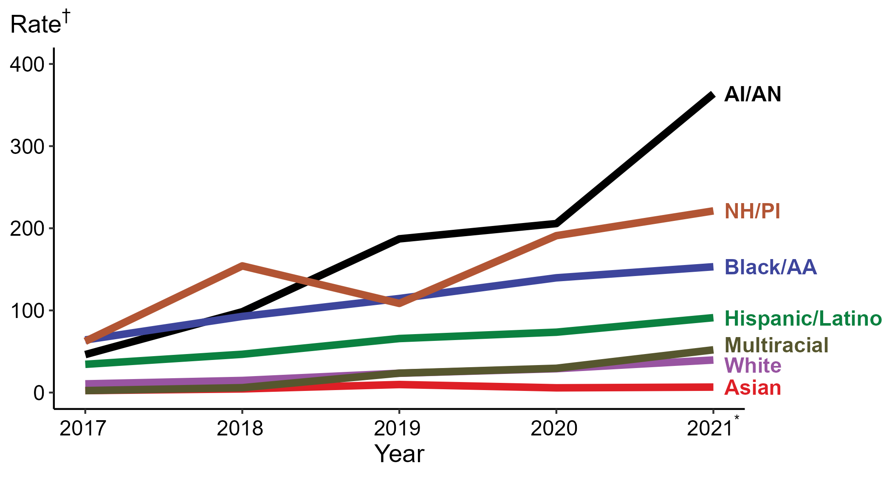
Congenital Syphilis — Rates of Reported Cases by Year of Birth, Race/Hispanic Ethnicity of Mother, United States, 2017–2021*
* Reported 2021 data are preliminary as of July 7, 2022
† Per 100,000 live births
ACRONYMS: AI/AN = American Indian/Alaska Native; Black/AA = Black or African American; NH/PI = Native Hawaiian/Pacific Islander
Notes:
Among pregnant people with untreated early syphilis, up to 40% of their pregnancies will result in spontaneous abortion, stillbirth, or perinatal death. In addition, untreated infants, including those asymptomatic at birth, may develop late manifestations, which usually appear after two years of age and involve the central nervous system, bones and joints, teeth, eyes, and skin.
In Montana, American Indian people make up 89% of all congenital syphilis cases. The Montana Department of Health ran a descriptive analysis of nineteen pregnant people who delivered babies with congenital syphilis or had a syphilitic stillbirth in which they found that 47% did not receive any prenatal care, and among those who did receive care, 70% entered care in the second trimester or beyond. Of those interviewed, barriers included lack of transportation to prenatal care, lack of reliable communication methods (such as cell phones), concurrent intravenous drug use, and administration of the incorrect treatment.

Slide 5
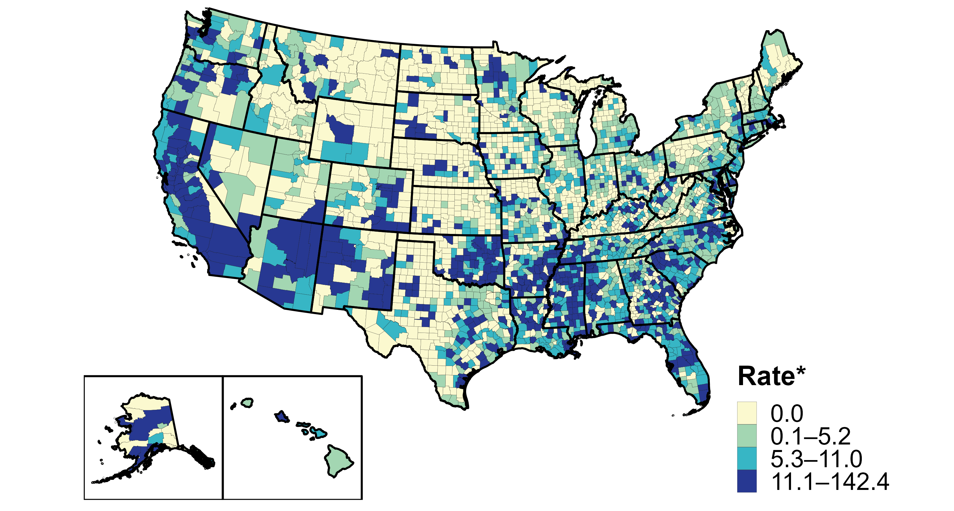
Primary and Secondary Syphilis — Rates of Reported Cases by County, United States, 2020
Notes:
This map demonstrates primary and secondary syphilis rates of reported cases. Much of the dark blue, where rates are the highest, are in larger cities. However, if you look across the Nation, there are dark blue pockets that pop up in more rural places, especially West of the Mississippi. In most cases, these dark blue counties overlap with Indian Reservations.
There’s no question that these data represent a disparity in syphilis and congenital syphilis in Indian Country. Now, we have to act on these data to make a real difference in the trajectory.

Slide 6
Syphilis response: Best practices in high burden areas
Case investigation and contact tracing
Rapid testing and treatment
Presumptive treatment
Screening of pregnant women
Expanded screening field treatment
Electronic health record (EHR) accurate entries
Community Engagement
Health Education and Outreach
Notes:
IHS has continued to address several clinical points listed here related to our syphilis response. For example, the national PHN lead has issued field treatment guidelines, and OIT is actively working on a syphilis screening reminder and streamlining STI test bundles with our laboratory leads.
Also, some facilities have implemented rapid point-of-care testing for syphilis. With these rapid tests, we can now get results for syphilis antibodies in just 10-15 minutes compared to days or sometimes weeks. The fast turnaround time means we can treat the patient immediately if they test positive and have the potential to notify their partners rapidly to get them in for testing and treatment.
But service units are in different places in their implementation of best practices, and we need to continue to provide TA and capacity building whenever possible.

Slide 7
Substance Use Disorder
Prioritize access to substance use disorder treatment
Remove punitive measures for substance use
Encourage routine syphilis testing for patients reporting methamphetamine use
Notes:
Nationwide and in Indian Country, there is a clear connection between increase drug use and rising syphilis rates. Having sex under the influence is known as “chemsex.” However, certain substance like methamphetamines increase sexual drive and decrease inhibitions and safer sex practices, resulting in riskier behavior and increased STIs. Drug use, particularly use of methamphetamine and injection drugs, is associated with sexual behaviors that increase the risk for acquiring syphilis. Of course, other risk factors include having multiple sex partners or concurrent sexual partnerships, inconsistent condom use, and exchanging sex for drugs.
Almost every congenital syphilis case is linked to substance use disorder, which in turn is linked to no prenatal care or nor care after month six of pregnancy.
IHS must prioritize access to substance use disorder treatment at the various service units. This includes medications for opioid use disorder (MOUD treatment), alcohol treatment, behavioral health and mental health services, as well as prevention services, interventions and harm reduction services.
IHS could remove punitive measures for people – especially pregnant people – who disclose any substance use and encourage routine syphilis testing for patients reporting methamphetamine use regardless of symptoms.
These syphilis numbers are high not because of cultural reasons; they are a function of care access. More individuals treated late – or not at all – add to the overall reservoir of disease transmission. We must create clear policy tools that work for us in the current reality of severe clinician shortages that reduce our capacity for partner services. All of these policies have caveats, but they aren’t dealbreakers. Clear guidelines, especially for those aimed at local implementation – including those with safeguards to ensure HIPAA and security compliance – and those that are not overly burdensome on staff, will give us the best chance to stem the epidemic.

Slide 9
Bicillin (benzathine penicillin G) Current Status:
Preferred treatment protocol for Syphilis
There is adequate supply through the Pharmaceutical Prime Vendor (PPV) McKesson
NSSC will provide a weekly update on the supply
There is an increasing amount of available Bicillin for all I/T/U and no shortage at this time
The public health nurses can provide the treatment outside the facilities

Slide 10
RSV (Respiratory Syncytial Virus)
AI/AN children have a high burden of RSV
Hospitalization 1.7-7.1X, amongst the highest in the world
Greatest burden in full-term infants
RSV prevention strategy is essential
Maternal immunization
Monoclonal antibodies
It should be available to all infants

Slide 11
Treatment
Nirsevimab (Beyfortus) monoclonal antibody
Given to infants under 1 year entering the first RSV season
Recommended that AI/AN babies get a second dose before the second RSV season
Maternal RSV vaccine Abrysvo 32-36 weeks of pregnancy

Slide 12
RSV in AI/AN infants
IHS has advocated since August for prioritization of nirsevimab access for AI/AN infants/children in their first and second RSV season. This resulted in the current ACIP recommendation and the addition of the product to the IHS National Core Formulary (before any other federal program). Studies showed that AI/AN infants were vulnerable to RSV with higher rates of hospitalization and deaths
IHS has provided regular clinical guidance (written guidance and webinars) to I/T/U programs about nirsevimab indications and availability.
IHS leadership has advocated with OPDIVS and the Department to support tribal communities with nirsevimab via the Vaccines for Children (VFC) program.

Slide 13
Current Status
The manufacturer of nirsevimab for the prevention of RSV in infants notified the CDC that there is an impending shortage of the medication
Meetings were held with the CDC concerning the need for an adequate supply of nirsevimab for our vulnerable population. CDC was not able to provide additional doses to the I/T/U system through the VFC system
The IHS NSSC procured a supplemental supply (8,000 doses) of nirsevimab from the manufacturer, Sanofi, and has already distributed roughly 1/3 of this supply to tribal communities in multiple Areas that have requested it (with more supply arriving weekly through January).
IHS was also able to establish a higher percentage of distribution of
nirsevimab from the VFC program working with the CDC

Slide 14
Thank you!

