Slide 1
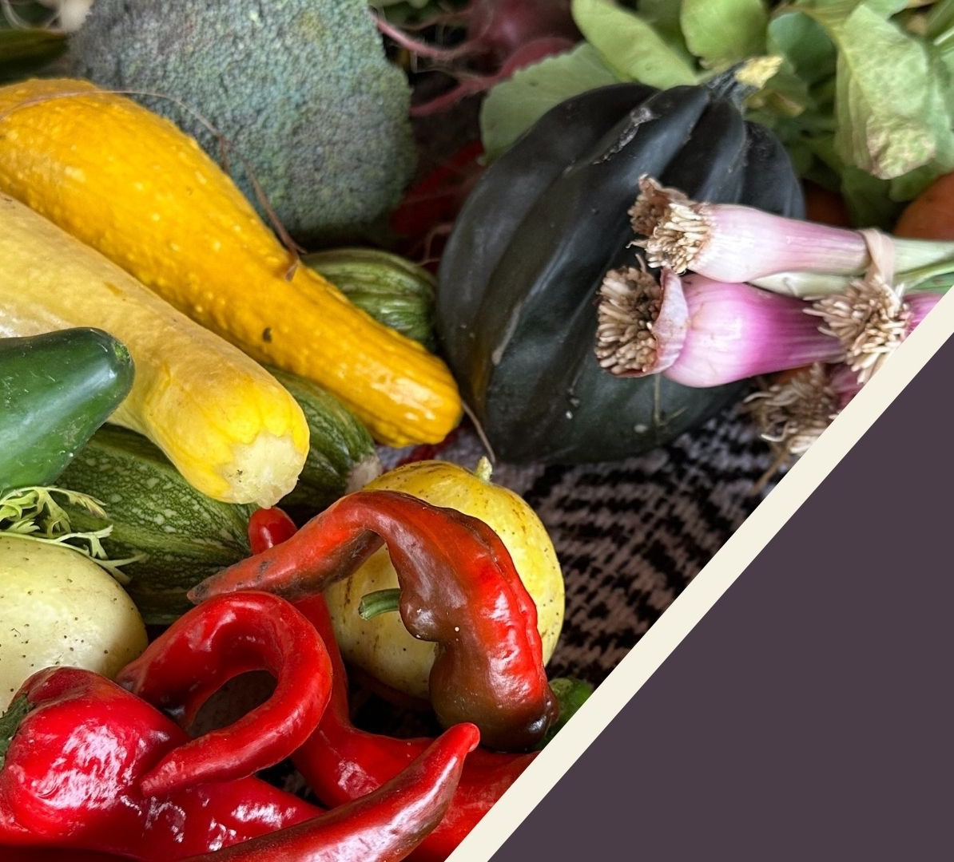
IHS Produce Prescription Pilot Program (P4) TSGAC Meeting
December 13, 2023
Notes:
CLH

Slide 2
IHS Nutrition Security Initiative
Food Security
Food Insecurity
High food security:
no reported indications of food-access problems or limitations.
Marginal food security:
one or two reported indications—typically of anxiety over food sufficiency or shortage of food in the house. Little or no indication of changes in diets or food intake.
Low food security:
reports of reduced quality, variety, or desirability of diet. Little or no indication of reduced food intake.
Very low food security:
reports of multiple indications of disrupted eating patterns and reduced food intake.
https://www.ers.usda.gov/topics/food-nutrition-assistance/food-security-in-the-u-s/definitions-of-food-security

Slide 3
Food Insecurity in AI/AN Communities
About one in four Native Americans experience food insecurity, compared to 1 in 8 Americans overall.
Native American families are 400% more likely to report being food insecure, with limited access to sufficient, affordable food.
Prevalence of food insecurity is much higher among adults with diabetes compared with those without diabetes (16% vs. 9%).
Challenges and Barriers:
Food access in rural AI/AN communities
Limited full-service food markets
Food deserts, with long distances to get to grocery stores
Family members with chronic health conditions and quarantine
High cost of fresh food in rural markets
Disruption of traditional food systems, even more significant in rural areas
Higher rates of chronic disease and diet-impacted conditions like diabetes, chronic kidney disease, heart disease, and obesity
https://moveforhunger.org/one-in-4-native-americans-is-food-insecure#:~:text=About%20one%20in%20four%20Native,access%20to%20sufficient%2C%20affordable%20food.
cdc.gov/diabetes/data/statistics/statistics-report.html

Slide 4
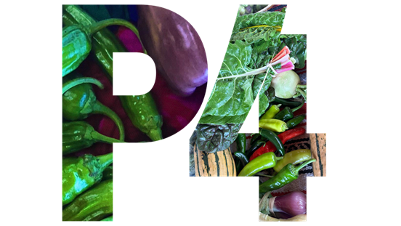
IHS Produce Prescription Pilot Program (P4)
IHS has been authorized recurring funding to implement a P4 to increase access to produce and other traditional foods within AI/AN communities.
Goal:
Demonstrate and evaluate the impact of Produce Prescription Programs on AI/AN people and their families by:
Reducing food insecurity;
Improving overall dietary health by increasing fruits, vegetables, and traditional food consumption; and
Improving healthcare outcomes.
The 5-year grant program started in 7/2023.

Slide 5
Notes:
Dr. C or CLH

Slide 6
How did we get here?
24 Apr 2023
Notice of Funding Opportunity - published April 24, 2023
8 June 2023
Application Deadline - Closed June 8, 2023
June 2023
Objective Review Process
60 Applications Reviewed
July 2023
Notice of Awards
5 Awards at $500,000/yr
Grant period is 5 years
31 July 2023
HHS Press Release – July 31, 2023
Notes:
Stacy

Slide 7
Meet the Team
Carmen Licavoli Hardin
P4 Grant Authorizing Official and Director
Division of Diabetes
Stacy Hammer
P4 Grant Program Official and
National Nutrition Consultant
Division of Diabetes
Kelli Wilson Begay
P4 Grant Nutrition Specialist
Division of Diabetes
Paula Acevedo
P4 Grants Management Specialist
Division of Grants Management
Wendy Castle
P4 Grant and Training Coordinator
Division of Diabetes

Slide 8
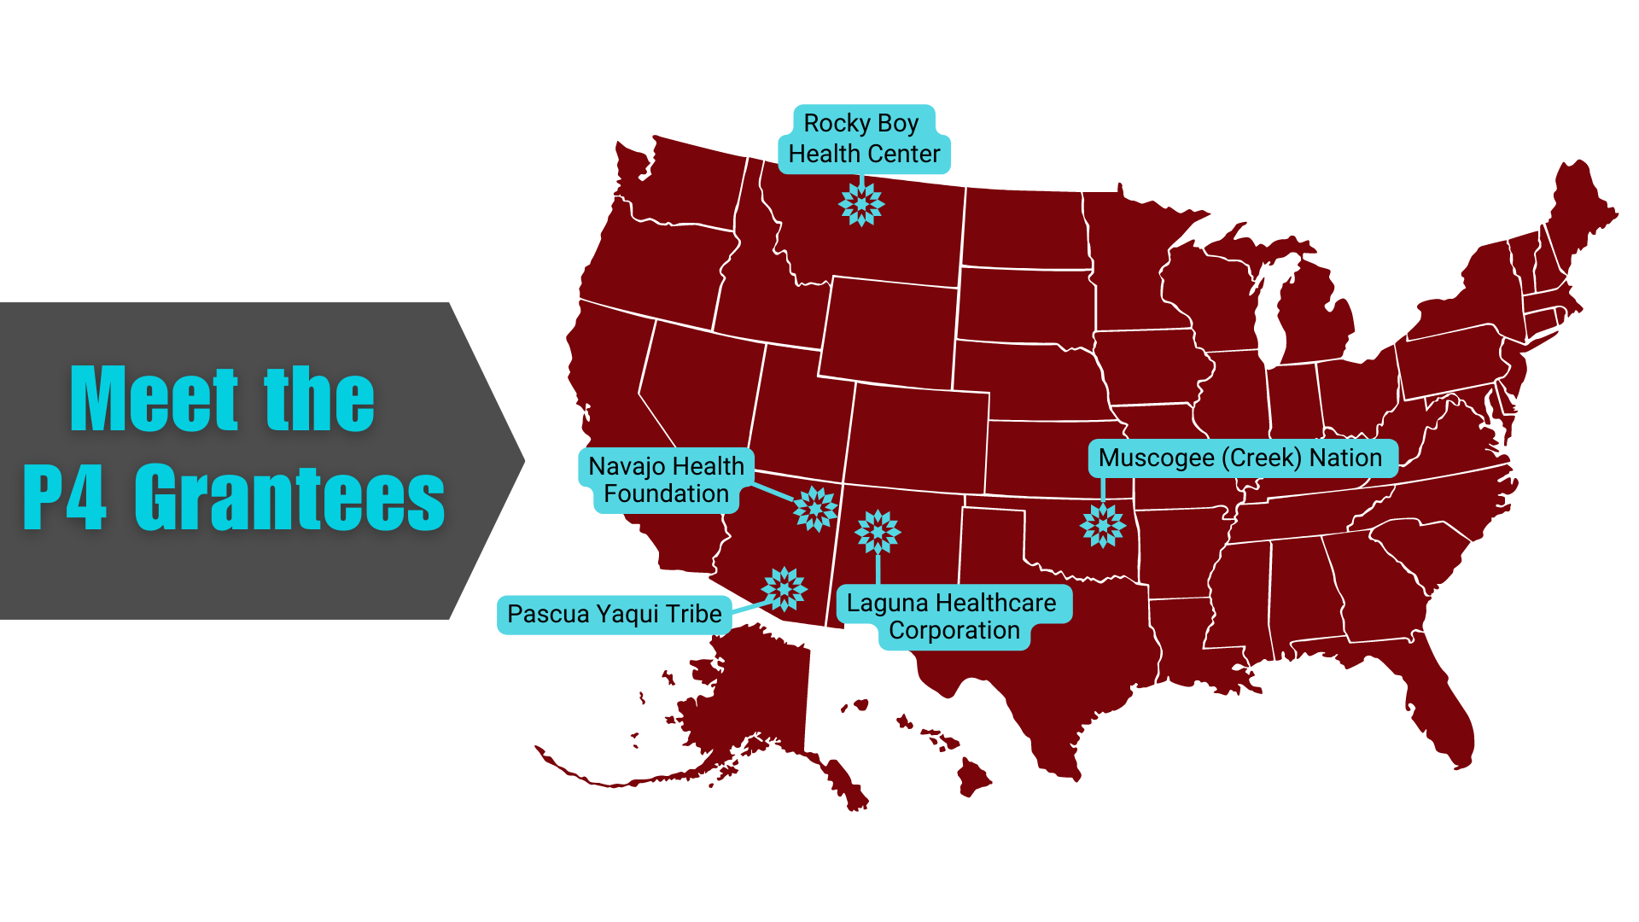
Notes:
Stacy
All the grantees are coordinating in some capacity with their SDPI programs.

Slide 9
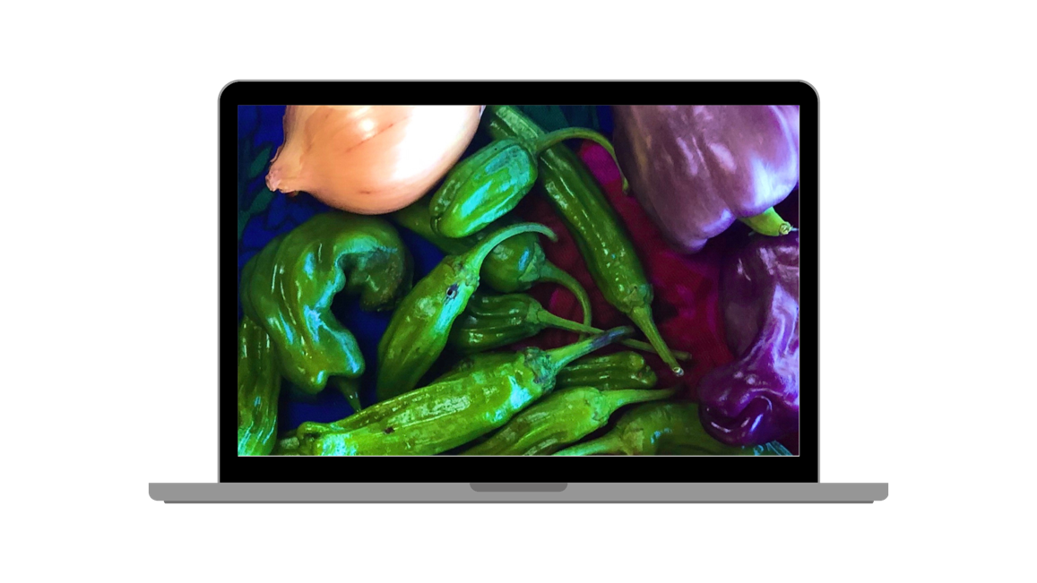
P4 Requirements
All awardees are required to:
Identify a target population;
Develop an infrastructure that fosters collaboration with a health care facility and local markets/organizations/services that provides fresh fruits and vegetables and/or traditional foods;
Implement a nutrition education program; and
Develop an evaluation plan that measures:
Food insecurity,
Health outcomes, and
Utilization of services over time.

Slide 10
Evaluation Plan
Measurement of food insecurity over time using the U.S. Adult Food Security Survey Module.
Did food insecurity rates decrease, increase, or remain unchanged by participating in P4?
Participant's use of services offered by the program.
How is the implementation of P4 measured?
What percentage of participants redeem the produce vouchers?
How is consumption of produce measured and what percentage of participants consume the produce?
How much fruit and vegetables are consumed at baseline and how did that amount change over time, in comparison to the number of vouchers prescribed by the health care provider?
Did the participants attend the education programs?

Slide 11
Evaluation Plan (Cont.)
3. Evidence of improvement in health outcomes.
Are healthcare facility records available and accessible, in accordance with privacy laws, to track changes in participant's clinical parameters such as A1C and lipid levels?
Are anthropometric measures also available through the healthcare facility or measured in separate facilities and made available for analysis?
4. Changes in access to healthy and traditional foods.

Slide 12
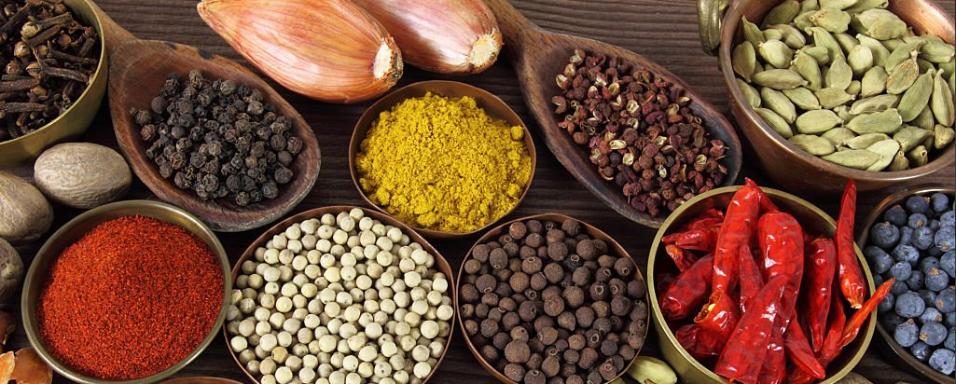
P4 Grantee Profiles
Target Group:
Pre-diabetes and diabetes (4 grantees)
BMI >30 (1 grantee)
Proximity to accessing healthy foods (1 grantee)
Hypertension, obesity (1 grantee)
Implementation Timeline:
One site: in full implementation
Three sites: in full implementation by January 2024
One site: in full implementation by early spring 2024
Staff and Partners:
Partnerships are established with grocers, local farmers, and other distributors
P4 teams built in clinic and community health settings

Slide 13
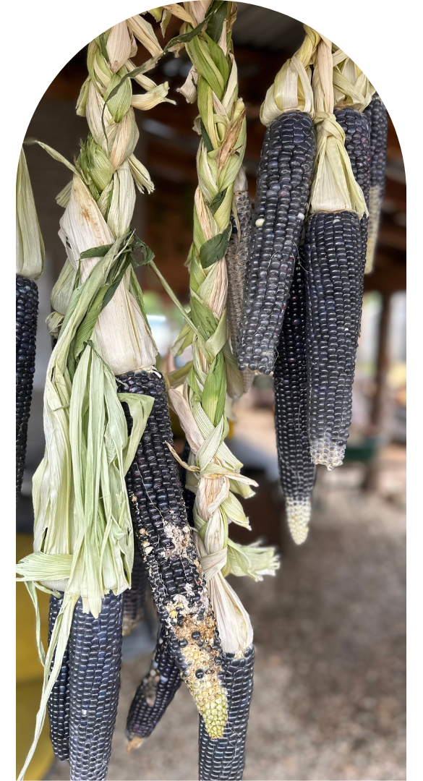
P4 Grantee Support
Conducting monthly one-on
one-meetings with grantees
Conducting monthly cohort meetings
Planning site visits in 2024
Nutrition website resources

Slide 14
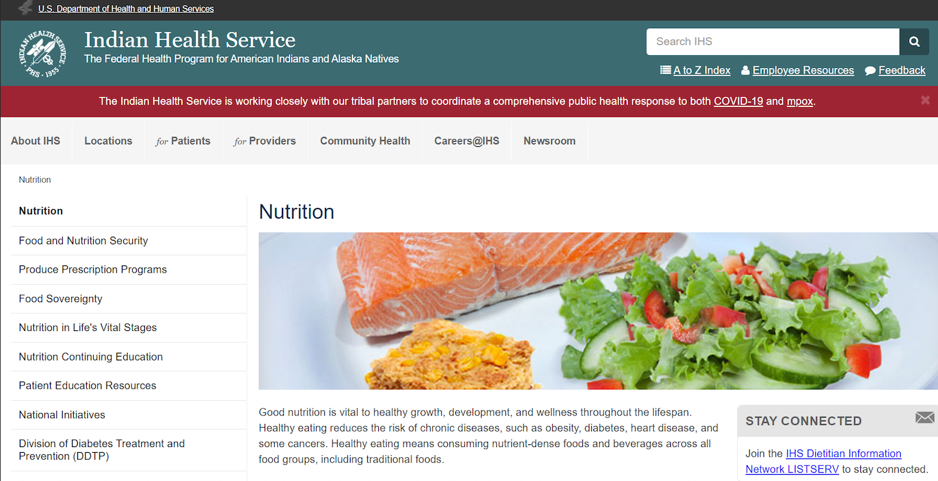
https://www.ihs.gov/nutrition/
Notes:
Stacy

Slide 15
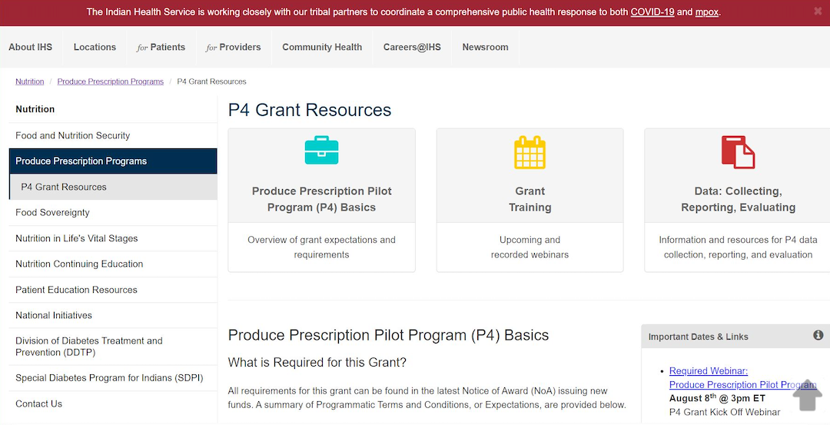
P4 Grant Resources
Main source of information for the P4 Grantees.
https://www.ihs.gov/nutrition/Produce-prescription-programs/p4-grant-resources/
Notes:
Stacy will share desktop to do a short ”tour” of P4 grant resources

Slide 16
Q&A

