Slide 1
SGAC Budget Update
December 11, 2023

Slide 2
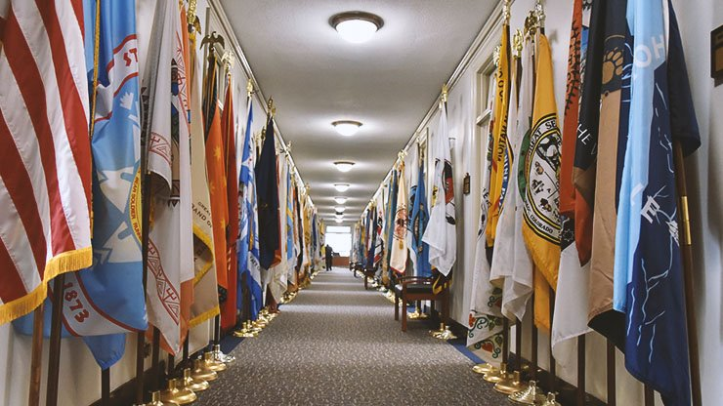
FY 2024 Distribution of Funds
Continuing Resolution (CR) through February 2, 2024.
Tribal Transfers
IA implemented FY 2024 Tribally requested transfers of TPA base funding under CR1 and CR2. Allows funding to be posted to the lines on which Tribes anticipate using the funding in FY 2024 and avoid reprogramming issues when final funding is provided for FY 2024.
Exception Apportionment
OMB approved IA’s request to provide 100% of TPA base and Law Enforcement funding to FY Tribes under CR1. Funds should be with Tribes or on its way. Work with IA awarding officials to claim funds in ASAP.
OMB approved request to provide 100% of TPA base and Law Enforcement funding to CY Tribes under CR2 last week. IA working on allocating funds to the regions. Work with IA awarding officials to claim funds in ASAP.
Debt ceiling agreement 1% automatic reduction could result in the need to claw back exception apportionment funding.

Slide 3
FY 2024 Budget Request by IA Bureaus
BUREAU ACCOUNT | 2023 ENACTED | 2024 TRIBAL REQUEST | 2024 REQUEST | 2024 HOUSE | House Change from Enacted | House Change from Request | 2024 SENATE | Senate Change from Enacted | Senate Change from Request | Senate Change from House
TOTAL, INDIAN PROGRAMS | 3,953,727 | 20,754,217 | 4,642,087 | 4,087,632 | +133,905 | -554,455 | 4,030,444 | +76,717 | -611,643 | -57,188
BUREAU OF INDIAN AFFAIRS | 2,441,016 |  | 2,922,388 | 2,583,952 | +142,936 | -338,436 | 2,519,217 | +78,201 | -403,171 | -64,735
OPERATION of INDIAN PROGRAMS | 1,906,998 | - | 2,257,637 | 2,012,074 | +105,076 | -245,563 | 1,934,548 | +27,550 | -323,089 | -77,526
CONTRACT SUPPORT COSTS ACCOUNT^{1/} | 328,000 | - | - | 342,000 | +14,000 | - | 342,000 | +14,000 | - | -
PAYMENTS for TRIBAL LEASES^{1/} | 30,000 | - | - | 64,000 | +34,000 | - | 64,000 | +34,000 | - | -
INDIAN LAND CONSOLIDATION | 8,000 | - | 30,500 | - | -8,000 | -30,500 | 8,000 | - | -22,500 | +8,000
LWCF TRIBAL LAND ACQUISITION | - | - | 12,000 | - | - | -12,000 | - | - | -12,000 | -
CONSTRUCTION | 153,309 | - | 199,814 | 153,309 | - | -46,505 | 154,809 | +1,500 | -45,005 | +1,500
SETTLEMENTS | 825 | - | 976 | 825 | - | -151 | 976 | +151 | - | +151
INDIAN GUARANTEED LOAN PROGRAM | 13,884 | - | 15,461 | 11,744 | -2,140 | -3,717 | 14,884 | +1,000 | -577 | +3,140
CONTRACT SUPPORT COSTS ACCOUNT^{1/} |  |  | 342,000
PAYMENTS for TRIBAL LEASES^{1/} |  |  | 64,000
BUREAU OF INDIAN EDUCATION | 1,401,439 |  | 1,610,601 | 1,399,504 | -1,935 | -211,097 | 1,407,051 | +5,612 | -203,550 | +7,547
OPERATION OF INDIAN EDUCATION PROGRAMS | 1,133,552 | - | 1,194,389 | 1,131,617 | -1,935 | -62,772 | 1,136,725 | +3,173 | -57,664 | +5,108
EDUCATION CONSTRUCTION | 267,887 | - | 416,212 | 267,887 | - | -148,325 | 270,326 | +2,439 | -145,886 | +2,439
BUREAU OF TRUST FUNDS ADMINISTRATION | 111,272 |  | 109,098 | 104,176 | -7,096 | -4,922 | 104,176 | -7,096 | -4,922 | -
FEDERAL TRUST PROGRAMS | 111,272 | - | 109,098 | 104,176 | -7,096 | -4,922 | 104,176 | -7,096 | -4,922 | -
^{1/} 2022-23 Enacted & 2024 Request updated to reflect current CSC & 105(l) Actuals; Requested as Current Mandatory in 2024

Slide 4
FY 2025 Budget Request
Proposed Request sent to OMB on September 11, 2023.
OMB Passback and Appeals is in early December.
IA continues to prep Greenbook for publication which typically occurs in February but sometimes later.

Slide 5
FY 2026 Budget Formulation
Tribes
Tribal Priority Ranking Tool
Bi-year – IA will use the FY 2025 National Ranking to inform FY 2026
IA will accept an updated Tribal Priority Ranking if a Tribe has changes to their FY 2025 submission
Recommendations to enhance, update the Tool
BIE working group
Regional Offices and Agencies
Working group to improve the process
Central Office
Departmental budget formulation kickoff – Spring 2024

Slide 6
THANK YOU!

