Slide 1
ISDEAA 105(l) Facility Lease
Overview
2023/2024

Slide 2
Indian Self Determination and Education Assistance Act (ISDEAA)
The act is statutory and requires the Secretaries of the Department of the Interior and the Department of Health and Human Services, upon request of a tribe or tribal organization, to enter into a facility lease agreement for certain facilities used for the provision (PFSAs) assumed under ISDEAA.
I05(l) Tribal leases support facility costs for contracted and compacted Programs, Functions, Services, or Activities (PFSAs)

Slide 3
What is a 105(l) Facility Lease?
They are facility cost agreements that compensate the Tribes for facility operational expenses associated with using their facility to administer (ISDEAA) contracted/compacted services.
They are not traditional leases.

Slide 4
Types of 105(l) Facilities Proposed for Tribal Leases
FY 2023: 562 Renewals and Initial Lease Request by Type
Administration | 110
Education (8 Schools) | 61
Public Safety | 86
Social Services | 63
Environmental | 41
Maintenance | 91
Storage | 12
Workforce/477 | 1
Mixed Use | 58
Other | 39
Notes:
The Tribe can prove interest in the facility with a quitclaim or warranty deed, trust title, or lease/rental agreement.

Slide 5
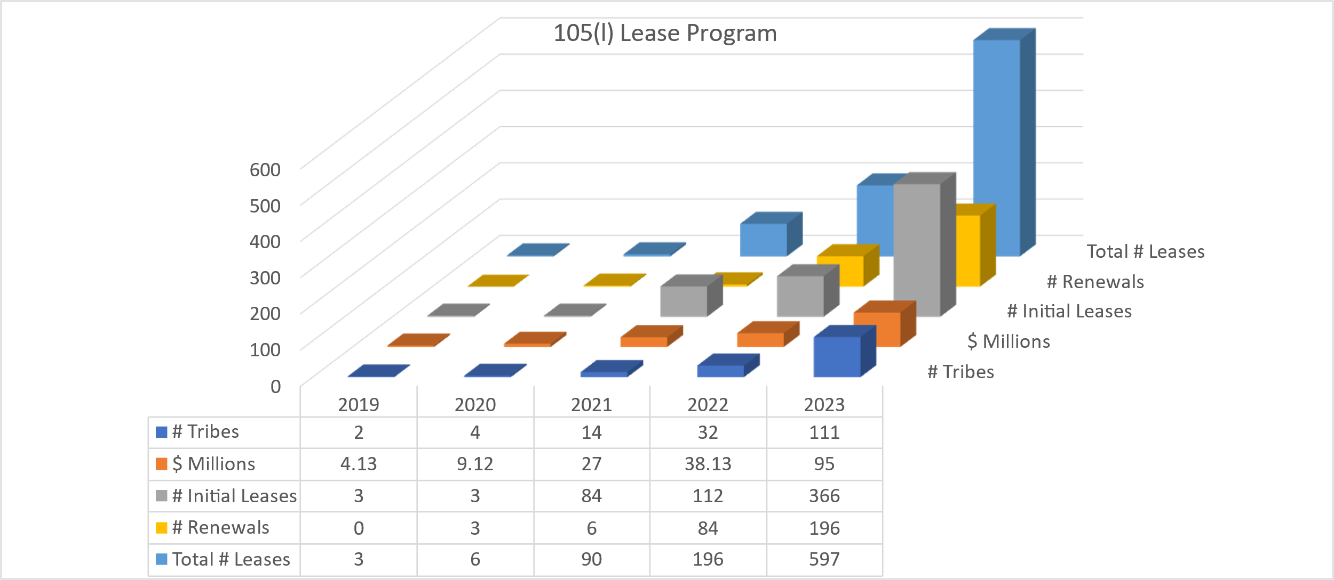
Growth in 105(l) Tribal Leases

Slide 6
Importance of Mandatory and Administrative Funding
Mandatory Funding: The 2024 Request continues IA’s proposal to reclassify the program to meet legal requirements to Tribes from discretionary to mandatory funding.
  Contract Support Costs, 105(l) leases, and Construction, have grown from 12% of budget in 2013 to 24% of Budget in 2024 President’s Budget.
Administrative Funding: The FY 2024 Request includes additional funding to allow the program to have enough staff to adequately process leases in a timely manner and have systems to manage the process efficiently and enhance communications with Tribes.
Payments for Tribal Leases
At time of budget request, IA estimated at least $82.5M to fully fund costs for signed lease agreements under section 105(l) of ISDEAA. Based on the number of lease applications funded over the last two years, this is almost a 50% increase over 2022.

Slide 7
105(l) Technical Assistance Guidebook Overview
(ISDEAA) Section 105(l)
Eligibility Requirements
Types of Compensation
How to Start the Process
Required Documents
Lease Terms & Renewals

Slide 8
The Tribe’s Considerations
Types of Compensation
Eligibility
Tribe must hold:
  A title to the facility; or
  A leasehold interest in the facility; or
  A trust interest in the facility
The facility must be occupied, the space must be used for a qualified program function or activity, and the PFSA must be in an approved ISDEAA Self-Determination contract, Self-Governance compact, Public Law 100-297 grant, or 477 program.
Fair Market Rental
Cost Elements listed in 25 CFR Section 900.70 (a) – (h) only
Combination of Fair Market Value and Cost Elements
* Costs included in compensation must be reasonable and not duplicative.
Chapters 1 and 3
Chapter 1
Notes:
The Tribe can prove interest in the facility with a quitclaim or warranty deed, trust title, or lease/rental agreement.

Slide 9
Cost Elements listed in 25 CFR Section 900.70 (a) – (h) only
To the extent that no element is duplicative, the following elements may be included:
(a) Rent (sublease)
(b) Depreciation on the useful life of the facility based on acquisition costs not financed with Federal funds
(c) Contributions to a reserve for replacement of facilities
(d) Principal and interest paid or accrued
(e) Operation and maintenance expenses, to the extent not otherwise included in rent or use allowances
(f) Repairs to buildings and equipment
(g) Alterations needed to meet contract requirements
(h) Other reasonable expenses
Chapters 1 and 3
Notes:
The Tribe can prove interest in the facility with a quitclaim or warranty deed, trust title, or lease/rental agreement.

Slide 10
How to Start the Process
  There is no standard application
  Contact us at ISDEAA105L@BIA.GOV
  The lease proposal should confirm the following:
  - The Tribe holds title to, a leasehold interest in, or a trust interest in the facility;
  - The Tribe is using the facility to administer an approved ISDEAA PFSA ;
  - List the PFSAs administered in each facility;
  - The type of compensation the Tribe is seeking;
  - The address for each facility; and
  - Identify the Tribe’s accounting system; fiscal or calendar year
Chapter 2

Slide 11
Required Documents
  Proof of ownership
  Certificate of occupancy
  Recent photos of the facility’s interior and exterior
  FMRA and or proof of actual cost
  Floor plan showing all the PFSAs, and any non-PFSAs, common areas, shared space, and a description if there are other tenants in the facility
  Financial certification
  Tribal resolution
Chapter 3

Slide 12
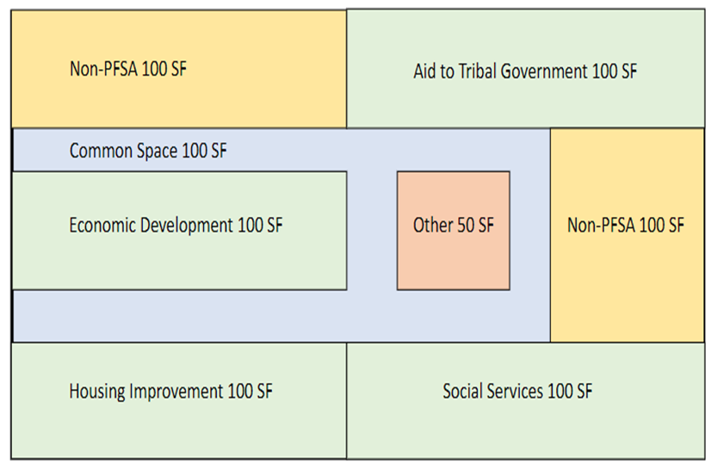
Floor Plan Example

Slide 13
Lease Process Overview
Proposal Chapters 1-2
  Determine eligibility
  Determine the method of compensation
  Tribe submits proposal to ISDEAA105L@BIA.GOV
  IA verifies the PFSAs qualify based on the Tribe’s current funding agreement
  Review the required documents
  Follow on (Technical Assistance) meetings as needed
  Tribe review the draft lease
  Surnaming/Legal sufficiency review
  Final lease execution and funding
Draft and Review Chapters 5-6
Approval and
Execution
Chapter 6

Slide 14
Lease Terms and Renewals
The initial lease term for either a calendar year or fiscal year will be prorated to the approved proposal letter’s date of receipt.
The awarding official will incorporate the 105(l) lease agreement into the ISDEAA agreement or 297 grant.
Lease Renewals:
Request 90 days before the expiration of the current lease.
Terms are for a full calendar year or fiscal year, per annual appropriation.
Terms may be renegotiated at renewal.
Chapters 6 - 7

Slide 15
The Path Forward
  Contact us at ISDEAA105L@BIA.GOV
Published Guidebook https://www.bia.gov/as-ia/ofpsm/brpl/105lp.
105(l) team will provide sample templates for required documents.
The 105(l) team will provide technical assistance as needed.
The 105(l) team will coordinate with IHS to ensure no overlaps.

Slide 16
Thank You!
www.indianaffairs.gov

