Slide 1
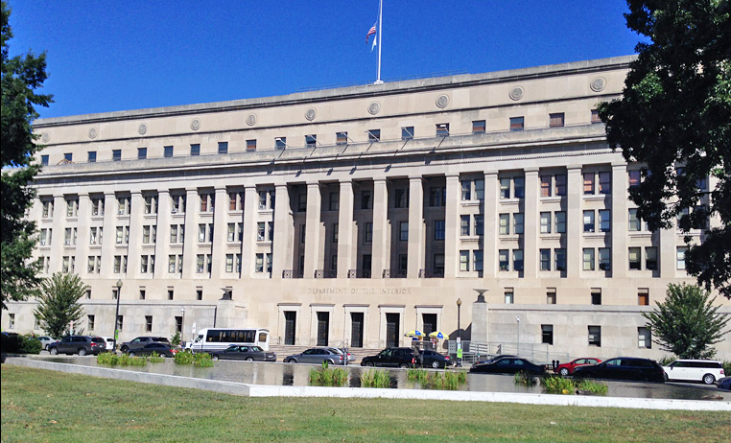
Office of Self Governance Update
December 11, 2023

Slide 2
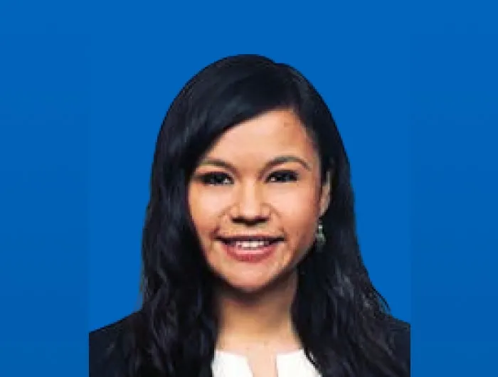
Personnel Changes
Rose Petoskey has transferred from her role at DOI and accepted a position at the White House as a Senior Advisor to the White House Office of Intergovernmental Affairs and Director of Tribal Affairs for the Biden-Harris Administration.

Slide 3
Office of Self Governance – Finance (2022)
To date in FY 2024, OSG has received and obligated approximately $811,437,430 in FY 2022 funding to Self Governance Tribes/Consortia

Slide 4
Office of Self Governance – Finance (2023)
To date in FY 2024, OSG has received approximately $796,824,604 in FY 2023 funding for Self Governance Tribes/Consortia

Slide 5
Office of Self Governance – Finance (2024)
To date in FY 2024, OSG has received approximately $343,953,414 in FY 2024 funding for Self Governance Tribes/Consortia

Slide 6
Contract Support Cost (CSC)
FY 2019 – 2023 Update
Fiscal Year | Amount Distributed | Number of Tribes Unresponsive
2019 | $ 108,522,309.00 | 5
2020 | $ 115,203,893.00 | 6
2020 – CARES | $ 27,866,064.00 | 36
2021 | $ 111,266,852.00 | 8
2021 – ARPA | $ 46,407,527.00 | 29
2022 | $ 117,999,060.00 | 27
2023 | $ 103,137,881.00 | 44

Slide 7
Contract Support Cost (CSC)
FY 2024 Update
To date, OSG has not received FY 2024 CSC funding for distribution.
Indian Affairs has requested Excepted Apportionment for CSC. The date that apportionment is expected to be available is pending.

Slide 8
Contract Support Email Address
OSG-CSC@bia.gov
Self Governance Tribes/Consortia are requested to please email all correspondence and documentation regarding Self Governance CSC to this email address, including CSC Data.

Slide 9
Self Governance Negotiations
OSG’s negotiators continue to prioritize completion of PROGESS Act Negotiated Rulemaking.
OSG’s historical cyclical processes for negotiating Funding Agreements is disrupted, due in large to:
25 U.S.C. § 5363(p) – authorizing Tribes/Consortia to retain an existing Funding Agreement without disrupting the award of funds (funds are still being paid to Tribes/Consortia)
Many Tribes/Consortia electing to allow PROGRESS Act Rulemaking to complete before negotiating a successor Funding Agreement
Tribes/Consortia moving forward with negotiations at various times of the year

Slide 10
Self Governance ATOs
SGDB Updates:
Auto-Signatures on ATOs was implemented at the end of September 2023. Signed reprints of ATOs are available for 2023, 2022, and various 2021 ATOs.
A New Messages tab on the Login page was implemented in November 2023. New Messages notice will automatically display until a Tribal User views the pending message(s).
More to come…

Slide 11
ATO Information
If a Tribe/Consortium is awaiting an ATO, please contact:
Doug Dan by email Douglas.Dan@bia.gov; or
Upon request, OSG Finance can provide FBMS and SGDB print screens which display data useful to support the drawdown of available amounts in ASAP
Lance.Fisher@bia.gov can assist with Tribal/Consortium issues with ASAP or ID.me registration

Slide 12
The End

