Slide 1
FY 2022 and 2023 Tribal Priority Allocation Natural Resources General Increases
Trina Locke, BIA, Office of Trust Services

Slide 2
FY 2022 General Increases
Natural Resources TPA
$3M General Increase
Forestry TPA
$3M General Increase
Water Resources TPA
$2M General Increase
Wildlife and Parks Program TPA
$2M General Increase

Slide 3
Process for FY 2022 Determination of Distribution
Leadership discussions between all supporting offices kicked off.
Office of Trust Services coordinated with Office of Budget and Performance Management, Office of Field Operations, and the Office of Self Governance to:
determine initial list of existing Tribes and program amounts; and
determine new Tribes seeking to establish a program or fund an existing unfunded program.
OTS program managers added as many new Tribal programs and provided increases to several existing Tribal programs.

Slide 4
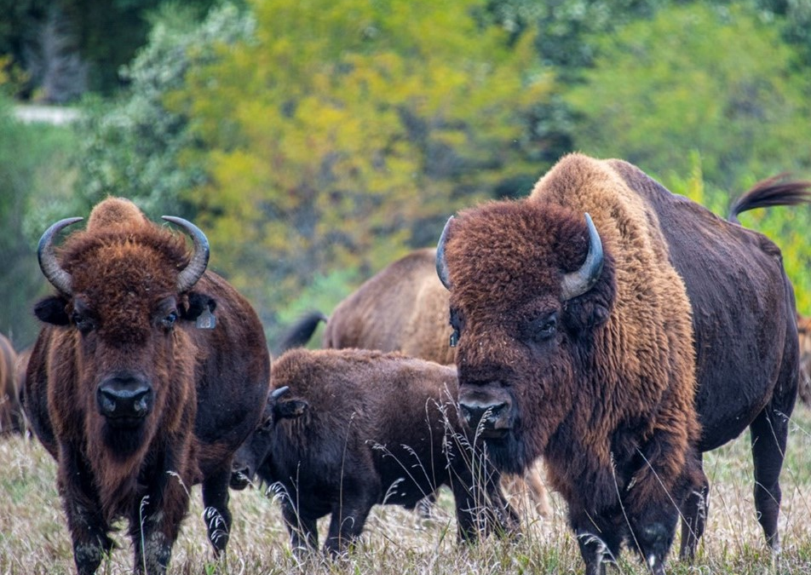
Natural Resources TPA $3M General Increase
42 new Tribes added at $25K each
79 existing Tribal programs received increases up to $26K
Amount was established to set a program baseline.

Slide 5
Forestry TPA $3M General Increase
7 new Tribes added
26 existing Tribal programs received an increase
Amounts vary and are based on the existing formula and special factors like Forest Acres, Indian Forestry Status, Volume Available, Value, etc.

Slide 6
Water Resources TPA $2M General Increase
Due to the extremely high volume of requests for new Tribal programs it was determined to partially fund as many requests as possible. The few that were denied did not meet the criteria for this program.
62 new Tribal programs were added, based on proposals

Slide 7
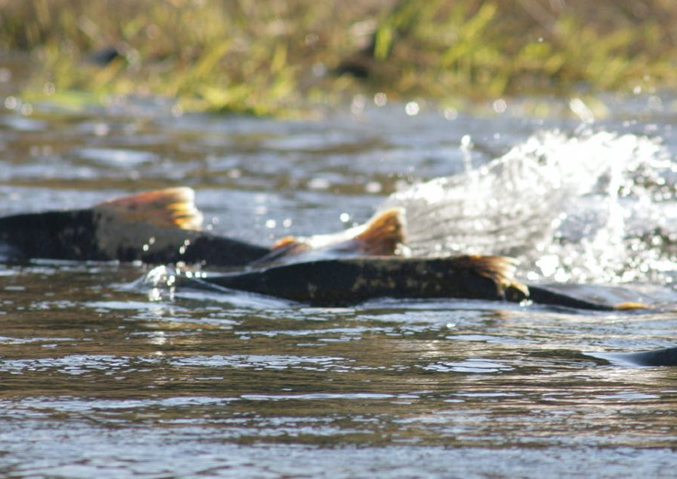
Wildlife and Parks Program TPA $2M General Increase
46 new Tribes added
32 existing Tribal programs received increases up to 20K
New Tribal program amounts were based on proposals and are anywhere from $10K to $35K.

Slide 8
Process to become permanent base
For the FY 2022 Natural Resources General Increases the Office of Trust Services (OTS) is responsible to transfer funds to appropriate Regions or OSG with instruction for distribution to new or existing Tribes.
Once we obtain FY 2024 appropriation, Office of Budget and Performance Management and OTS will coordinate to ensure amounts become permanent part of base.

Slide 9
Pain Points and Lessons Learned
Time it takes to obtain data needed to verify Tribal programs and validate amounts
Processing time
and the OTS’ inability to obtain status updates once it leaves our fund center

Slide 10
OTS Improvements
Documented Process
Implementation of STAT a Smartsheet application
OTS specific Tableau to monitor Regions and Pub. L. 93-638
Increased Budget Support with subject matter expertise in Self Governance
Existing personnel obtained additional training and development in Self Governance in FY 2023
OTS Program managers are ready and willing to coordinate with the Tribal POCs to aid in drawdown if OSG can inform OTS when everything has been complete, and funds are ready for the Tribes.

Slide 11
FY 2023 General Increases
Natural Resources TPA
$1.3M General Increase
Forestry TPA
$2.5M General Increase
Water Resources TPA
$1.5M General Increase
Wildlife and Parks Program TPA
$2M General Increase

Slide 12
Next Steps
Continue to review OSG Program List to determine any Tribes that may have been overlooked in FY 2022 distribution.
Once Tribes have been identified, ensure those Tribes are given the same as the FY 2022 distribution and then determine distribution of remaining funds.
Anticipate FY 2023 initial distribution to be complete by April 2024.

Slide 13
QUESTIONS?

Slide 14
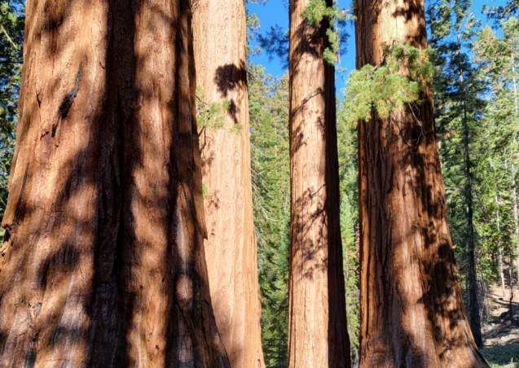
Visit us at:
https://www.bia.gov/bia/ots

