Slide 1


Contract Support Cost 101
Indian Health Service
Johnnita Tsabetsaye, CSC Director
April 15, 2024

Slide 2
Contract Support Costs (CSC)
Indian Health Service CSC Policy Overview IHM 6-3
CSC Negotiation Template
Indirect Cost Rates

Slide 3
CSC
Indian Health Manual Part 6, Chapter 3
IHS POLICY
Purpose. This chapter of the Indian Health Manual provides guidance to both Tribal and Agency personnel in the preparation, negotiation, determination, payment, and reconciliation of contract support costs (CSC) funding in support of new, expanded, and/or ongoing Indian Self-Determination and Education Assistance Act (ISDEAA), as amended, codified at 25 United States Code (U.S.C.) Section (§) 5301 et seq., contracts and compacts.
Chapter 3 - Contract Support Costs | Part 6
www.ihs.gov/IHM/pc/part-6/p6c3/

Slide 4
CSC – ISDEAA FUNDING
CSC is ISDEAA-specific and is defined across several statutory provisions
25 U.S.C. §§ 5325(a)(2)-(3)
25 U.S.C. §§ 5325(a)(5)-(6)
25 U.S.C. § 5326

Slide 5
CSC – Legal Definitions
25 U.S.C. § 5325(a)(2) | 25 U.S.C. § 5325(a)(3)(A) | 25 U.S.C. § 5325(a)(5) | 25 U.S.C. § 5325(a)(6)
“[A]n amount for the reasonable costs for activities which must be carried on by a tribal organization as a contractor to ensure compliance with the terms of the contract and prudent management, but which— (A) normally are not carried on by the respective Secretary in his direct operation of the program; or (B) are provided by the Secretary in support of the contracted program from resources other than those under contract.” | The contract support costs that are eligible costs for the purposes of receiving funding under this chapter shall include the costs of reimbursing each tribal contractor for reasonable and allowable costs of— (i) direct program expenses for the operation of the Federal program that is the subject of the contract, and (ii) any additional administrative or other expense incurred by the governing body of the Indian Tribe or Tribal organization and any overhead expense incurred by the tribal contractor in connection with the operation of the Federal program, function, service, or activity pursuant to the contract, except that such funding shall not duplicate any funding provided under subsection (a)(1) of this section. | Subject to paragraph (6), during the initial year that a self-determination contract is in effect, the amount required to be paid under paragraph (2) shall include startup costs consisting of the reasonable costs that have been incurred or will be incurred on a one-time basis pursuant to the contract necessary— (A)to plan, prepare for, and assume operation of the program, function, service, or activity that is the subject of the contract; and (B)to ensure compliance with the terms of the contract and prudent management. | Costs incurred before the initial year that a self-determination contract is in effect may not be included in the amount required to be paid under paragraph (2) if the Secretary does not receive a written notification of the nature and extent of the costs prior to the date on which such costs are incurred.

Slide 6

CSC
CALCULATING CSC FUNDING
The ISDEAA does not provide any formula or
methodology for calculating CSC funding, however, IHS
has had a CSC Policy for many years in order to provide additional guidance on this issue.
The CSC Policy is based on the principles in the statute.

Slide 7
CSC – Cost Principles
OMB Cost Principles
Code of Federal Regulations
2 CFR Part 200 -- Uniform Administrative Requirements, Cost Principles, and Audit Requirements for Federal Awards
“§ 200.400 Policy guide. The application of these cost principles is based on the fundamental premises that:(a) The non-Federal entity is responsible for the efficient and effective administration of the Federal award through the application of sound management practices…”
HHS Cost Principles
PART 75—UNIFORM ADMINISTRATIVE REQUIREMENTS, COST PRINCIPLES, AND AUDIT REQUIREMENTS FOR HHS AWARDS
Cost principles. Subpart E

Slide 8
IHM Part 6 Chapter 3 - Contract Support Costs
Manual Exhibits | Description
Manual Exhibit 6-3-A | Title 25, Chapter 14, Miscellaneous, Subchapter II, Indian Self-Determination and Education Assistance, Part A "Indian Self-Determination," Section 5325 and Section 5326
Manual Exhibit 6-3-B | Calculating IDC Associated with Tribal Shares and the Contract Support Costs Amount Based on a Detailed Analysis
Manual Exhibit 6-3-C | Calculating IDC Associated with Tribal Shares and the Contract Support Costs Amount Using the 80/20 Method
Manual Exhibit 6-3-D | Calculating IDC Associated with Recurring Service Unit Shares and the Contract Support Costs Amount Based on a Detailed Analysis
Manual Exhibit 6-3-E | Calculating IDC Associated with Recurring Service Unit Shares and the Contract Support Costs Amount Based on the 97/3 Method
Manual Exhibit 6-3-F | Contract Support Costs Negotiation Template
Manual Exhibit 6-3-G | Standards for Review and Approval of Contract Support Costs in the Indian Health Service

Slide 9
CSC Negotiation Template
This Template is a tool used by the Indian Health Service (IHS) for calculating and negotiating CSC. Neither this Template nor any other negotiation documents creates a contractual obligation on behalf of either IHS or a T/TO. The CSC amount that the parties agree is required under any Indian Self-Determination and Education Assistance Act (ISDEAA) agreement will be identified in the agreement itself - Manual Exhibit 6-3-F

Slide 10


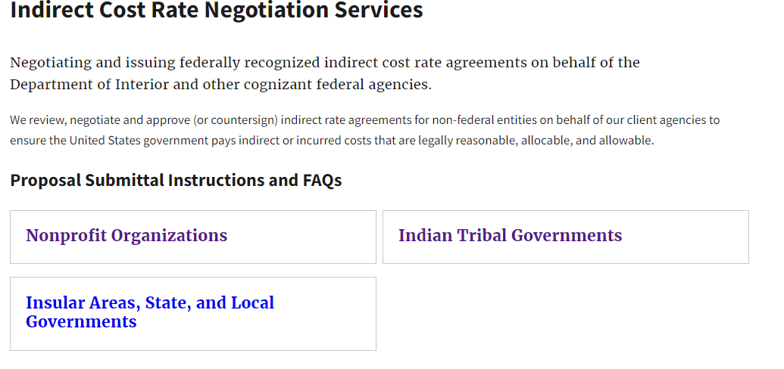
Indirect Cost Rates
Cognizant Agency
DOI
HHS
Indirect Cost Negotiations Contact Us
Western Field Office
San Francisco, CA
CAS-SF@psc.hhs.gov
(415) 437-7820
Colleges and Universities, Hospitals and Nonprofit Organizations
U.S. States and Territories: Alaska, Arizona, California, Colorado, Hawaii, Idaho, Montana, Nevada, North Dakota, Oregon, South Dakota, Utah, Washington, Wyoming, American Samoa, Guam, and Northern Mariana Islands
Lucy Siow
Branch Chief
lucy.siow@psc.hhs.gov
(301) 492-4891
State, Local and Tribal Governments
U.S. States and Territories: Alabama, Alaska, Arizona, California, Colorado, Georgia, Hawaii, Iowa, Kentucky, Maryland, Mississippi, Nebraska, New Mexico, North Carolina, North Dakota, Oregon, South Carolina, South Dakota, Utah, Washington, American Samoa, District of Columbia, Guam, and Northern Mariana Islands
Cora Coleman
Branch Chief
cora.coleman@psc.hhs.gov
(415) 437-7821
Indirect Cost Rate Negotiation Services | IBC Customer Central (doi.gov)

Slide 11
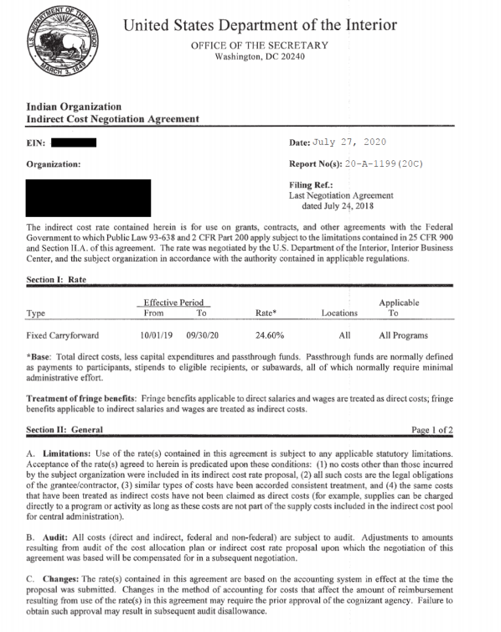
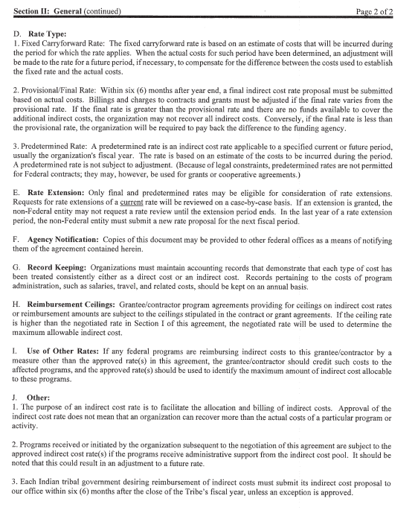
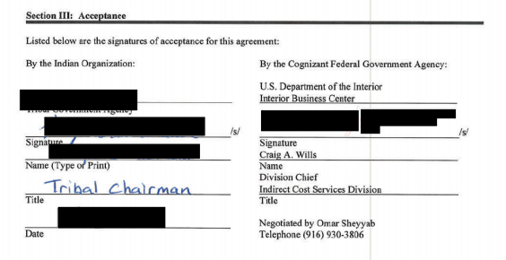
Indirect Cost Negotiation Agreement – DOI IBC

Slide 12
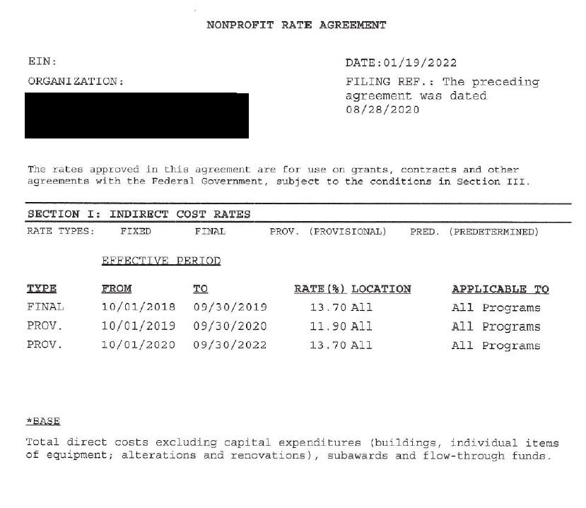
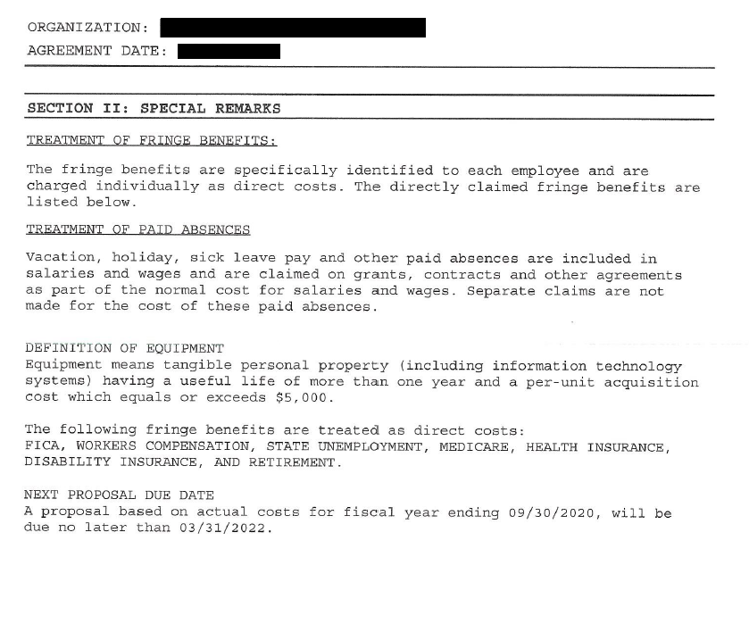
Indirect Cost Negotiation Agreement – HHS CAS

Slide 13
INDIRECT COST RATES
Special Considerations for States, Local Governments and Indian Tribes
2 CFR Part 200 Uniform Administrative Requirements, Cost Principles, and Audit
§ 200.416 Cost allocation plans and indirect cost proposals.

Slide 14
IDC RATE TYPE
Rate Type:
Fixed Carryforward Rate: The fixed carryforward rate is based on an estimate of the costs that will be incurred during the period for which the rate applies. When the actual costs for such period have been determined, an adjustment will be made to the rate for a future period, if necessary, to compensate for the difference between the costs used to establish the fixed rate and the actual costs.
Provisional/Final Rate: Within six (6) months after year end, a final indirect cost rate proposal must be submitted based on actual costs. Billings and charges to contracts and grants must be adjusted if the final rate varies from the provisional rate. If the final rate is greater than the provisional rate and there are no funds available to cover the additional indirect costs, the organization may not recover all indirect costs. Conversely, if the final rate is less than the provisional rate, the organization will be required to pay back the difference to the funding agency.
Predetermined Rate: A predetermined rate is an indirect cost rate applicable to a specified current or future period, usually the organization's fiscal year. The rate is based on an estimate of the costs to be incurred during the period. A predetermined rate is not subject to adjustment.

Slide 15
Indirect Cost Negotiation Agreement
Effective Period for Fixed Carryforward
  IHS CSC Policy - IHM 6.3 E (1)
  Use of Negotiated IDC Rates. The amount of IDC expected to be incurred by awardees using rates negotiated with the cognizant Federal agency will be estimated annually by applying the most recent negotiated IDC rate(s) to the appropriate direct cost base amount, as discussed below in this paragraph and subject to paragraphs 6-3.2E(3)-(4). The amount determined as the awardee’s CSC requirement will be consistent with the individual awardee’s IDC rate agreement and reflect any exclusions required by the IDC rate agreement.
  If an awardee’s IDC rate is applicable to a FY that is more than three years old, IHS will not provide IDC associated with the application of that IDC rate. In these cases, the Area will negotiate "indirect-type costs" with the awardee (see paragraph 6-3.2E(2) that follows). The rate applicable to the current FY is considered current, and the rate applicable to the previous FY shall be considered one year old. Thus, for example, in FY2016 a rate agreement for FY2013 is the oldest rate that will be used in these calculations.
For 2024
2024 – considered current
2023 – 1 year old
2022 – 2 years old
2021 – 3 years old, the oldest rate that will be used
2020 – too old/expired

Slide 16
Q & A
You may also send questions:
Johnnita Tsabetsaye - Johnnita.Tsabetsaye@ihs.gov
Johanna Sanchez Zoeller - Johanna.SanchezZoeller@ihs.gov

